Slide 1

Towards a pesticide-free Europe? Insights from the TYFA scenario
INRAe webinaire on crop protection, September 24th 2020
Pierre-Marie Aubert & Xavir Poux

Slide 2
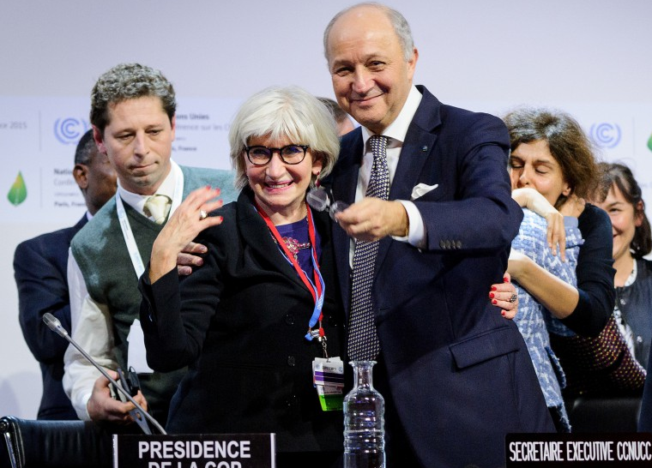
The Institute for Sustainable Development and International Relations (IDDRI)
Independent policy research institute
A non-profit organisation funded by donations / grants / subsidies
Applied and multidisciplinary research
Convening multi-stakeholders platforms
Identify drivers of sustainability and ways to implement them

Slide 3
TYFA’s ID
Ten Years For Agroecology :
  A future study
  Making agroecology a credible option for Europe
  A joint IDDRI and AScA initiative, with different funders
First step: a biotechnical modelling
  What is agroecology? What are the explicit assumptions?
  Modelling at the EU scale
  An unprecedent scientific project
Work in progress: regionalization, socio-economic and policy aspects

Slide 4
TYFA: why?
Contribute to a debate structured by a climat smart narrative

Slide 5
European Commission, 2017

Slide 6
TYFA : why?
Contribute to a debate structured by a climat smart narrative
  Producing more with less: yields increase and efficiency (e.g. +30% to +70% in yields by 2050)…
  … to spare land for climate mitigation and “pristine nature” conservation => major land use changes

Slide 7
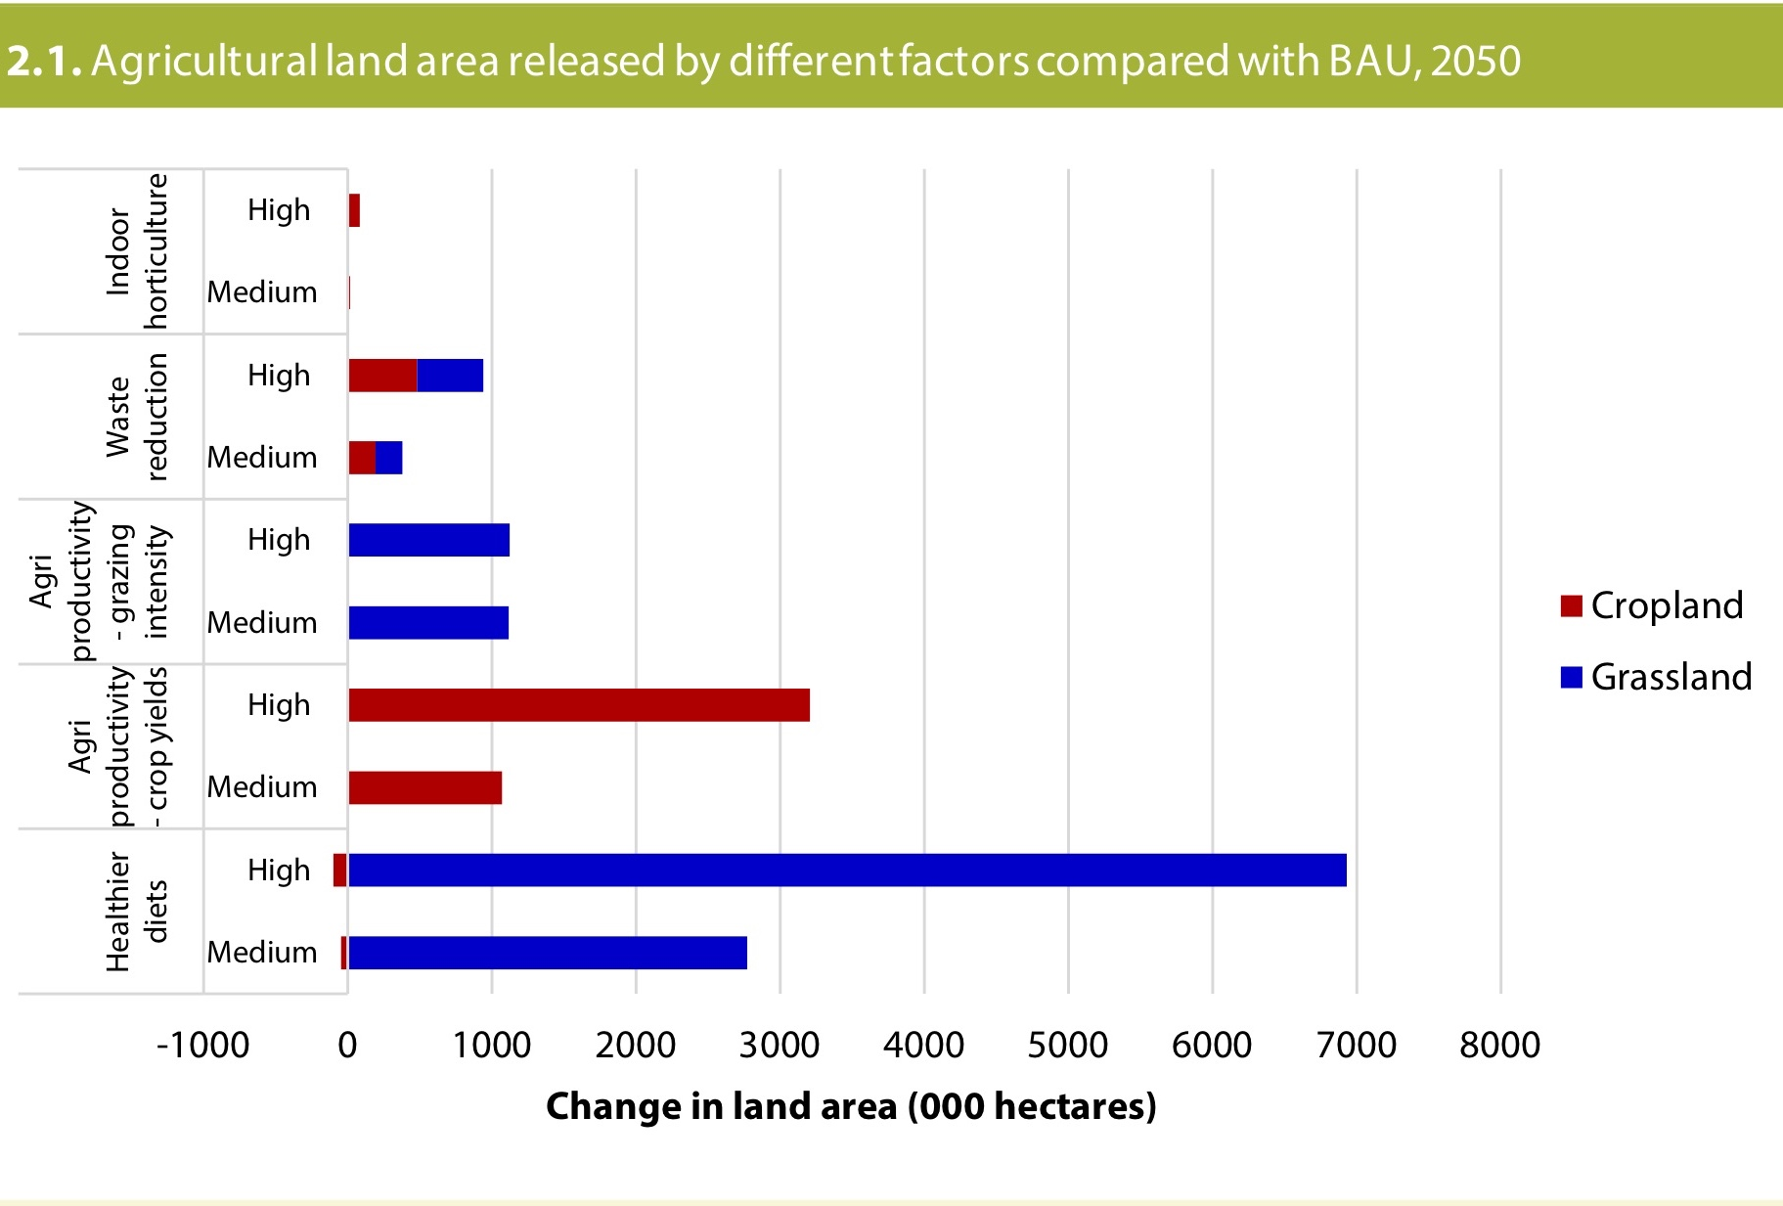
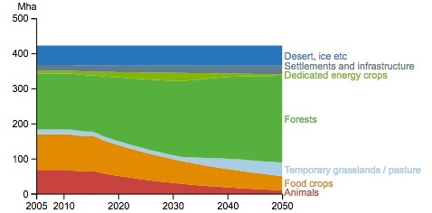
Cumultative measures could lead to the conversion of up to
–72% grasslands
–70% croplands
at the UK level in the CCC scenarios
CCC UK, 2018
or to the conversion of:
–30% of both grasslands and croplands at the EU level in ECF scenarios
ECF & Climact, 2018

Slide 8
TYFA : why?
Contribute to a debate structured by a climat smart narrative
  Producing more with less: yields increase and efficiency (e.g. +30% to +70% in yields by 2050)…
  … to spare land for climate mitigation and “pristine nature” conservation => major land use changes
Different shortcomings in such scenarios
  Biodiversity: is efficiency enough to alt its erosion considering its role as a production factor, its links to landscapes & CC adaptation

Slide 9
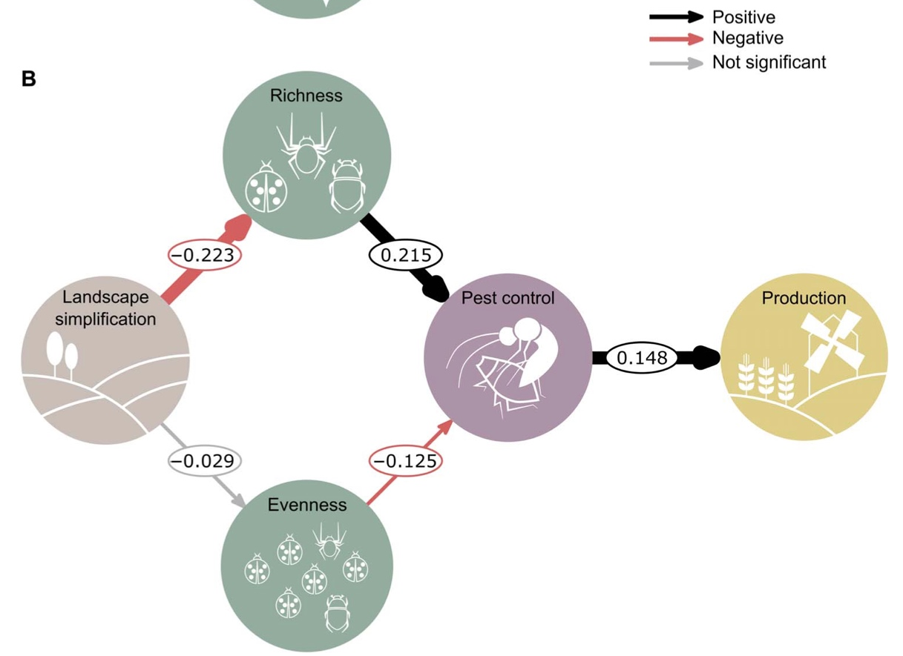
Dainese et al, 2019

Slide 10
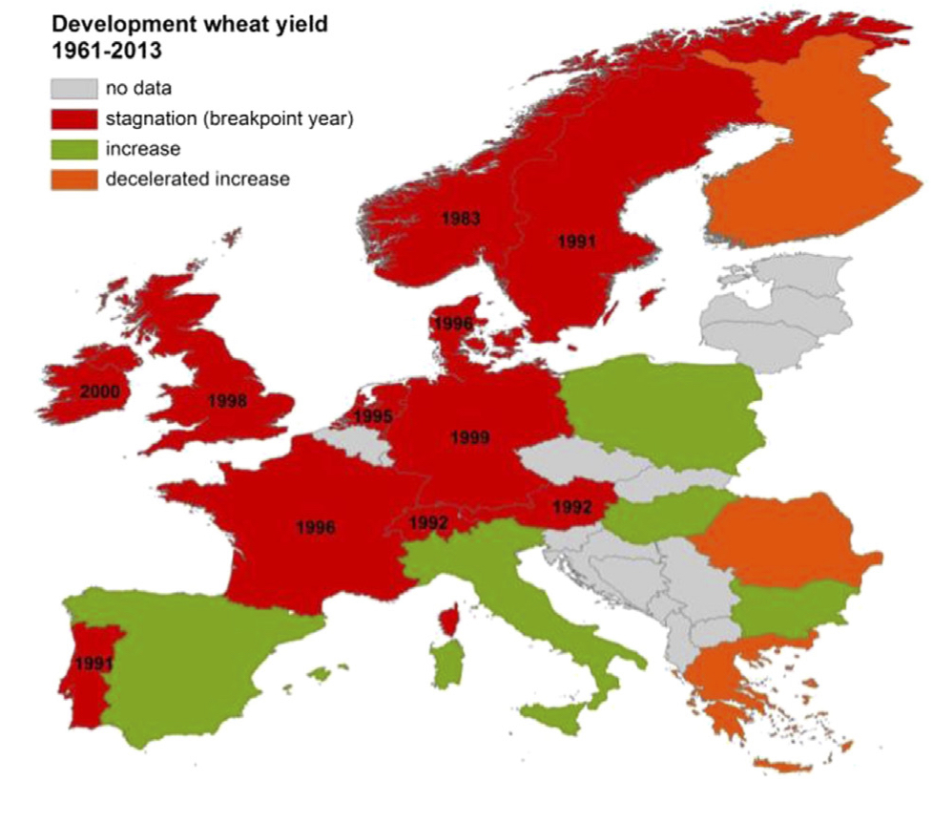
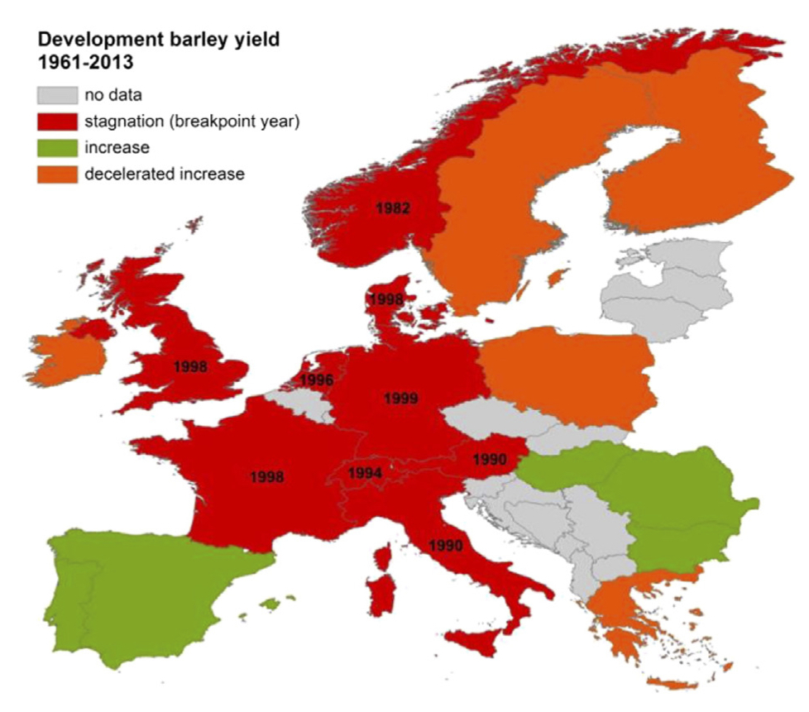
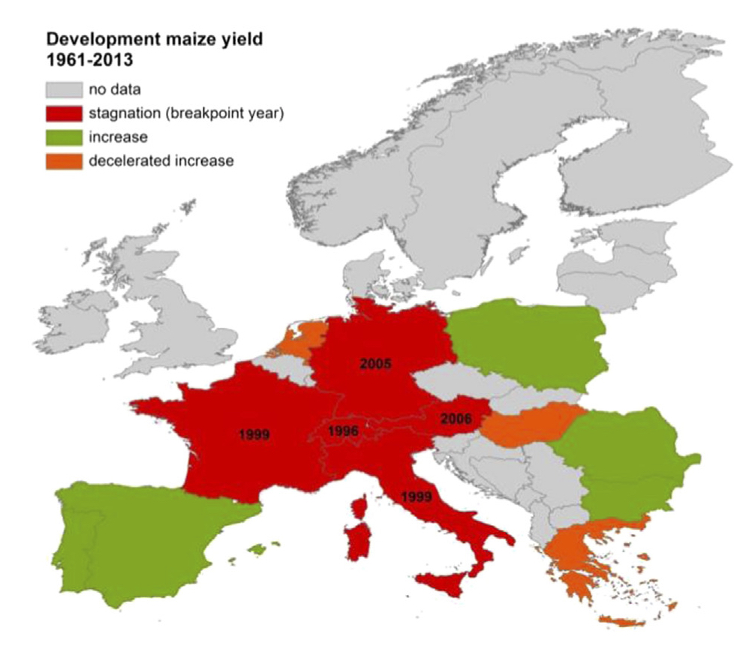
Development maize yields 1961-2013
Wiesmeier et al, 2015

Slide 11
TYFA : why?
Contribute to a debate structured by a climat smart narrative
  Producing more with less: yields increase and efficiency (e.g. +30% to +70% in yields by 2050)…
  … to spare land for climate mitigation and “pristine nature” conservation => major land use changes
Different shortcomings in such scenarios
  Biodiversity: is efficiency enough to alt its erosion considering its role as a production factor, its links to landscapes & CC adaptation
  Socio-economy: capital intensive scenarios
  Food: what is the quality of what we eat?
Proposing an alternative scenario
  Going beyond a collection of niche “success stories”

Slide 12
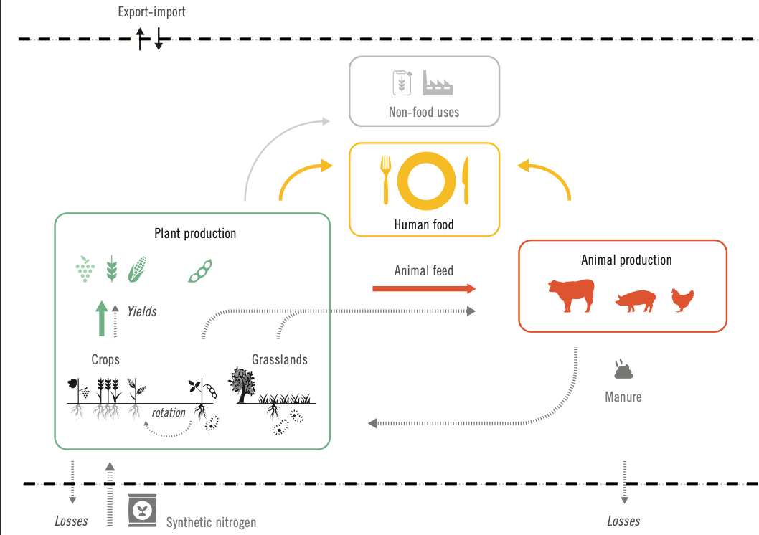
TYFA’s model - TYFAm
Input variables:
Cropping systems
Livestock systems
Diets
Waste and losses
Non food-uses
Output variables:
Production
Land use
GHG emissions
Biodiversity

Slide 13
An agroecological Europe: main hypotheses
1 Fertility management at the territorial level

Slide 14
An agroecological Europe: main hypotheses
2 Pesticide-free farming and extensification of crop production
Organic farming as a reference model

Slide 15
Pesticide free cropping systems
A focus on synthetic (vs natural) pesticides because of
  Their persistence in the agro-ecosystem (molecules or metabolites)
  Their impacts beyond the application point (e.g. Beketov et al, 2013)
How to cope with pests and disease without synthetic pesticides? And how to model it
  A matter of concerns for all cropping systems under CC…
  longer and more complex crop rotation – not as precise as Barbieri et al (2019)

Slide 16
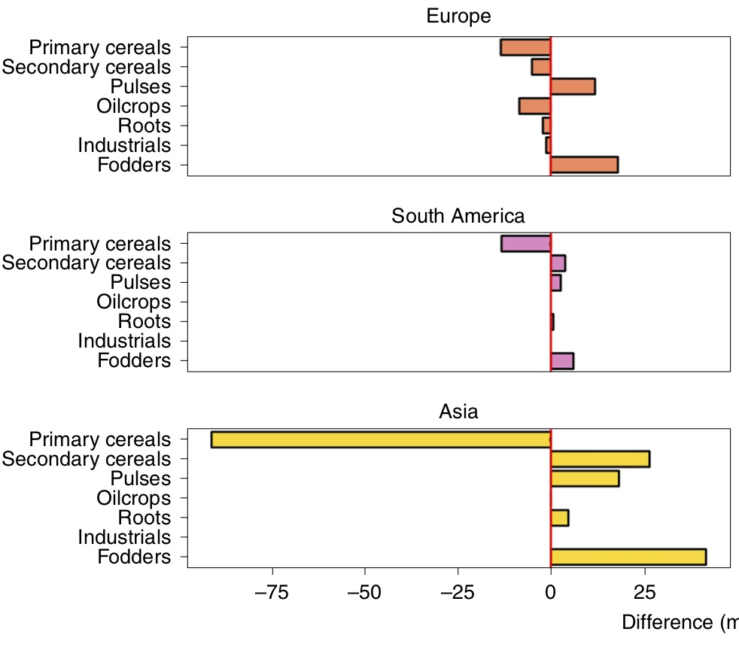
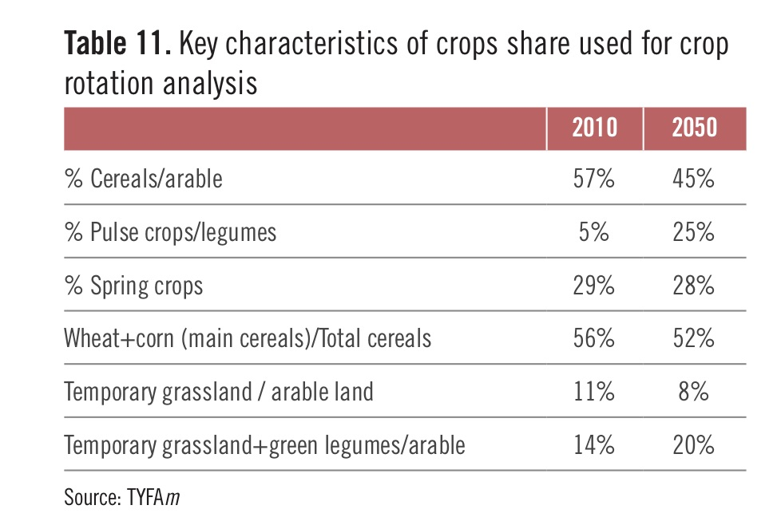
Crop rotations

Slide 17
Pesticide free cropping systems
A focus on synthetic (vs natural) pesticides because of
  Their persistence in the agro-ecosystem (molecules or metabolites)
  Their impacts beyond the application point (e.g. Beketov et al, 2013)
How to cope with pests and disease without synthetic pesticides? And how to model it?
  A matter of concerns for all cropping systems under CC…
  longer and more complex crop rotation – not as precise as Barbieri et al (2019)
  More complex landscapes (permanent grasslands + agroecological infrastructures (Dainese et al, 2019) – but controversial (Karp, 2019)
  The use of biocontrol: an open / complex question (Louda et al, 2003)
  No specific hypotheses on genetic improvements

Slide 18
An agroecological Europe: main hypotheses
1 Fertility management at a territorial level
2 Pesticide-free farming and extensification of crop production
Organic farming is the reference model
3 Redeployment of permanent grassland

Slide 19
An agroecological Europe: main hypotheses
4 Livestock extensification (phase-out of industrial modes)

Slide 20
An agroecological Europe: main hypotheses
5 Healthy and sustainable diets

Slide 21
An agroecological Europe: main hypotheses
6 Food first, then feed, then biodiversity, then non-food use

Slide 22
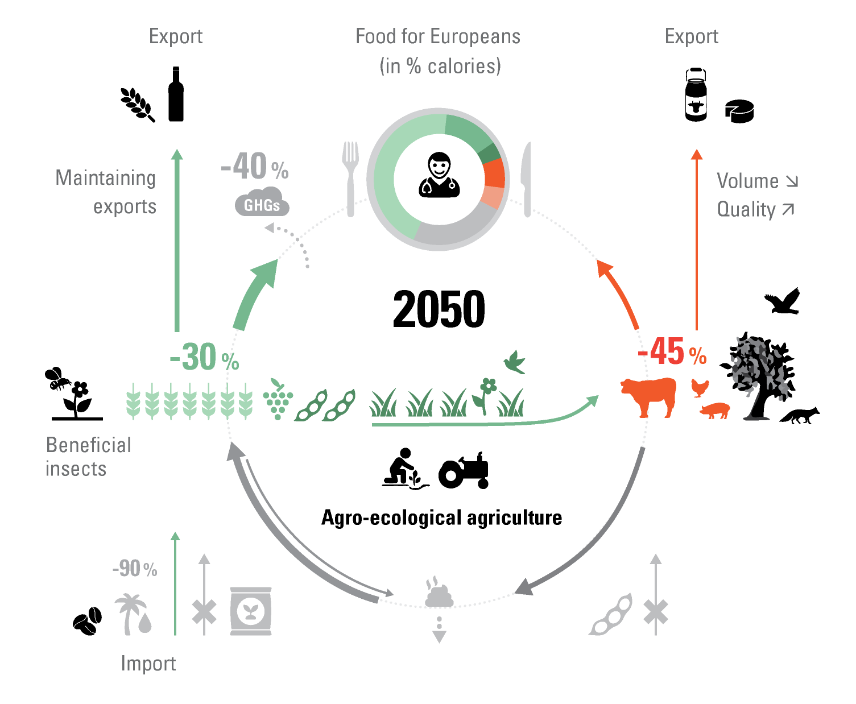
Main features of an agroecological Europe by 2050
3
2
1
-40%

Slide 23
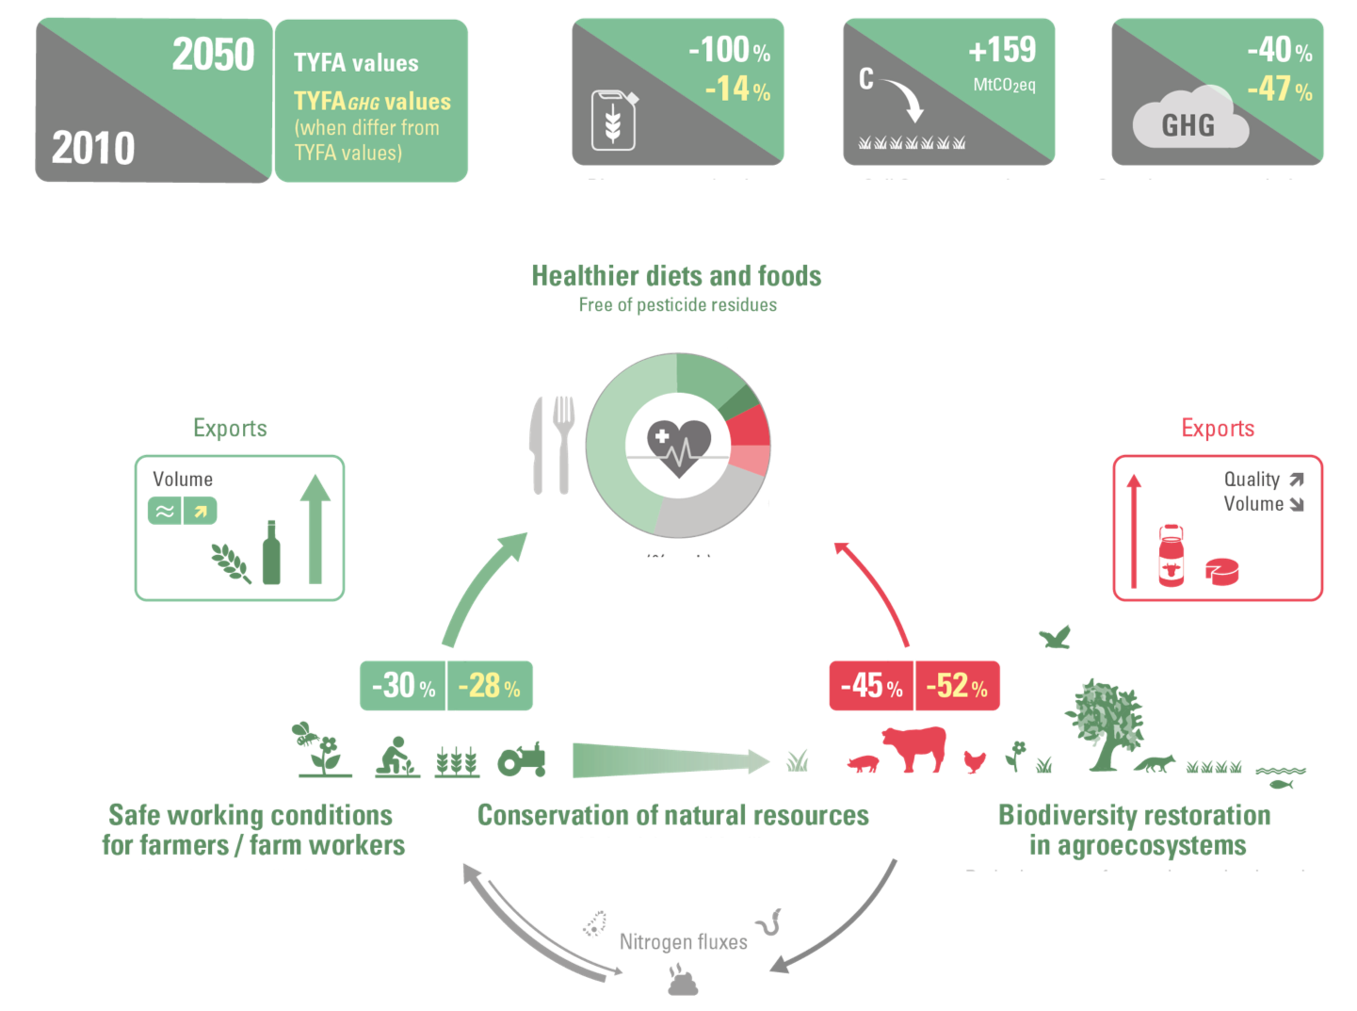
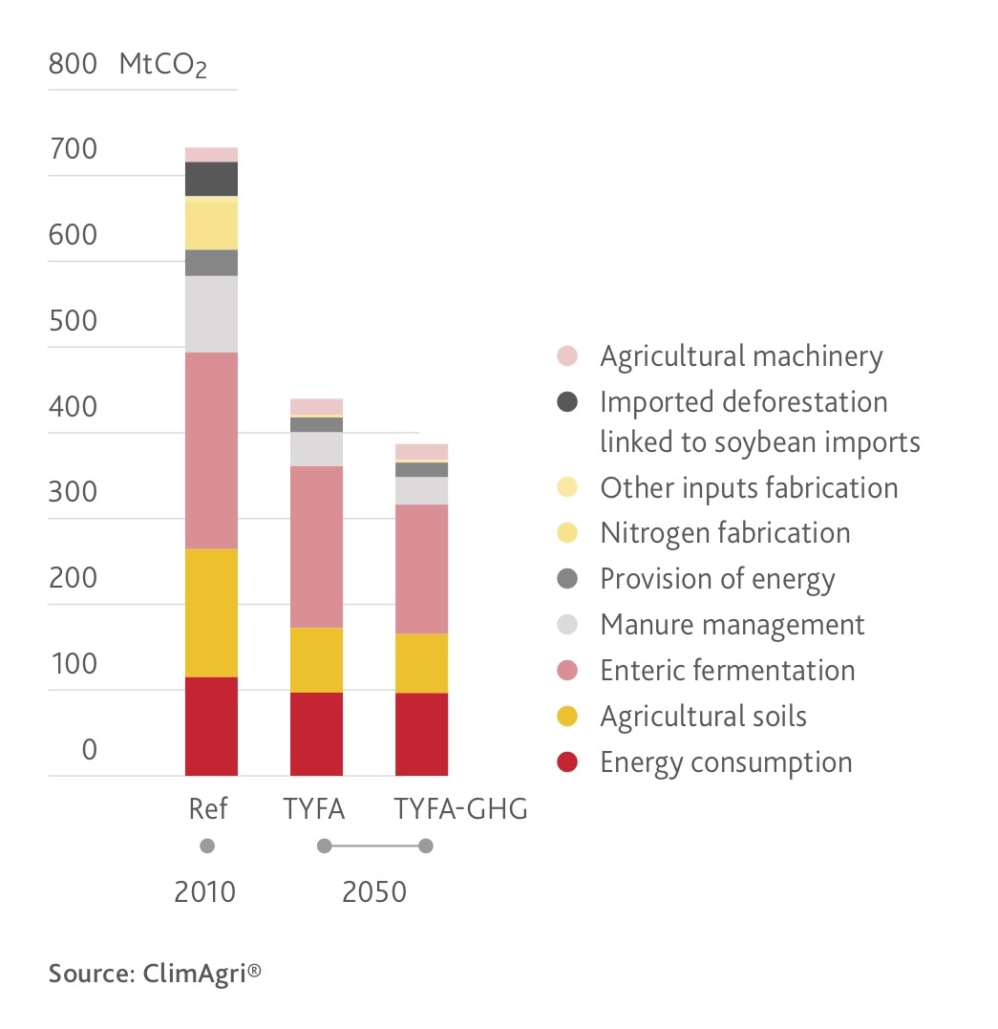
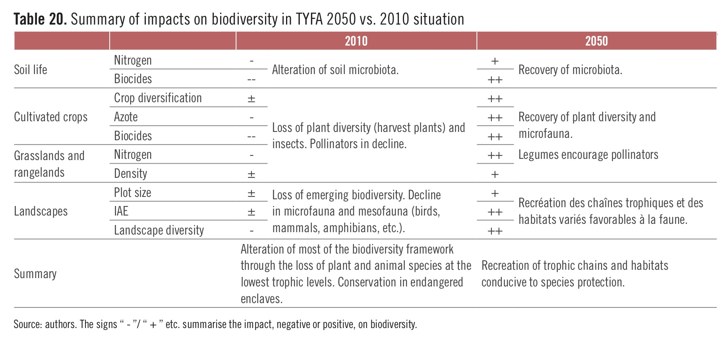
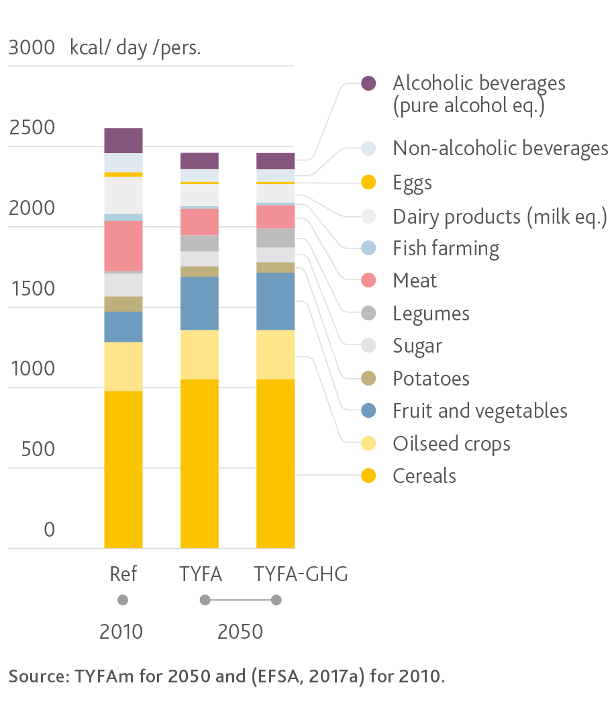
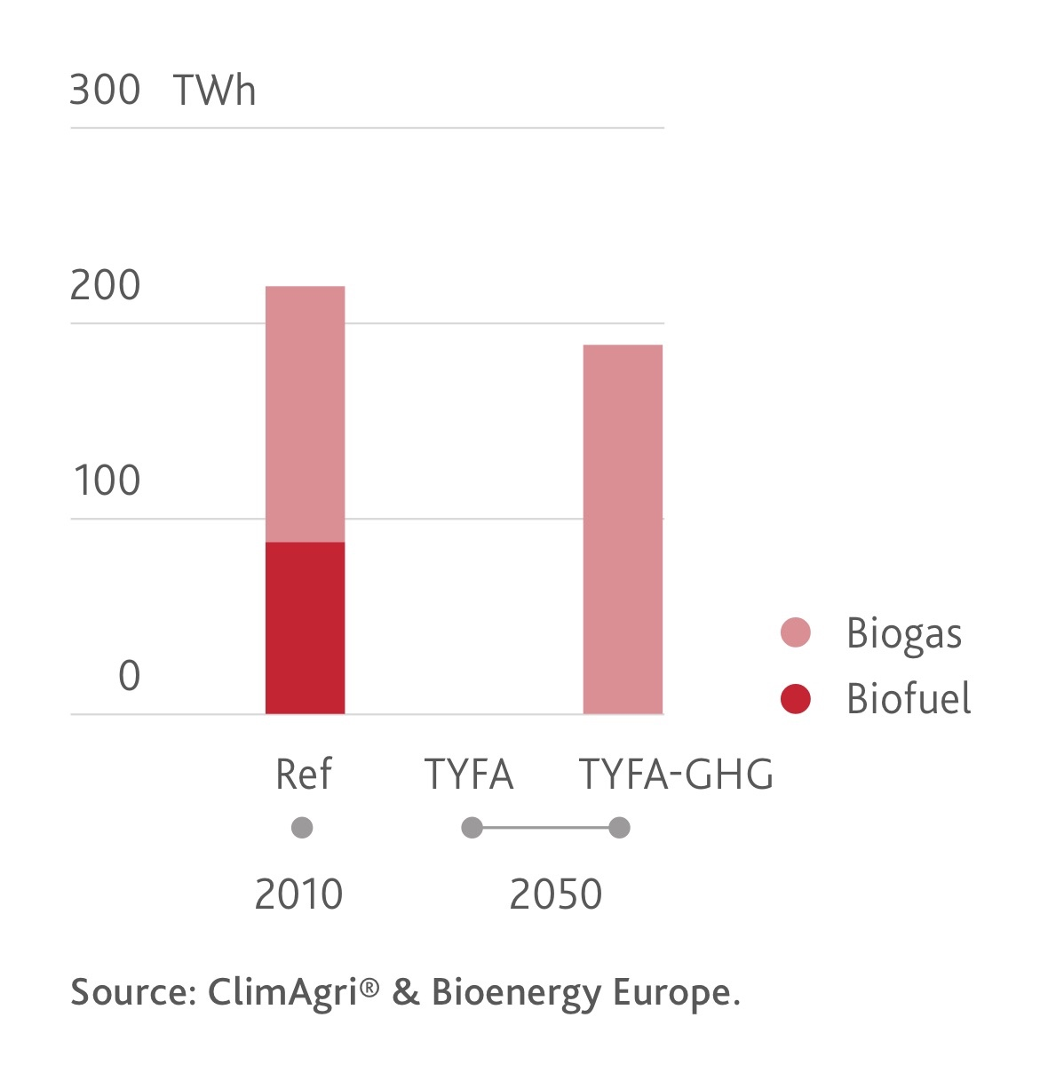

Slide 24
Conclusion
An ambitious scenario for the EU which makes explicit numerous questions any scenarios for our food system must address
Crop protection is one of them, in relationship to yields, food availability and the economic viability of farms
But the need for high yield cropping systems in the EU depends first and foremost on the relative importance of animal systems

Slide 25
How to get there?
Towards diversified and agroecological vegetal production
Changing diets
Moving away from large scale animal farming and replacing it with agroecological livestock
Trade policies

Slide 26
THANK YOU FOR YOUR ATTENTION!
Pierre-Marie Aubert (IDDRI) – pierremarie.aubert@iddri.org
Xavier Poux (AScA, IDDRI) – xavier.poux@asca-net.com
https://www.iddri.org/en/project/ten-years-agroecology-europe
www.iddri.org/tyfa
https://www.iddri.org/en/project/ten-years-agroecology-europe

