Slide 1
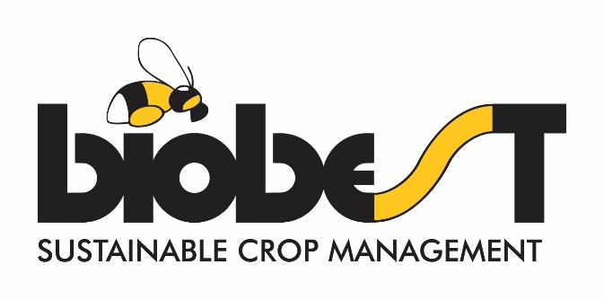
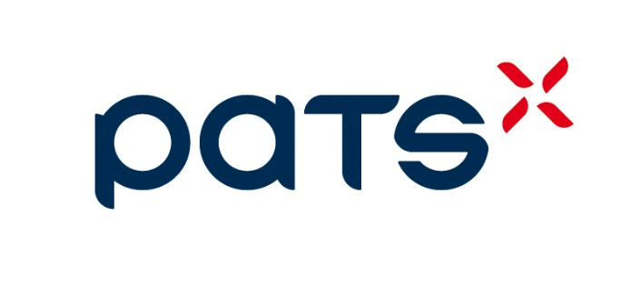
Trap-EYe™
Automates your sticky trap monitoring
Strategies and business models for scouting and monitoring activities supporting biocontrol deployment
Rob Moerkens – R&D Biobest Group NV
Notes:
Thank you for having us here today to discuss our innovative solution, Trap-Eye. Since presenting our concept last year, we have worked tirelessly and brought our innovation to the marked. We have chosen Greentech as the place and Bilboard to announce our Global launch from trap-Eye. In that light are absolutely thrilled to be nominated for the Greentech Innovation Award.
Today, we are excited to share with you how Trap-Eye can revolutionize the scouting process and provide growers with accurate insights to optimize their IPM program.

Slide 2
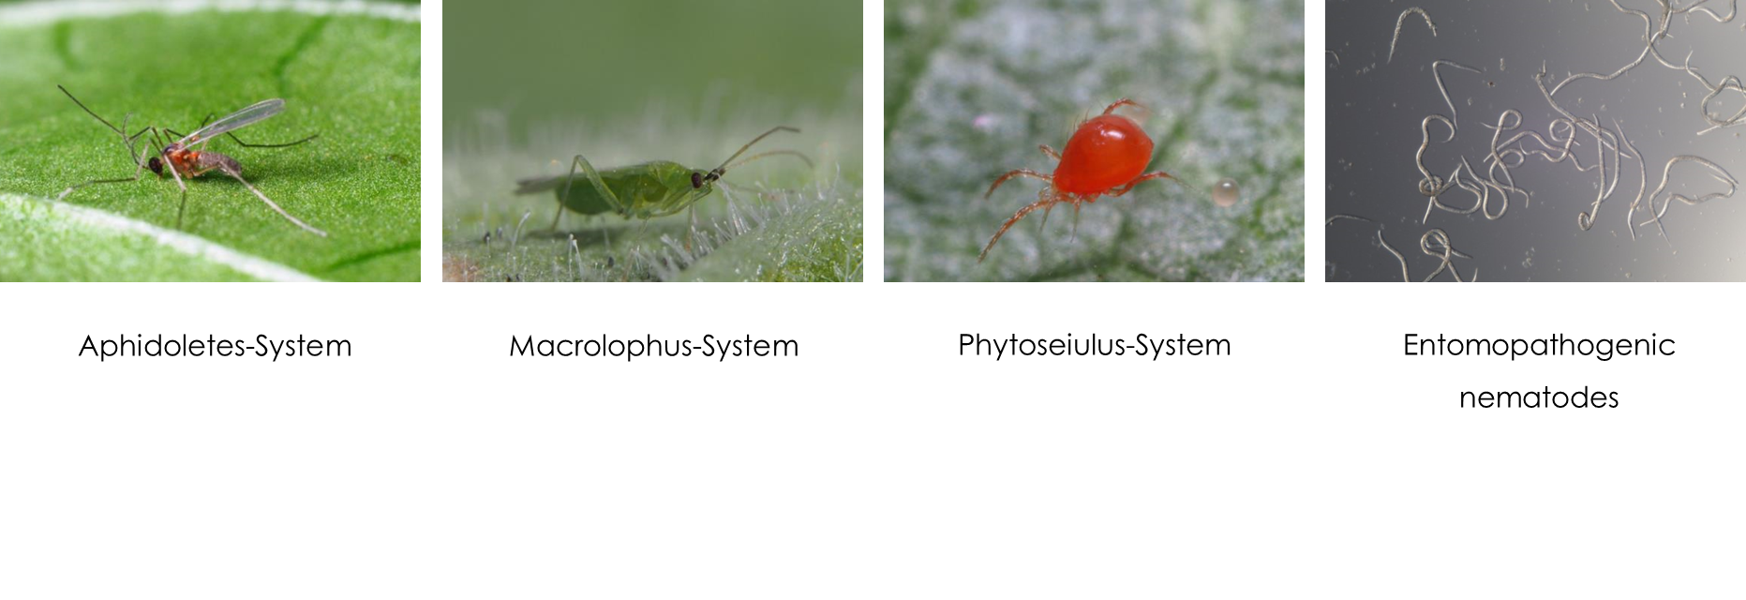
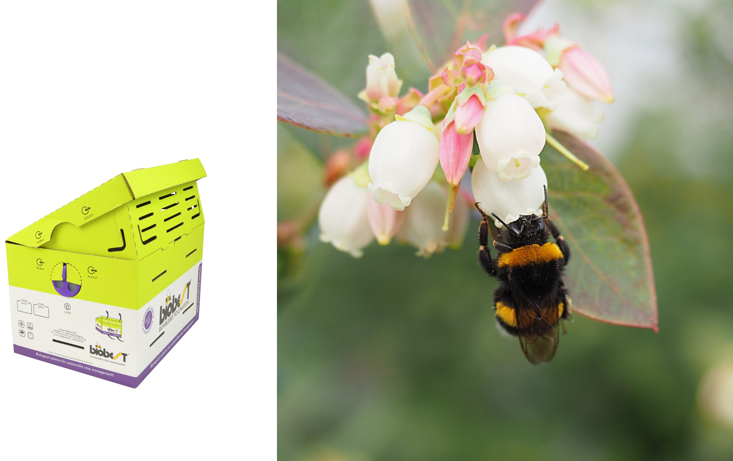
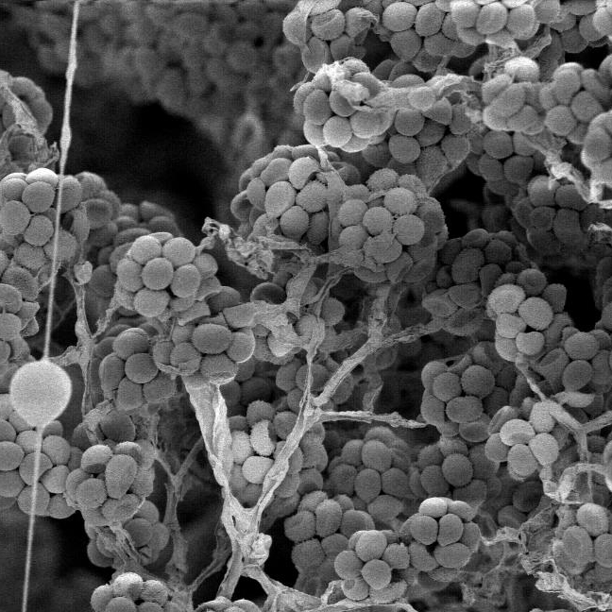
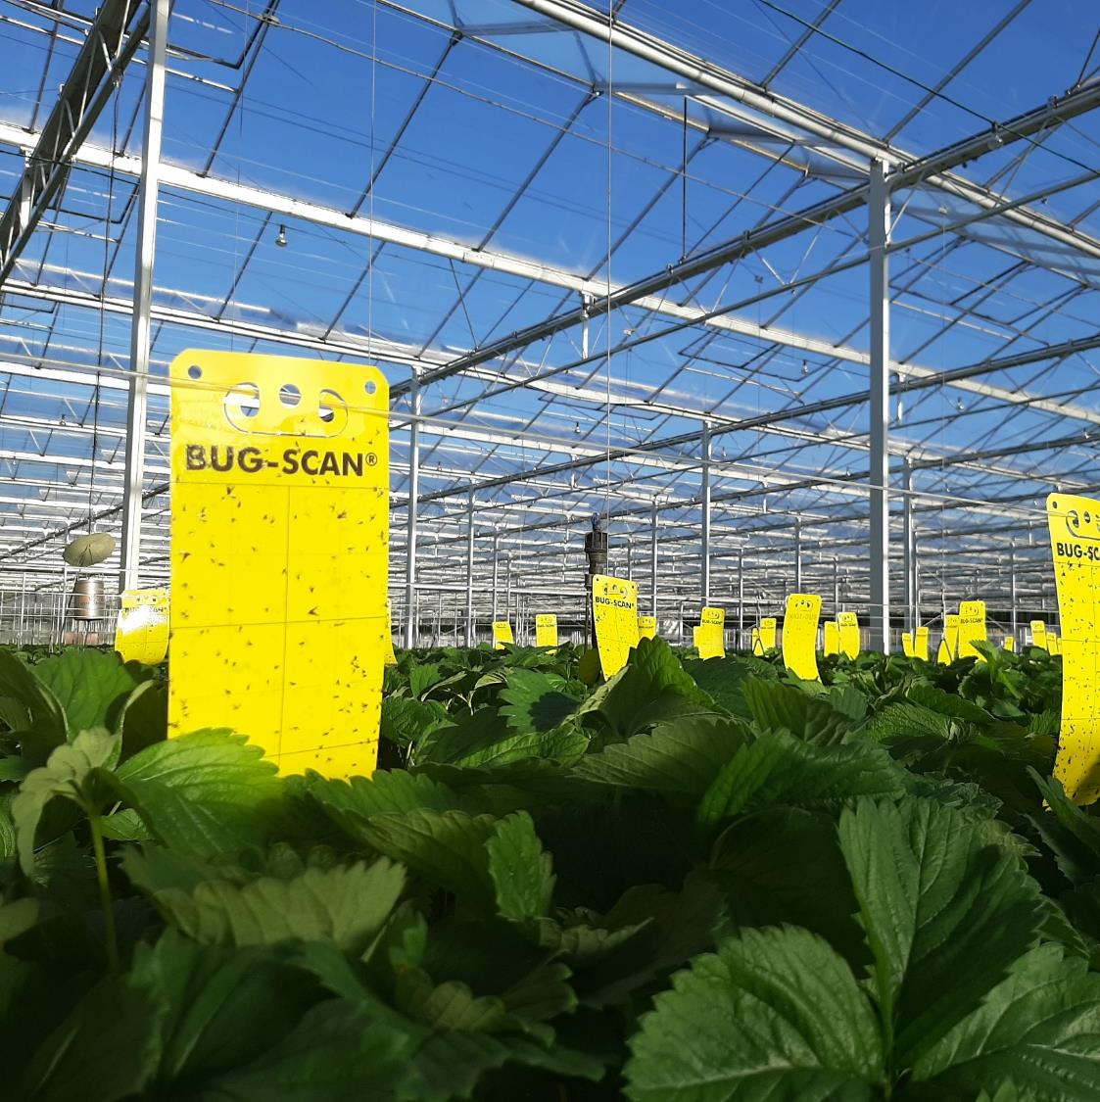
Biobest Group NV
Beneficial INsECTS, MITES & NEMATODES
BUMBLEBEE
POLLINATION
BIOPESTICIDES
MONITORING
TRAPS &
PHEROMONES

Slide 3
Free advice as a service
All sales are supported by experienced advisors
Weekly/biweekly field visits
Costly + time-consuming
Highly skilled personnel required
Better monitoring of the grower
= better advice
= faster (biological) interventions
= Less pesticide usage
= more sales of beneficial insects
=> Allows remote advice
Monitoring is costly!
Labour hours
Skilled personnel required

Slide 4
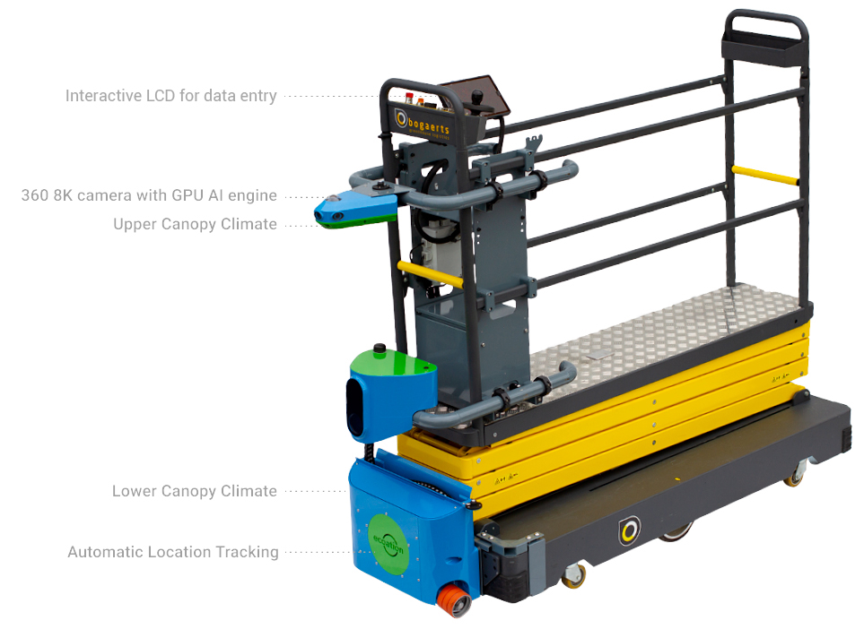
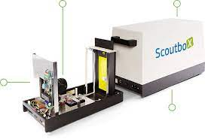
Automated monitoring using AI – brief overview
Electronic nose
Detect volatile organic compounds (VOCs)
Camera system
Mounted on a trolley or fixed camera
Fully automated or controlled by scout
Multispectral or RGB
Automatic yellow sticky trap counting
Mobile phone
Fixed camera

Slide 5
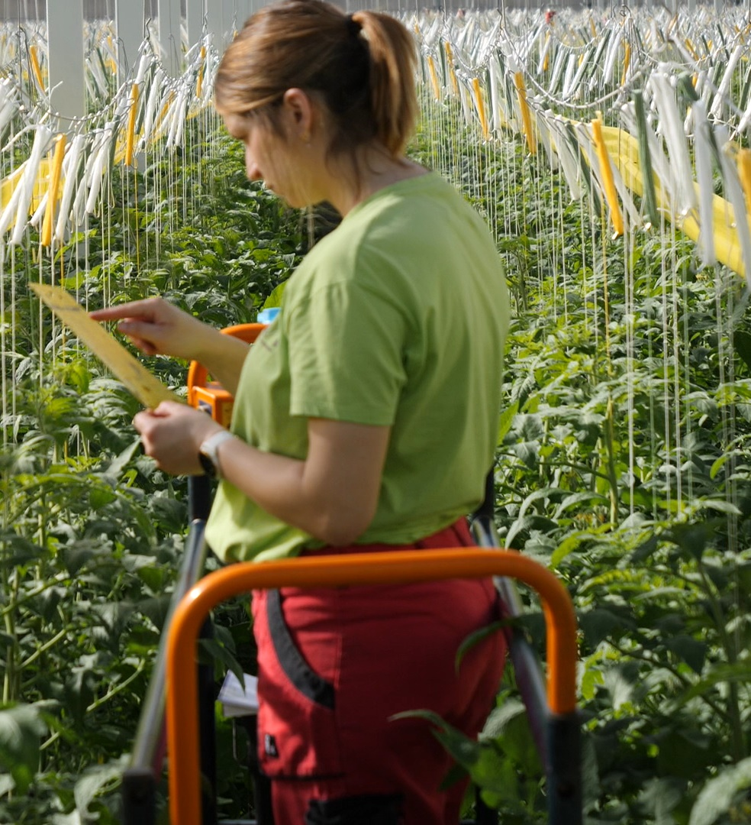
Sticky trap monitoring, Next generation.
Save time and labour
No skilled scouts needed
Scouting-As-A-Service
Notes:
Scouting is a crucial step in any successful IPM program, Traditional sticky trap monitoring can be time-consuming, labour-intensive, and also prone to human error.
With Trap-Eye, we have developed an automated solution that streamlines the scouting process and eliminates the need for skilled and trained scouts. Our innovative technology allows growers to maximize their efficiency by scaling up their greenhouse without increasing their scouting efforts. With Trap-Eye, you can trust that your pest control program is in good hands.
Scouting is a crucial part of a successful Integrated Pest Management (IPM) program. But let's face it, traditional sticky trap monitoring can be a real hassle. It takes up a lot of time, requires labor-intensive work, and mistakes can happen.
That's why we came up with Trap-Eye! It's an automated solution that simplifies the scouting process and removes the need for skilled and trained scouts. Our innovative technology does the job for you, allowing you to focus on other important tasks.
Our innovative technology allows growers to maximize their efficiency by scaling up their greenhouse without increasing their scouting efforts. With Trap-Eye, you can trust that your pest control program is in good hands. Let us handle the scouting while you enjoy the benefits of a streamlined and effective system."

Slide 6
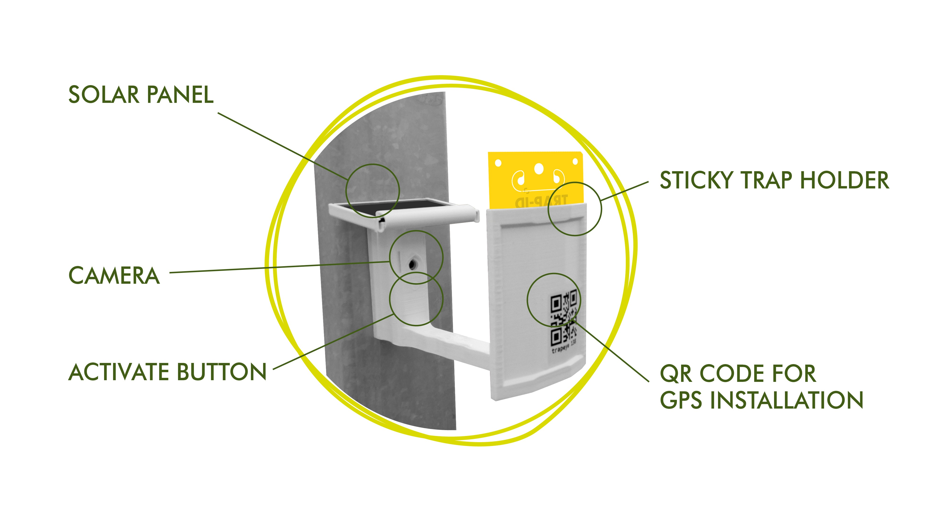
Trap-Eye™ Drop-in-place
Notes:
Trap-Eye is a drop-in-place alternative for current sticky trap scouting. Our product can be installed and maintained easily, just like hanging a sticky trap, making it suitable for all greenhouse environments, from low-tech tunnels to high-tech glasshouses
The magnets on the back of the unit allow for easy hanging on greenhouse posts or any other preferred spot without additional infrastructure needed.
Each unit is self-sufficient with a solar panel so a grower doesn’t need to be bothered with external power sources.
We developed a designated sticky trap to ensure that the whole surface of the sticky trap is monitored.
The camera takes a picture of the sticky trap at a grower-determined interval, making Trap-Eye a highly efficient scouting solution.
Introducing Trap-Eye - the solution to the burdensome and time-consuming task of scouting sticky traps. Our innovative system automates the entire process using a network of high-tech devices that take pictures of sticky traps. Using artificial neural networks, Trap-Eye accurately counts both pests and beneficial insects and presents the data in a user-friendly web-based dashboard.
Our technology eliminates the need for manual sticky trap counting, reduces the risk of errors, and saves you valuable time and resources.
With Trap-Eye, you can use optimal density in sampling points while achieving profitable, accurate, and high-density scouting data.
Better data leads to better IPM decisions, giving you the confidence to act anytime and anywhere.
Say goodbye to the burdensome and time-consuming task of manually scouting sticky traps because we have the perfect solution for you: Trap-Eye! It's a game-changer.
So here's how it works: Trap-Eye automates the entire process using a network of high-tech devices. These devices snap pictures of your sticky traps, and our advanced artificial neural networks kick in. They do all the hard work of accurately counting pests and beneficial insects.
But that's not all. Trap-Eye takes it a step further by presenting all the data in a user-friendly web-based dashboard. It's a breeze to navigate and understand. No more headaches from manual sticky trap counting!
With Trap-Eye, you can say goodbye to errors and save valuable time and resources. It's all about efficiency and effectiveness. You can achieve optimal density in sampling points, ensuring profitability and obtaining accurate and high-density scouting data.
Trap-Eye is here to make your life easier and your greenhouse operations more successful. Let us handle the heavy lifting while you enjoy the benefits of hassle-free scouting and data analysis."

Slide 7
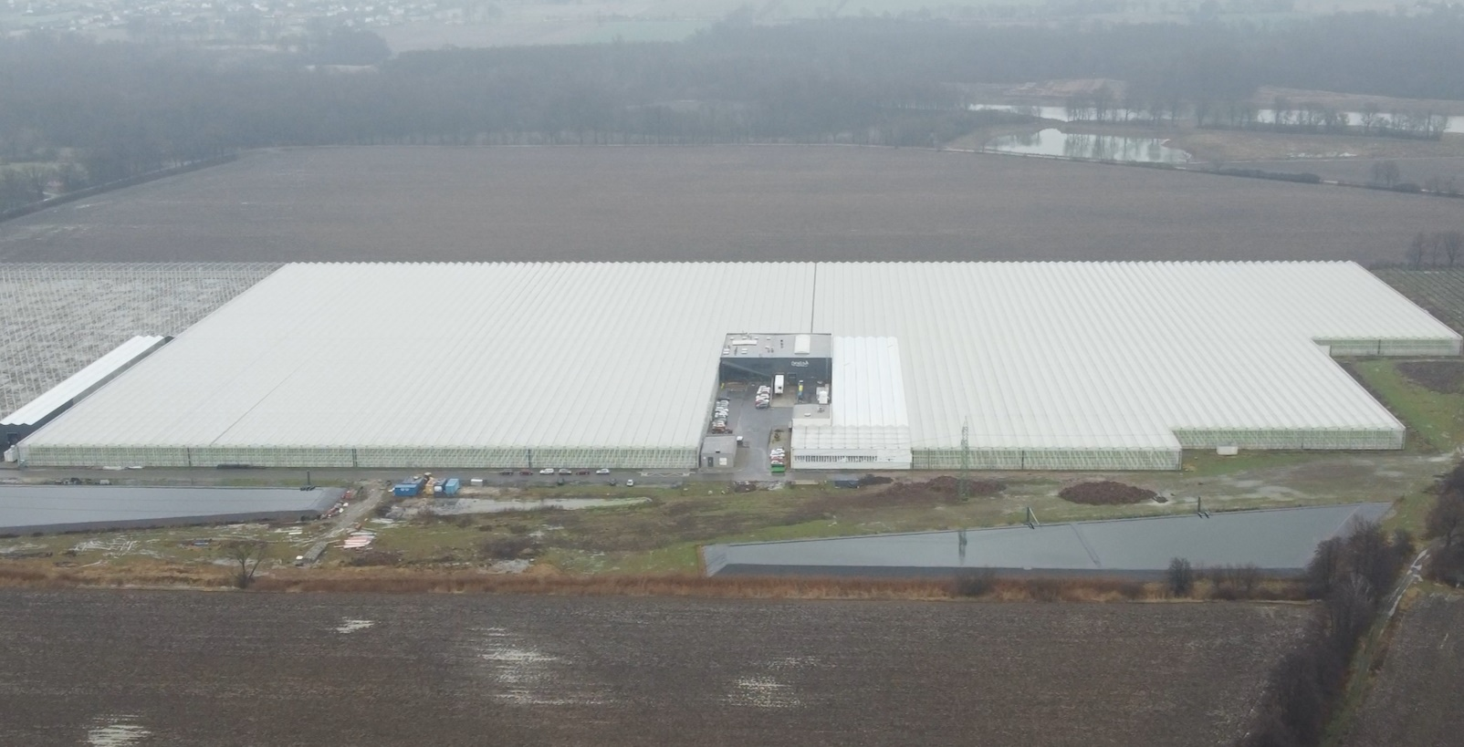
Notes:
Monitoring practices advise scouting 40 sticky traps per hectare to avoid missing any hot spots of insects in the greenhouse.

Slide 8
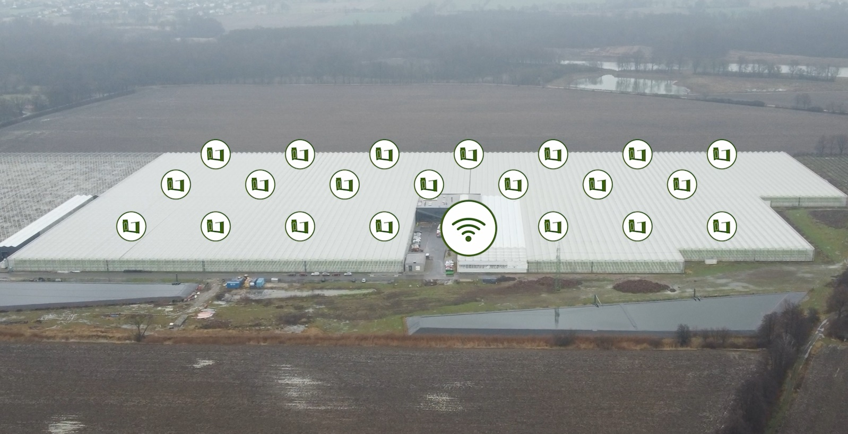
Notes:
With Trap-Eye, we maintain this sampling density without requiring scouting labor.

Slide 9
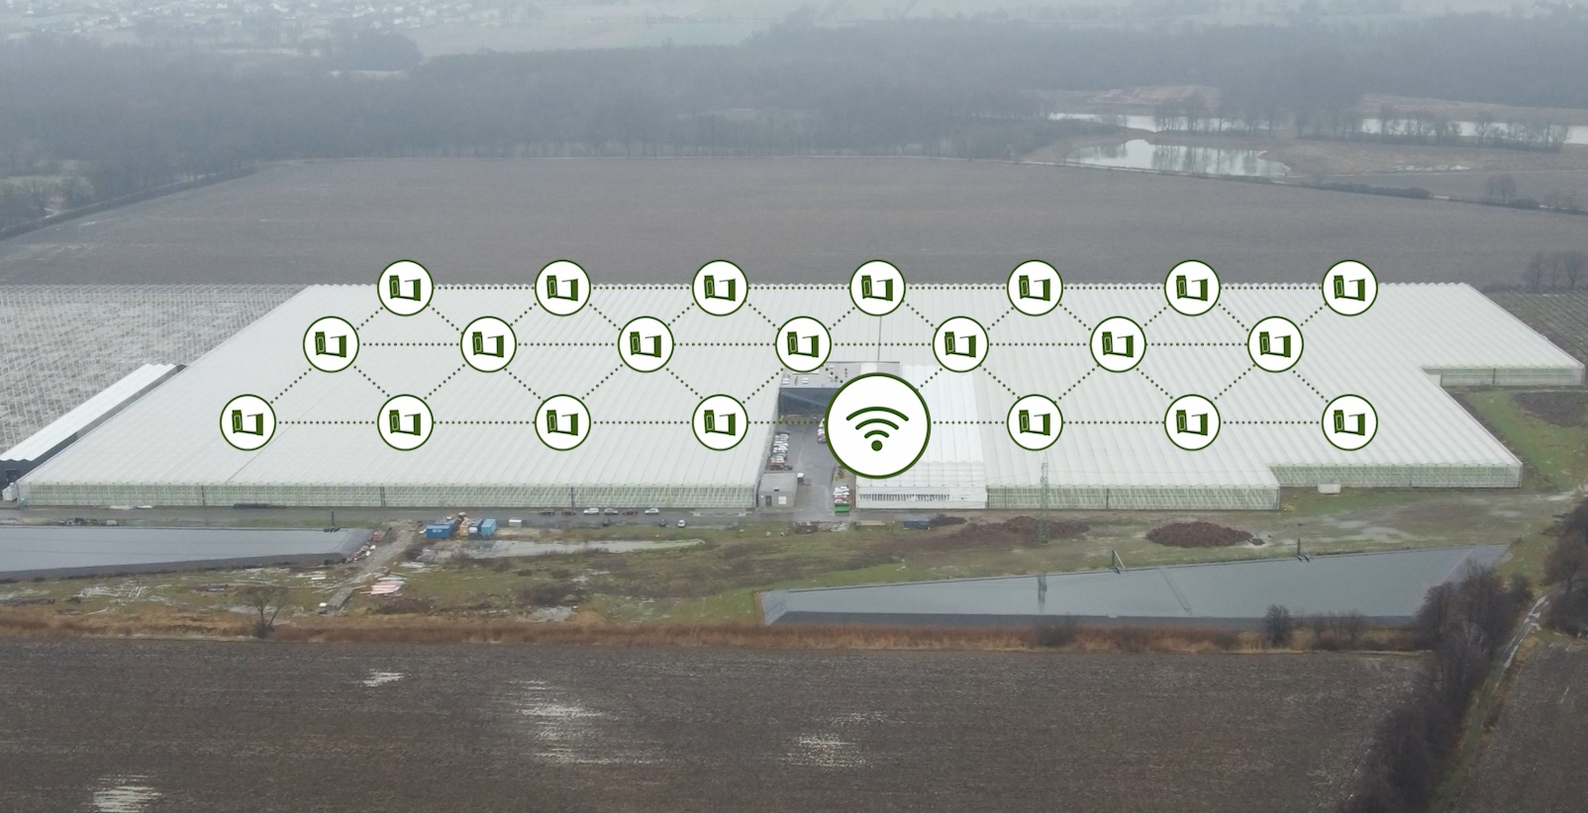
Notes:
Our units form a faultless collaborative network that communicates pictures to the cloud via one single internet hub, the Trap-Eye Gateway. Should 1 unit fail, the pictures are automatically sent through another path of units.
With this innovative solution, we made sure there is no need for full internet coverage of the greenhouse.

Slide 10
No Skilled scouts needed
Automatic detection of 6 common insect species
Thrips
Frankiniella occidentalis
Macrolophus
pygmaeus
Nesidiocorus tenuis
Whiteflies
Trialeurodes vaporarorium
Tuta
absoluta
Lyriomyza
spp.
Notes:
We developed an AI algorithm capable of recognizing six different insect species on YST with very high accuracy (go through insect list). Growers no longer have to count sticky traps themselves. The human variation and errors are replaced by a more standardized AI algorithm. This AI never gets tired and will look at a YST as a experienced scouter all the time. => explain graps

Slide 11
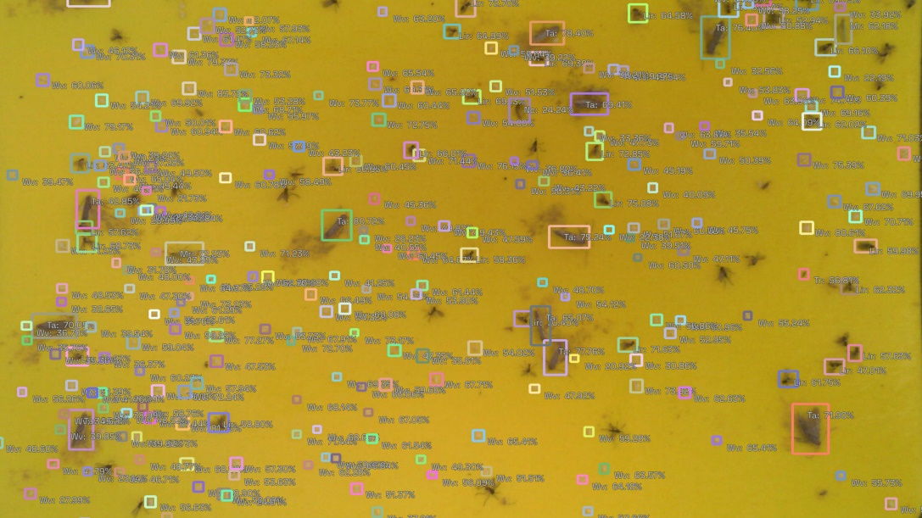
No Skilled scouts needed
Notes:
Together with a reliable partner (ePotentia) we developed the most advanced AI algorithm in the market. We labelled more than 200000 individual insects on sticky traps. Recognition of other insects is technically feasible and is part of our roadmap (e.g. Aphidius, Sciara flies, Scutella flies, Echinotrips, Be
Misia,…) Most advanced AI algorithm in the market , Trained on a unique dataset of >200.000 labelled insects

Slide 12
Human vs. machine
Avg. time spend > 10 mins
Avg. accuracy 71%
Avg. time spend < 1 mins
Avg. accuracy 86%
N =10 of our finest selection of scouts

Slide 13
Trap-Eye™
Scouting-as-a-service

Slide 14
Value proposition Trap-Eye™
Automated scouting in greenhouse
Standardized data
Not person dependent
Multiple insects in 1 go
High density sampling points
Better advice
Remote advice possible
Save time and labour
Scouting-As-A-Service
No skilled scouts needed

Slide 15
Contributions, gains and levers Trap-Eye™
Business development
Business plan/ market intelligence
Overall coordination and management
Marketing
R&D
Collecting data for AI
Testing prototypes – functionality, handling, quality,…
Sales & technical advisors
Value proposition
Engineering partner
Developer of the hardware
Developer of network mesh
Dashboard: visualisation
IT partner
Developer of AI algorithm

Slide 16
Contributions, gains and levers Trap-Eye™
Direct gains
Indirect gains
For Biobest (& PATS)
Sales of the hardware (& PATS)
Sales of licence (& PATS)
Remote advice
Less travel costs
More hectares per advisor
For grower
Save labour cost
For Biobest
Better advice = more trustworthy
Customer bonding
Higher/more efficient sales of beneficials
For grower
Better advice = better biocontrol
Less pesticide usage
Standardized overview of pests and beneficials on a dashboard

Slide 17
Contributions, gains and levers Trap-Eye™
Why did we develop this product now? Turning points? Obstacles in the past?
Greenhouses grow bigger and bigger (>10 ha)
Less pesticides allowed/ pesticide resistance/ demand from supermarkets
more biological control required
monitoring becomes more important
Big data collection is becoming more and more important in all fields – Decision support systems
AI possibilities are increasing exponentially
New hardware innovations allow cheaper products – high density network (high spatial resolution)
Due to virus restrictions access to greenhouses are often limited – remote advice
“Free advice” is costly – covering more acreages with the same amount of advisors

Slide 18
RISKS Trap-Eye™
Rapid aging of the technology is the biggest risk!
New camera systems
Better AI applications
Not an end point but a continuous investment in further development!

Slide 19
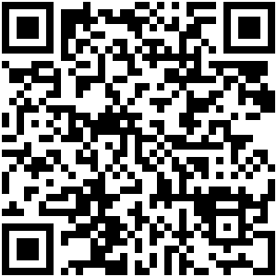
Any Questions?
How-to-use movie
Contact us
info@biobestgroup.com
+3214 25 79 80

