Slide 1
Upscaling Wild Seed Production for use in Conservation Biocontrol
Laurie MacIntyre and Mischa MacIntyre

Slide 2
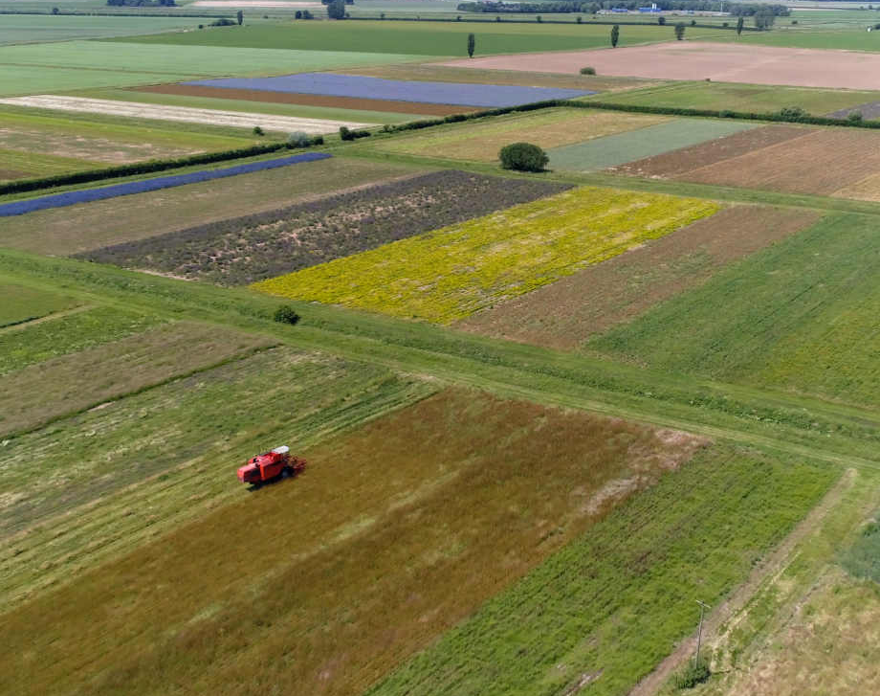
History of Emorsgate Seeds (UK)
Est. 1980, family owned, 18 in team​
200 Ha single species row crops
100 Ha alkaline and neutral meadows​
Production 2022 ~ 30 tonnes, 200 wild species ​and brush harvested mixtures
Restoration 2022 ~ 2,000 hectares​

Slide 3
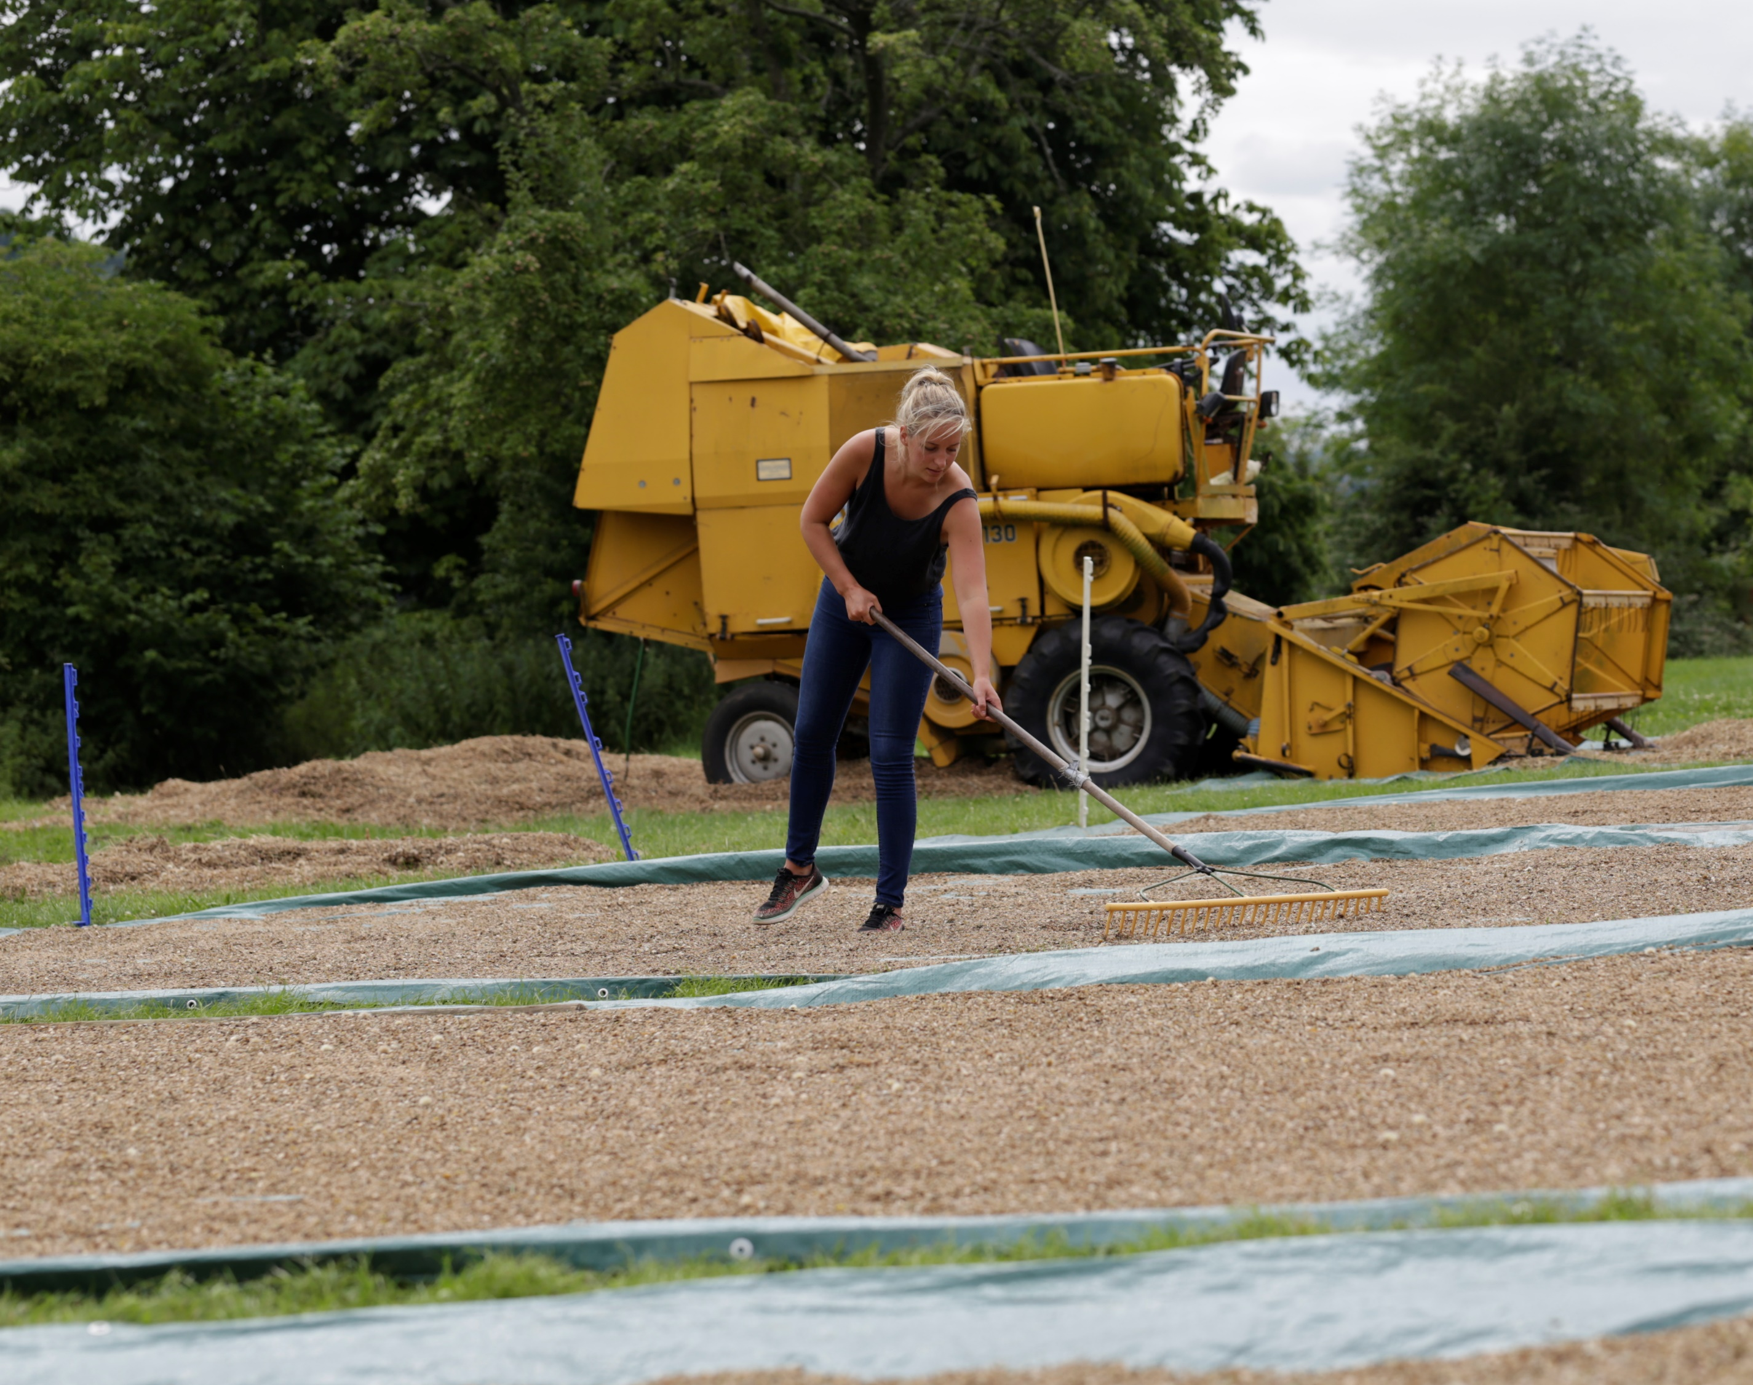
Seed production
Hand Harvesting​/ stock collection
Propagation and multiplication
Combine Harvesting​
Brush Harvesting​
Cleaning
Drying
Temperature and humidity-controlled storage

Slide 4
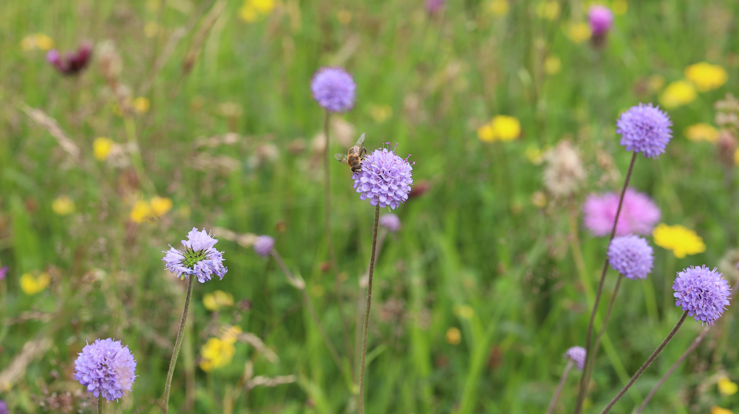
Advantages of using wild flower seed for biocontrol
Creates habitat diversity
Increases water holding ability
Encourages growth of beneficial fungi
Improves soil structure
Natural pest enemies
Resources for pollinators
Conservation of native flora
Nutrient cycling

Slide 5
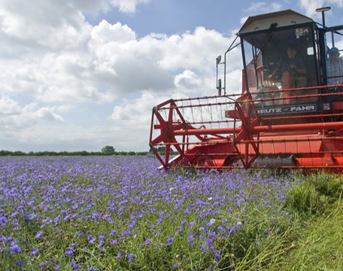
Business model introduction
The goal of this business model is to demonstrate the requirements needed to significantly increase the output of wildflower seeds, x10 our current production for the use in conservation bio control.

Slide 6
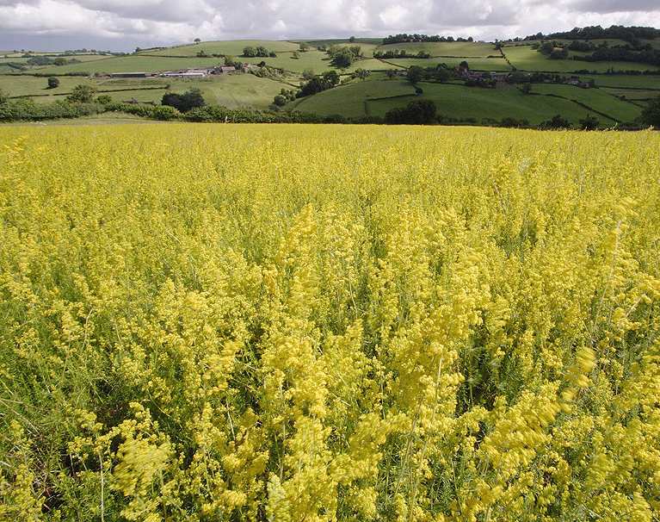
value proposition
Key tool for conservation biocontrol
Quality Wild flower & grass seeds​
Mixture design​
Consultancy​
Biodiversity and conservation​
Easy, convenient habitat solutions for all​
Sustainability and Ethics
Community engagement

Slide 7
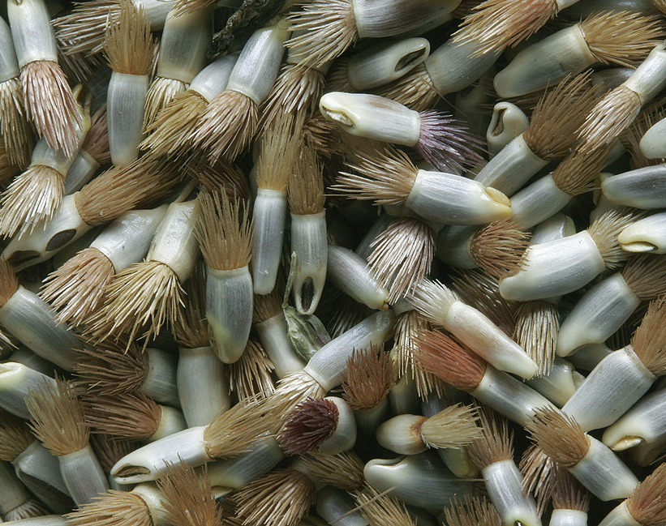
Value Network
Wild seed collectors & suppliers​
Government, Environment agencies and non-profits
Landowners
Customers
Educational institutions
Research & conservation
Logistics and distribution partners​

Slide 8
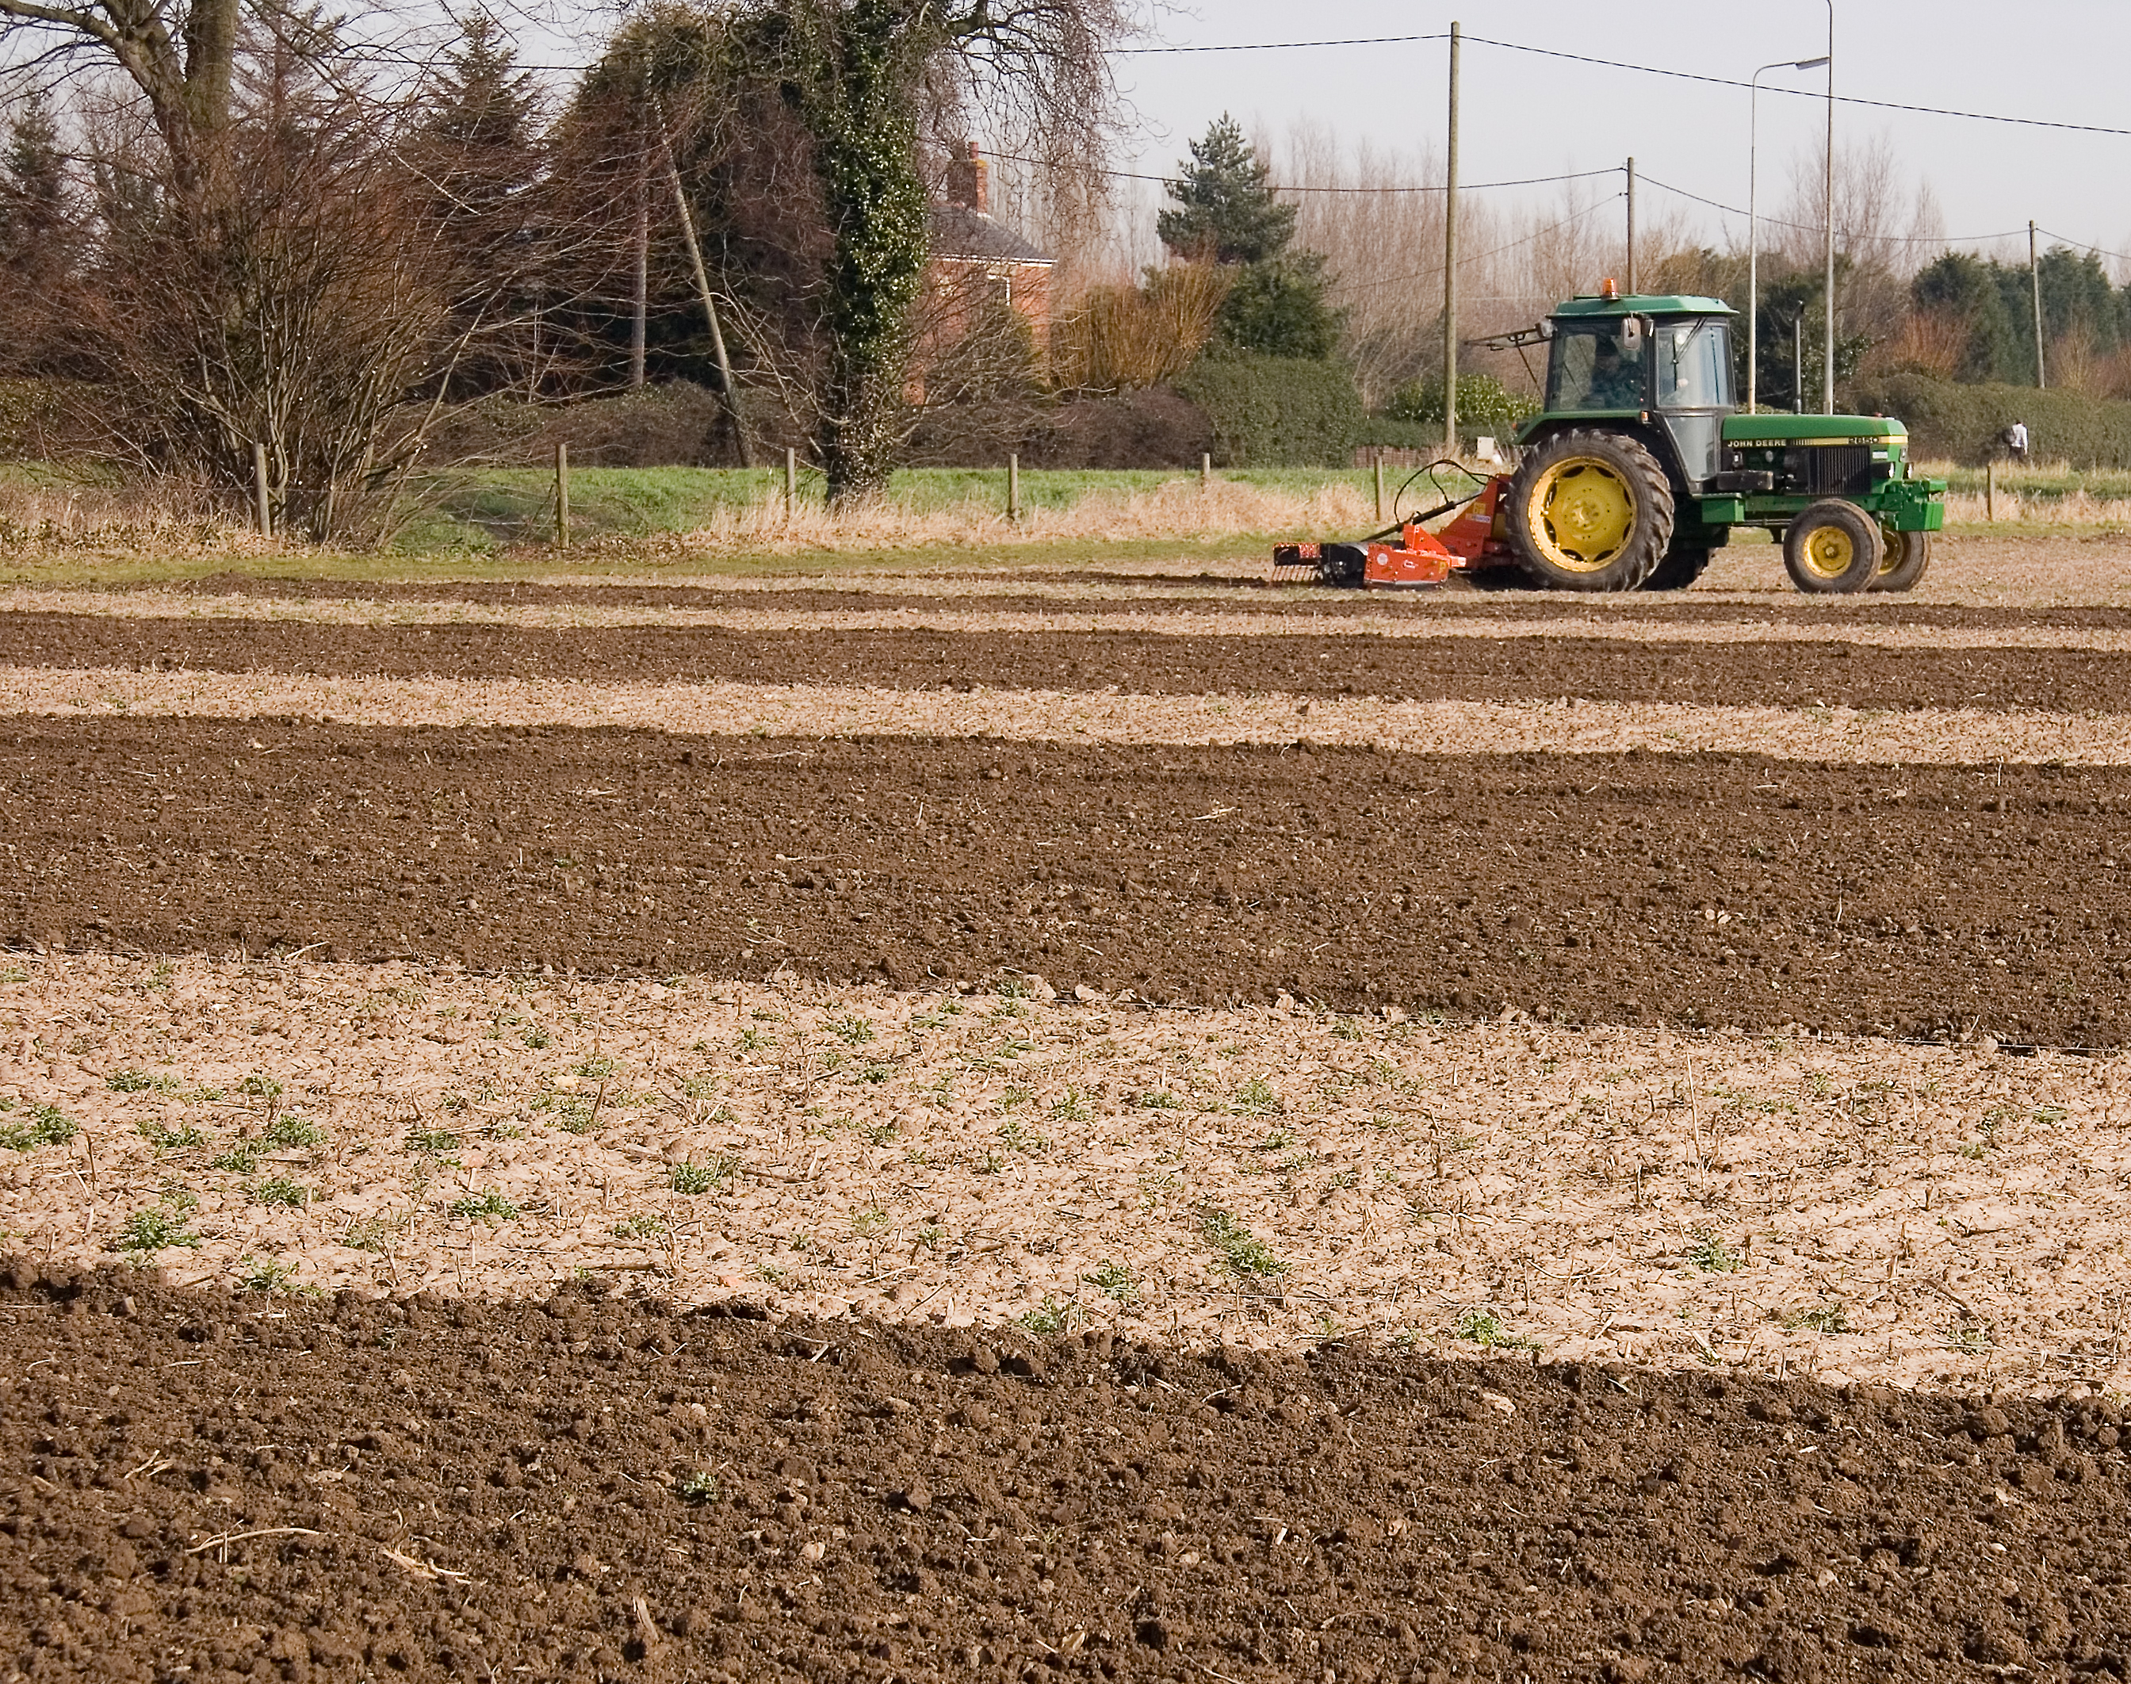
Key Resources
Land, buildings & Growing facilities
Seeds processing & storage infrastructure
Seed Skilled workforce
Research & development
Technology & Equipment​
Financial resources
stock & genetic diversity​

Slide 9
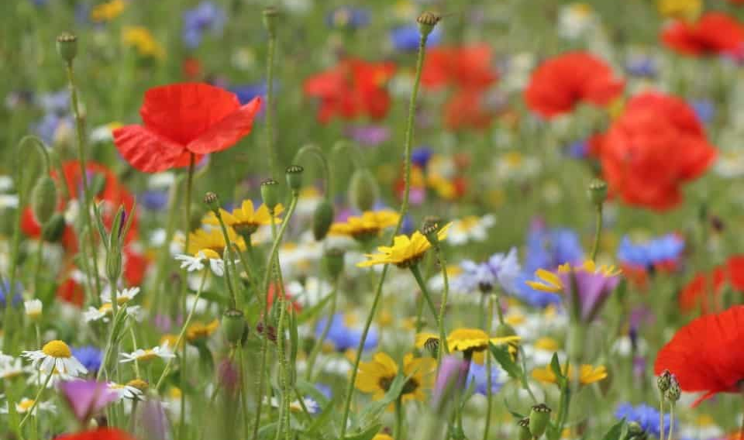
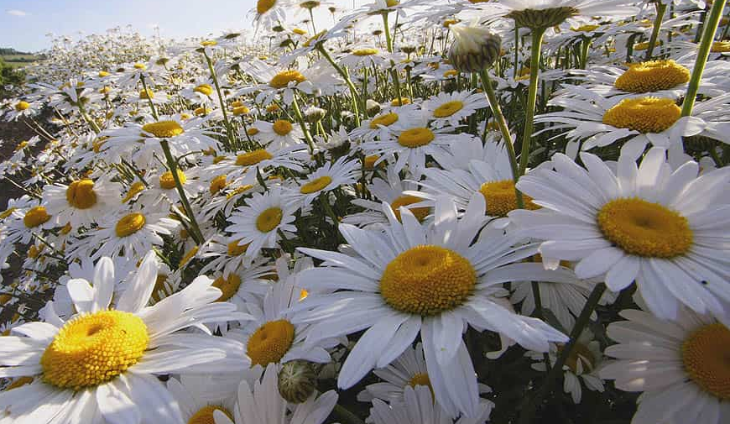
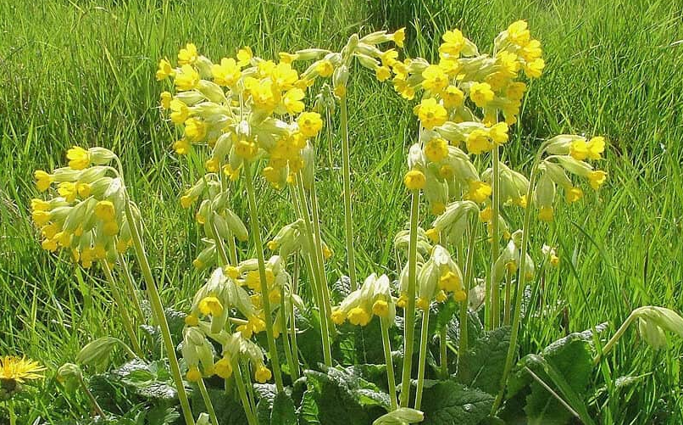
Upscaling
Cornfield Annuals
Short-lived Perennials
Long-lived Perennials
Wild harvested /Rhinanthus minor
Easy to obtain seed
2 years = many hundreds of KG/ Ha (only real limit is land)
Harder to obtain stock
specialist requirements
Generalist requirements
3 years = Up to 500 KG/ Ha
Harder to obtain stock
specialist requirements
3-5 years = <500kg/ Ha
Harder to obtain stock
specialist requirements
10-15 years = 100-200kg / Ha Up to25kg / Ha (R.minor)

Slide 10
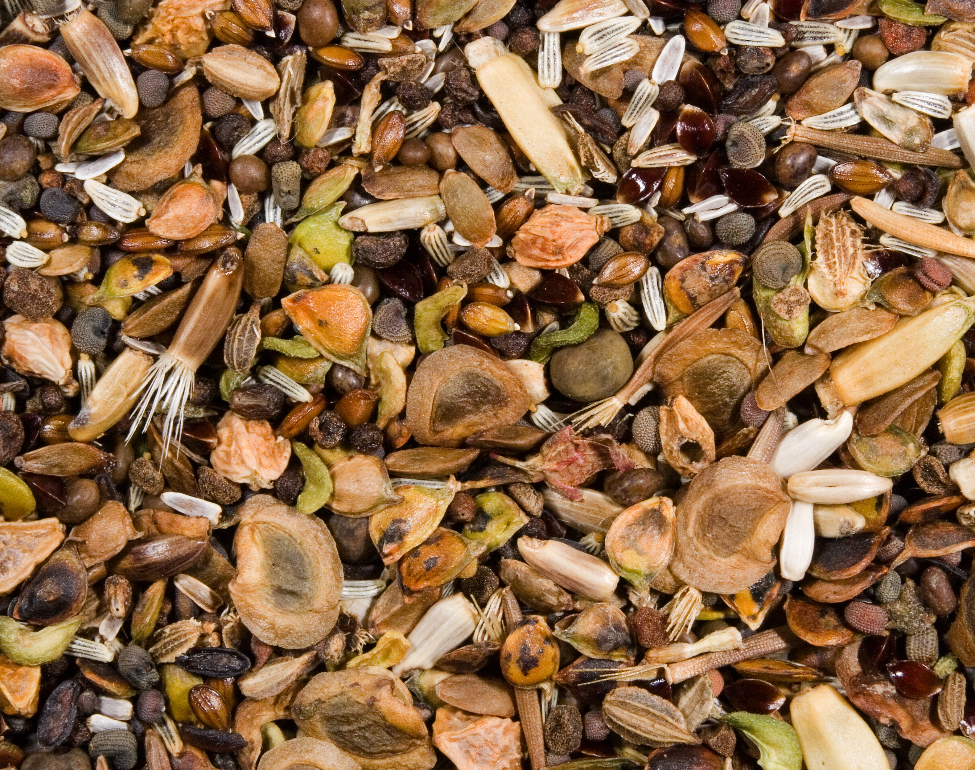
Mixtures
Affordable/ economical
Common cornfield annuals and generalist/widespread open flower perennials (Apiaceae and Asteraceae)
How important is a stable plant community? Timescales in arable situations?
Our aim is to try and emulate a natural plant community- thus create a base mixture for a self-sustaining habitat
‘similar mixtures of native plants can be used over large climatic gradients to improve biocontrol’ Bischoffa et al (2022).
BUT the margin for error is large, why?

Slide 11
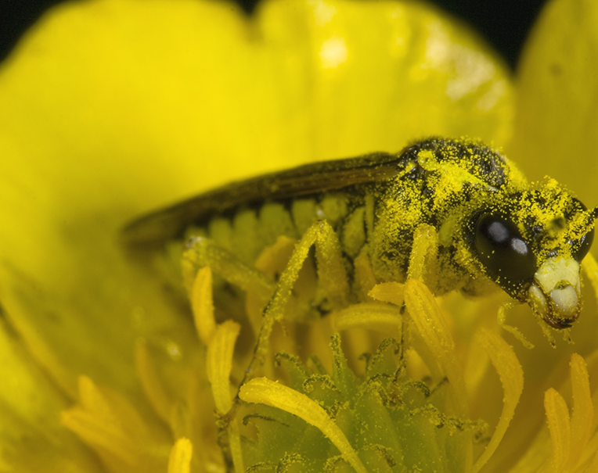
The use of wild flower seeds for conservation biocontrol has potential to produce the following:
Pest control
Reduced pesticide use
Financial saving
Conservation of native flora
Increase in biodiversity
Pollination services
Soil health and erosion control
Aesthetic/ recreational value
Many more

Slide 12
Thank you!

