Slide 1
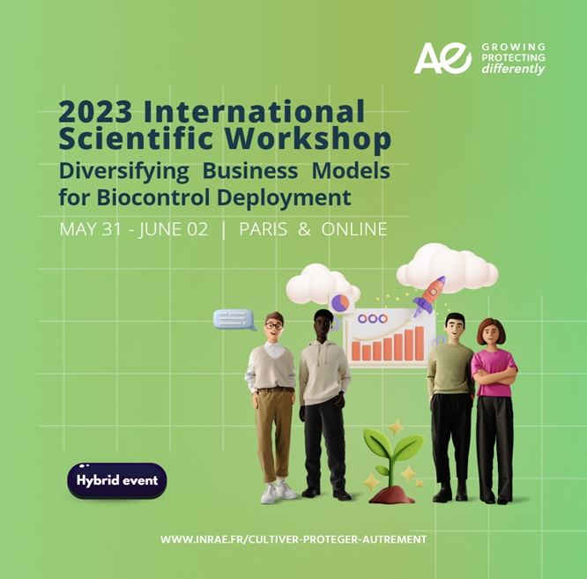
Diversifying Business Models for Biocontrol Deployment Elements for a conclusion
Manuel Boutet
(GREDEG, Université Côte d’Azur)
01/06/2023

Slide 2
Several fixation effects & paradoxes
All actors tend to think biocontrol as inputs/products only
Using an organism or a substance found by an academic laboratory…
… developed by a company selling products…
… sold to growers by a distributor of inputs
While biocontrol corresponds to a variety of strategies, beyond products.
Actors responsible for innovation are not only upstream crop protection companies.
Most initiatives & actors think of biocontrol in current dominant systems
→ Often systems in which chemical pesticides are the cornerstone.
→ Often systems that make litte use of biodiversity-mediated pest regulation services.
→ Oftne systems that are not favourable to biocontrol.
Manuel Boutet

Slide 3
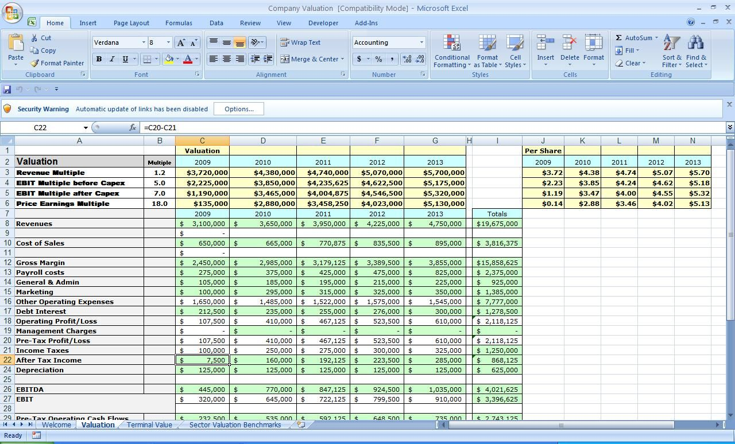
What are business models?
No, business models are not just about generating money
Manuel Boutet

Slide 4
What are business models?
Manuel Boutet

Slide 5
What are business models?
Some key features to take with you :
1. Look at practices, not discourses: new avenues are being explored and structured, their description is to make and lessons to learn from them.
Manuel Boutet
Notes:
(and sometimes, weaknesses can become strength : as with little farms in Africa where most of the farmers are women… It could be seen as a weakness, but it becomes an opportunity to rely on the community of women in each village)
(can it be reduced ? For example, maximum optimization would be 4 years from strain to production for Atoxigenic fungi)

Slide 6
What are business models?
Some key features to take with you :
2. Even when “solutions” are developed, the link to research is maintained and is very strong.
Competencies in biology are not only necessary for the initial “research”, they are also necessary to the continuous work necessary to maintain systems and solution presented.
Research is a way to build and rebuild the link to the territory and natural ecosystem.
Manuel Boutet
Notes:
(and sometimes, weaknesses can become strength : as with little farms in Africa where most of the farmers are women… It could be seen as a weakness, but it becomes an opportunity to rely on the community of women in each village)
(can it be reduced ? For example, maximum optimization would be 4 years from strain to production for Atoxigenic fungi)

Slide 7
What are business models?
Some key features to take with you :
3. Multiplicity of actors involved : a remarkable richness there, and more profoundly a link to local culture and social intelligence
“it is a gender specific problem, we offered a gender specific solution”
“sit down with the farmer and look at his plots”
“engaging with the public”
Manuel Boutet
Notes:
(and sometimes, weaknesses can become strength : as with little farms in Africa where most of the farmers are women… It could be seen as a weakness, but it becomes an opportunity to rely on the community of women in each village)

Slide 8
What are business models?
Some key features to take with you :
3. Multiplicity of actors involved… means also alternate measurements of gain to expect from the technique :
“saving the crop”
“public health”
“empowering farmers”
“landscape aesthetics”
“biodiversity”
“any % is a contribution”
“knowledge about” … problems, pests, environment, biodiversity, etc.
Manuel Boutet
Notes:
(doesn’t need to be the sole solution)

Slide 9
What are business models?
Some key features to take with you :
4. Time span :
for all techniques, most examples are developed over 10 to 20 years
> we really need to change the scale
Notes:
(can it be reduced ? For example, maximum optimization would be 4 years from strain to production for Atoxigenic fungi)

Slide 10
What are business models?
Some key features to take with you :
4. Really open imagination about agriculture
> we really need to change the scale :
To do that, we definitely need a better, more complete and more accurate road map of all the avenues of development before us.
Manuel Boutet
Notes:
(and sometimes, weaknesses can become strength : as with little farms in Africa where most of the farmers are women… It could be seen as a weakness, but it becomes an opportunity to rely on the community of women in each village)
(can it be reduced ? For example, maximum optimization would be 4 years from strain to production for Atoxigenic fungi)

Slide 11
What are business models?
Some key features to take with you :
5. What was perhaps lacking here ?
We need more time to discuss the difficult subjects: difficulties, conflicts and governance.
Manuel Boutet
Notes:
But it seemed to us preparing that important meeting that it was important to discuss first, both realistically and positively, the possibilities of development.

Slide 12
How to speed-up the growth of biocontrol strategies?
Support all types of biocontrol strategies & associated business models
Work on the organisational and institutional factors impacting business models
Focus on innovation pull strategy driven by downstream actors
→ Increase the focus on biocontrol innovations in the most sustainable systems
(as opposed to systems using chemical pesticides as cornerstone)
Remarks:
I do not suggest to stop the support to the development of biocontrol products!
The suggestion is rather to increase the support to all the most sustainable types of strategies.
Manuel Boutet

Slide 13
Why this international event?
Overall goal
Start a large-scale initiative promoting organisational and institutional innovations favouring the growth of business models enabling the most sustainable biocontrol methods
This Event is a kick-off to:
Highlight the diversity of biocontrol strategies available
Underline that these strategies mobilise a diversity of business models
Investigate, objectivize the business models used in BC, their success/failure factors
Pave the way for projects & actions
Manuel Boutet

Slide 14
Thank you for your attention!
Manuel Boutet

