Slide 1
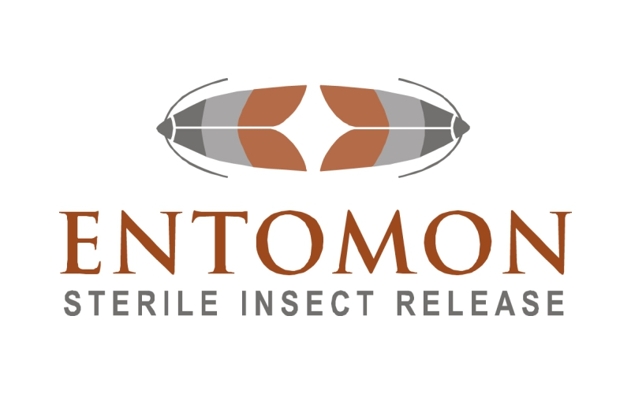
Diversifying Business Models for Biocontrol Deployment
R&D to Semi-Commercial operation;
The failure of Entomon Technologies (Pty) Ltd
Martin Wohlfarter
Regulatory Affairs Specialist - Koppert
B.Agric.Admin (US) ・ PG Dip Land & Agrarian Studies (UWC) ・ MBA (UCT GSB)

Slide 2
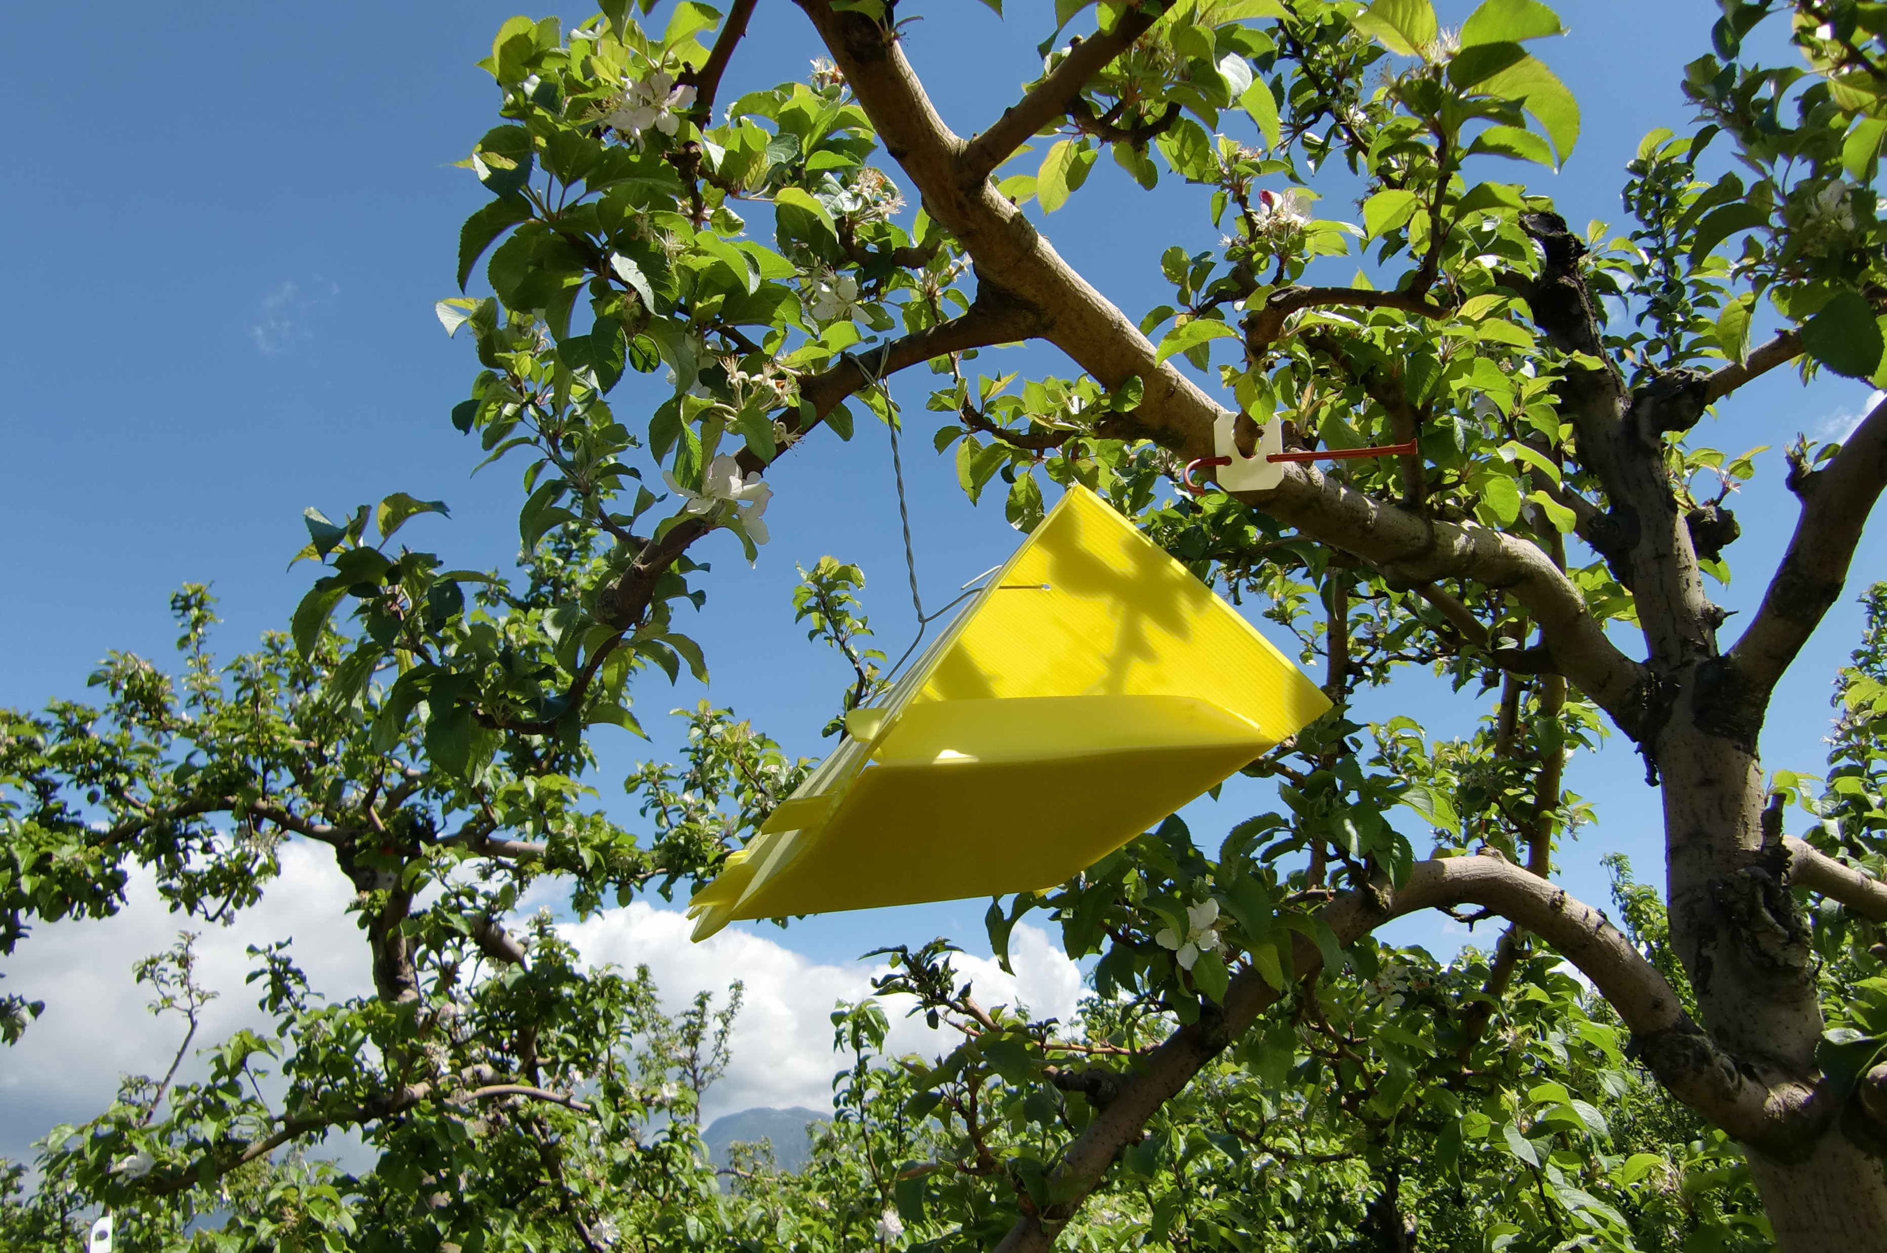
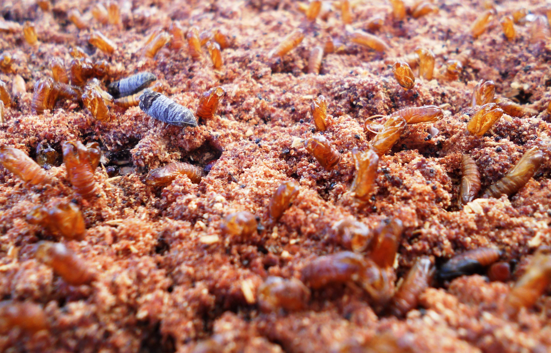
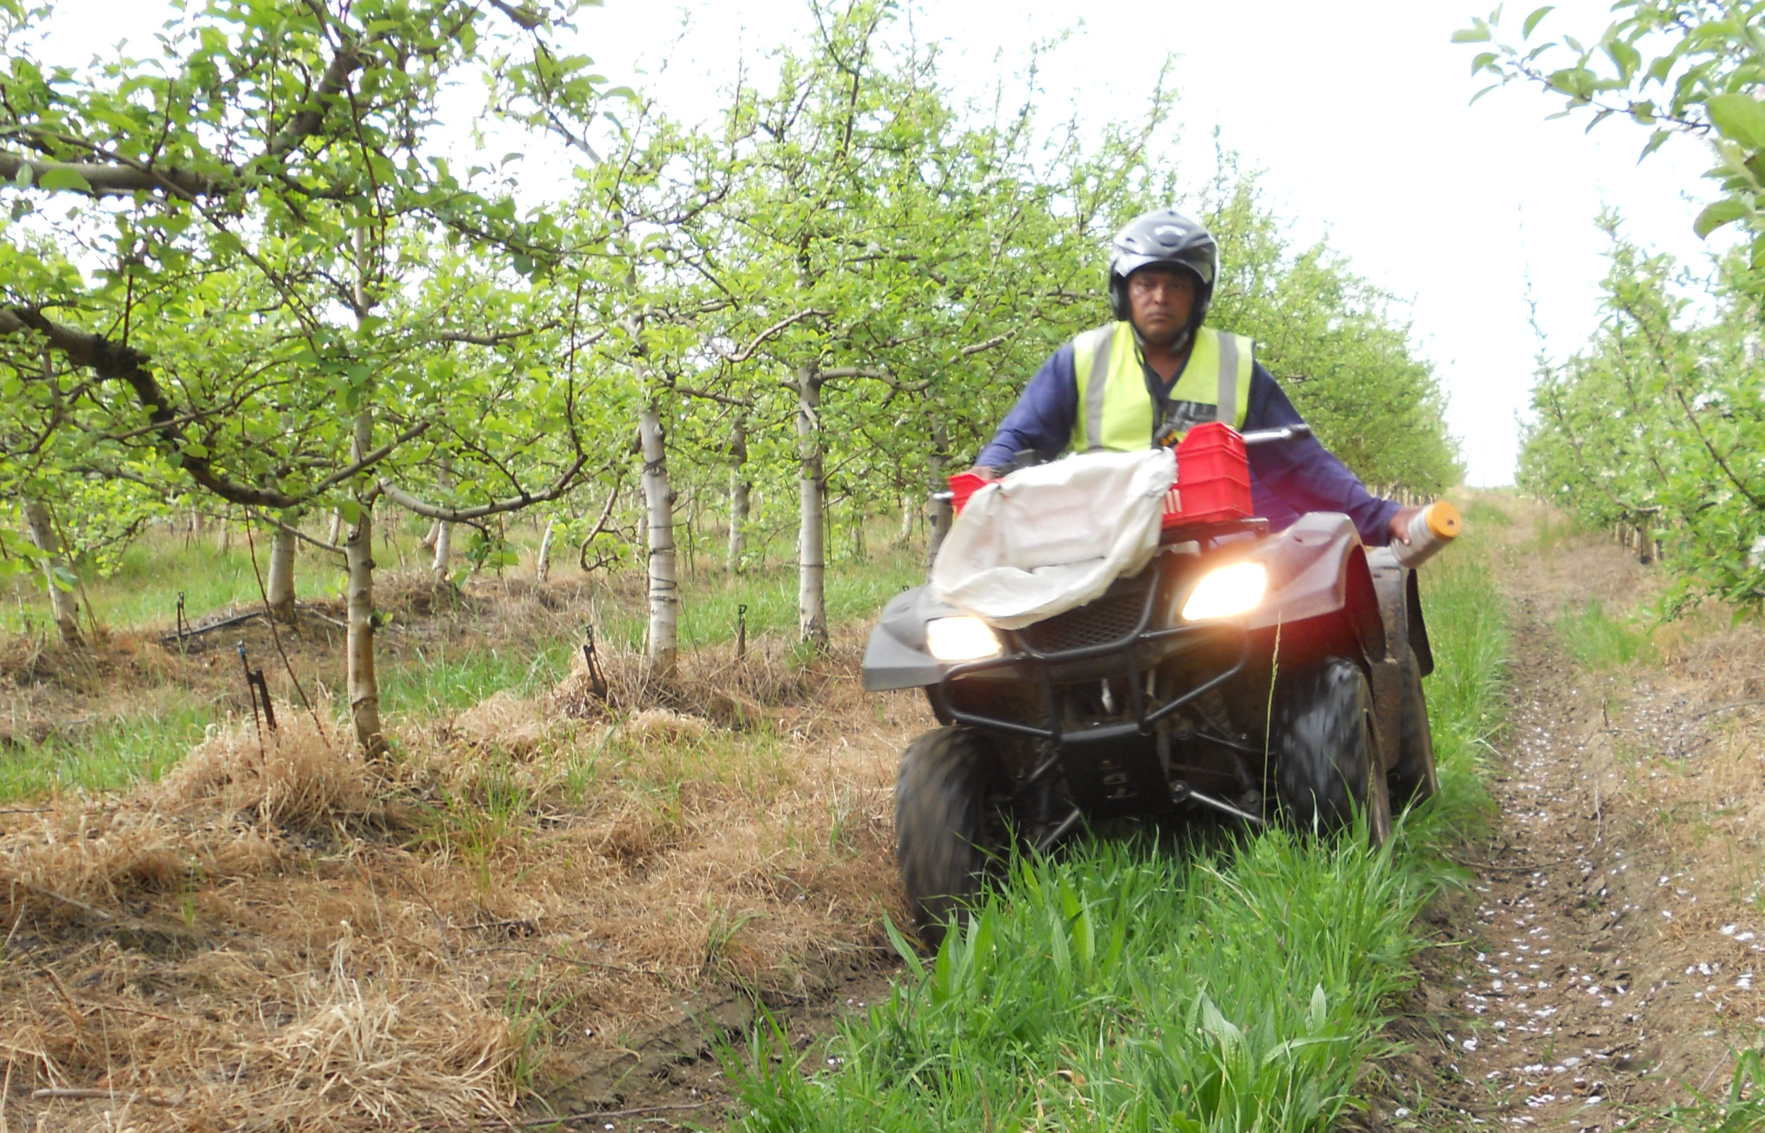
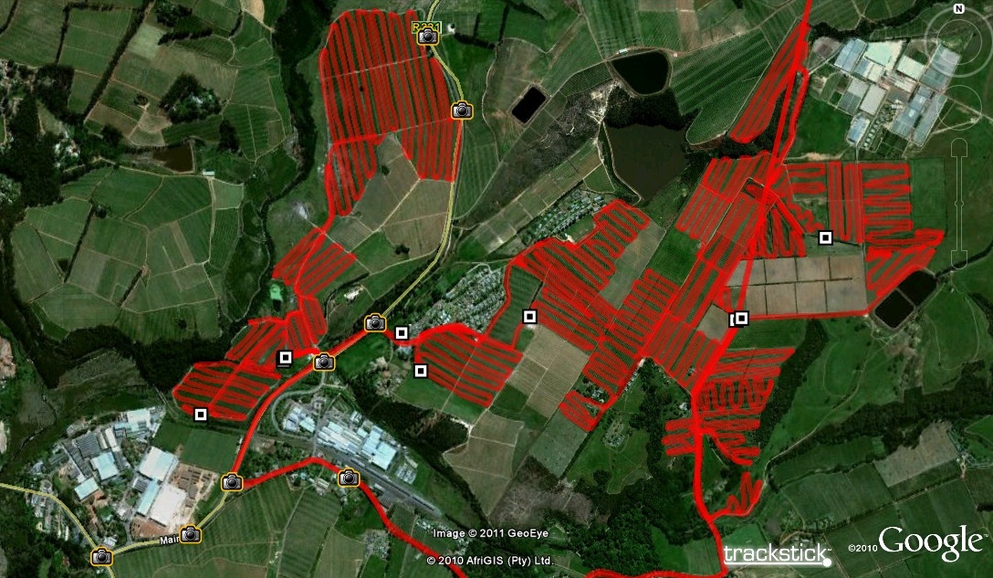
Technical description
Monitoring of resident pest population, mass-production and release of sterile codling moth

Slide 3
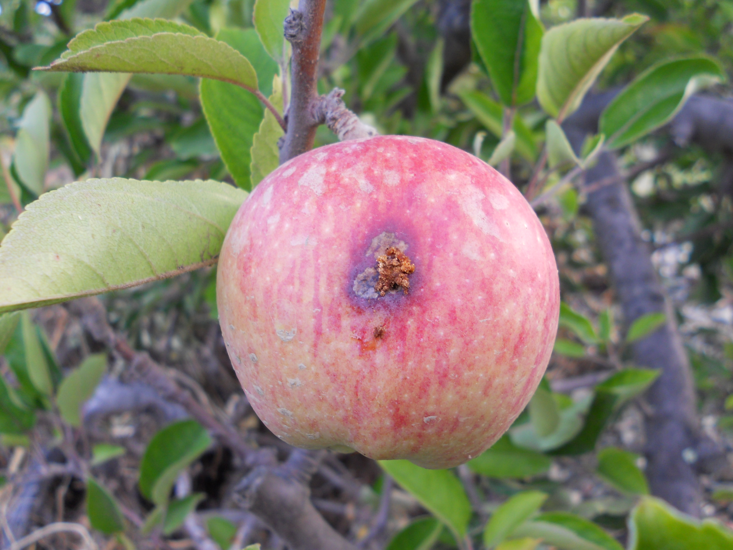
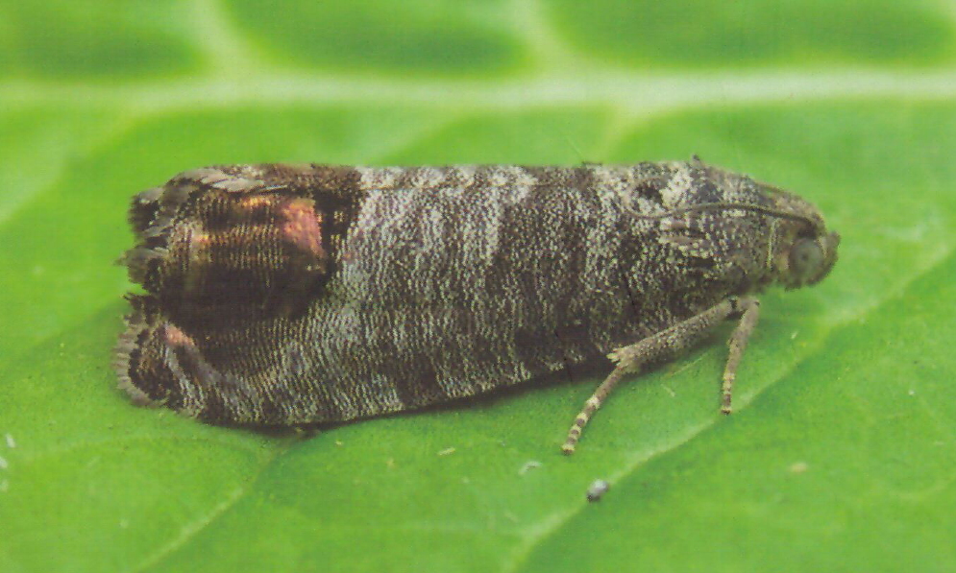
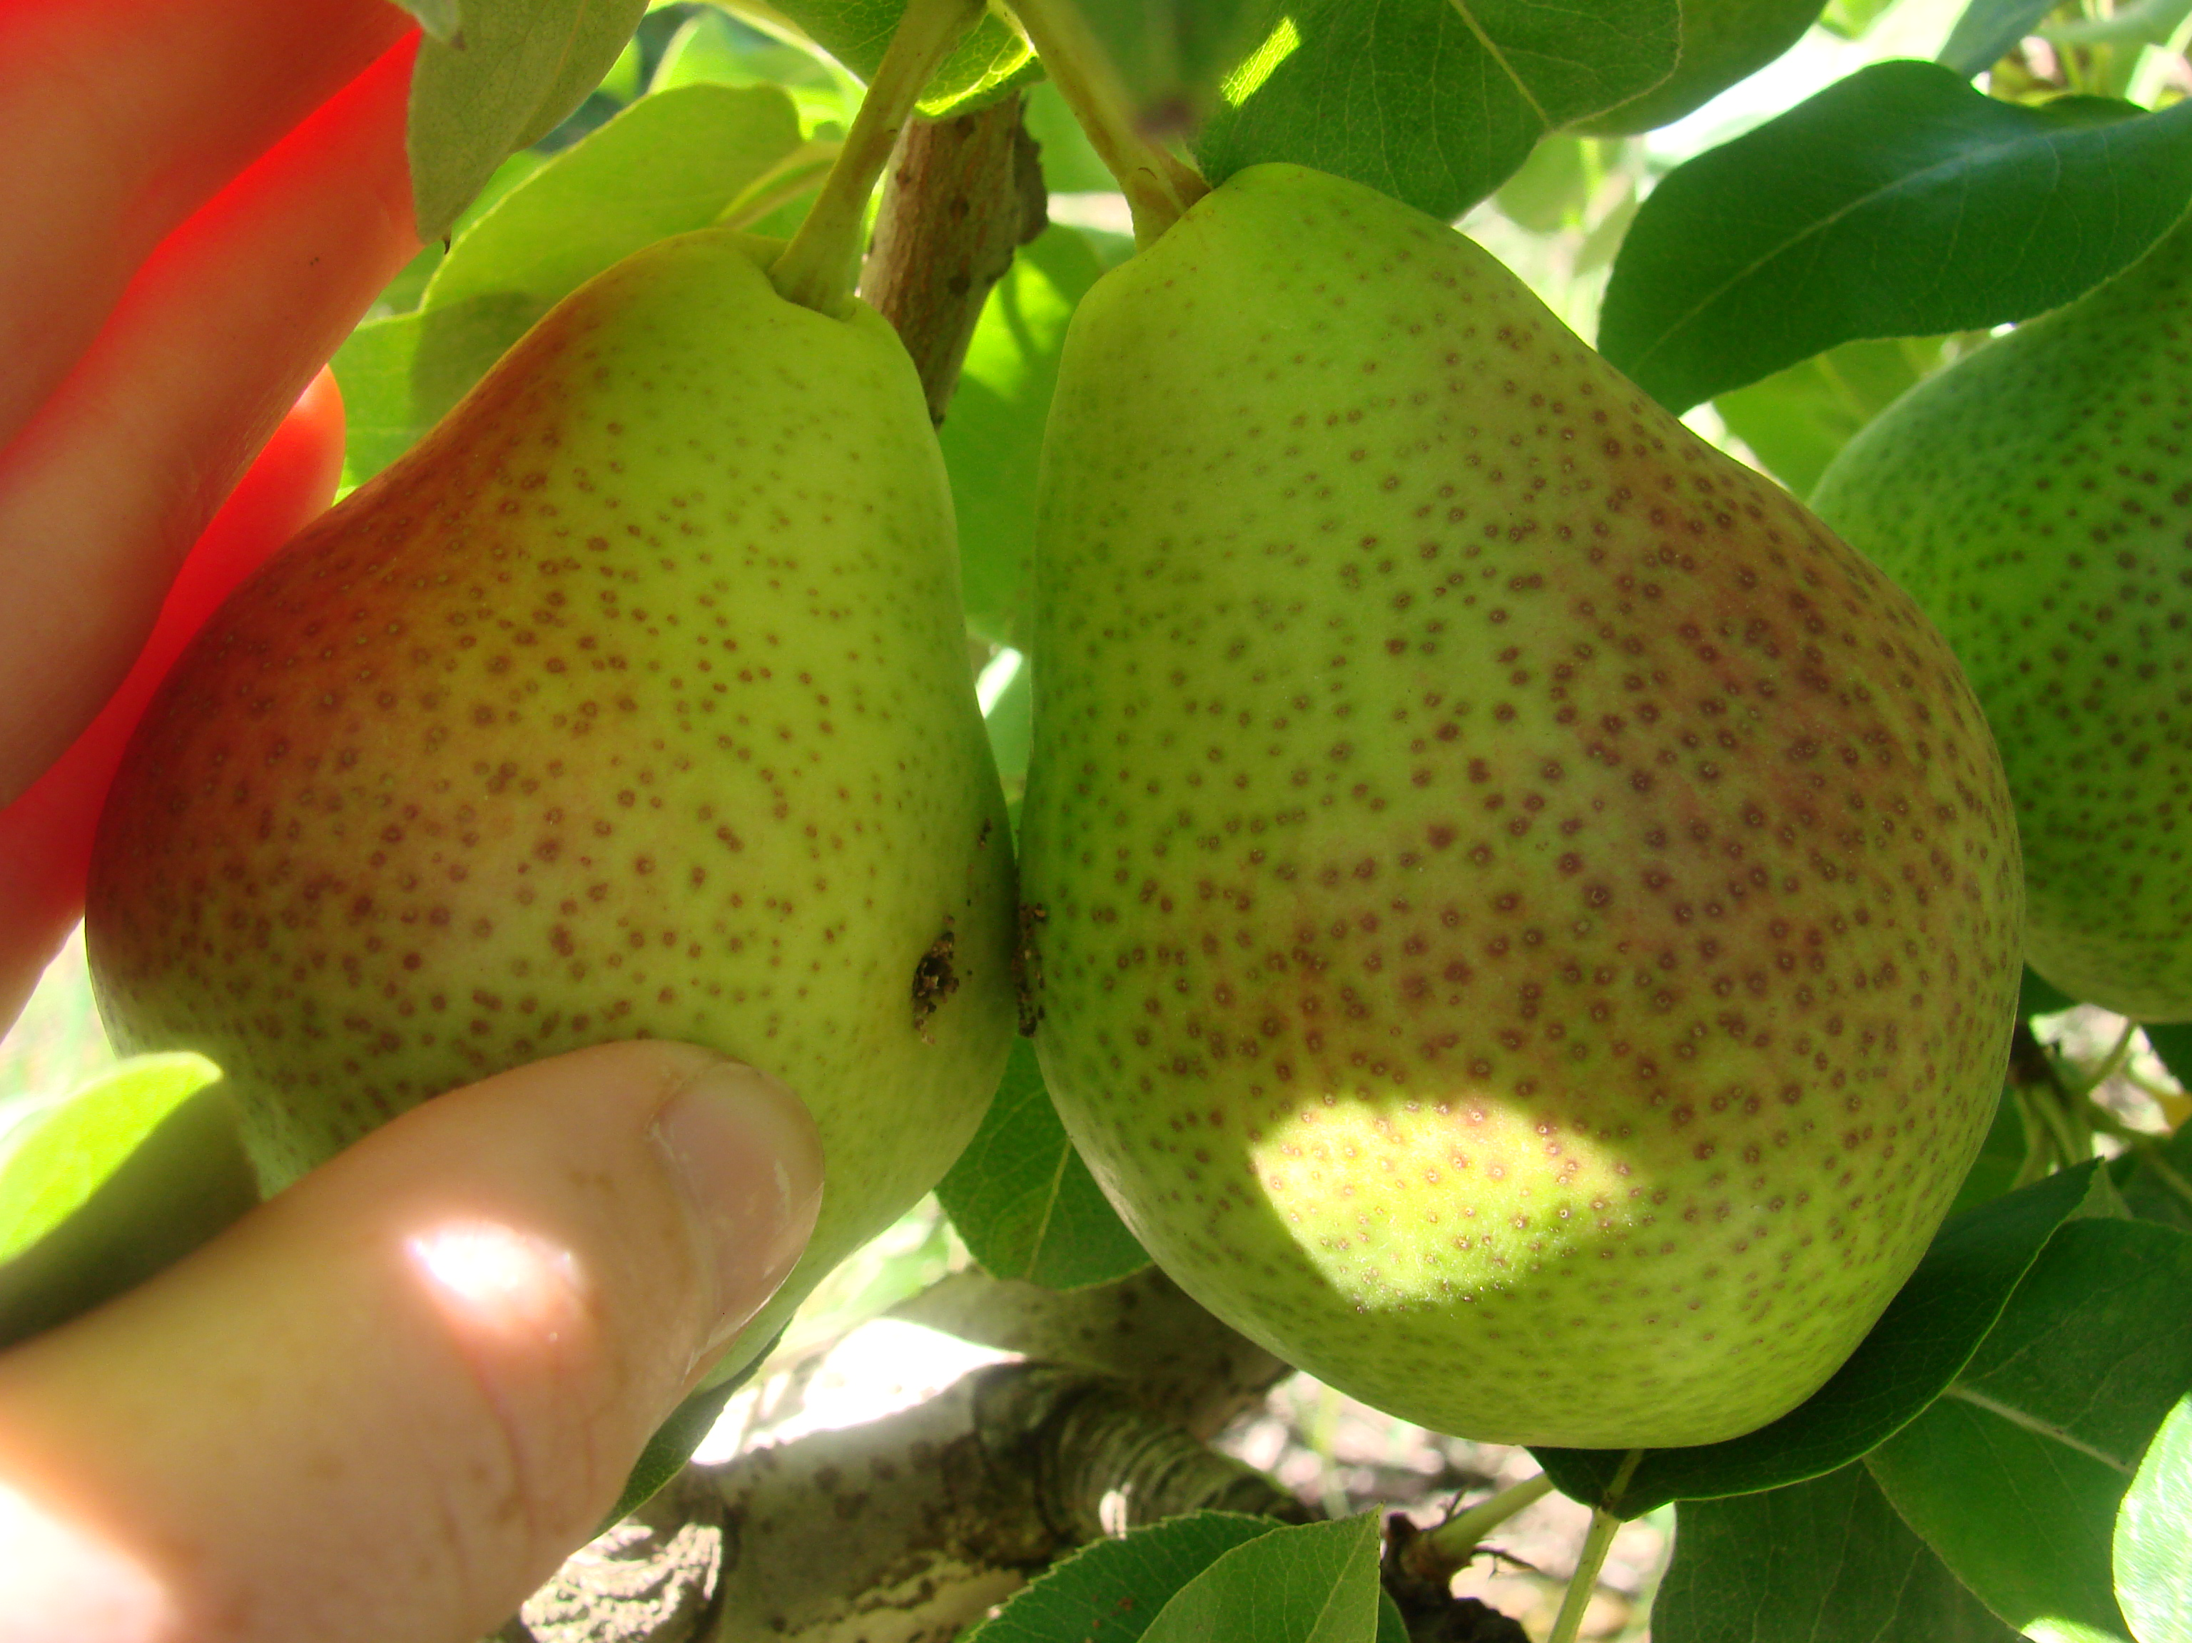
SIT - Codling moth (Cydia pomonella)
Copyright; Shane Farrell, Butterfly Conservation Cheshire & Peak District Branch

Slide 4
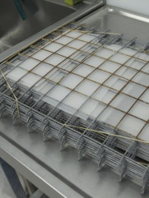
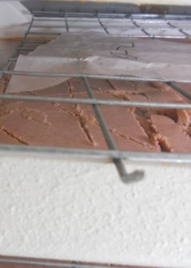
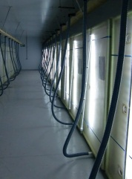
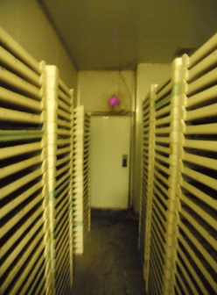
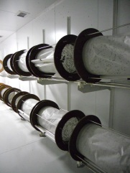
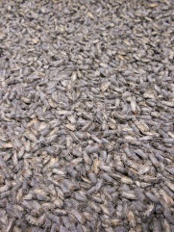
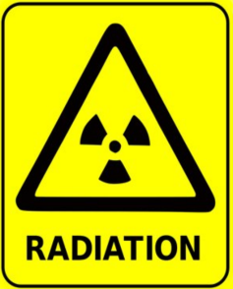
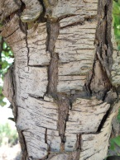
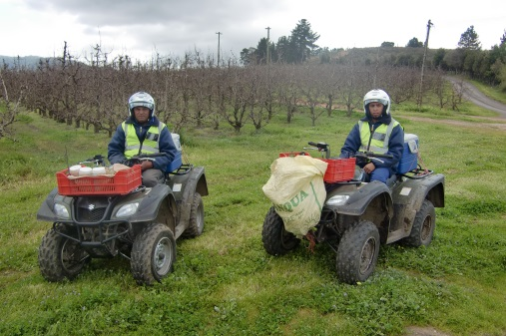
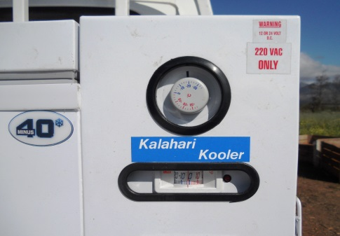
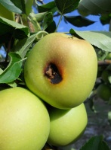
2
3
4
5
1
6
ENTOMON PROCESS
7
9
8
Notes:
This slide provides a brief photographic presentation of the production cycle applied at Entomon. A colony was started from wild moths collected. In order to maintain ‘colony fitness’ more wild moths were regularly introduced into the laboratory colony.
Egg production.
Quality control and washing of egg sheets. Egg sheets are washed to remove excess scales on which virus particles might persist.
Egg sheets on top of diet.
Rearing chambers.
Emmergence room; Emmerging moths fly towards the UV light and are collected.
Collected and cooled moths.
Before release moths are irradiated.
Cooled transport to release site.
Release by ATV in apples for 7-8 months @ 2x 1000 moth per week.

Slide 5
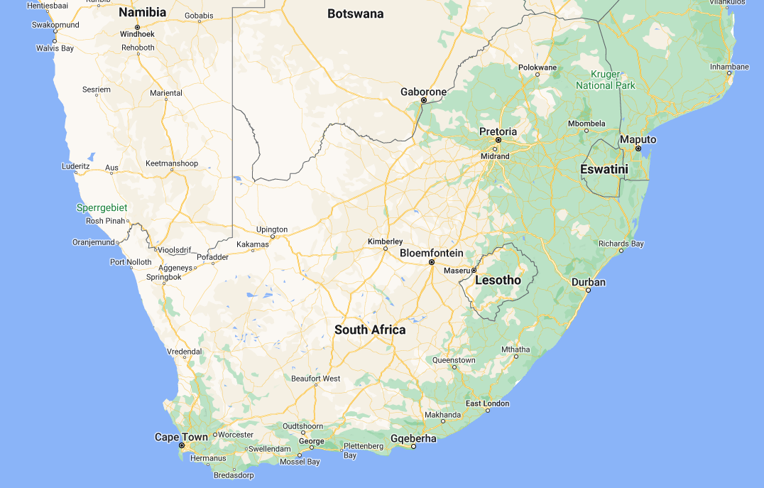
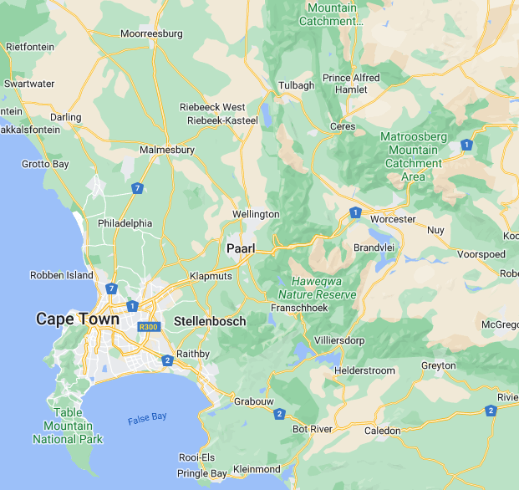

Slide 6
Value proposition and value network

Slide 7
Value Proposition
Codling moth management (long-term)
Monitoring (season long; pre- and post release).
Production (rearing) & Mass Release of Sterile Codling Moth.
Increased early season control by reducing number of fertilized females.
Reduction of 2nd and 3rd generation size.
Lower overwintering population.
Reduced reliance on conventional pesticides.
Reduction of pesticide residues (MRLs).
Reduced/slowed resistance development.
Increased marketability of fruit (low pesticide exposure).
Advisory services; custom IPM programme development.
Delivered by Entomon Technologies (Pty) Ltd
Private company (for-profit); non-statutory.

Slide 8
Value Network
South African Apple and Pear Producers Association (SAAPPA), a division of Hortgro Science (Pty) Ltd
Market Access lobby.
Start-up (seed) funding.
University of Stellenbosch
Facilities and R&D capacity.
Agricultural Research Council (ARC), a division of the Department of Agriculture (now DALRRD),
Initial R&D.
Irradiation facility.
National Department of Science and Technology
Technology Innovation Agency (T.I.A.) possible future funder of the expansion phase – new stakeholder.
South African Nuclear Energy Corporation (NECSA) and International Atomic Energy Agency (IAEA)
Funding of scientific missions and training.
Connecting international stakeholders (OKSIR).
Other Associations (non-monetary contributors)
Private crop production and pest & disease management advisory (consulting) services.
Packhouse- and Growers Cooperative extension officers.
Traditional Plant Protection Products (PPP) sales agents.

Slide 9
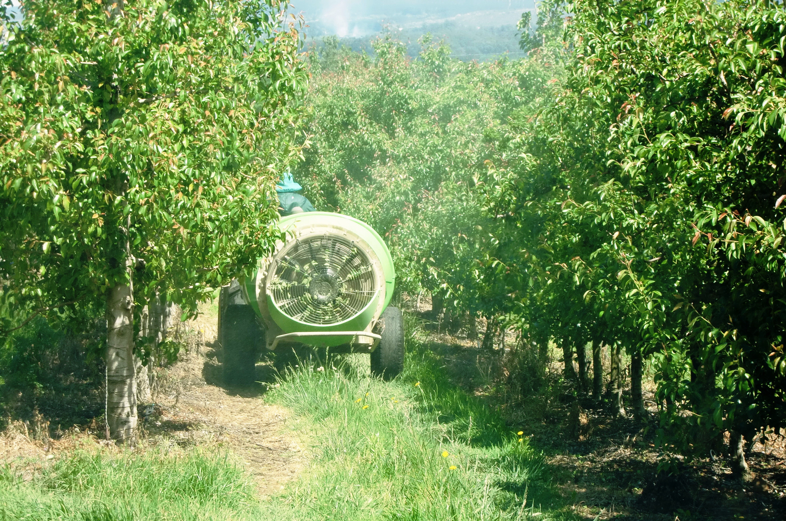
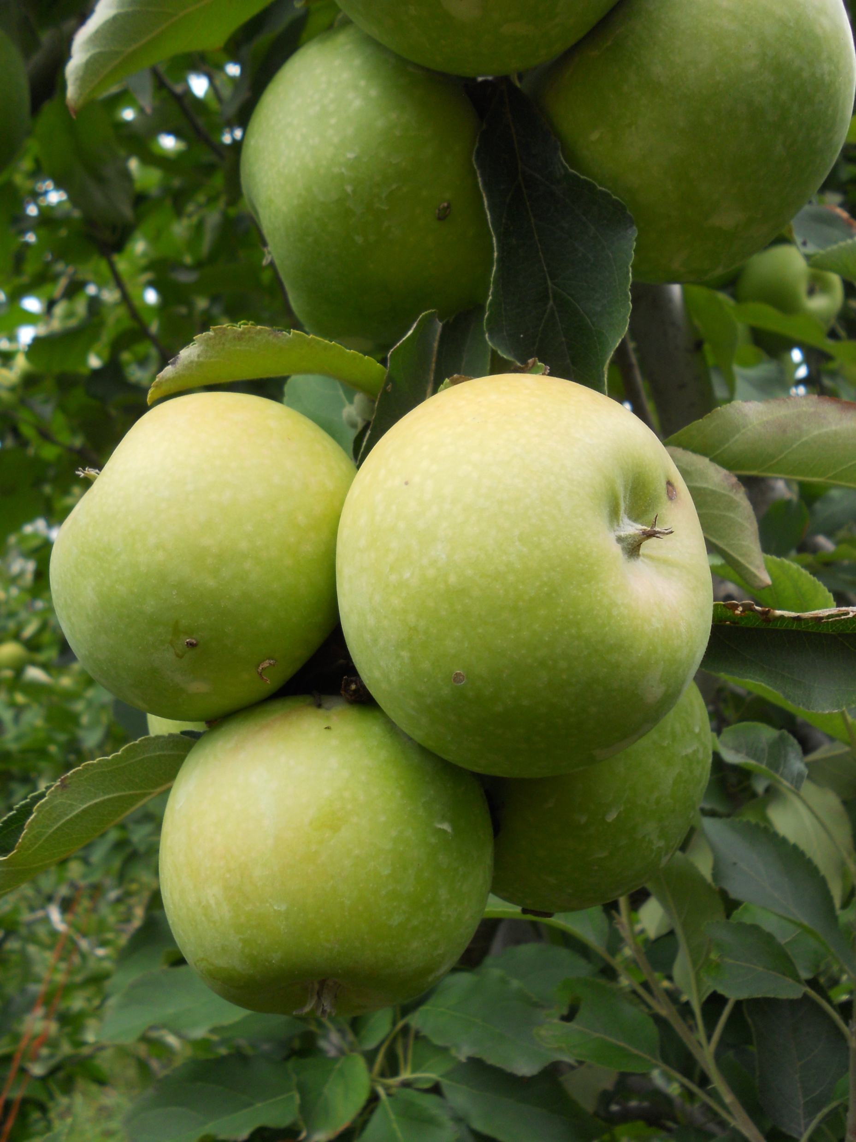
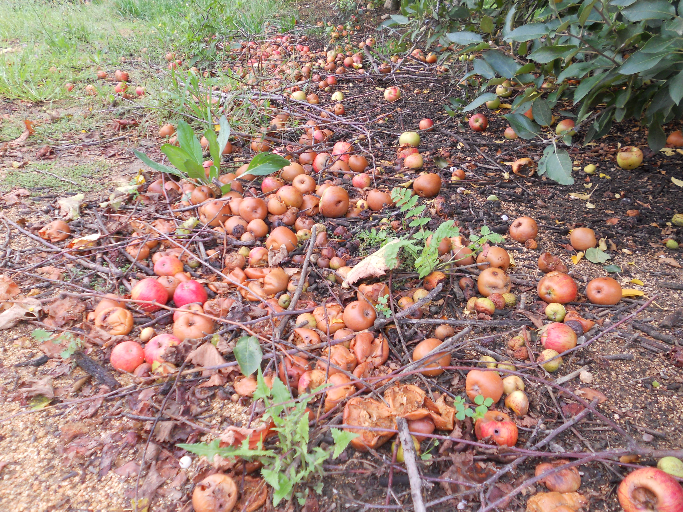
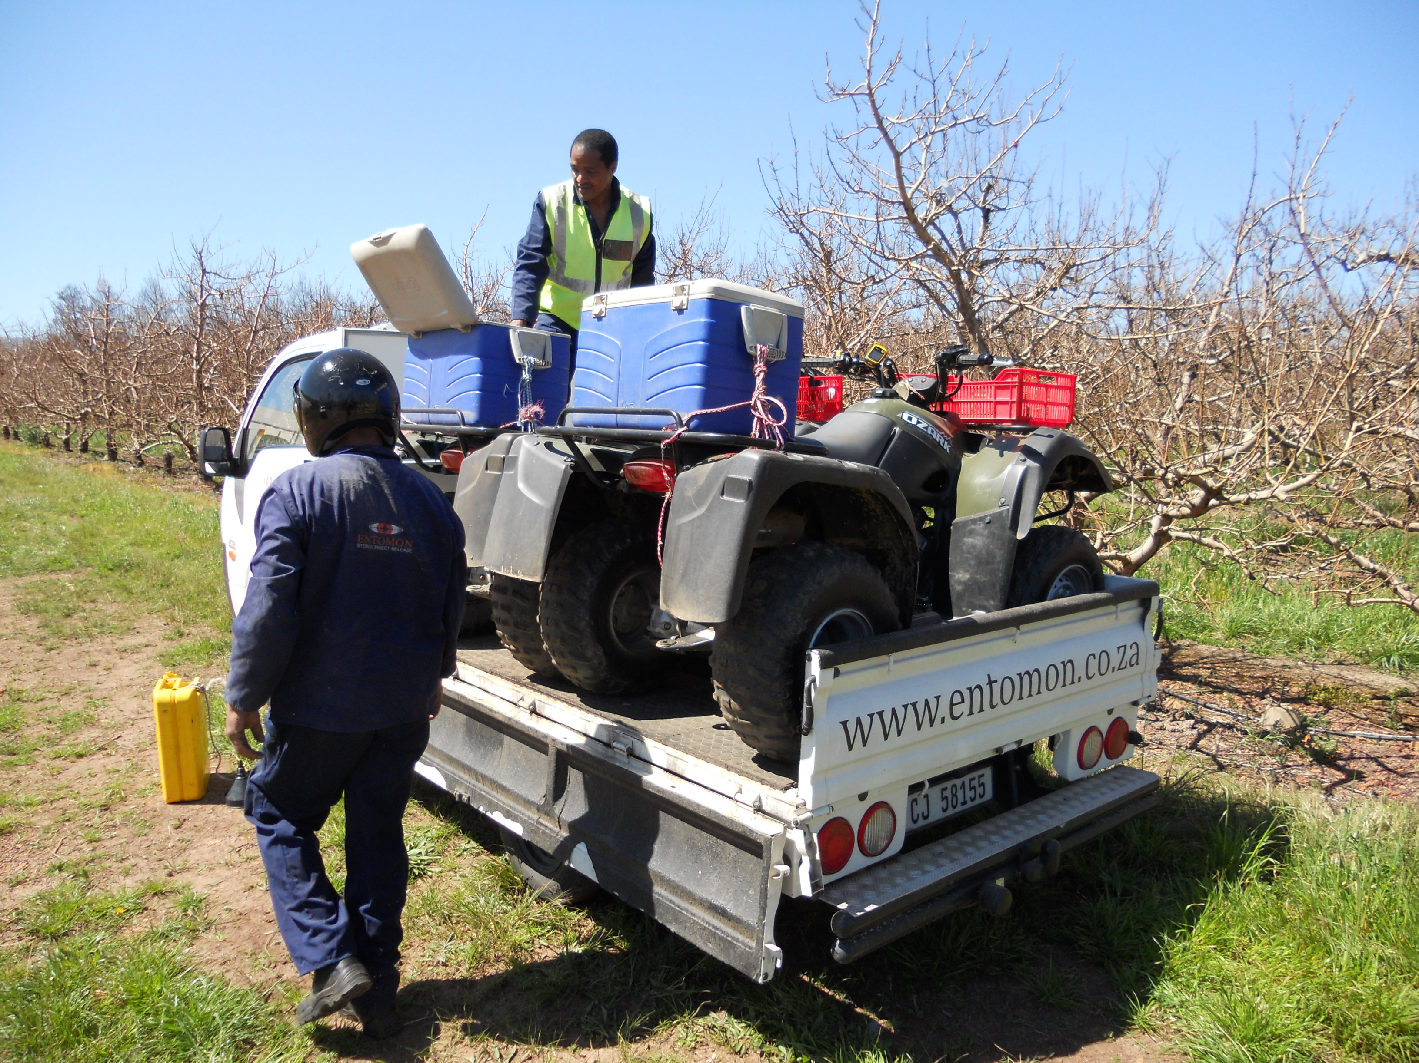
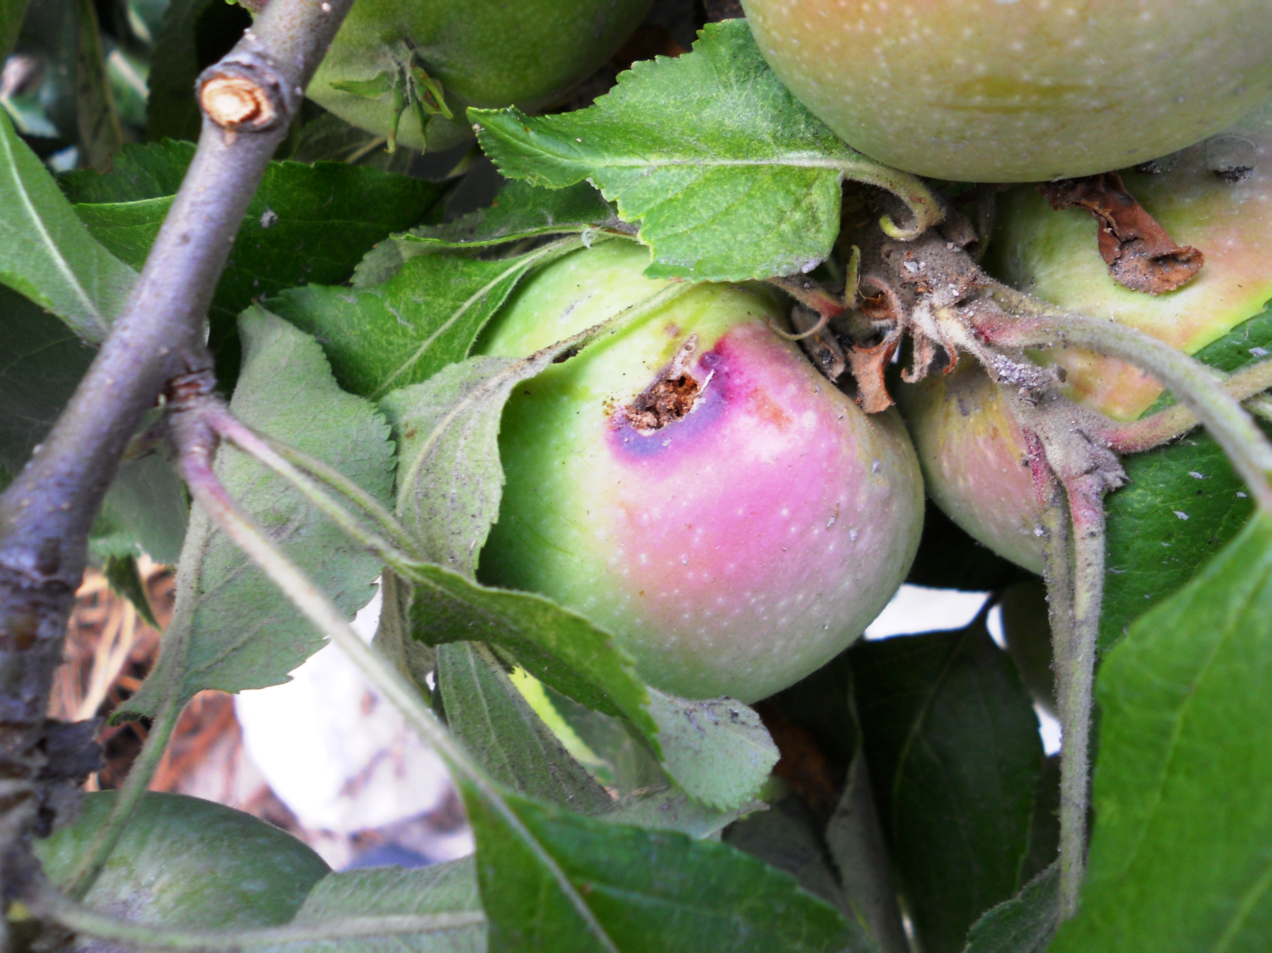
Contributions, gains and levers
Results achieved

Slide 10
Contributions; Business Model
Private For-Profit Business
Non-statutory; subject to free market; true price model.
Allow future investments, external shareholding.
Hortgro Services
Liaison (match maker) between all stakeholders.
Board members (directors); Hortgro Services,
Hortgro Sciences and SAAPPA.
Initial;
Start-up (seed) funding (financial services).
Marketing.
Human Resources
Obtained from open job market.
Continued training and development with NECSA and IAEA support.

Slide 11
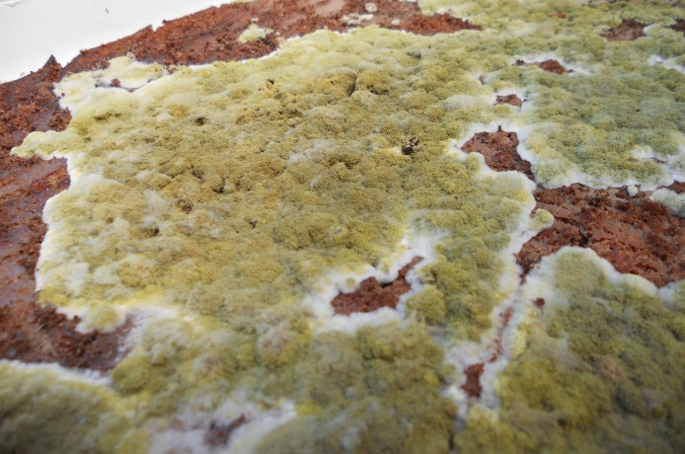
Gains; What did Entomon deliver?
Local Proof of Concept; Ability to Mass-Rear Codling Moth for SIR.
Cost-effective diet.
Decreased energy consumption.
Transport efficiency to ensure delivered quality.
Field Results
Reduction in wild moth catch (see following slide).
Reduced conventional PPP dependance.
Increased uptake of biological control.
R&D Incubator & Technology Transfer
University of Stellenbosch
EPN & EPF research.
Trichogramma wasp research.
Insect Rearing Training Course.
Cape Peninsula University of Technology (CPUT)
EPF research.
International collaborations (IAEA IPC CRP’s).

Slide 12
Average weekly wild codling moth trap catch
Action threshold – 2 CM/trap/week
Source: Combination of grower, University of Stellenbosch and Entomon data.

Slide 13
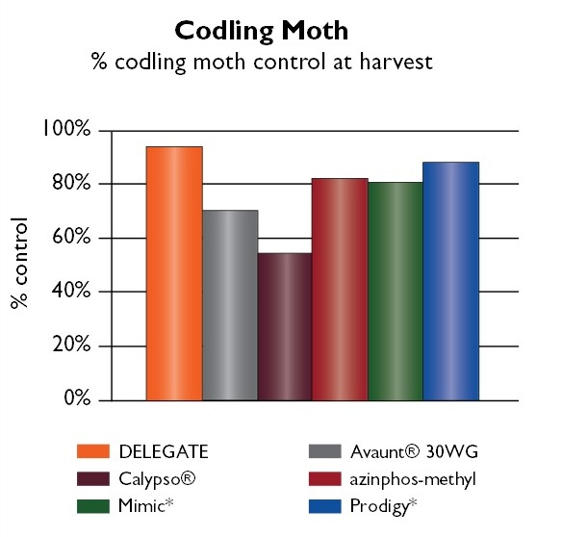
Development potential; Levers
R&D to Semi-commercialisation
Resistance development against conventional PPP’s in the 80s and 90s;
Lack of alternative/new chemistry.
Ban of further pesticides.
Development of OKSIR, in BC Canada.
High-level collaboration with the IAEA.
Local fruit fly control programme – availability of an irradiator.
Strong industry interest in sustainability (IPM).
Progressive thinking growers (and growers association).
Strong R&D ties with US and the ARC.
Business Failure
Over-optimism; no margin for error.
Weak business plan.
Weak assumptions.
Facility design, production problems (contamination), capacity limitation, ‘load shedding’ and loss of customer trust.
Lack of cost competitiveness.
Unwillingness to partner.
4X

Slide 14
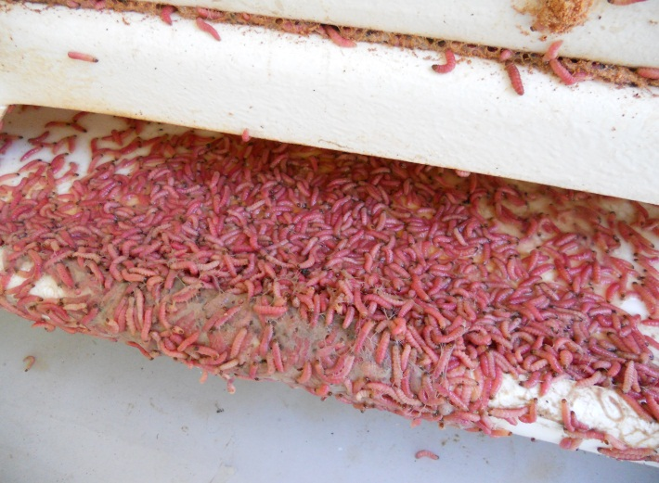
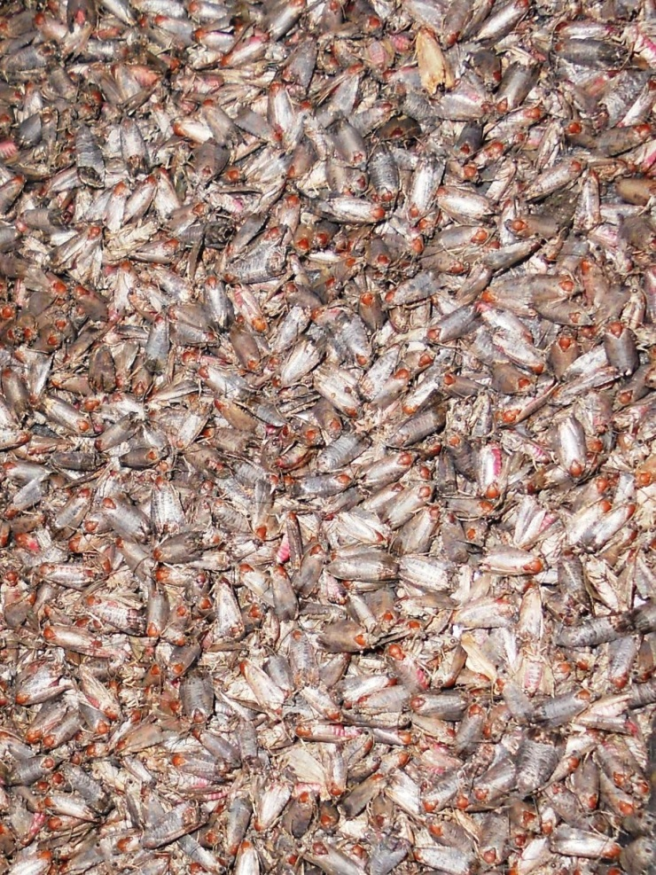
Development potential; Risk
Misalignment of the customers’ needs
R&D interests vs grower needs.
Pricing model.
Timing; missed schedule/delivery
Production capacity and contamination.
Inability to deliver and lack of sufficient contingency.
Public buy-in
Sufficient prior- and continued media coverage – popular press.
Effect of missed targets
Direct financial (bank balance).
Indirect on future funding.

Slide 15
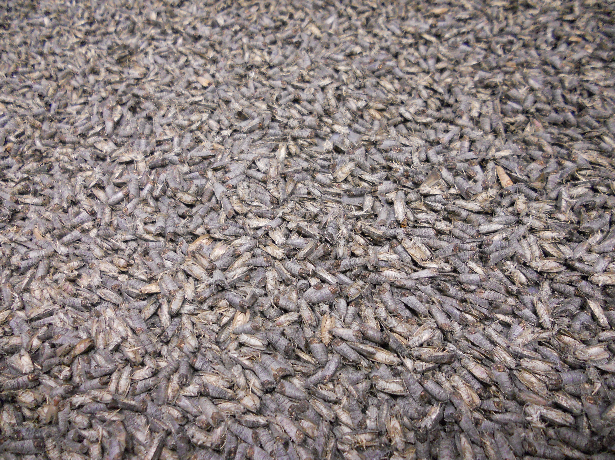
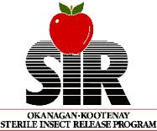
Martin Wohlfarter
Regulatory Affairs Specialist
mwohlfarter@koppert.nl
+31 (0)61 258 9493

