Slide 1
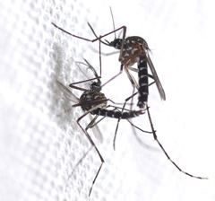
Application of the Sterile Insect Technique as a tool for the Integrated Management Vector (Aedes aegypti) in Brazil
Jair Virginio, PhD
Moscamed Brazil

Slide 2


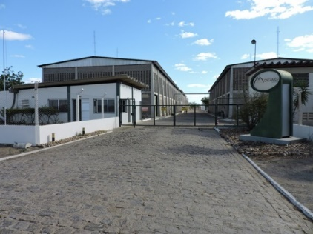
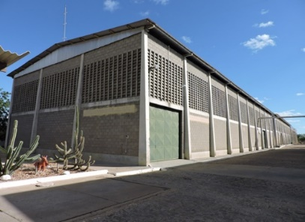
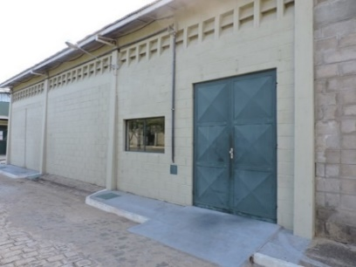
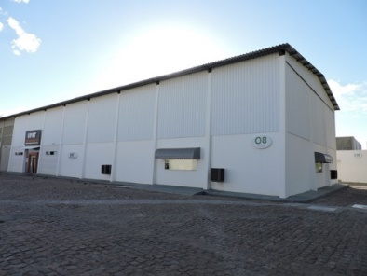
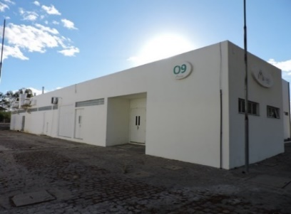
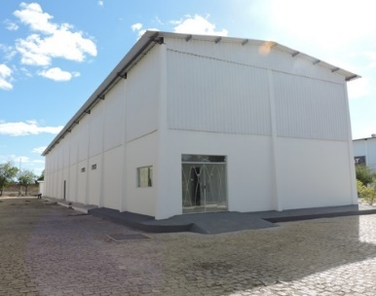

”Social Organization Moscamed Brasil "
Non-profit institution;
Deseginated as a IAEA Collaborating Centre;
Recognized as “ Social Organization” by Ministry of Agriculture, Livestock and Supply-MAPA and the Government of the State of Bahia;
  Biotechnology applied to Agriculture and Public Health

Slide 3
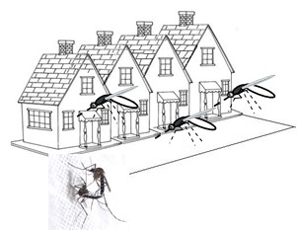
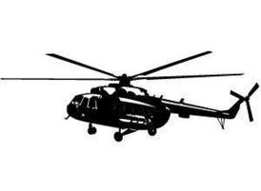


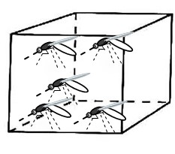
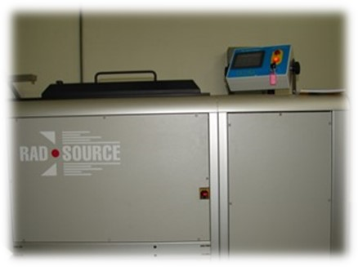

Integrated Vector Management - Mosquitoes
The Sterile Insect Technique can be used as a potential tools for the control of Aedes aegypti;
There are many challenges to be faced;
For implementation of SIT, It is necessary:
To develop;
To validate;
To optimized different methodologies (Mass-rearing, insect sterilization, packaging, chilling, transport and release methods, etc.).

Slide 4
Pilot Project
RLA5083- Enhancing the Capacity to Integrate Sterile Insect Technique in the Effective Management of Invasive Aedes Mosquitoes (2021-2022)
BRA5061- SIT National Project to Aedes aegypti control (2022-2023)

Slide 5
Pilot Project
Phases
1. Pré-realese
2. Supression
3. Pós-realese

Slide 6
Pré-realese
To hire local people for local team;
Baseline;
Colonize a strain with local genetic background;
Legal Frame Work.

Slide 7
In a mass rearing
Requires trained manpower, and turnover is high;
Separation of pupae is labor intensive;
Production is continuous 24/7. There are no weekends or holidays.
Expensive diet. Look for alternatives to reduce larval diet costs, looking for local ingredients, or mixing with local and imported ingredients;

Slide 8
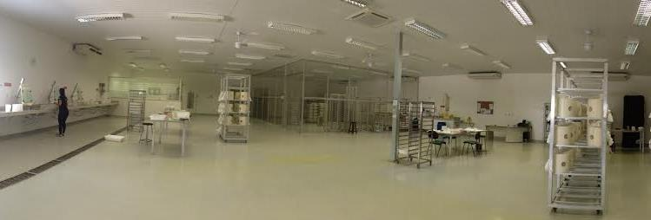
Rearing mosquitoes

Slide 9
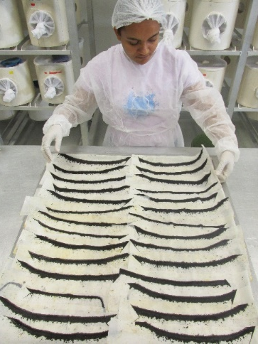
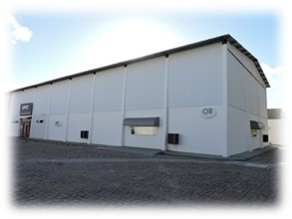
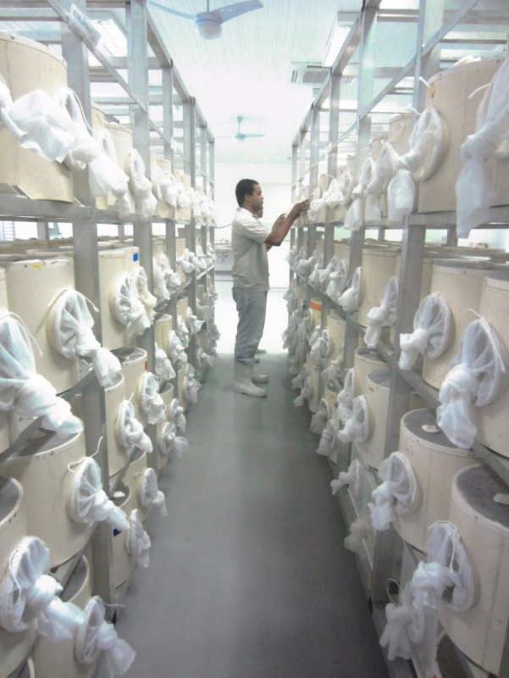
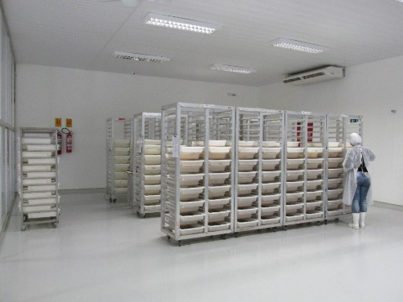
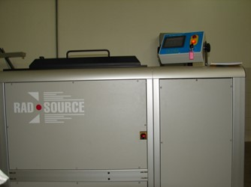
About Mass rearing of Ae. aegypti
Mass-rearing Unit
4 million sterile males/week
Strains: MBR-002
Local genetic background;
Origin: eggs collected in Recife

Slide 10
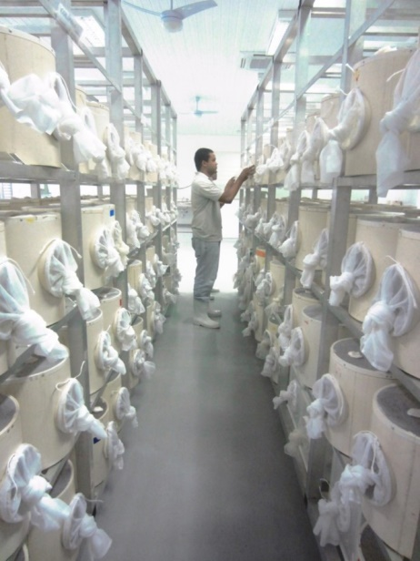
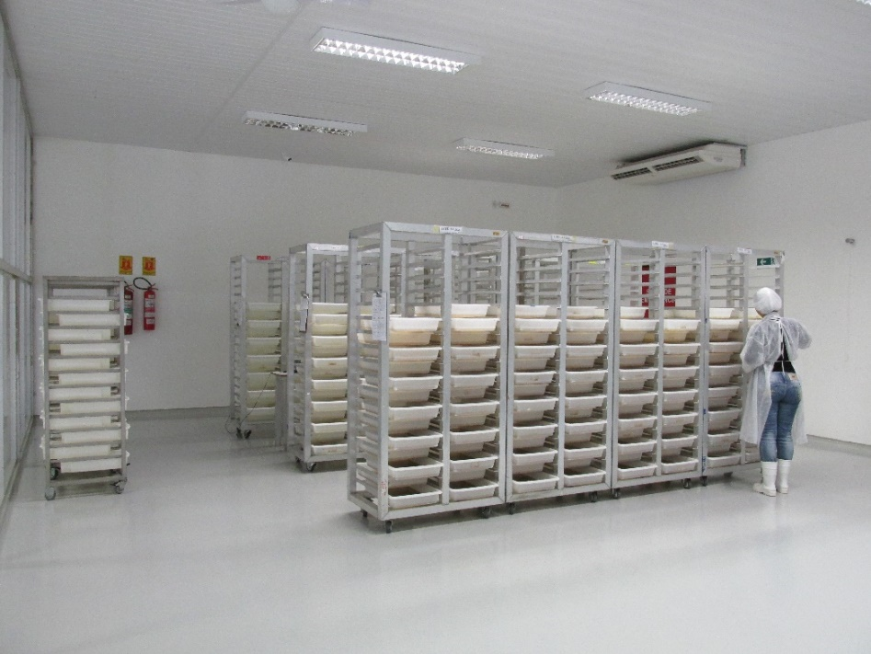
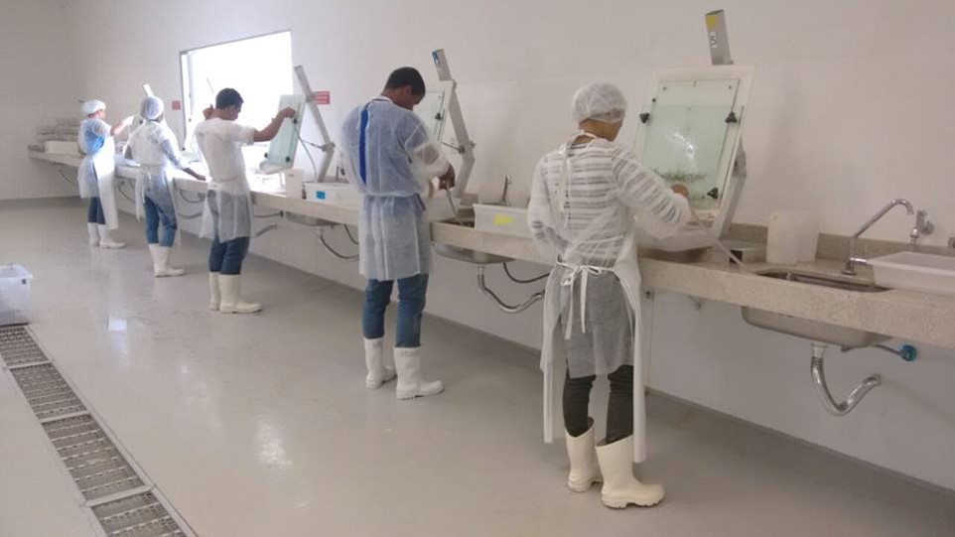
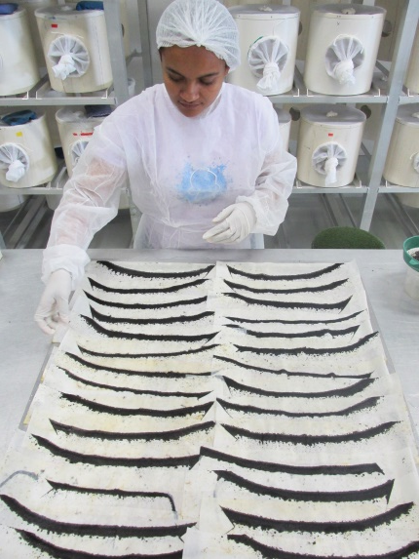
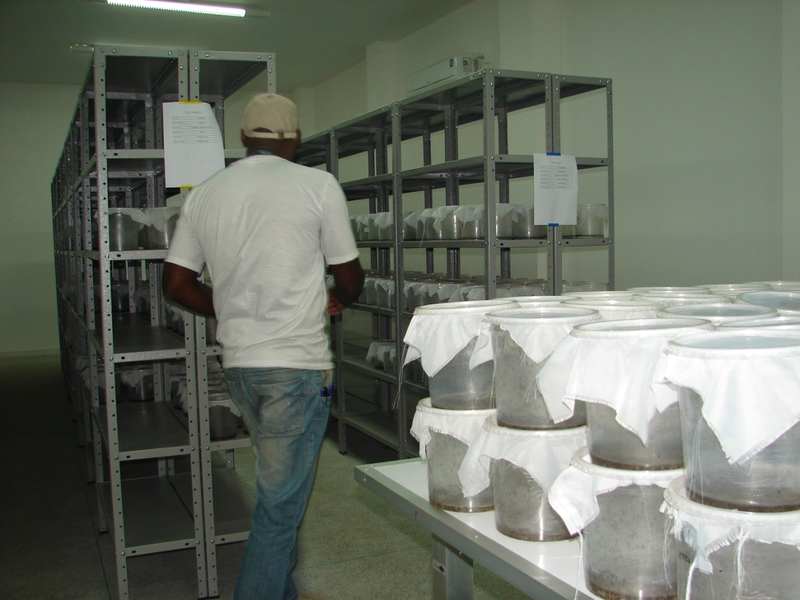
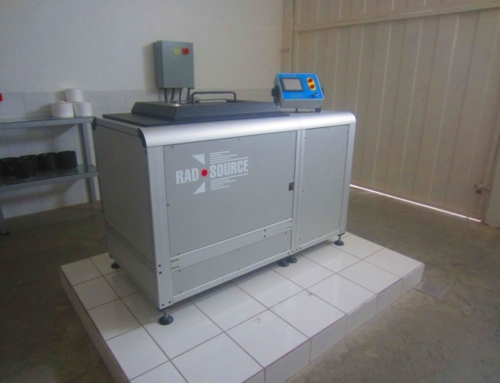
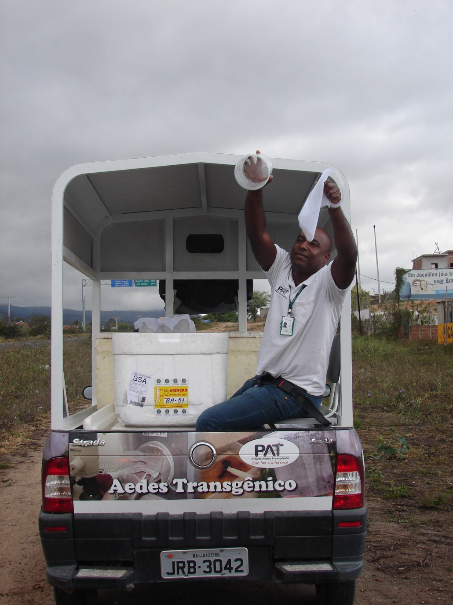
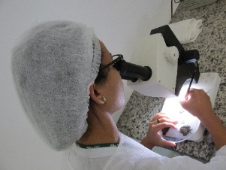
Protocols for mass—rearing of Ae. aegypti
Adults room
Eggs
Larval rearing
Sorting Pupae
Adult Emergency Room
Release
Quality Control
Sterilization
Mass rearing protocols described by Carvalho et al., (2014), some adaptations

Slide 11
Packaging and transport
Transport logistics must prioritize the shortest travel time;
Cold chain is crucial for this phase;
Develop devices that facilitate the packing and transport of mosquitoes. Density is key.

Slide 12
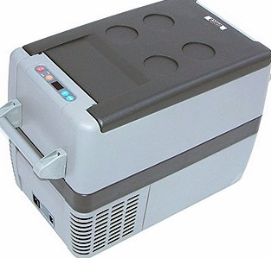

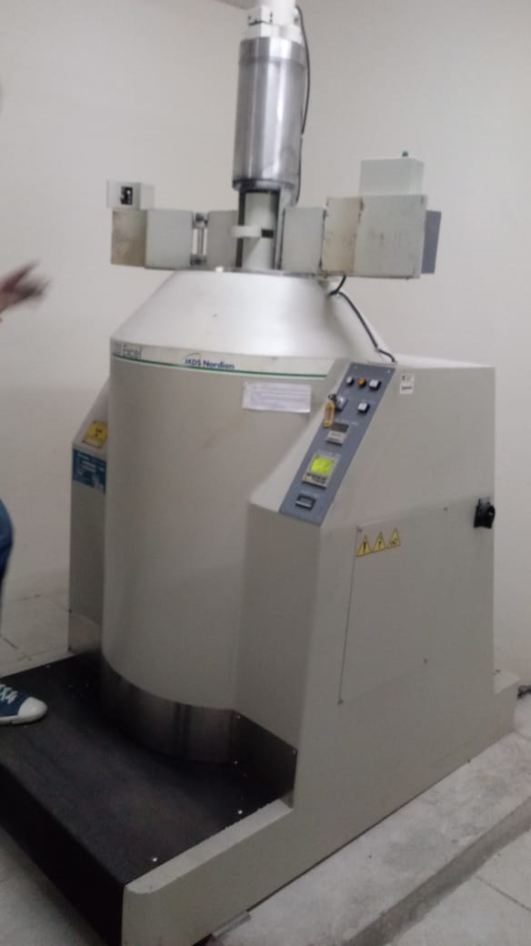
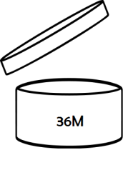
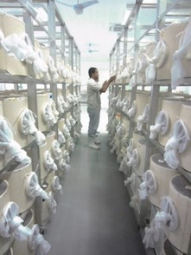
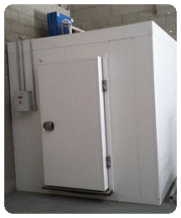


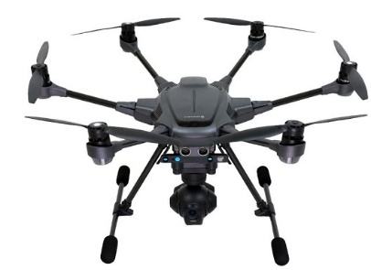
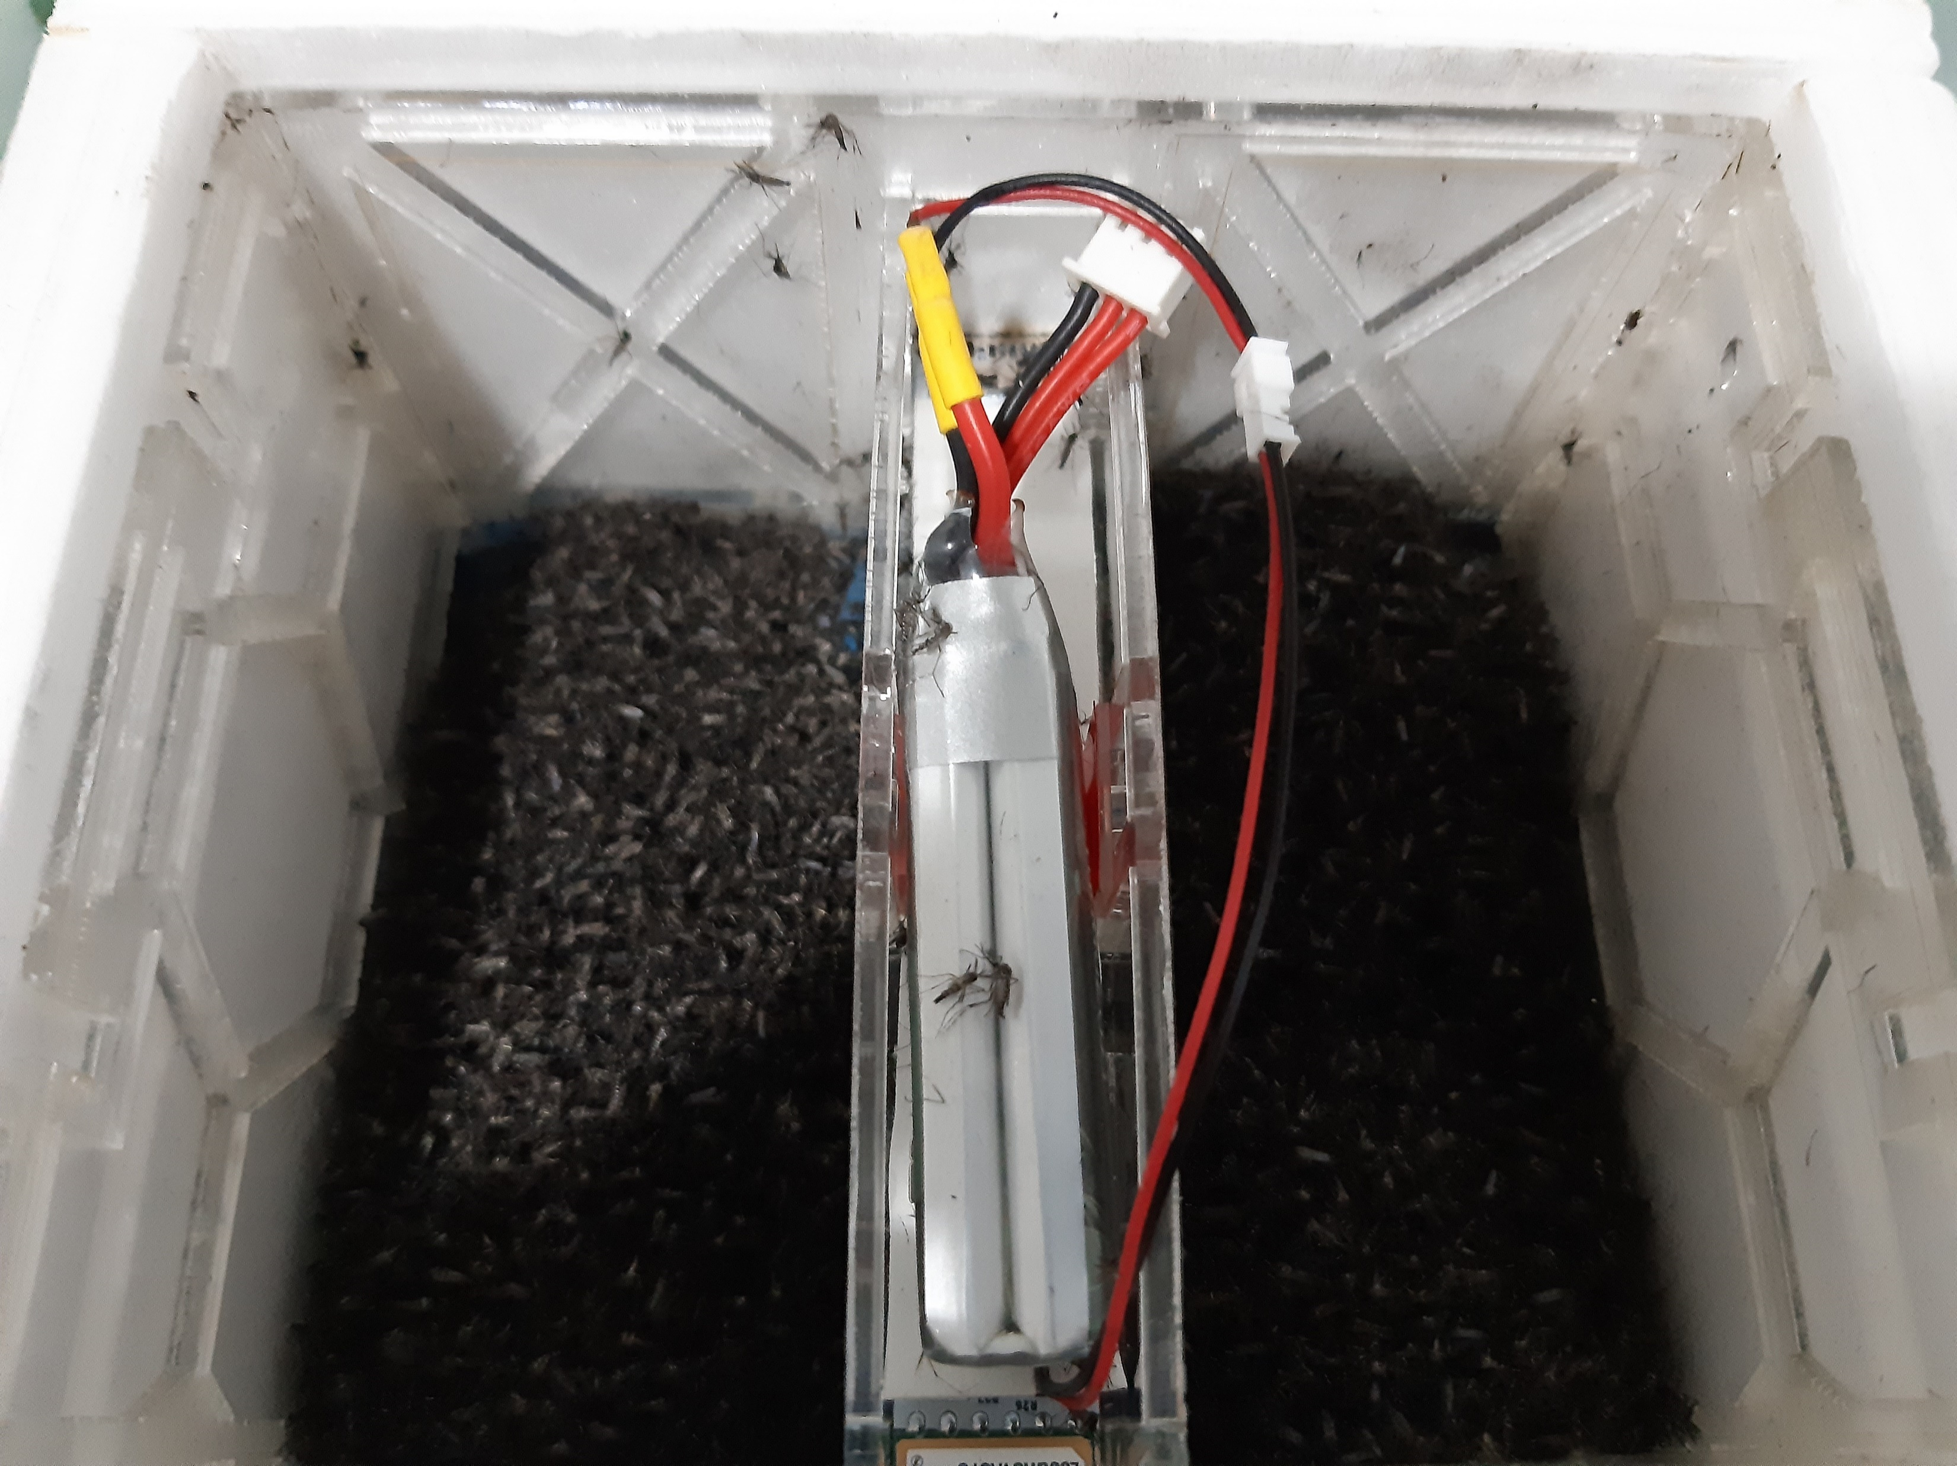
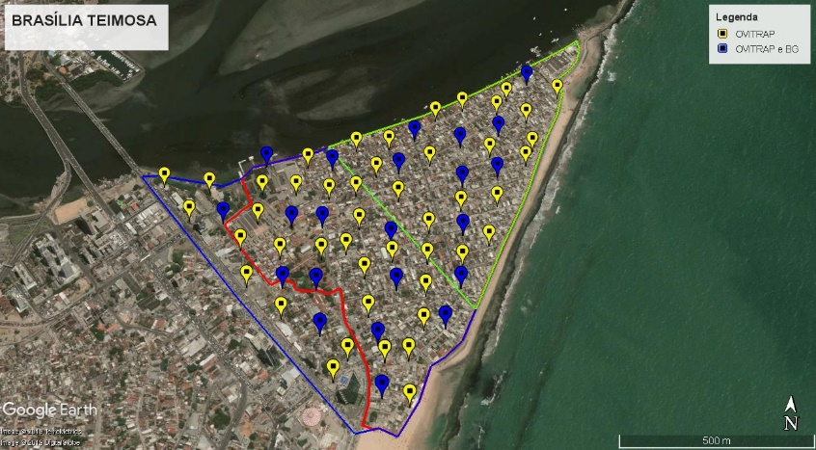
DEN/ UFPE
Esterilização dos insetos
Imobilização, compactação e transporte
Transporte de adultos (Laboratório → irradiador)
Criação de machos
Acondicionamento de machos irradiados em gaiolas (24h), sacarose 10%
Imobilização, compactação e transporte
Liberação com Drone

Slide 13
Realese
Vector control AW-IVM
Population suppression of mosquitoes before start with SIT:
  Dissemination Station (PPF)
  Mass Egg Capture (Ex. BTi or Spinosad)
Continuous data analysis for course correction in field
  Bufer zone
  Realese once or twice a week;

Slide 14
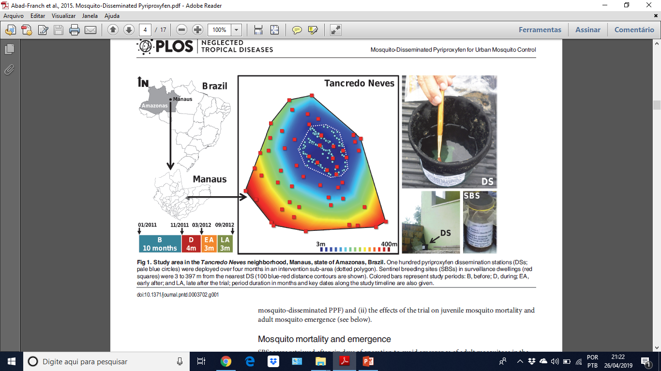
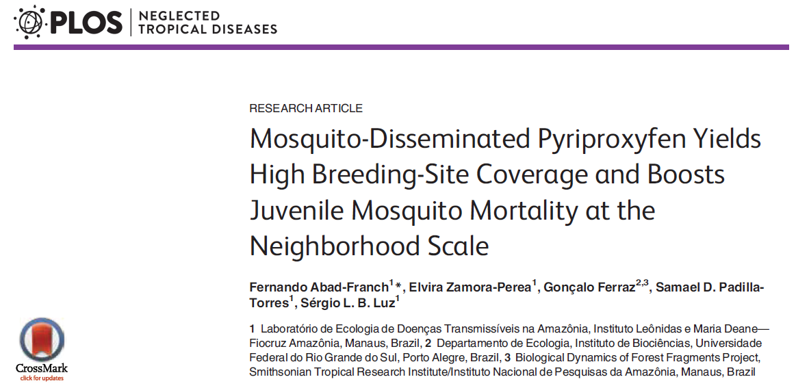
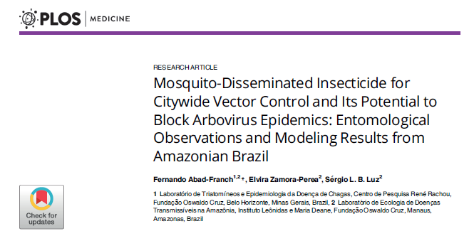
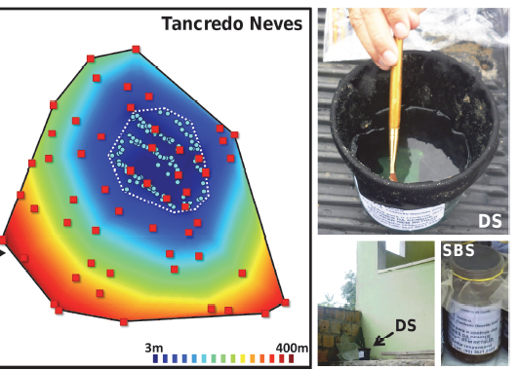
MÉTODOS

Slide 15
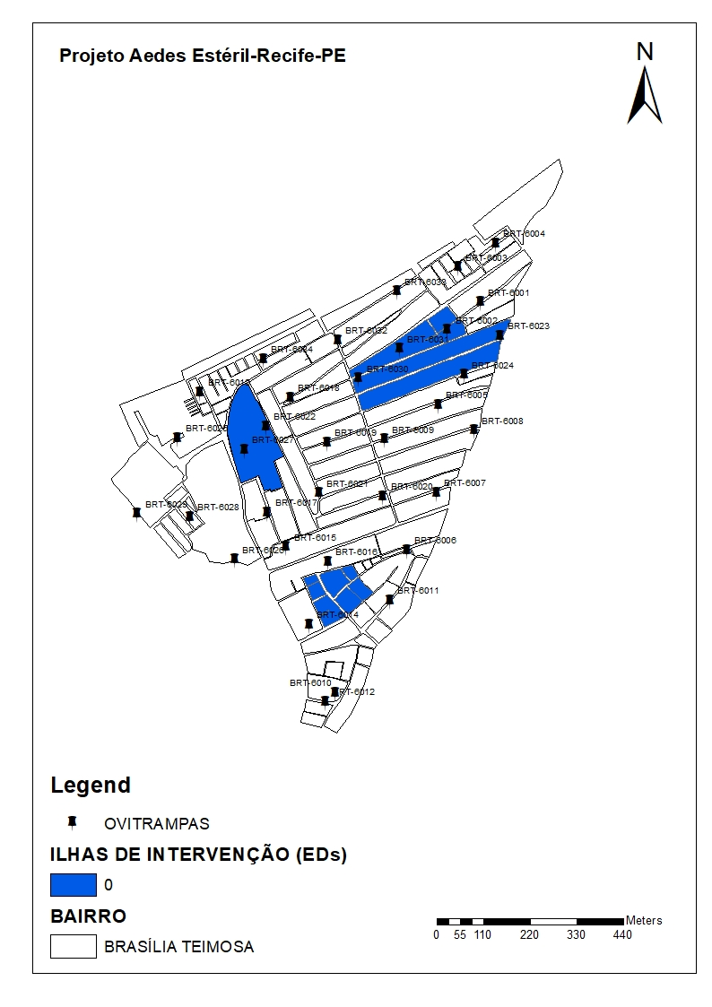
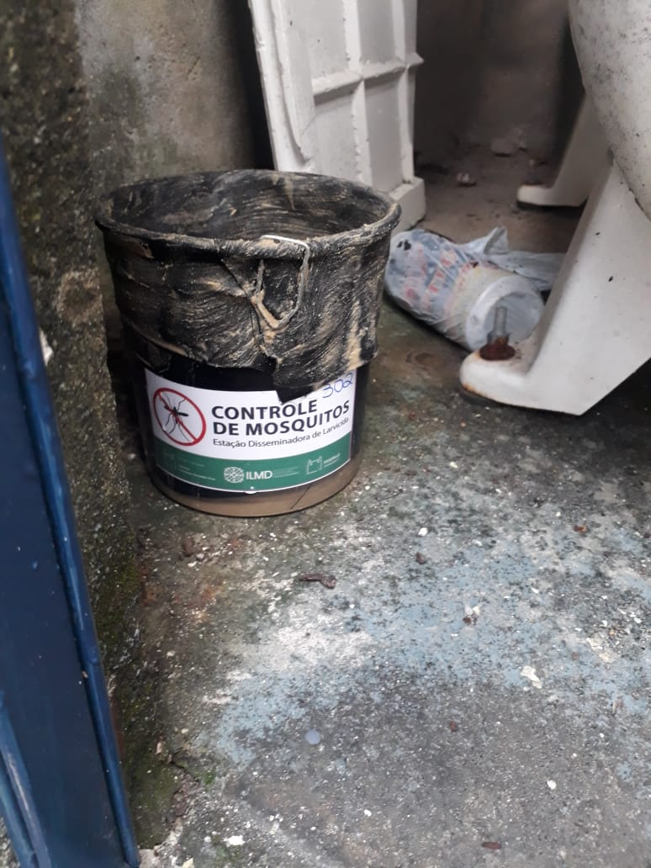
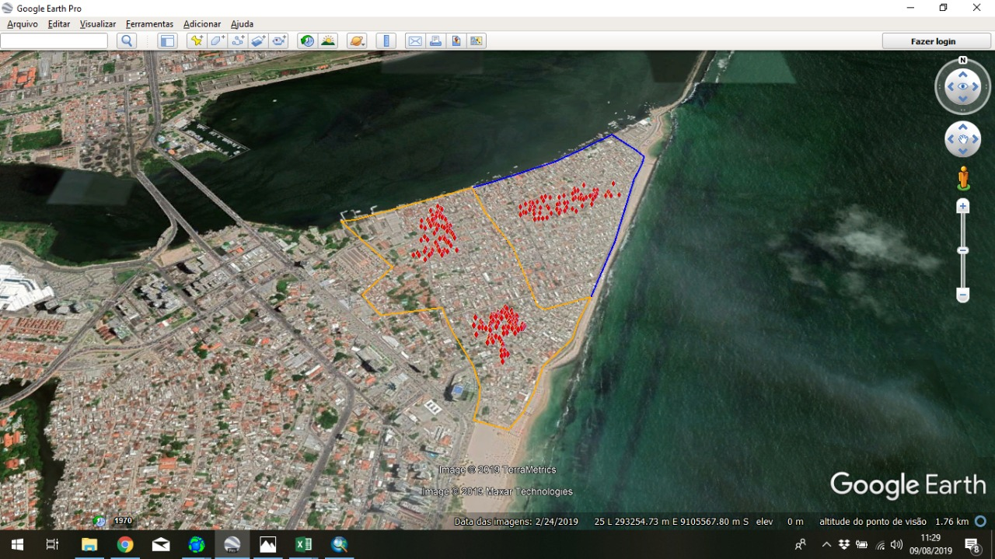
Manutenção mensal das Eds;
SEMANAL
Ovitrampas (34)
(N° de ovos/ovitrampas + taxa de eclosão)
BGs traps (30)
(Densidade de adultos, espécies)
MENSAL
Monitoramento do material biológico (H2O + palhetas) até a fase adulta.
Ilha 3
88 EDs
Ilha 2
88 EDs
Ilha 1
126 EDs
Data de Instalação: 2-9/julho
Nº de manutenções: 3
Frequência manutenção: mensal
Supervisão: quinzenal

Slide 16
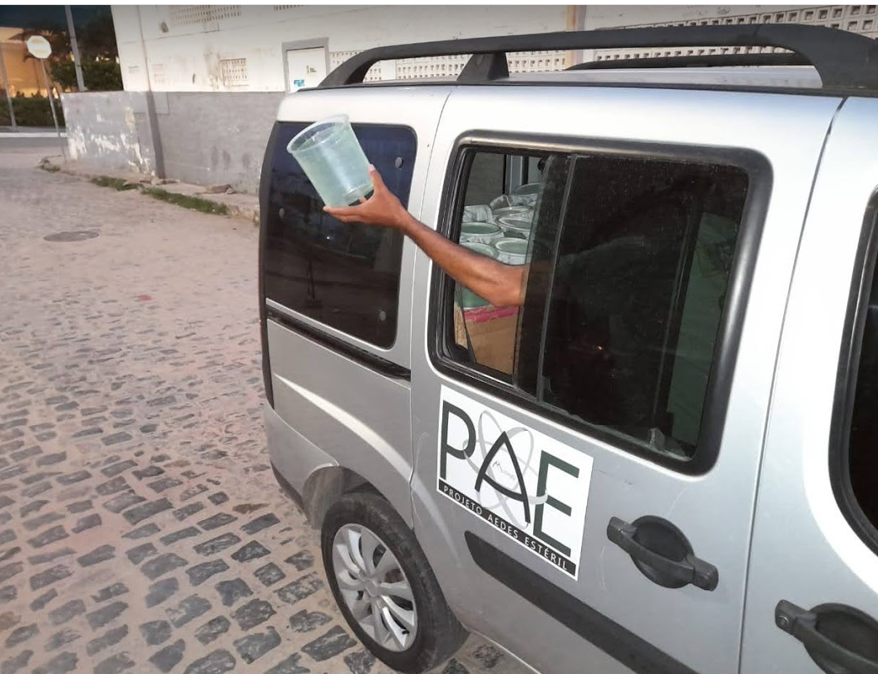
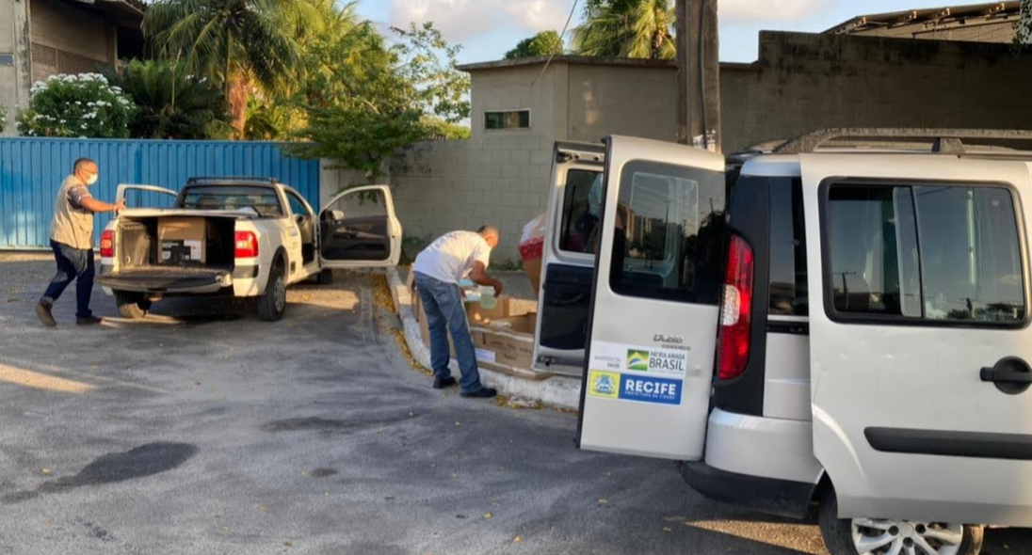
Ground Release Steriles Males
Ground release
  1 plastic pot with a 1.000 steril males
Twice a week, 0,5 - 0,7 million/week;
5.000 – 9.000 mosquitos/ha;

Slide 17
Monitoring
The ovitraps offered a better answer to understand what goes on in the field;
We were in doubt if the BG's were on all the time;
It was very common to relocate traps for better development of activities;
We have to analyze the data constantly to understand what is going on. It is essential to have a database installed to facilitate assessments during project execution.
Production of maps helped a lot in the interpretation of data.

Slide 18
Eggs Hatching - Pina and B. Teimosa
one release/week
MRR

Slide 19
Percentage of decreased egg density
Two releases per week

Slide 20
Induced eggs sterility
Two releases per week

Slide 21
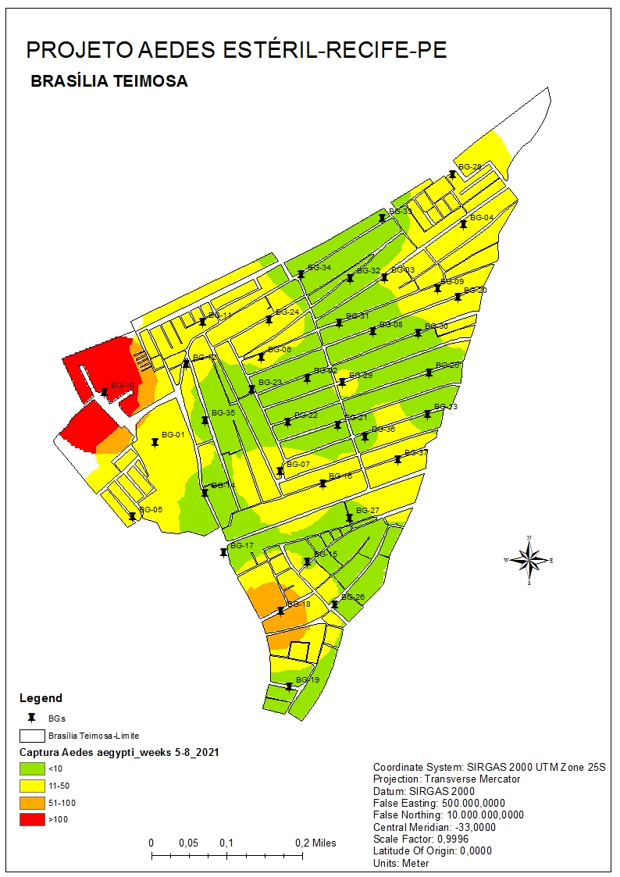
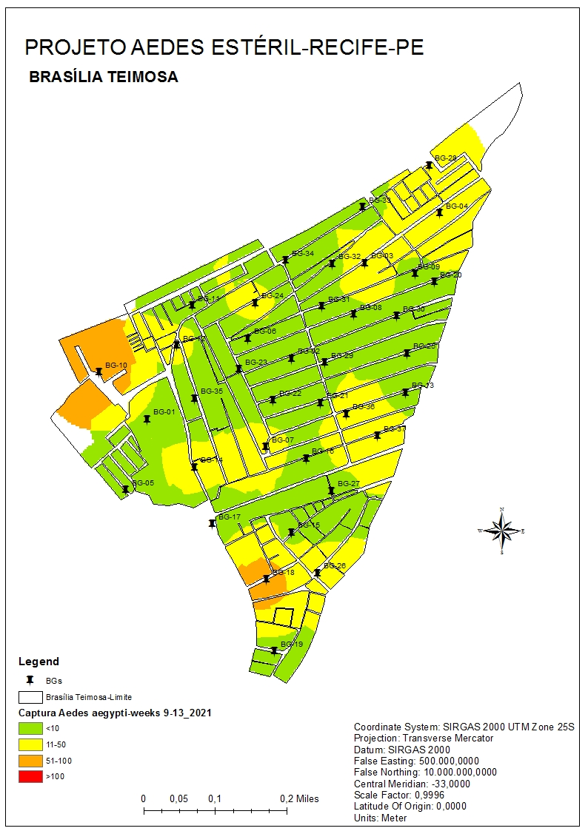
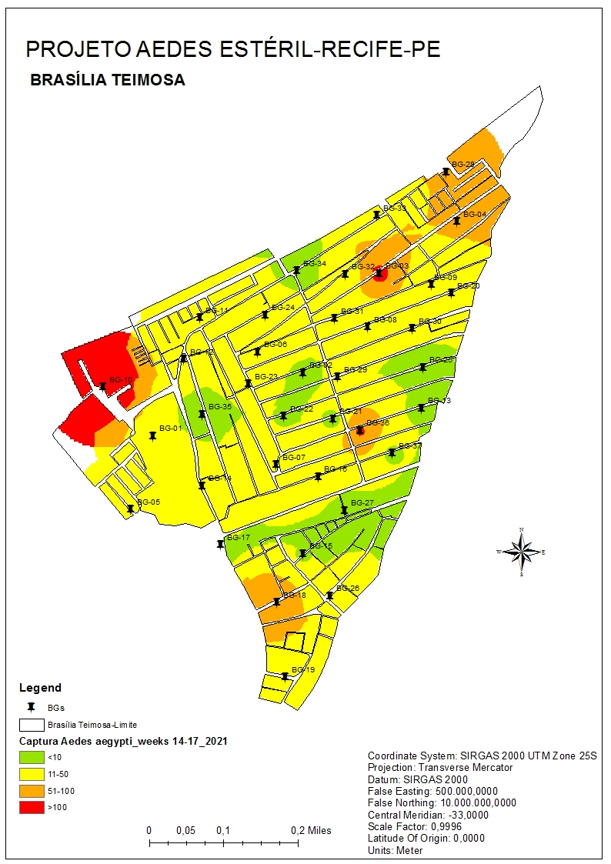
Mapas BGs- Fevereiro a Abril/2021
February
March
April
Figura 01 - Indice de infestação de adultos de Ae. aegypti no Bairro Brasília Teimosa, Recife, PE, durante os meses de fevereiro, março e abril.

Slide 22
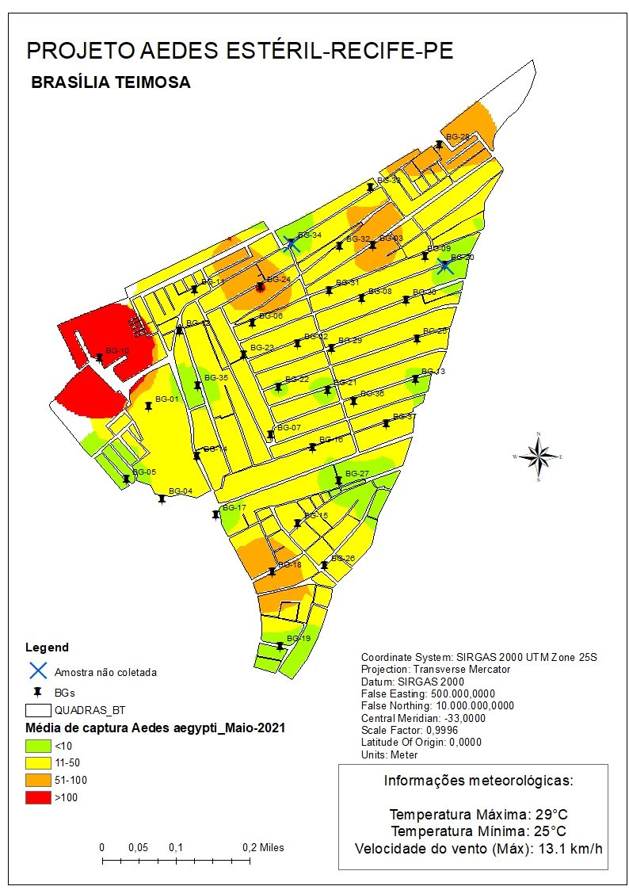
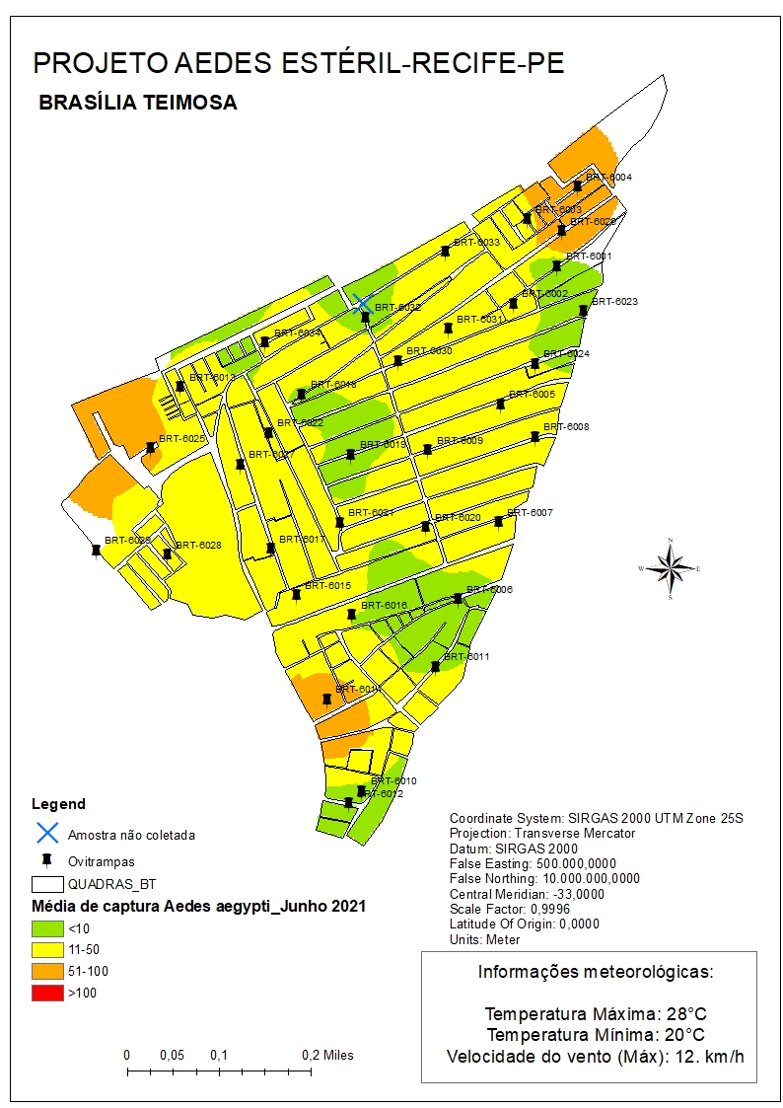
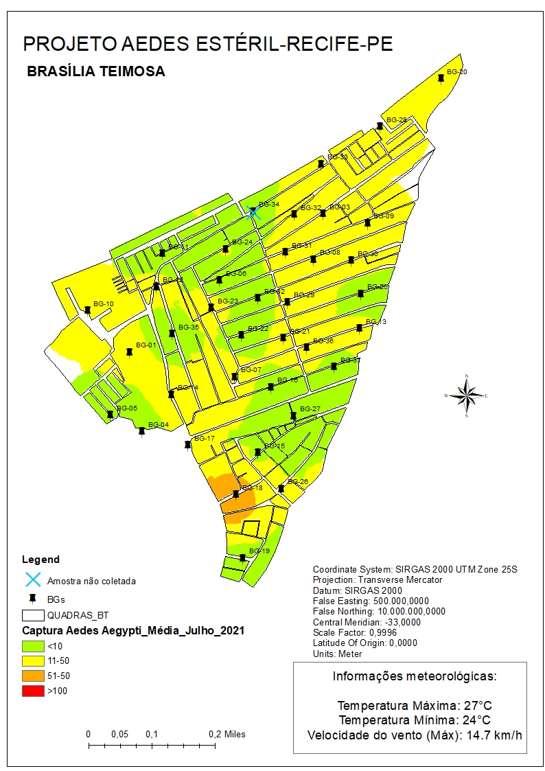
Mapas BGs- Maio e Julho/2021
May
June
July
Figura 01 - Indice de infestação de adultos de Ae. aegypti no Bairro Brasília Teimosa, Recife, PE, durante os meses de maio a julho.

Slide 23
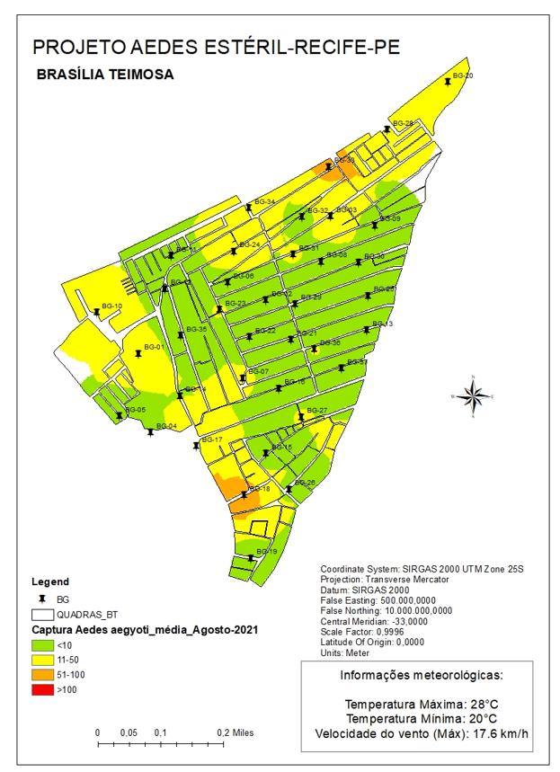
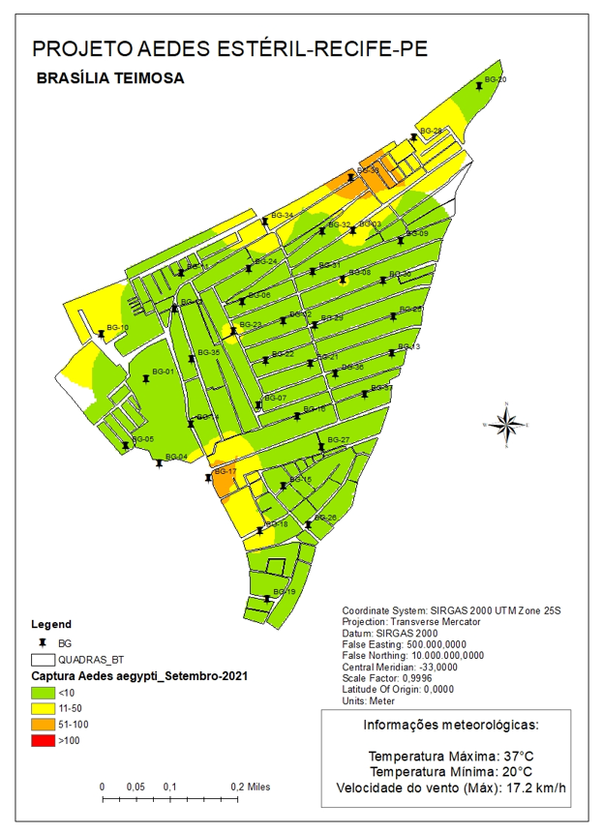

Mapas BGs- Agosto – Outubro /2021
October
August
September

Slide 24

Community Engagement Activities
Pre-Release
Site selected to carry out pilot projects
Contact Local Authorities and Community Leaders
National Public Education
Project approval by Ethics Committee
Permits needed
Release
Local Public Education
Post-Release

Slide 25











Community Engagement Activities: Pre-releases.

Slide 26
Permanent Institutional Support
The COVID-19 Pandemic forced us to constantly adjust the schedule and budget and without the support of intuitions we would not have been able to get where we are.

Slide 27

Institucional Support
Recognized as Collaborating Centre of the International Atomic Energy Agency-IAEA
DG IAEA, Rafael Grossi, visit the PAE in Recife, jul/21.

Slide 28
Some insigths
Keep an open mind to understand the results;
Create an institutional advisory group, with people from entomology and epidemiology approach;
Look at the quality of mosquitoes;
Look for the release mechanisms that are easier to use (it doesn't matter if the release is terrestrial or aerial);
To promote the integration of the Sterile Insect Technique with the others control methods of the Aedes aegypti vector.

Slide 29
Next steps
Continue with actions to support SIT, as a tool to control the Aedes aegytpi vector, in partnership with MS, IAEA, PAHO and WHO;
- Implement the Aedes aegypti vector control project on Fernando de Noronha Island.

Slide 30
Institutions involved
Ministry of Health: financial agent; end-user of the evaluated technology;
Ministry of Science, Technology and Inovation – financial support. CNPq and FINEP.
Secretary of Health of Recife – financial agent and final user of the evaluated technology.
Department of Nuclear Energy / Federal University of Pernambuco State
Insect irradiation, supporting the dose definition tests, dose map and dosimetry.
Organización Panamericana de Salud - technical support.
International Atomic Energy Agency – technical and financial support.

Slide 31












Obrigado!
jair@moscamed.org.br
www.moscamed.org.br

