Slide 1
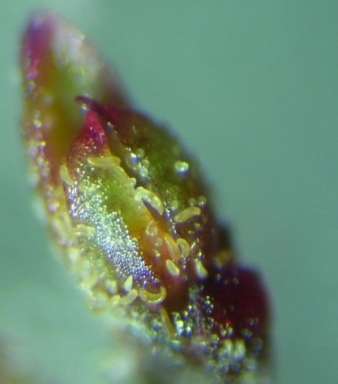
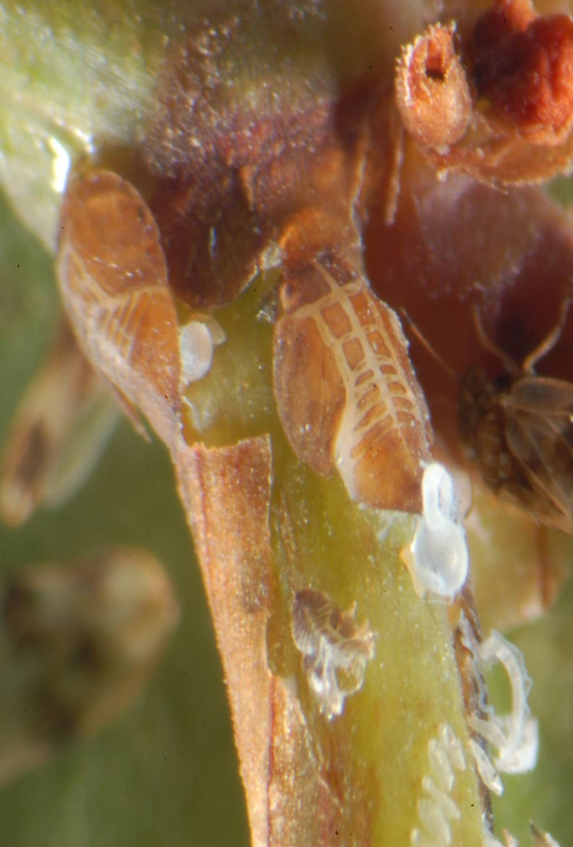
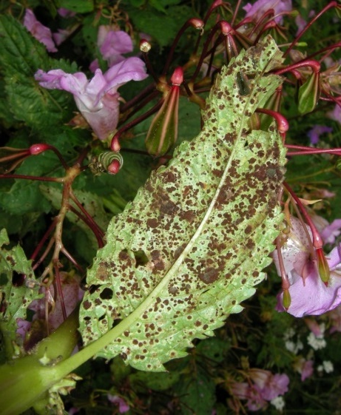
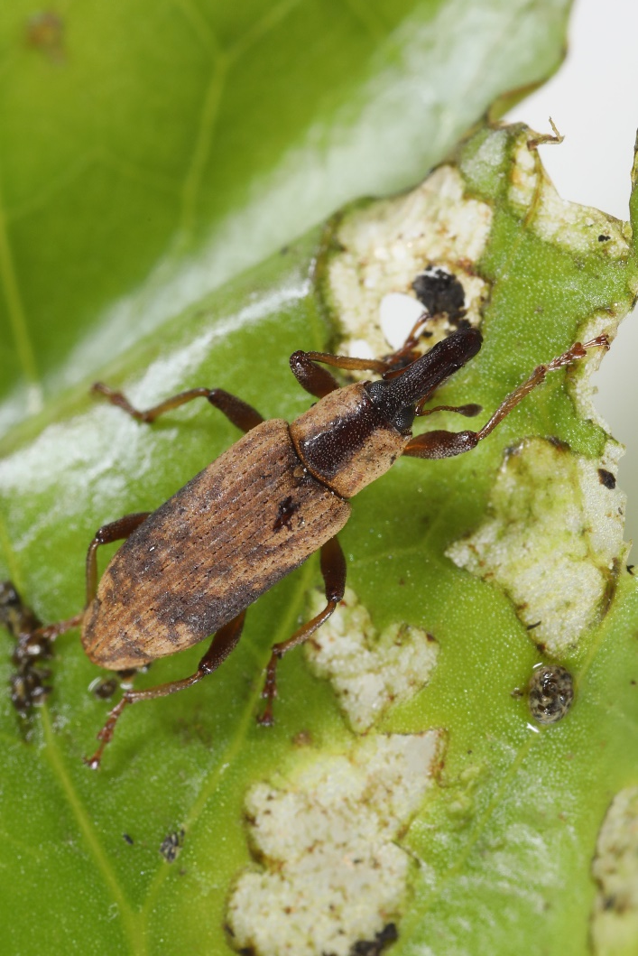
Diversifying Business Models for Biocontrol Deployment
Establishment biocontrol: case studies from the UK
Djami Djeddour
June 2023

Slide 2

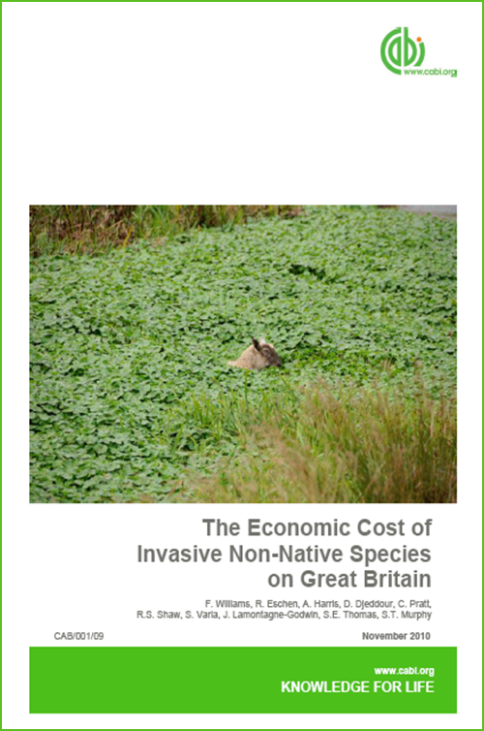
In brief
CABI
  (Centre for Agriculture and Biosciences International)
CABI
  CABI provides scientific expertise and information about agriculture and the environment
  Not-for-profit, established in 1910
  Activities include: scientific publishing, rural development projects, invasive species research, pest risk and economic analyses, e-resources and compendia and microbial services
  Owned by 49 member countries
  Global reach with over 490 staff working 26 locations worldwide
  Weed biocontrol team based in the UK (15 staff with expertise in ecology, entomology, acarology, social science and plant pathology, molecular biology, quarantine facilities)
  Long legacy of biological control activities worldwide

Slide 3
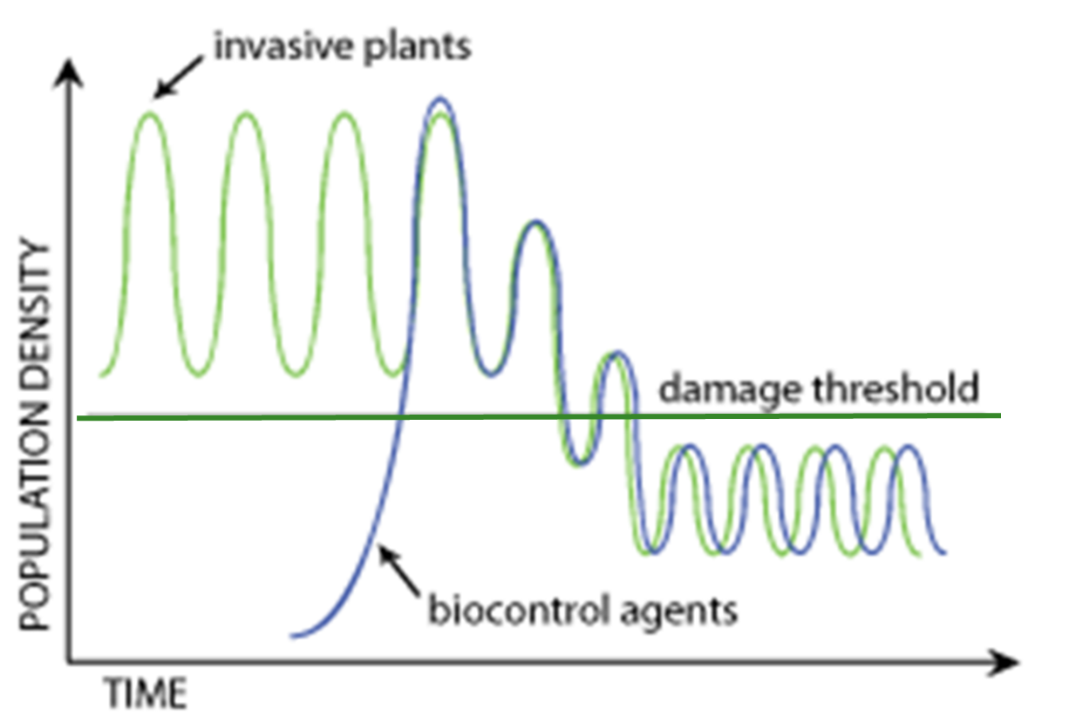
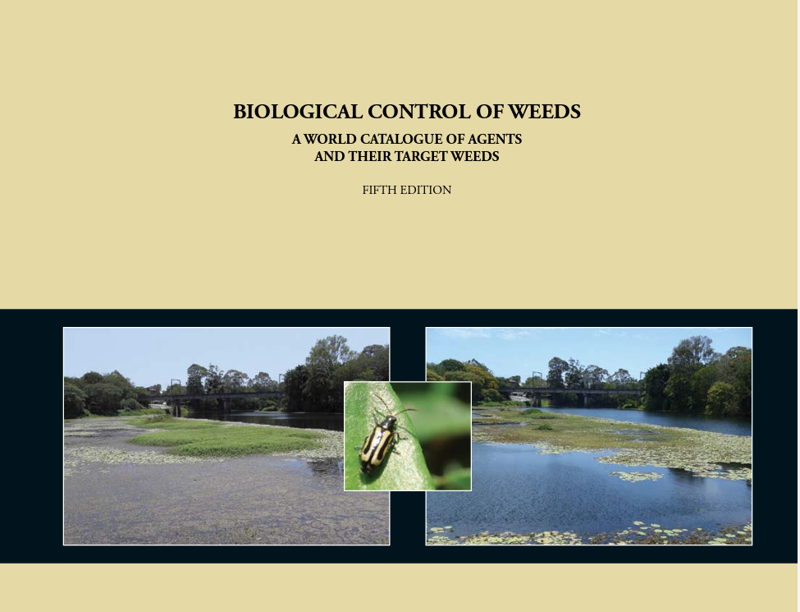
Method: Classical Biological Control in the UK and Europe
Non-native plant species arrived in the exotic range without the natural enemies that keep them in check in their native range
Those native species which do attack them do not cause enough damage
Some of the many insects and diseases in the native range may be safely released as biological control agents in the invaded range (following regulatory risk analysis)
This approach has been implemented across the globe for over 100 years with great successes (>260 weed species targeted with 600+ agents)
New to Europe: to date, there have only been 5 exotic biocontrol agent species intentionally released to target invasive weeds in the UK and Europe
Generalized Model of Biocontrol of Invasive Plants (adapted from Luck et al. 1995)
*
*Winston et al. (2014) Biological Control of Weeds: A World Catalogue of Agents and Their Target Weeds, 5th edition. 838 pp.

Slide 4

Impacts/Results
Proactive engagement and long-term investment from government, public and private stakeholders – push towards strategic and sustainable management of damaging invasive plant species + horizon scanning
Contribution to awareness raising among stakeholders and the public about the threat of invasive species to the economy and environment AND the potential for natural, long term solutions
Establishment and streamlining of regulatory processes in UK and Europe around release of exotic agents (arthropods and fungi)
Influencing national, environmental policy and plans, linkages with regulatory bodies, coordinated management
Technology transfer –”piggy-backing” of projects, benefitting from research and field results to improve chances of success in other countries (e.g. establishment and impact, strain/agent selection)
Bridging the gap between conventional pest control and natural control….making strategic alliances nationally
Promoting the adoption of biological control and the fair and equitable utilisation /exchange of genetic resources through international collaboration and benefit sharing

Slide 5
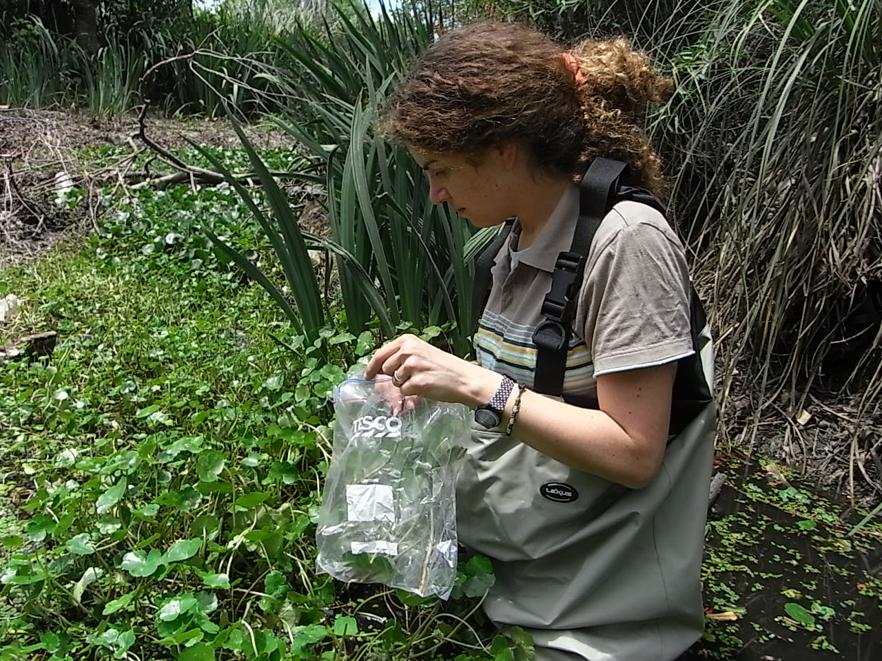
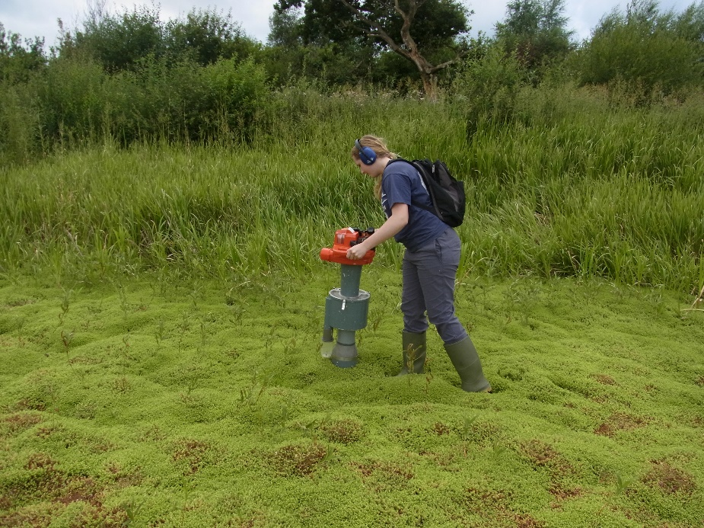
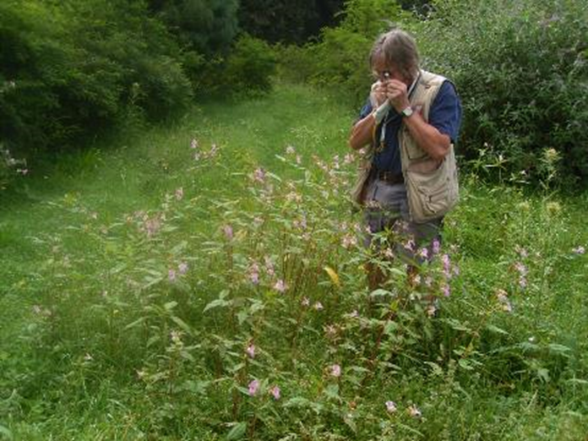
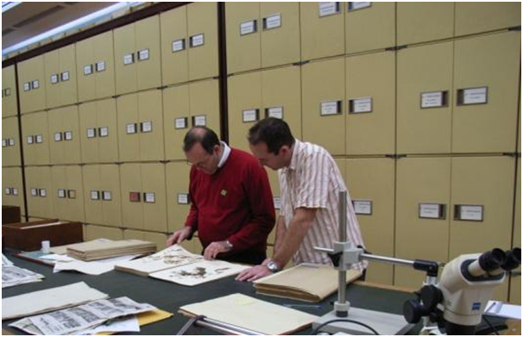
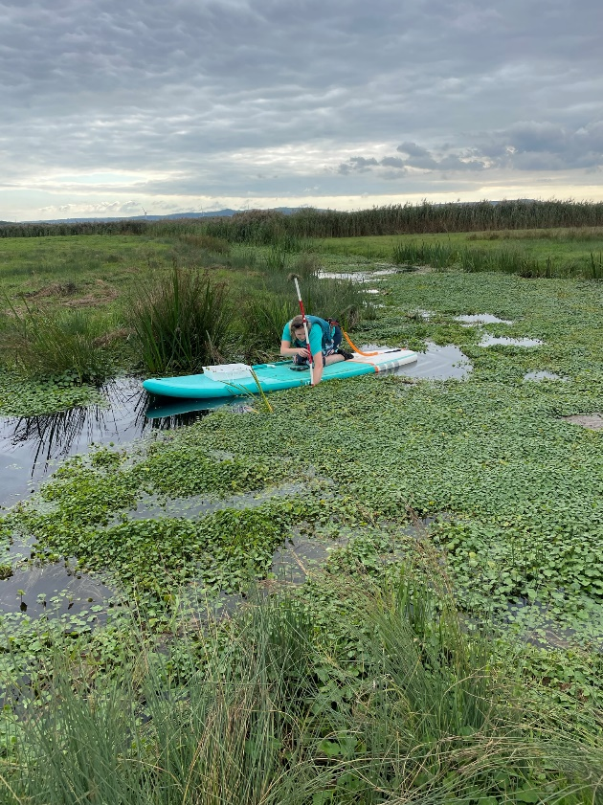
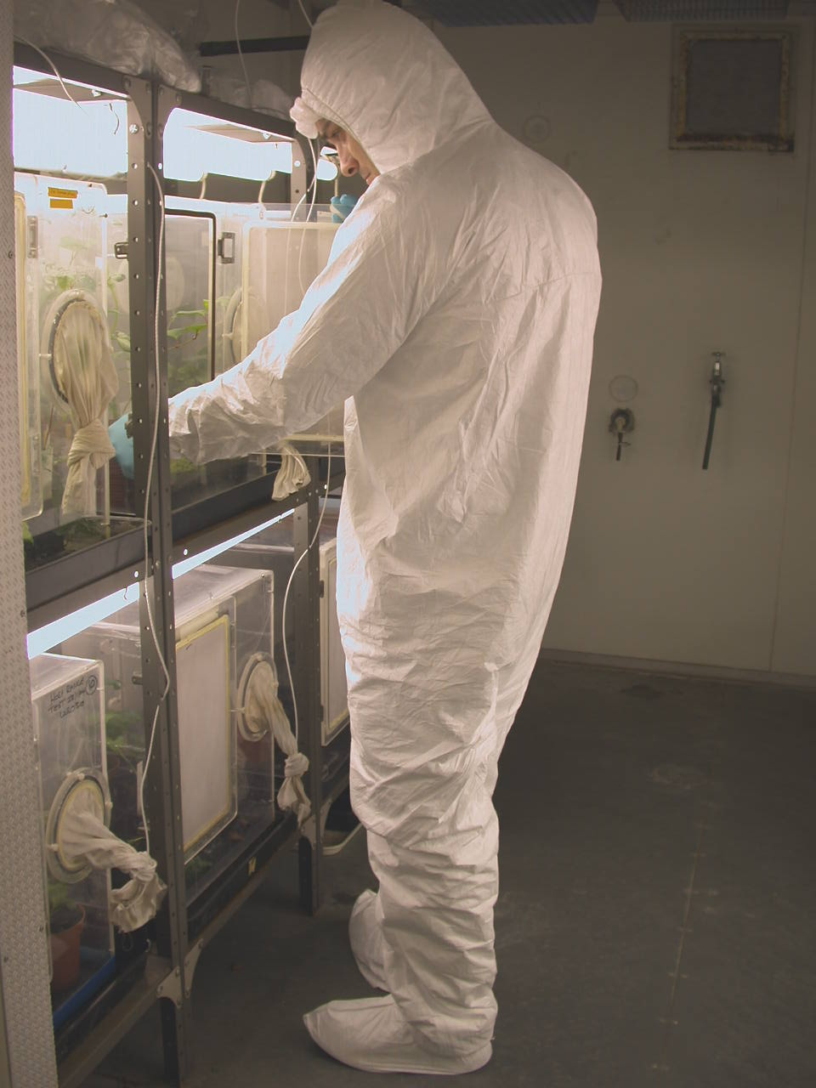
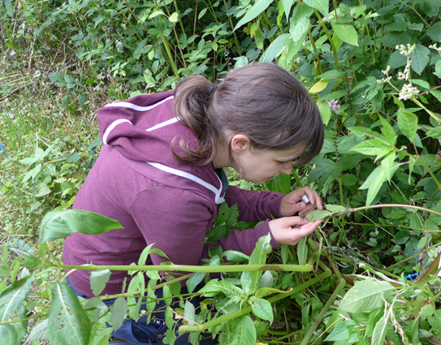
Technical aspects

Slide 6
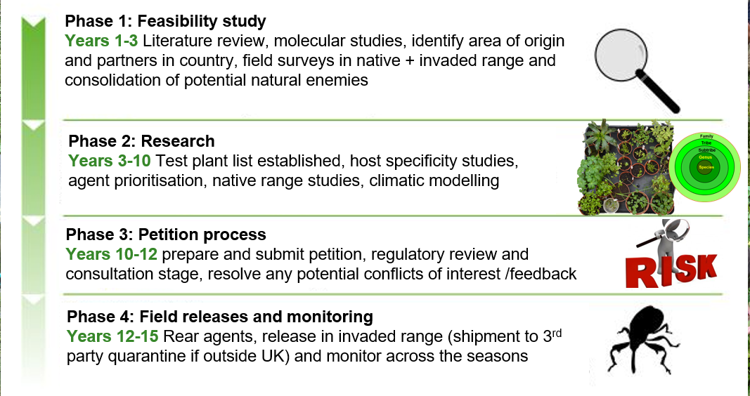

Slide 7
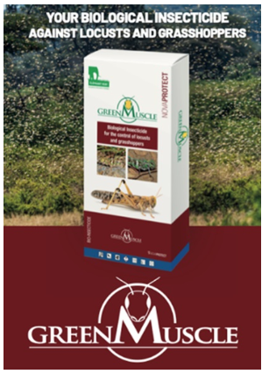
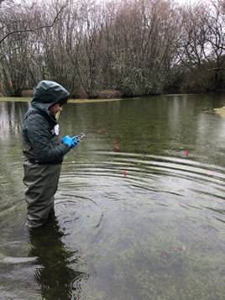
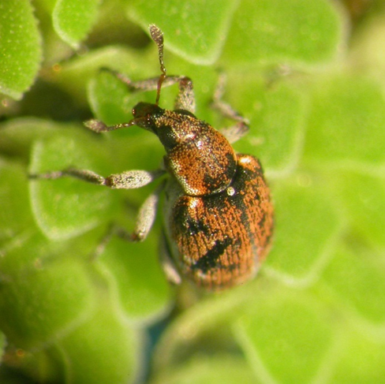
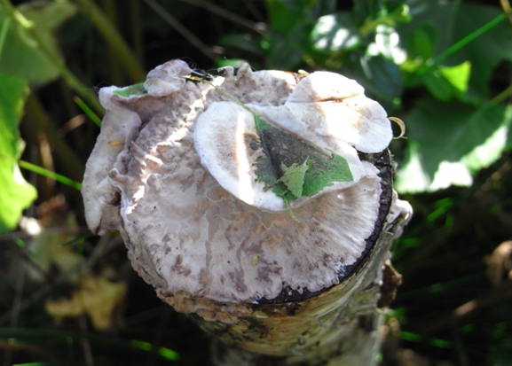
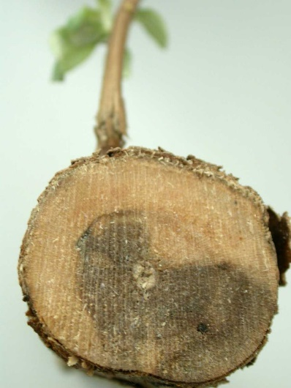
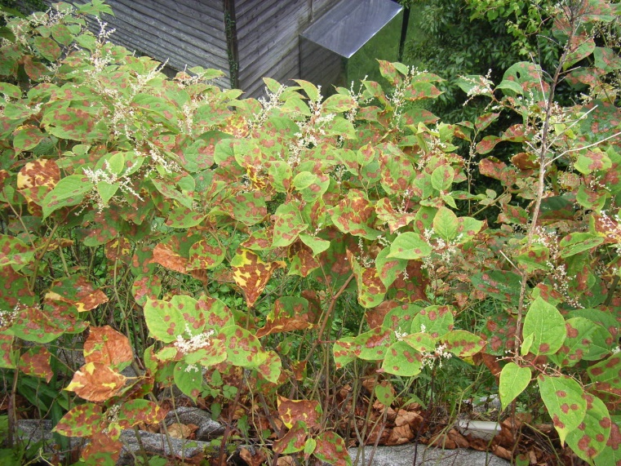
Value Proposition
Operated by CABI, in partnership
Classical weed and insect biocontrol (Service provided)
Augmentative biocontrol/mycoherbicide (e.g. for Azolla, Japanese knotweed, Buddleja and Rhododendron) (semi-commercial service and research into wood rotting fungal product development)
Licenced biopesticide product (Green Muscle™) for locust and grasshopper control (revolutionary multidonor project)
Stenopelmus rufinasus
Wood rotting basidiomycetes on Rhododendron and Buddleia
Mycosphaerella leafspot fungus on Japanese knotweed

Slide 8
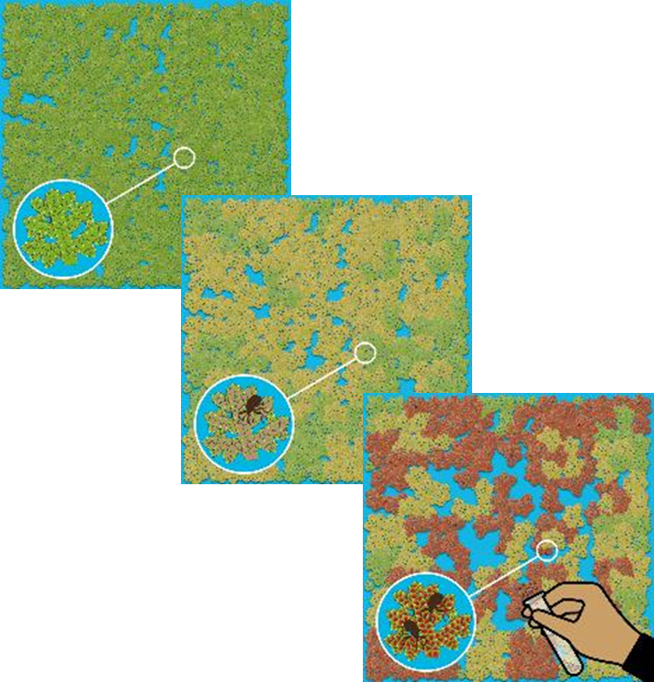
Without the weevil – Azolla would cost
£8.4 to 16.9 million to manage annually
With naturalised weevil population – costs
reduced to £0.8 to £1.6 million
With augmentation programme – costs
reduced to £31.5 to £45.8 thousand
The arrival of Stenopelmus rufinasus is estimated to save around £8 - 15 million per year and the augmentation programme saves a further £0.77 - 1.5 million
Augmentation gives a benefit : cost ratio in the range of 44 – 88 : 1
Management of Azolla filiculoides in the UK
Pratt et al. (2022) CABI Agriculture and Bioscience 3: 70

Slide 9
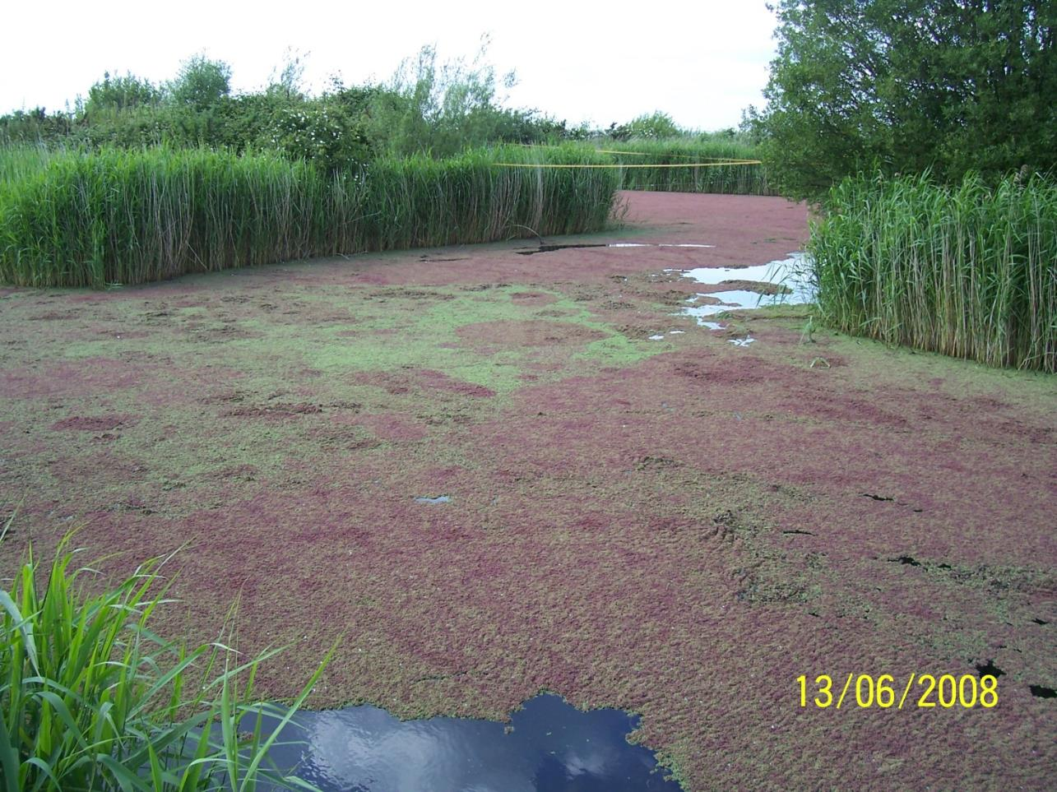
Notes:
Faversham angling club

Slide 10
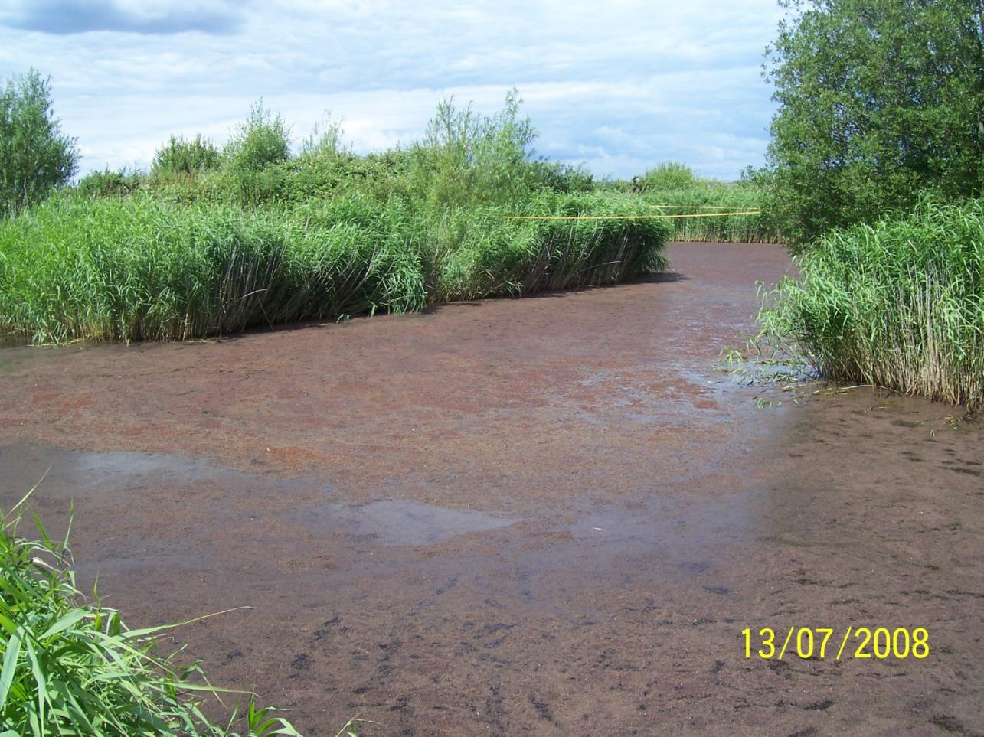

Slide 11
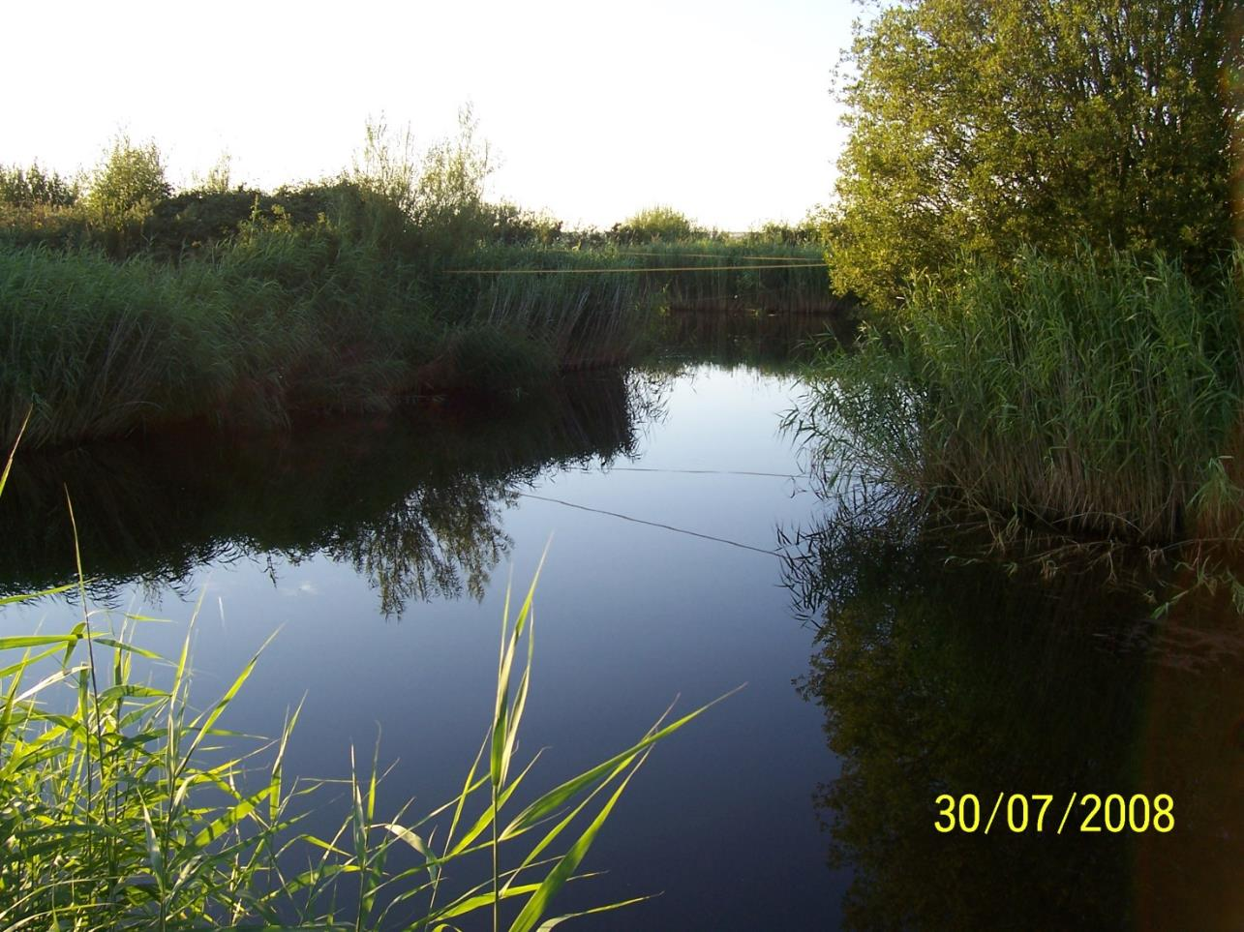


Slide 12
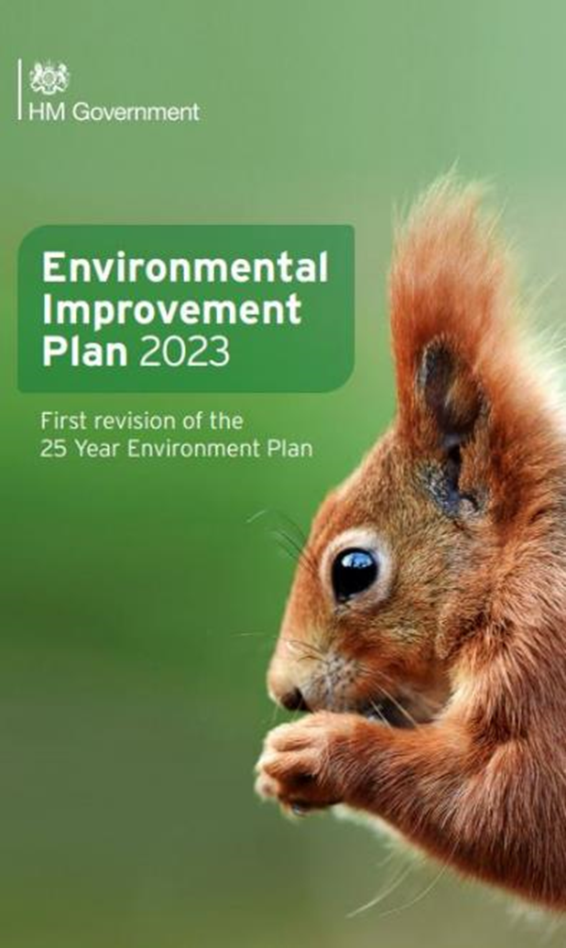
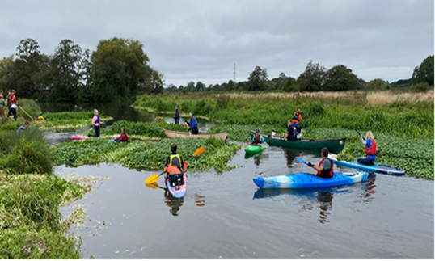
Actors for UK activities (Donors/Partners)
  Central and devolved government funding (Defra, Department for international --Development, UK Aid agencies, Welsh Government, Darwin, Overseas Territories)
  Numerous public and government bodies/agencies/ societies (e.g. Natural England, Environment Agency, UK Space Agency, Network Rail, RSPB, Ministry of Defence, Fisheries, Angling clubs, Canoeing clubs, local councils, research councils, local action groups and wildlife trusts, farmers)
  Private companies and landowners (e.g. water firms)
  International sponsors and collaborators, private and government
Motivations
  Global push for sustainability and fighting the drivers of climate change (CBD and COP biodiversity protection and invasive species mitigation goals, water framework)
  Lack of viable alternatives (and aim to reduce pesticide use)
  Economic impact costs of priority species
  Public perception and “green washing”?
  Precedence with existing initiatives and successes worldwide
  Fitting into national strategy and action plans for invasive alien weeds
Citizens army tackling invasives

Slide 13
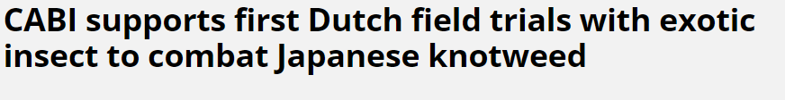
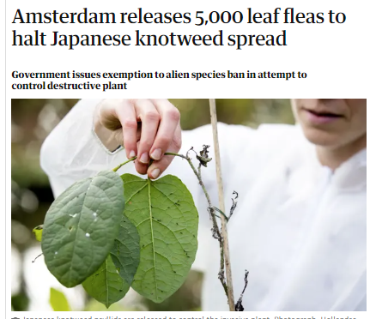

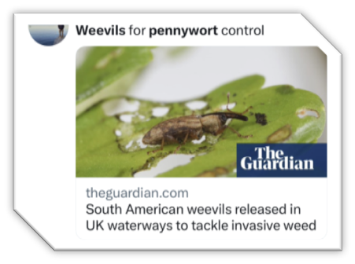
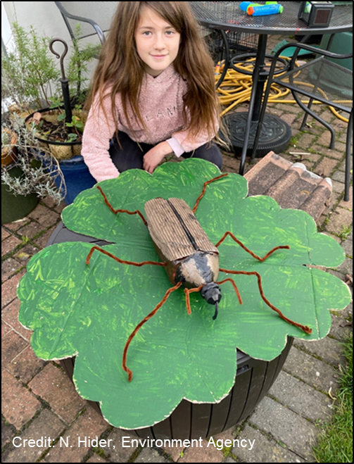
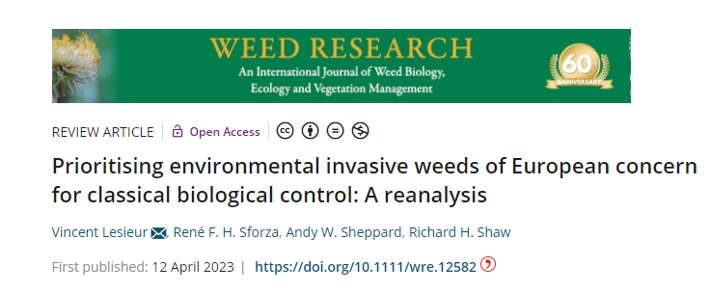
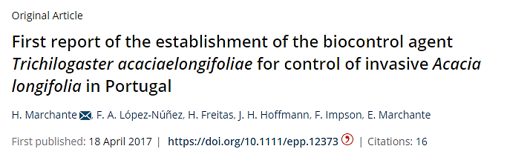
Gains, direct and indirect
Economic, social and environmental gains from potential control and no undesirable effects
Technology transfer and capacity building potential (psyllid to NL, Canada /US; Azolla weevil demonstration trials in NW Europe; Hydrocotyle weevil for NL waterboards)
Regulatory pathways for plant biocontrol identified and streamlined in the UK/Europe (insects, mites and pathogens) –plant health regulators even attending biocontrol meetings!
Awareness raising of INNS: strategic, audience appropriate communications through popular media channels and events, tackling risk aversion (>10 years)
Collaborations to identify and prioritise new targets from list of species of EU concern, joint publications

Slide 14
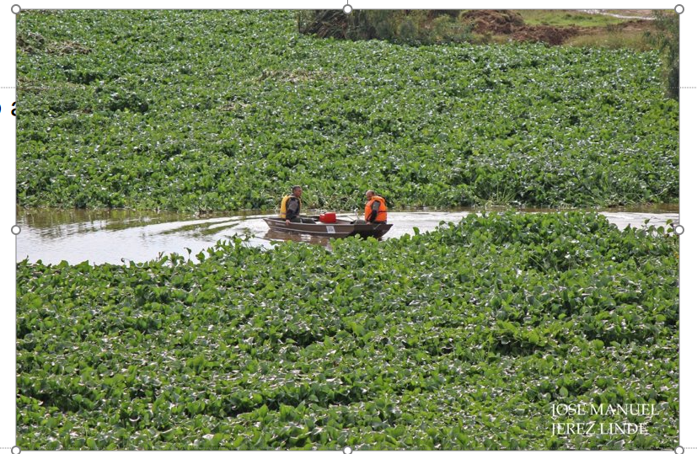
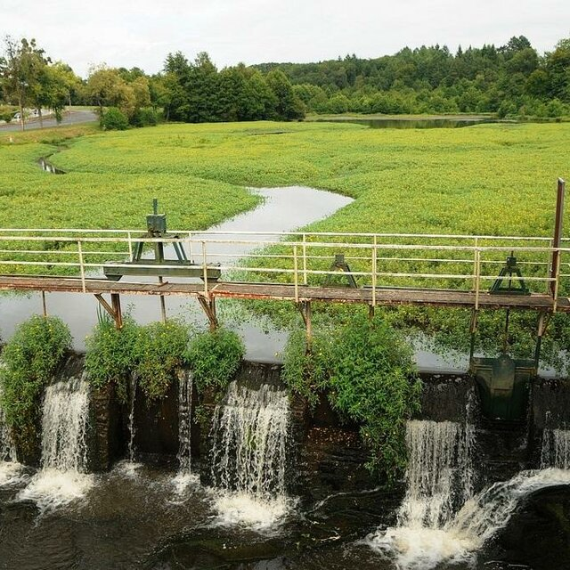
Development potential: levers and risks
Over a decade since 1st release approval for Japanese knotweed- strong momentum, established relationships, public consultations and longer term funding/loyalty/visibility
Invasive alien weeds are not going away! Climate change further exacerbates their range and mechanical and chemical options are inefficient and costly e.g Guadiana river (Spain) Water hyacinth removal =€100 million and counting…
Plenty of tried and tested off-the shelf agents for common targets, especially aquatics
No non-target impacts; highly effective, replicable initiative with Azolla project
Water hyacinth, Spain
Need a “success” for sustained investment + managing expectations, not a quick fix
Risk aversion and conflicts of interest may limit potential…important to choose the right target and to anticipate opposition during prioritisation process
Some targets may not have suitably specific natural enemies or may not establish
Need more economic analyses of impact on INNS to help establish costs vs benefits
Exchange of genetic resources can be hindered by red tape and bureaucracy
Ludwigia invasion, France

Slide 15
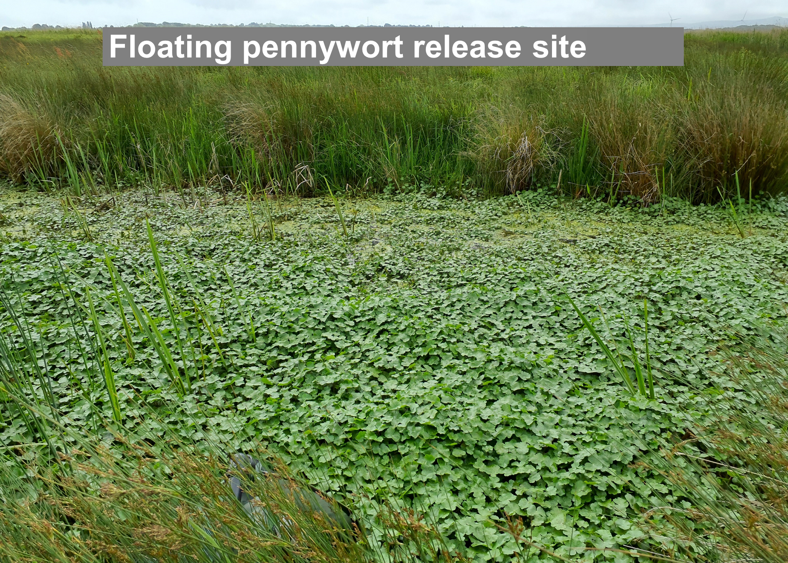

Slide 16
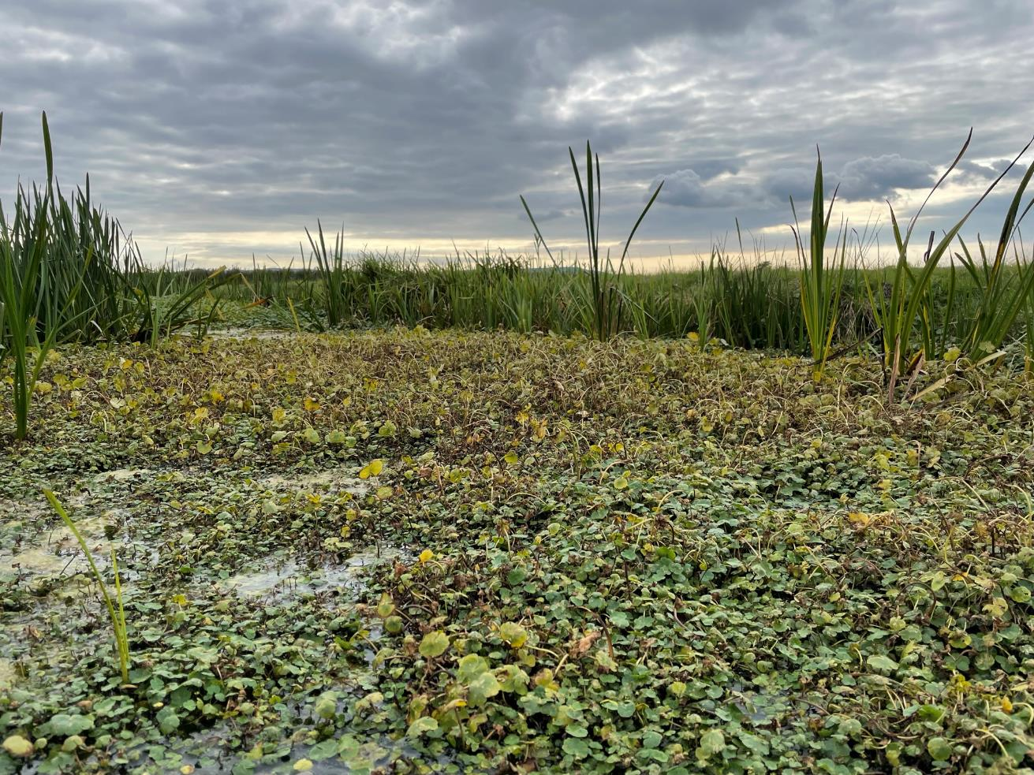
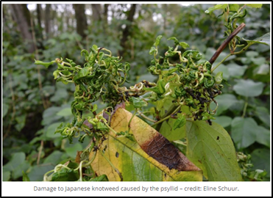
Weevil damage 6 months after release
6 months post release

Slide 17
https://www.invasive-species.org/united-kingdom/
Notes:
Key components to be considered during a biological control programme include appropriate assessment of: (a) Potential impacts (risks and benefits) on economic, environmental, social and cultural values and assets, including of local and indigenous communities; (b) Prioritised target invasive alien species selection for biological control based on (i) environmental impact, (ii) feasibility of biological control and (iii) likelihood of successful biological control (van Klinken et al., 2016); (c) Biological control programme cost-benefit or cost-effectiveness analysis; (d) Collaboration and cooperation amongst stakeholders, government (NPPO) and non-government agencies and scientific and technical experts both nationally and internationally (RPPO) across agriculture environment and health throughout the process; (e) Open and active dialogue/consultation with the public (stakeholders and non-stakeholders) (f) Biological control cost effectiveness - investment in delivery versus likely benefit from control; (g) Biocontrol agent selection based on (i) likely level of specificity and (ii) expected level of efficacy (through native range field tests (Briese et al. 2005; Sheppard et al., 2006) and tests under appropriate containment conditions (Sheppard et al. 2005); (h) Host-range/host-specificity of biocontrol agents against the targeted invasive alien species and closely related non-target species; (i) Other non-target impacts in the recipient environment; (j) Appropriate regulatory frameworks and Pest Risk Analysis processes for building the case for release and against which objective release decisions can be made – built around the IPPCInternational Standards for Phytosanitary Measures or similar to them. (k) Mechanisms to assist establishment and spread of the biocontrol agent to ensure effective control; (l) Mechanisms or instruments to prevent the spread of biocontrol agents into areas/countries outside the scope of the PRA. (m) Post release evaluation of environmental and native species benefits and assessment of any non-target impacts on related species or other species within the local ecological community/ecosystem.
A cost- benefit analysis or cost-effectiveness analysis should be undertaken where possible before initiating any classical biological control programme. Tools are available to assist this46. Explicitly capturing the monetary costs of application of biological
Risks prior to release: (a) Target not sufficiently impactful and the feasibility (can it be done) and likelihood (is it likely to work) of biological control success to justify investment in a biological control programme; (b) Insufficient biocontrol agent host specificity or poor protocols for undertaking such risk assessment (Sheppard et al., 2003; 2005); (c) Selection of ineffective agents due to a lack of understanding of target and agent biology and ecology ;control and benefits for environment, agriculture and cultural integrity can help to justify the necessary investment. Risks post release: (a) Unexpected non-target impacts – failure of hosts specificity testing (e.g. failure to apply the most conservative starvation tests so biocontrol agent exhibits broader host range in the field at high densities post-release); (b) Lack of impact – agent fails to establish or spread or was poorly selected based on a capacity to suppress the target; (c) Insufficiency of monitoring post release to understand level of effectiveness and measure target and non-target impacts; (d) Unexpected incompatibility of the biocontrol agent to the introduced environment - climate extremes (temperature drought), unintended impacts from native predator species (e.g. ants) or day length asynchronies with the native range.

