Slide 1
Establishment biocontrol in Eucalyptus plantations in Portugal
Manuela Branco¹, Carlos Valente², Ana Reis³, André Garcia¹, Catarina Afonso¹, Cátia Martins², Catarina Gonçalves²
1 – Centro de Estudos Florestais CEF, ISA, Ulisboa
2- RAIZ – Forest and Paper Research Institute, The Navigator Company
3- ALTRI Florestal
International Scientific Workshop "Diversifying Business Models for Biocontrol Deployment"
Paris, 2023

Slide 2
The biocontrol strategy
Paris, 2023
Organizations
Biocontrol method background
Technical description
Value proposition and network

Slide 3
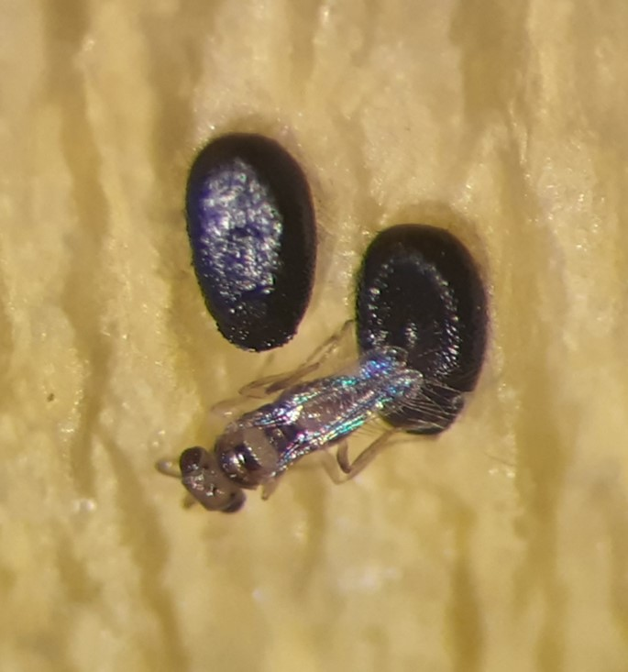
Organizations
Paris, 2023

Slide 4





Organizations involved in the biocontrol
Paris, 2023
Organization
Type
RAIZ – Forest and Paper Research Institute
The Navigator Company
Altri Florestal
Forest Research Center -CEF, School of Agriculture - ISA, University of Lisbon
R&D unit from The Navigator Company
Forest Company
Forest Industry Enterprise
Academy, R&D

Slide 5
RAIZ and The Navigator Company
Paris, 2023
Big numbers
Forest production area (ha)
Eucalyptus area (ha)
Forest certification area FSC, PEFC
R&D personnel - RAIZ
107 000
73%
100%
100%

Slide 6
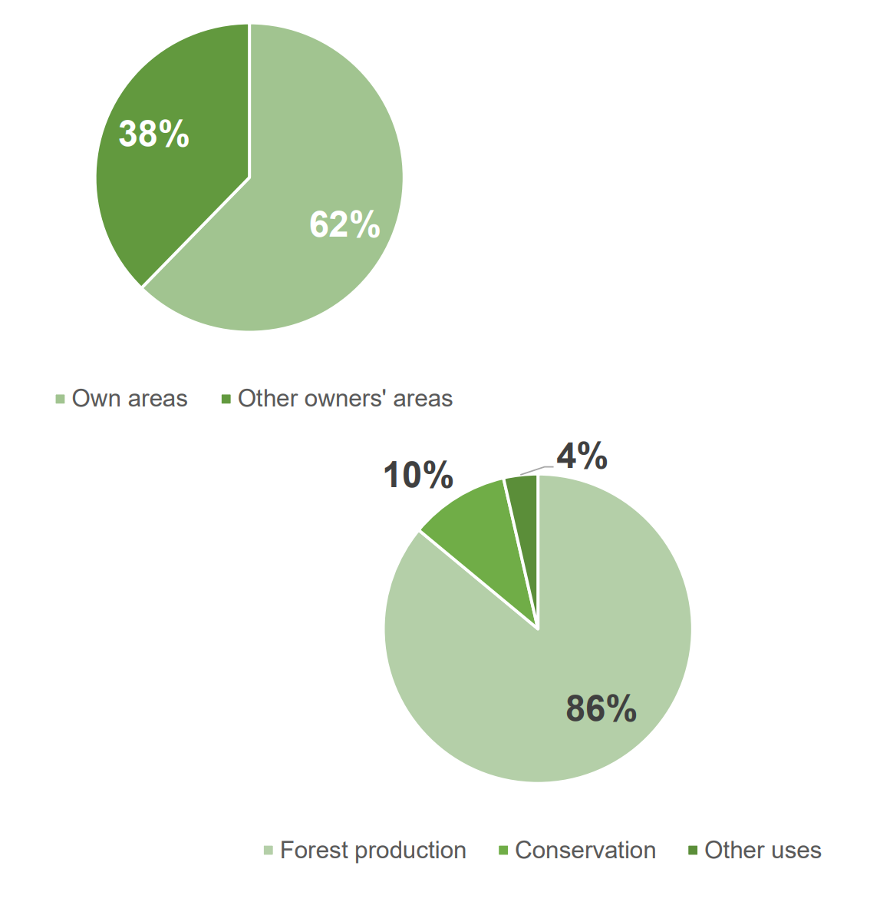
Altri Florestal
Paris, 2023
Big numbers
Forest production area (ha)
Conservation area (ha)
Eucalyptus area % total
Forest certification area FSC &PEFC
R&D investments
74 081
8 976
84%
100%
4 M€

Slide 7
Biocontrol method background
Paris, 2023

Slide 8
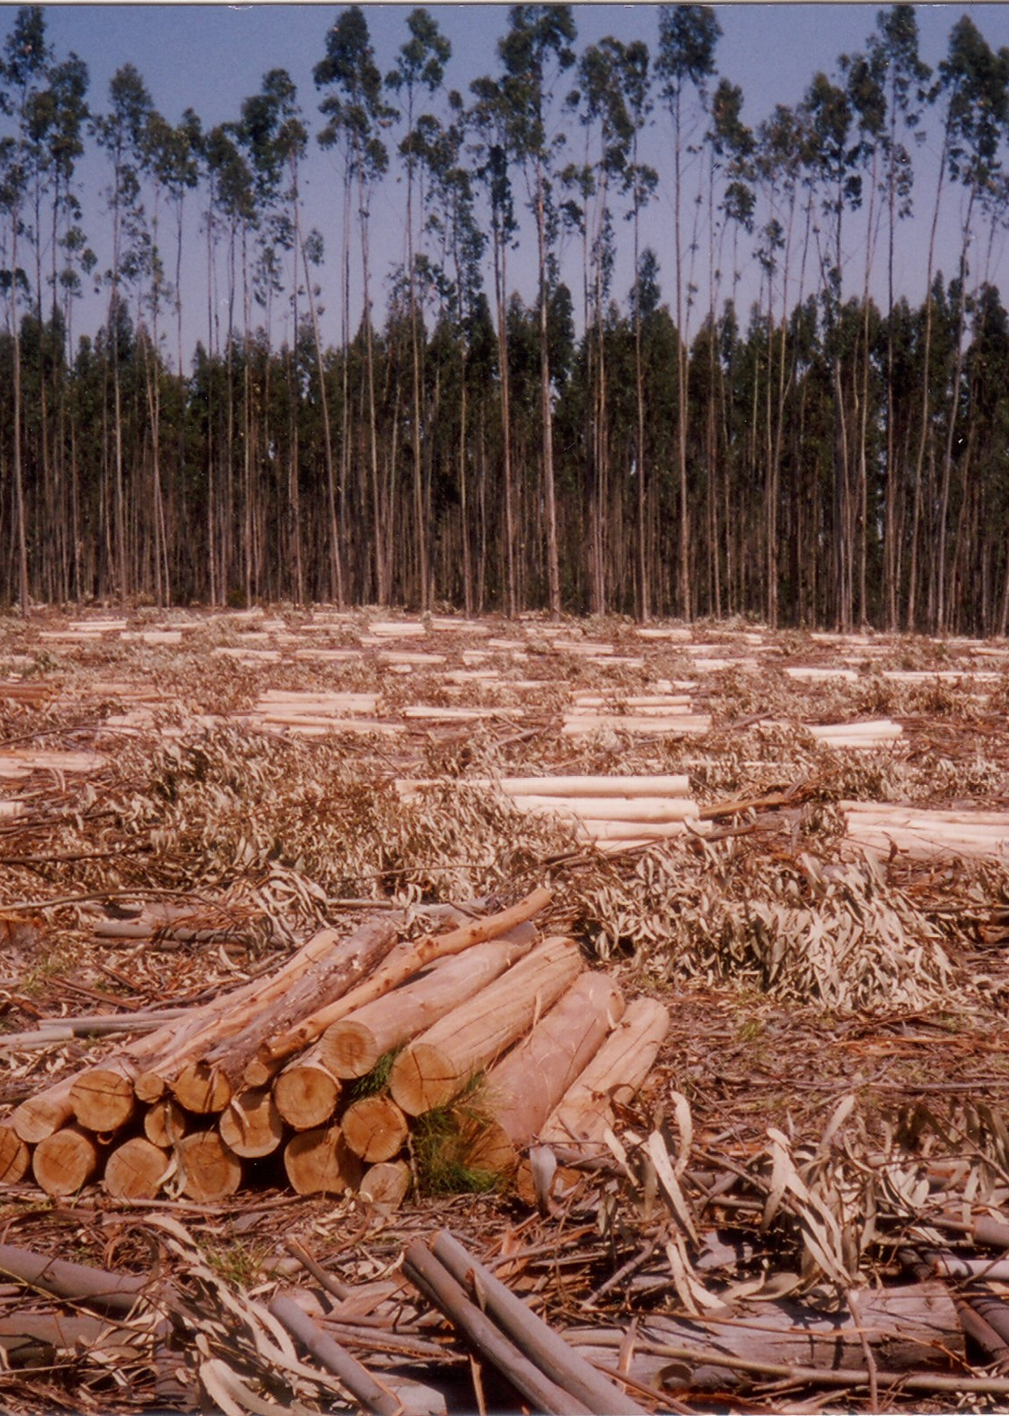
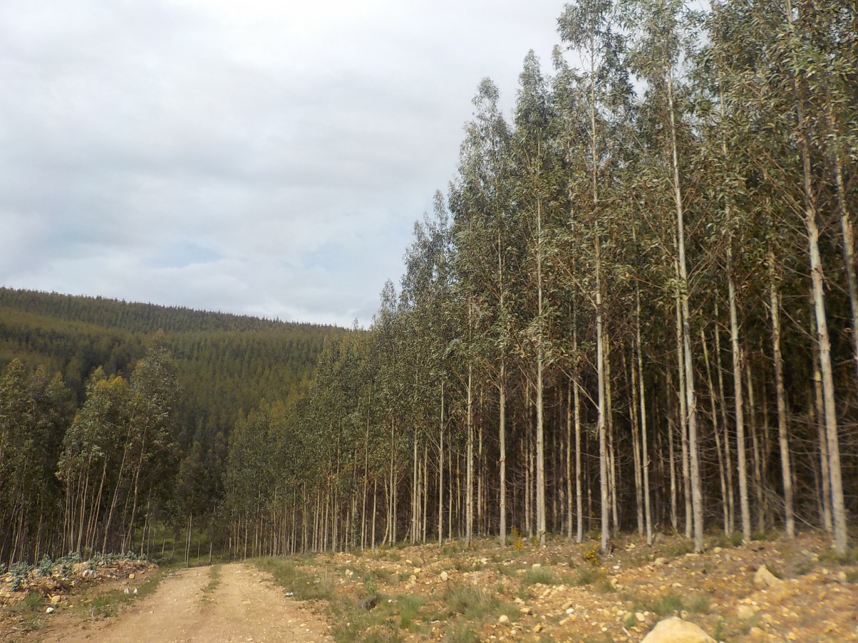
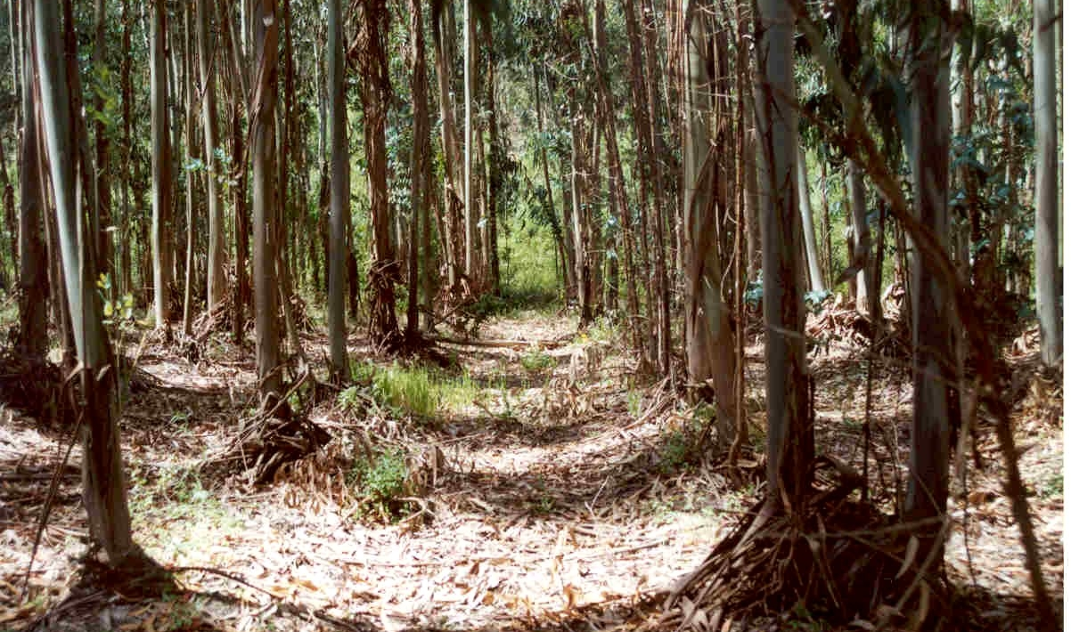
Eucalyptus plantations in Portugal
Paris, 2023
Area and silviculture
Portugal has about 845 thousand hectares of Eucalyptus plantations
Eucalyptus globulus is the most planted species, mainly for the pulp industry
Exploited in short rotation (10-12 years)

Slide 9
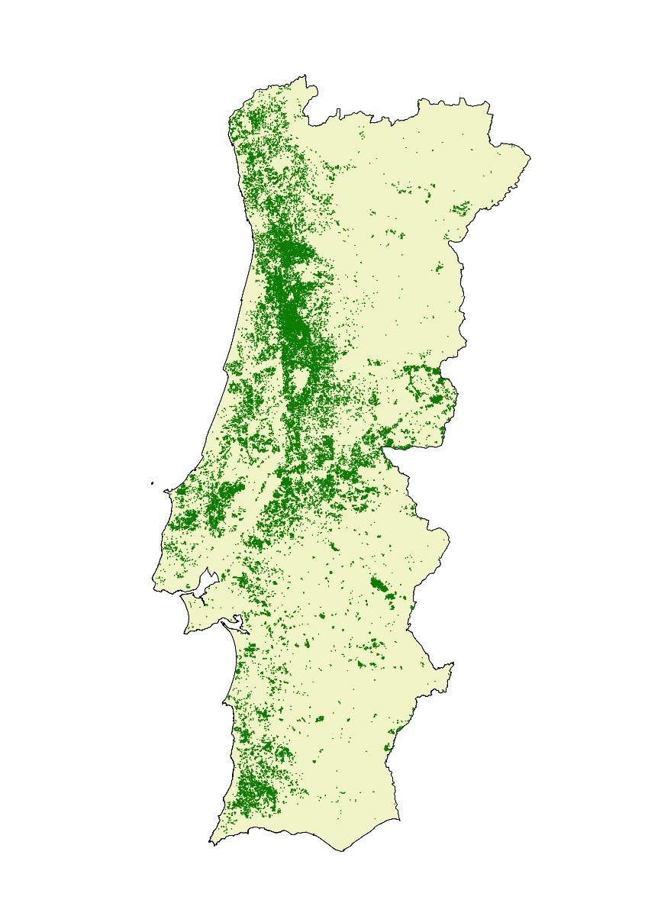
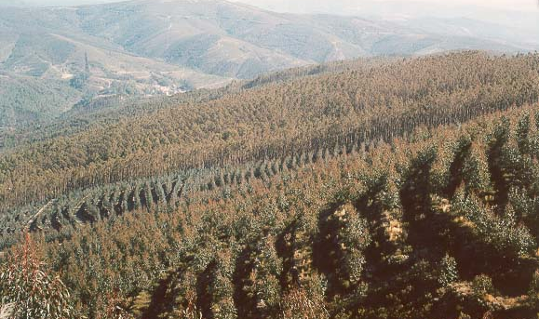
Eucalyptus plantations in Portugal
Paris, 2023
Eucalyptus distribution in the country
Economic relevance
Eucalyptus represent 26% of the country’s forest area
Productivity is higher in northern and central areas with higher annual precipitation
Sales of the pulp, paper, and board sector > 2800 M€ in 2021 (Source: Biond)

Slide 10
The increasing number of Eucalyptus pest species
Paris, 2023
Currently, there are at least 17 invasive Eucalyptus pests in Europe, 15 of which are in Portugal
Pests of E. globulus (in red).

Slide 11
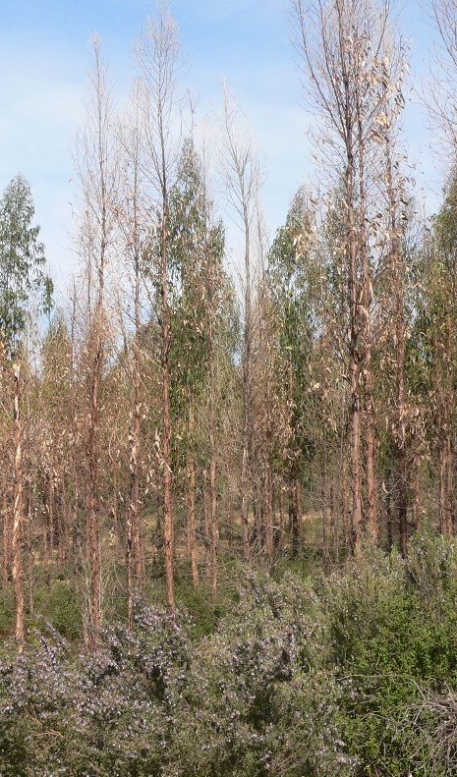
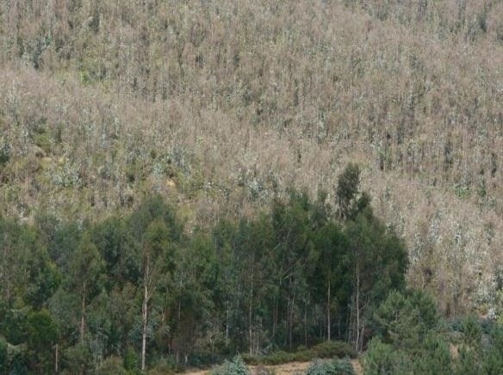
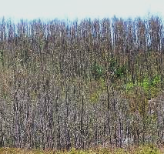
Economic impacts
Paris, 2023
E. globulus
Damage and impacts
Heavy defoliation
Tree mortality
Wood production loss
Changes in land use
E. delegatensis

Slide 12
Establishment biocontrol part of the solution
Paris, 2023
Pest species on E. globulus | BC agents arrived by chance | Establishment biocontrol programs
Phoracantha recurva / P. semipunctata | Avetianela longoi | _
Gonipterus platensis | _ | Anaphes nitens Anaphes inexpectatus * Anagonia lasiophthalmia *
Ctenarytaina eucalypti | Psyllaephagous pillosus | _
Ctenarytaina spatulata | _ | _
Thaumastocoris peregrinus | _ | Cleruchoides noackae
Trachymela sloanei | _ | (importation for lab studies applied, Enoggera nassaui)
Ophelimus mediterraneus | _ | _
Biocontrol programs were carried out for two pest species; 4 BC agents were imported;
2 BC agents were first imported from Australia *

Slide 13
Technical description
Paris, 2023
Targeted pests
Biocontrol agents

Slide 14
Targeted pests
Paris, 2023

Slide 15
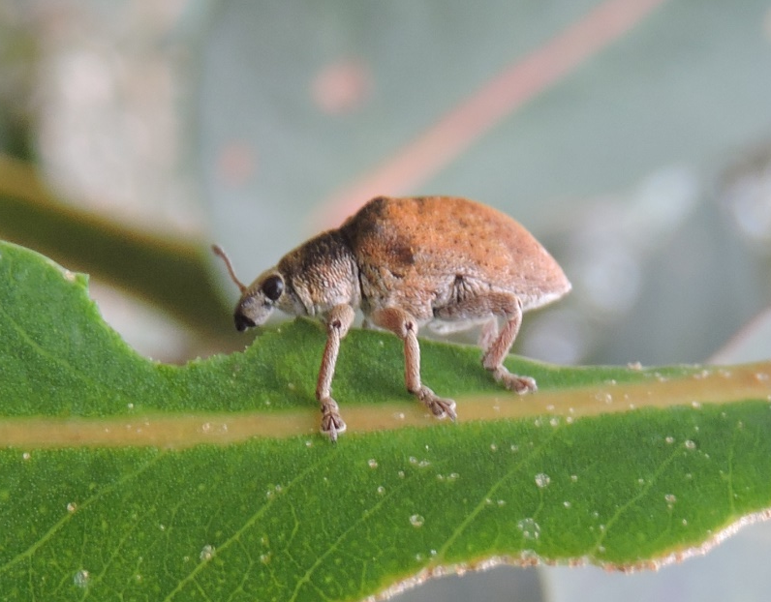
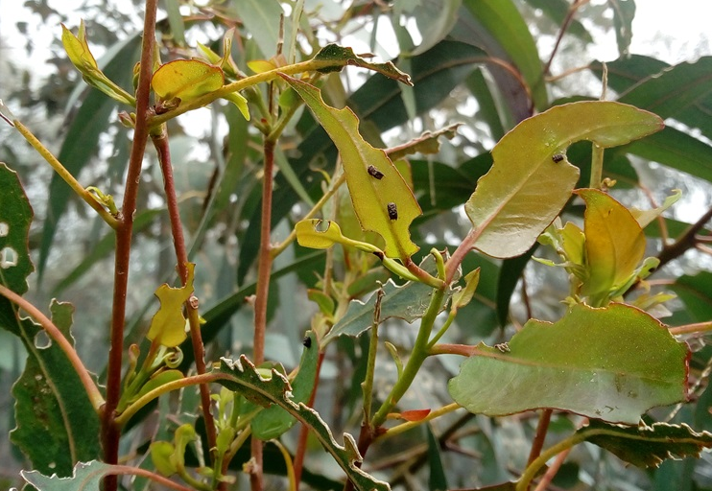
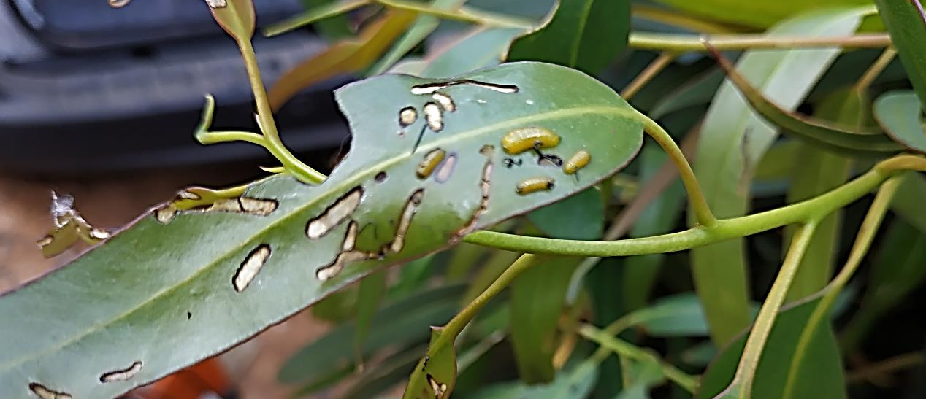
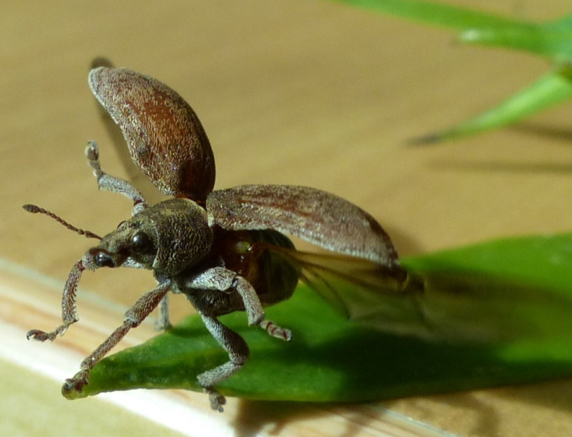
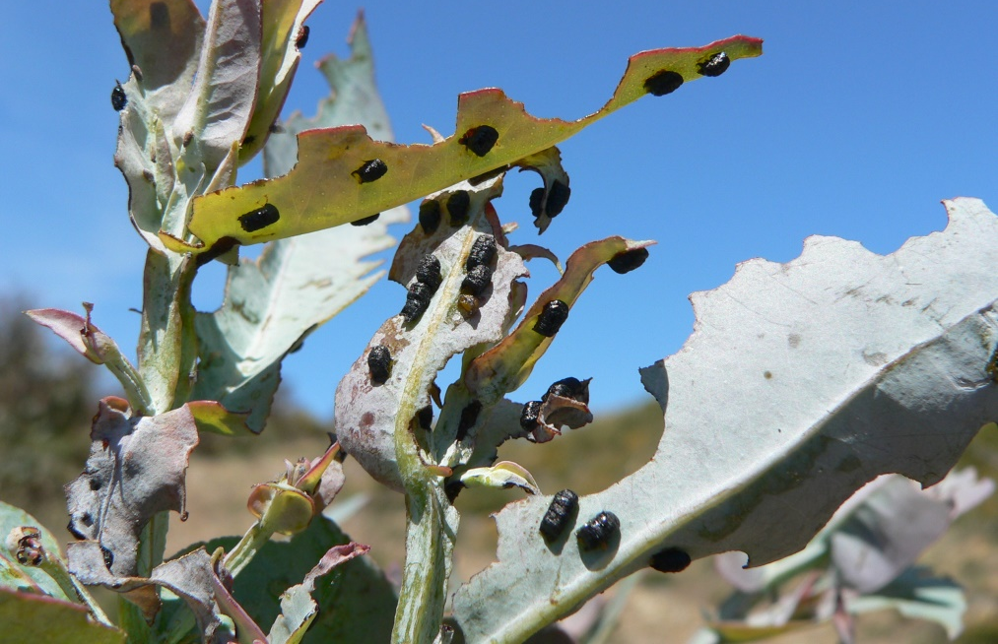
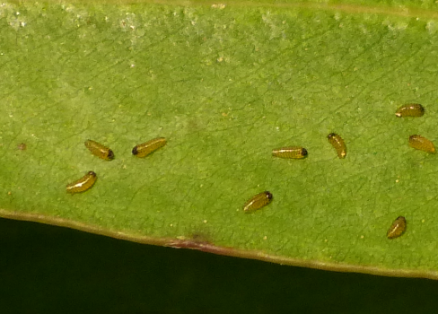
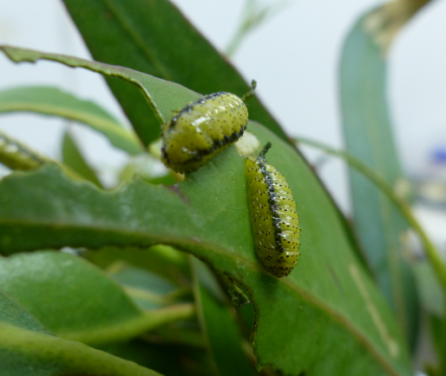
Gonipterus platensis (Col: Curculionidae)
Paris, 2023
Establishment of biocontrol in Eucalyptus plantations in Portugal

Slide 16
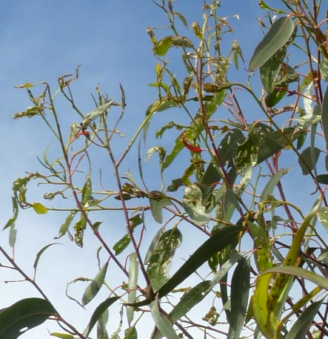
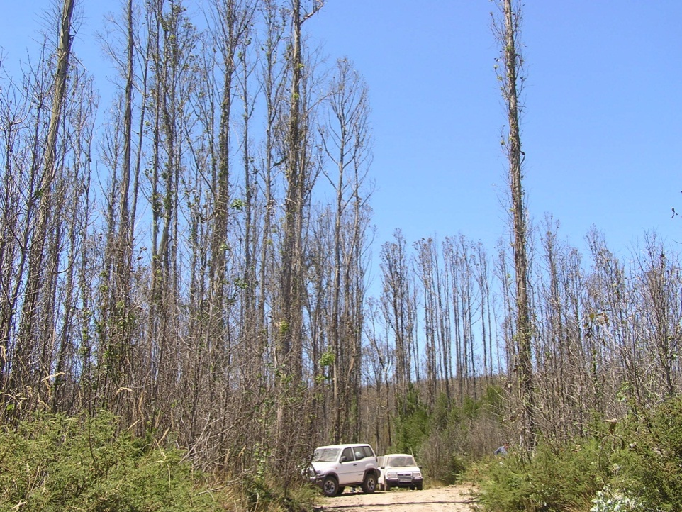
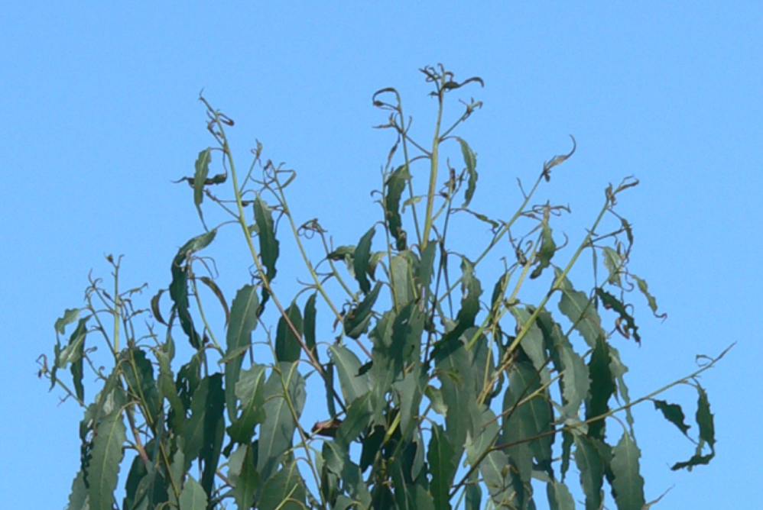
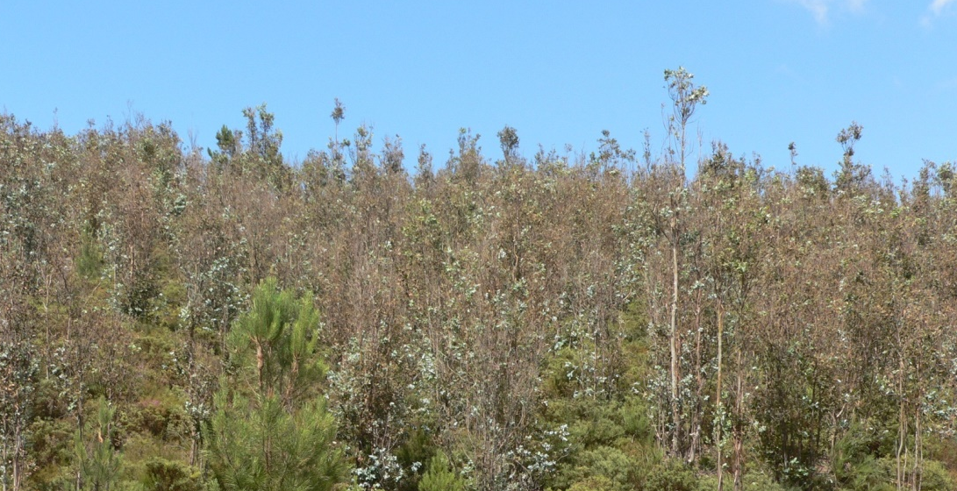
Gonipterus platensis
Paris, 2023
Damage

Slide 17
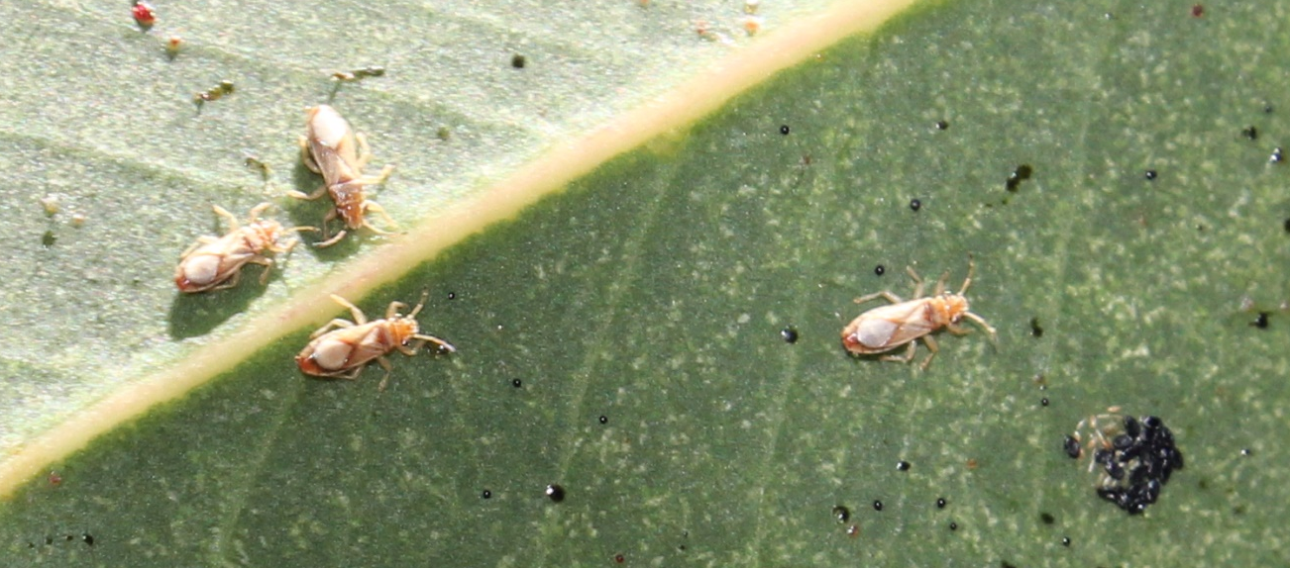
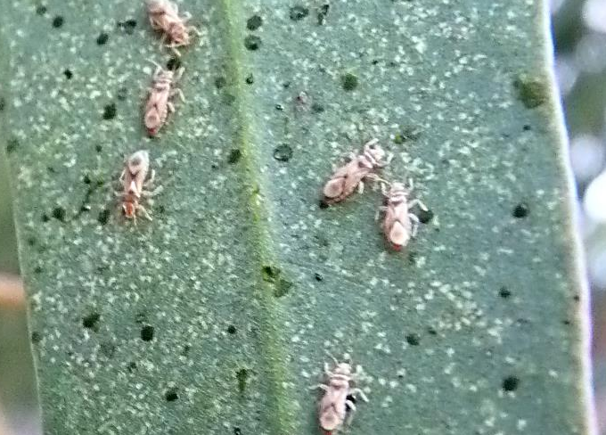
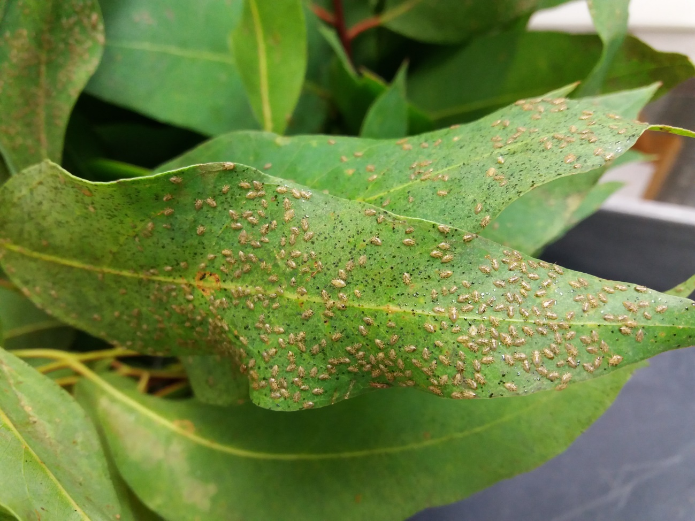
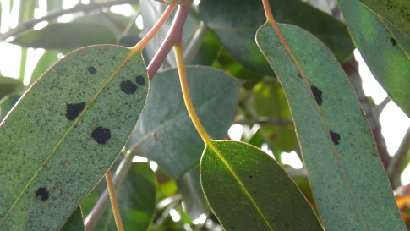
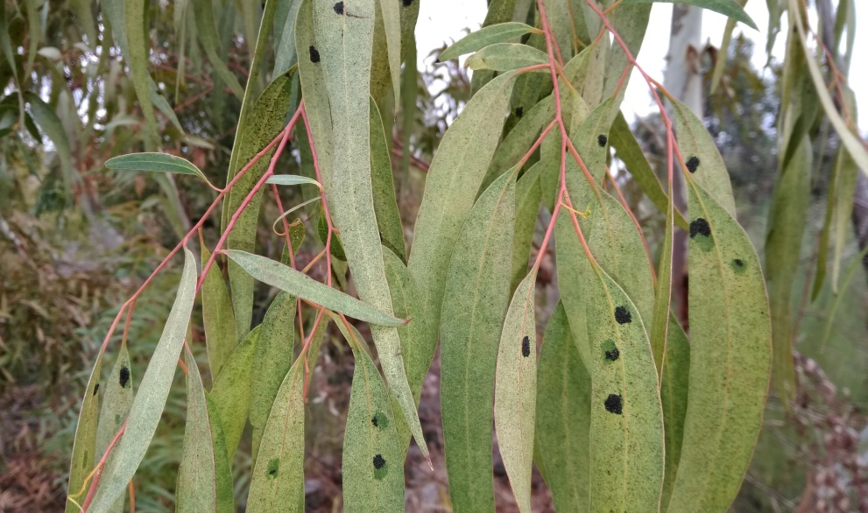
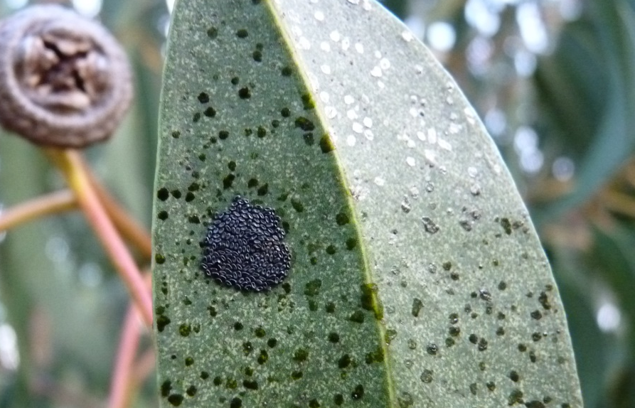
Thaumastocoris peregrinus (Hem: Thaumastocoridae)
Paris, 2023

Slide 18
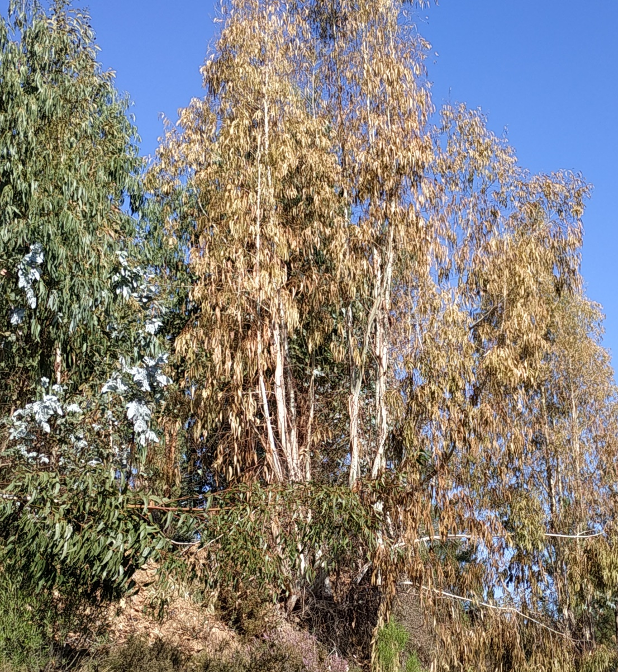
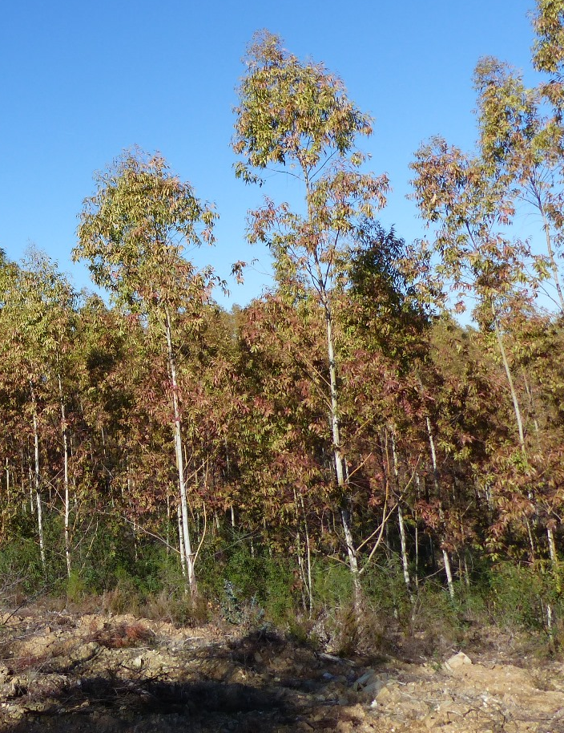
Thaumastocoris peregrinus
Paris, 2023
Damage

Slide 19
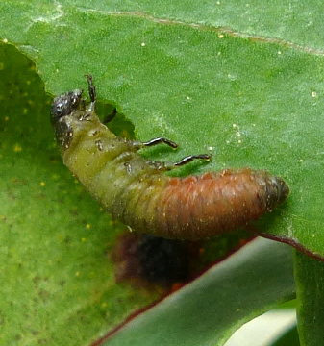
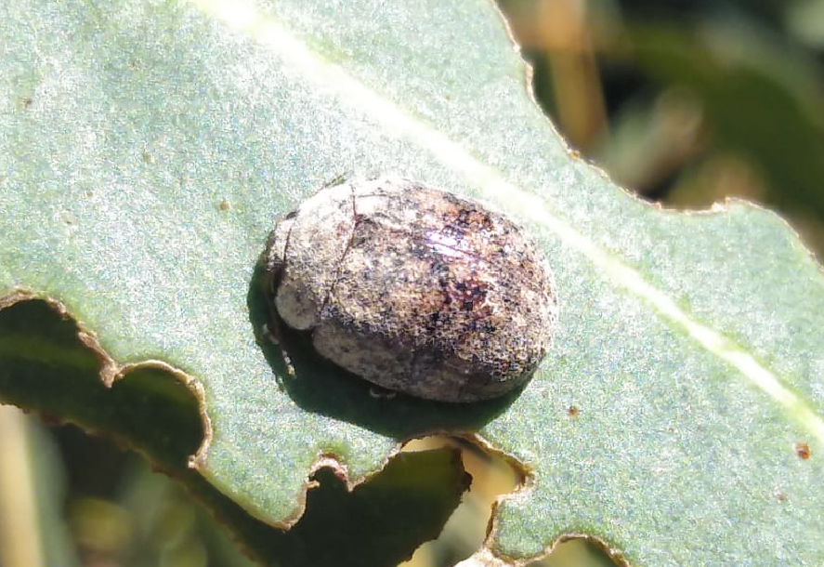
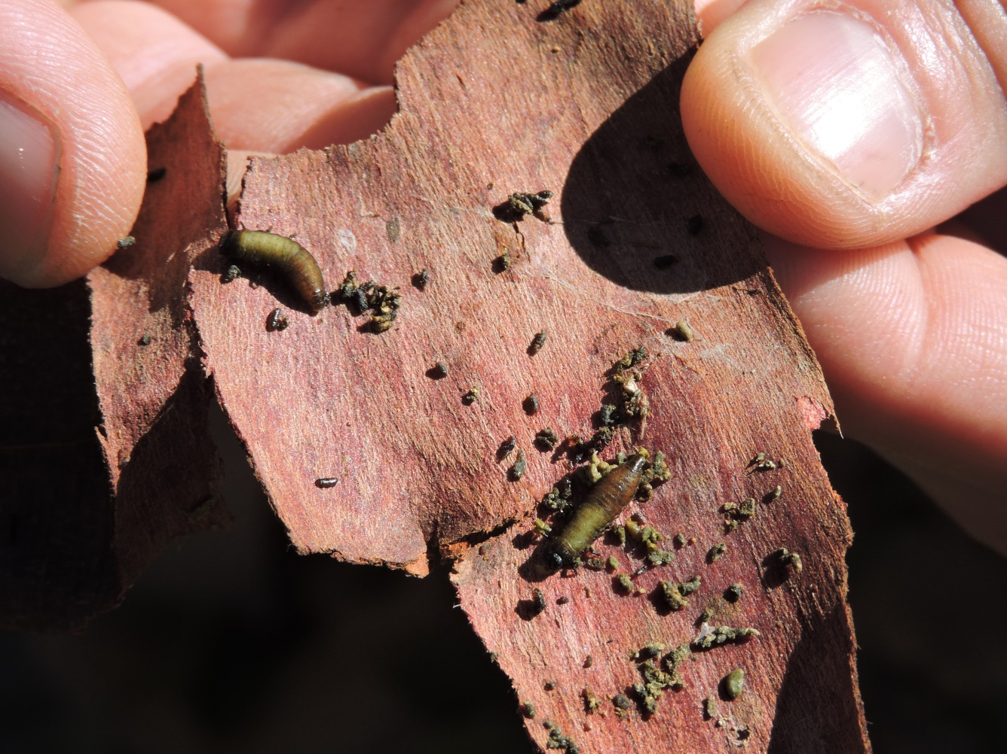
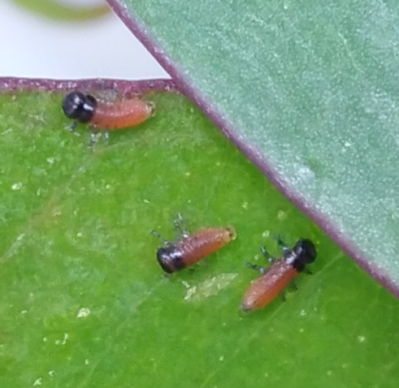
Trachymela sloanei (Col: Chrysomelidae)
Paris, 2023

Slide 20
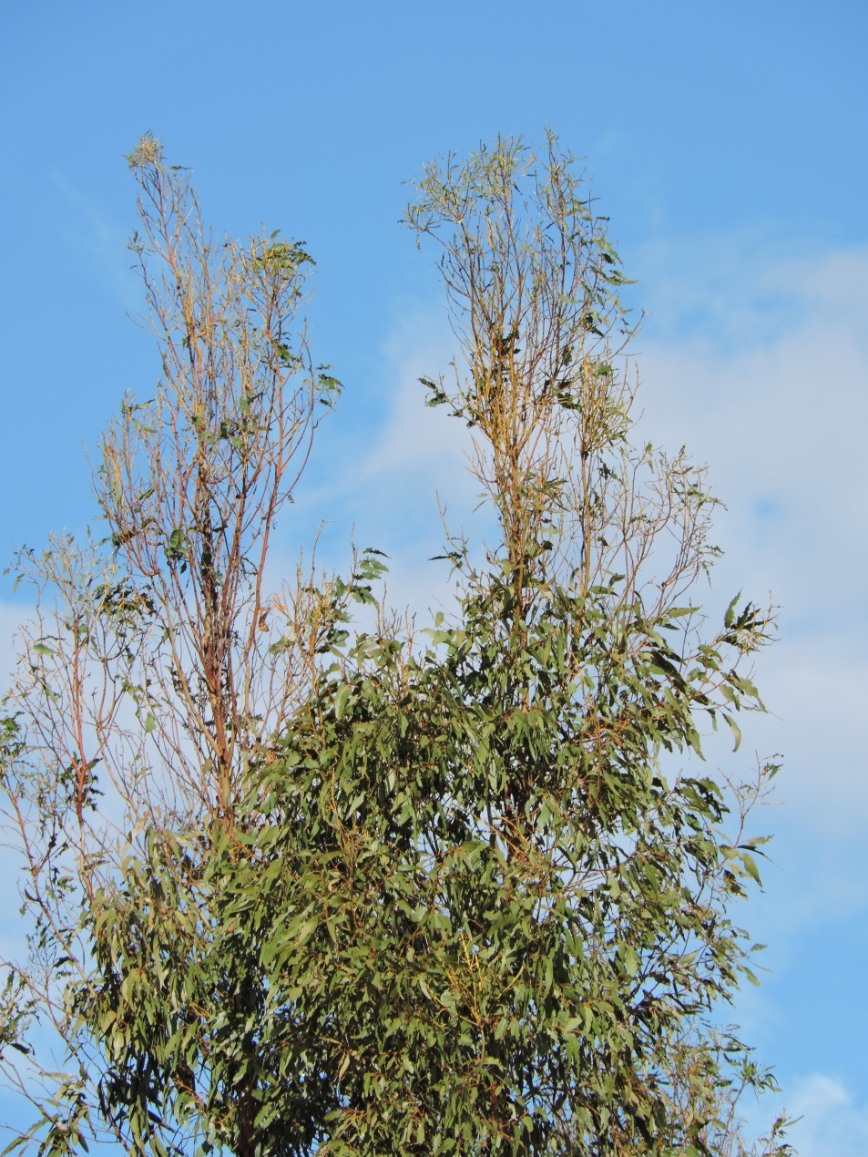
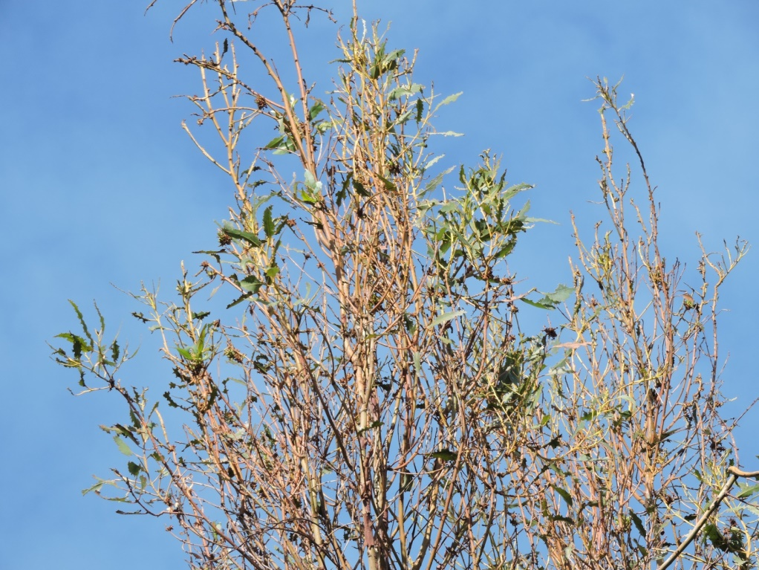
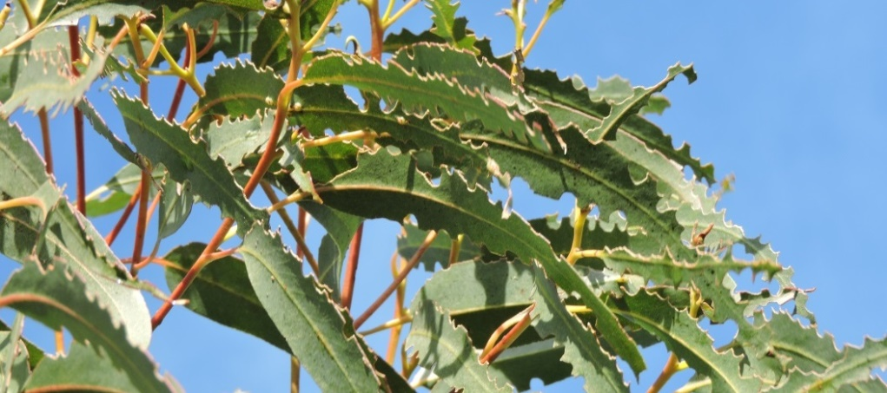
Trachymela sloanei
Paris, 2023
Damage

Slide 21
Biocontrol agents
Paris, 2023

Slide 22
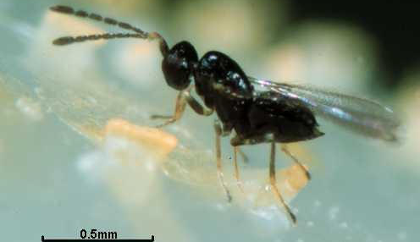
Anaphes nitens (Hym: Mymaridae)
Paris, 2023
Egg parasitoid of G. platensis
First released in South Africa in 1926
Released in Portugal since 1996

Slide 23
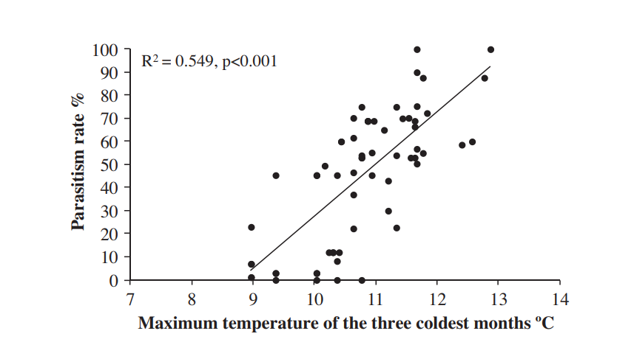
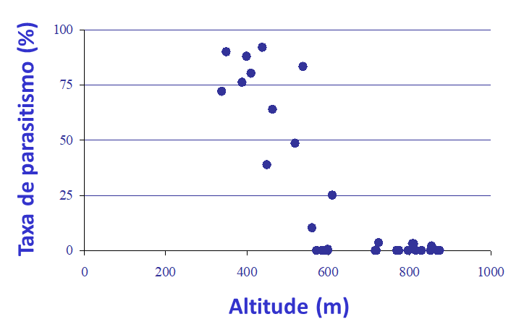
Constraints with A. nitens
Paris, 2023
Spring parasitism rates:
>75% at low elevations (< 400 m altitude)
But, parasitism rates decrease with
- increasing elevation
- lower average winter temperature
Wood volume in 10 years of rotation decreased by half, from 141 m³ to 70 m³ ha, in the areas where parasitism rates are low

Slide 24
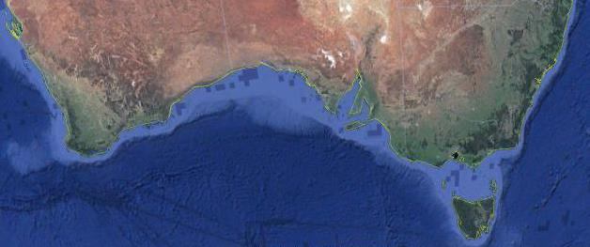
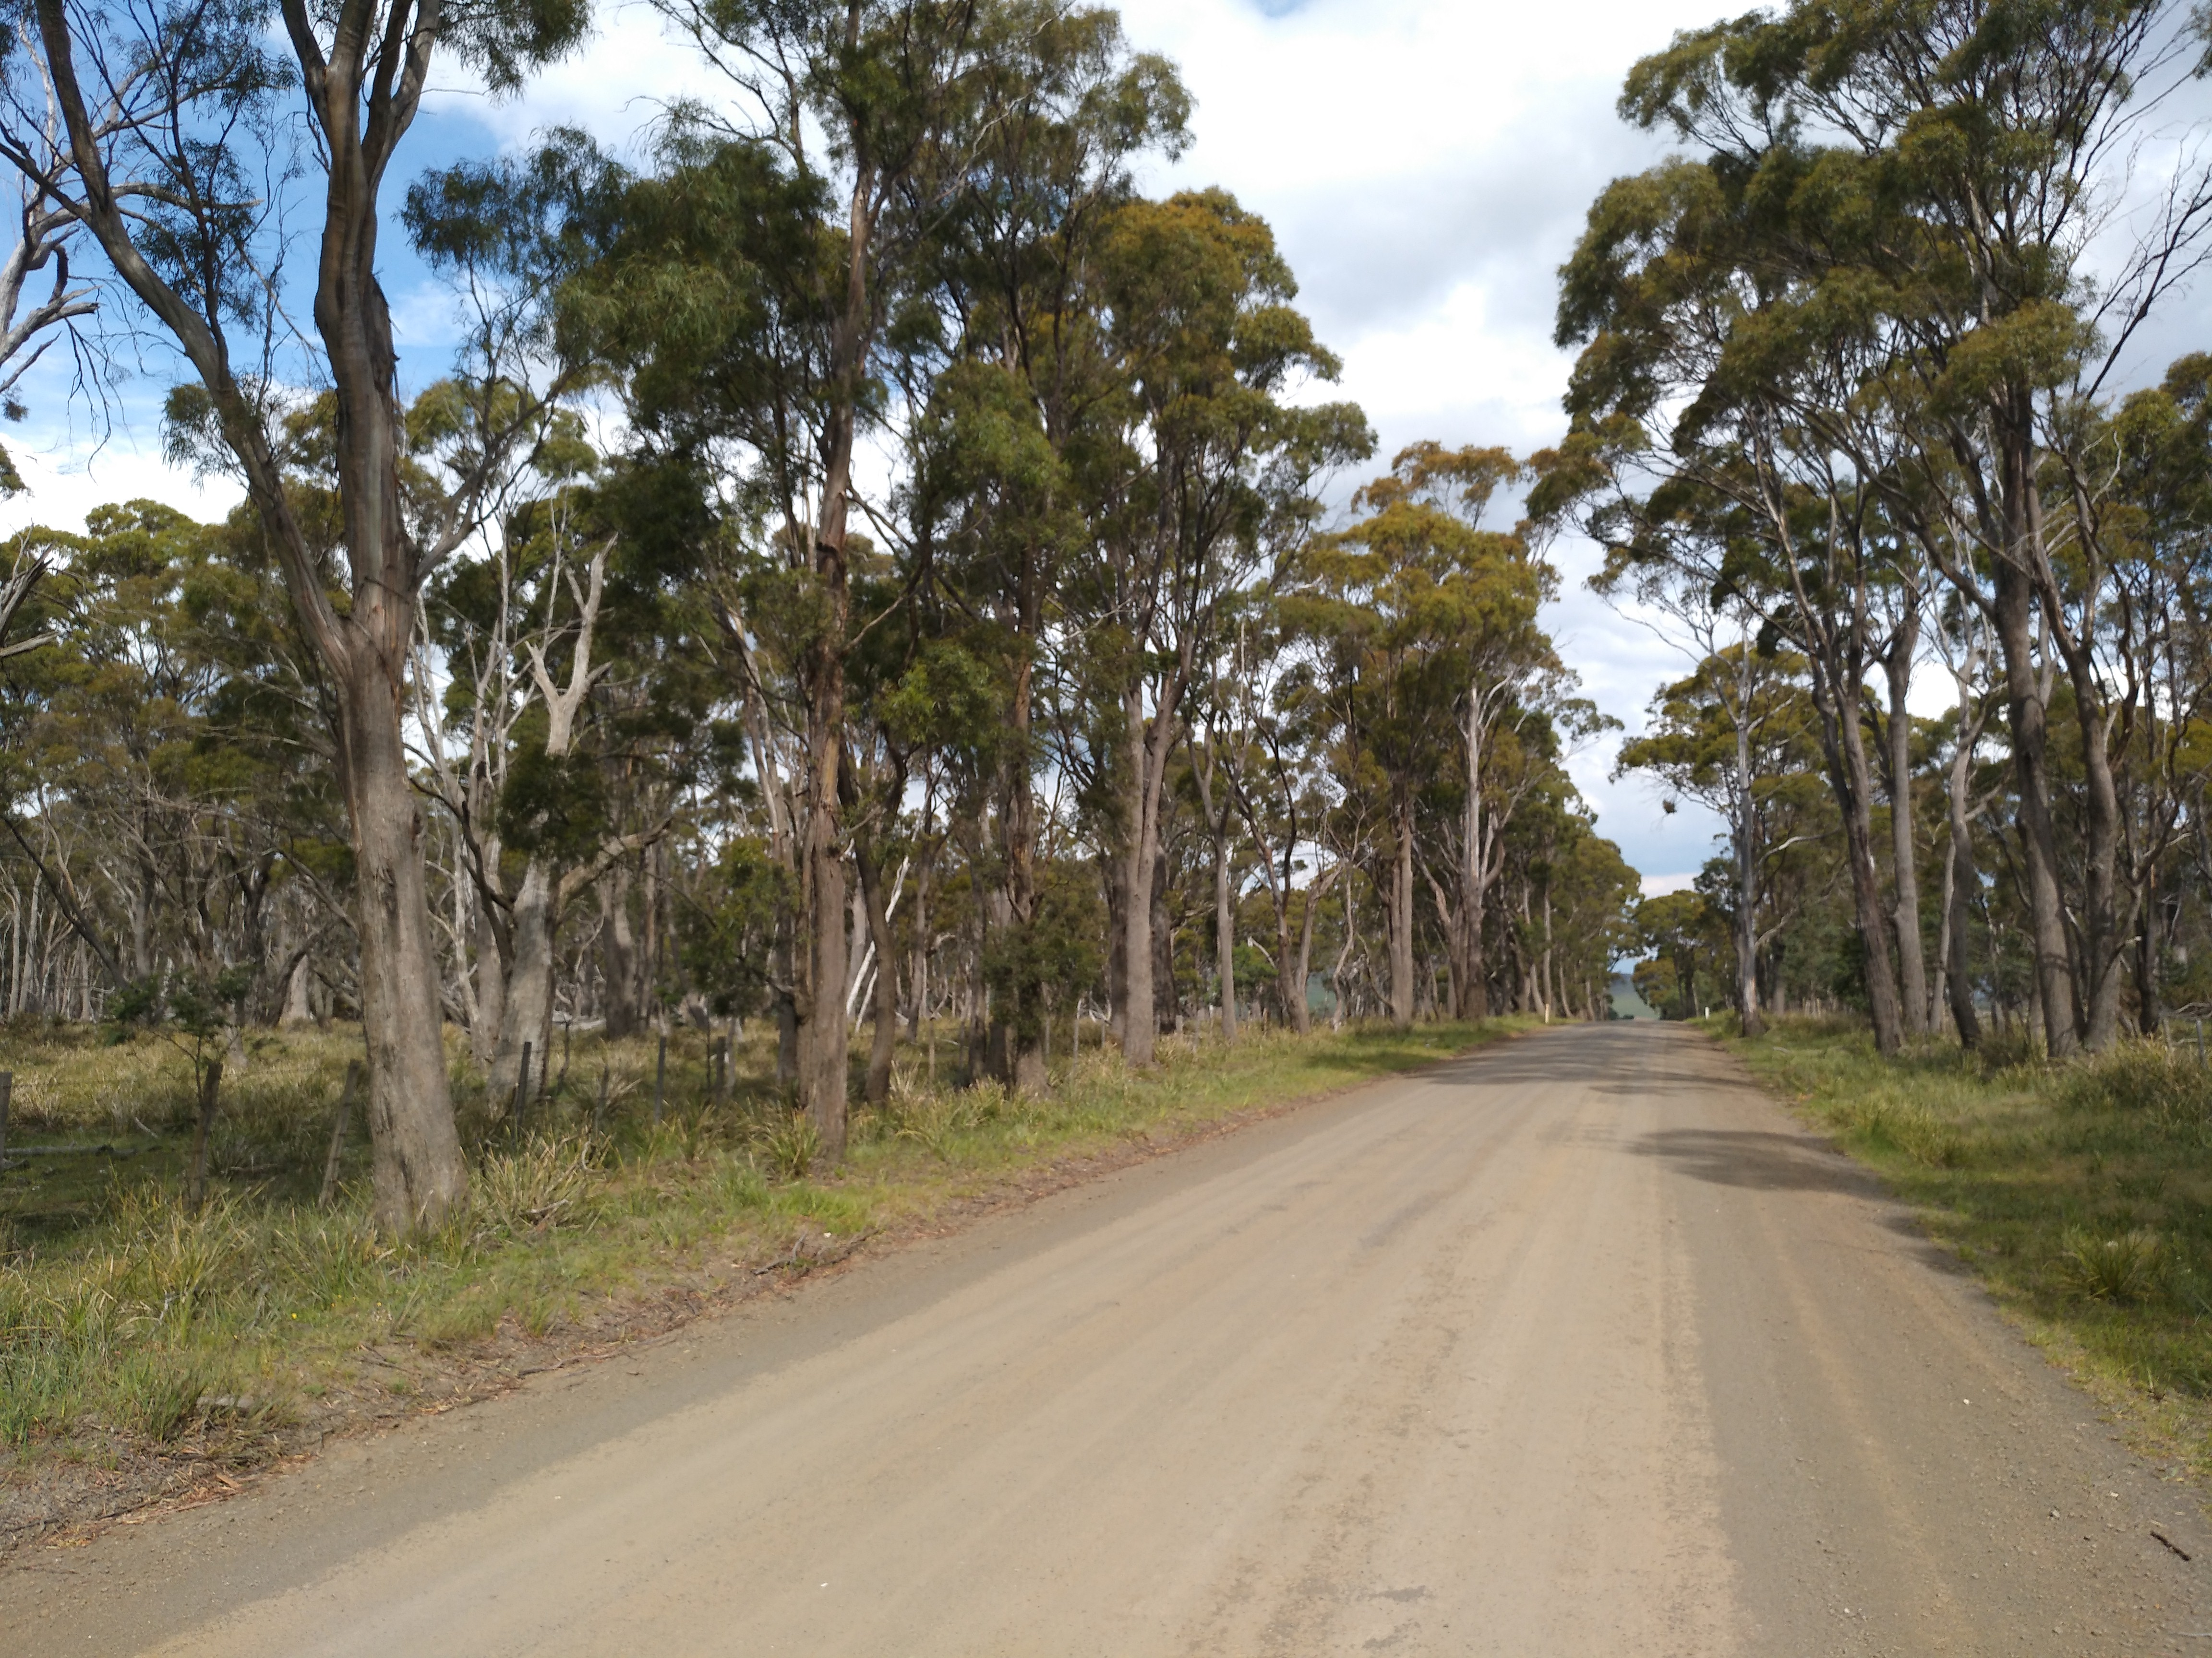
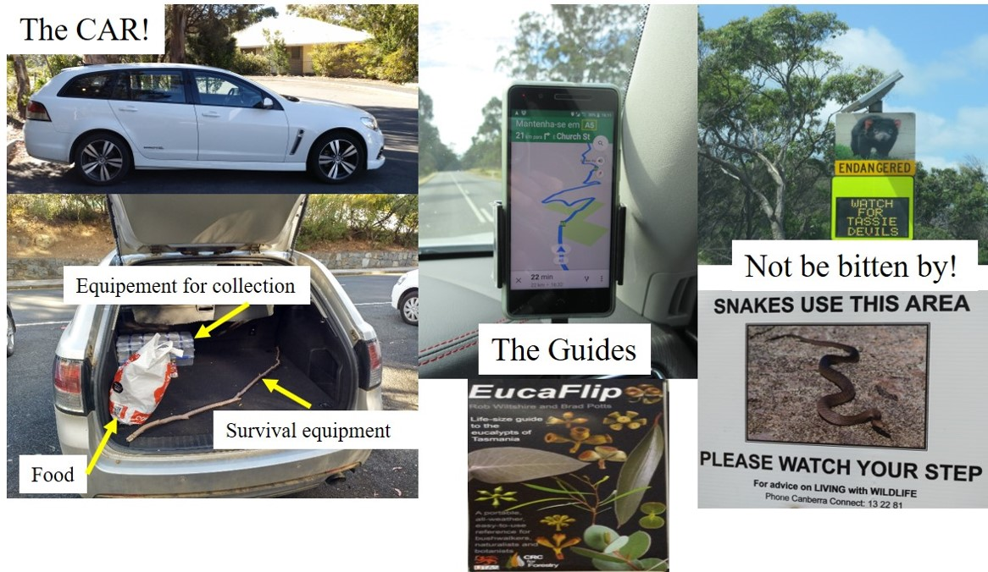
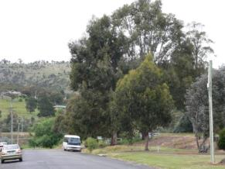
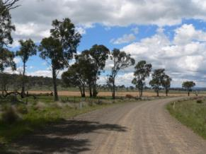
Searching for new biocontrol agents
Paris, 2023
2008-2018
Several incursions were made in Tasmania, Australia, looking for other parasitoids of G. platensis

Slide 25
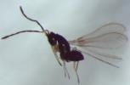
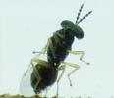
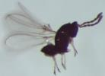
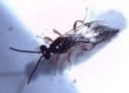


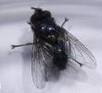
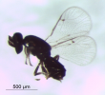
Searching for new biocontrol agents
Paris, 2023
Egg parasitoids
Larval parasitoids
Anaphes tasmaniae
Anaphes inexpectatus
Centrodora damoni
Cirrospilus sp.
Euderus sp.
Entedon magnificus
Oxyserphus sp.
Anagonia lasiophthalma
Two selected for risk assessment

Slide 26





Anaphes inexpectatus (Hym: Mymaridae) biology and risk assessment
Paris, 2023
A. inexpectatus
Higher R0 at 10 °C and higher tolerance at 30 °C than A. nitens But lower R0 for temperatures in the range of 15-25 °C
Highly host specific and no non-target effects are expected in the field
The two species may coexist, although competition interference is expected

Slide 27


Anaphes inexpectatus
Paris, 2023
2009-2012: Biological and risk assessment studies performed - permission for field release
2012-2019: Release of A. inexpectatus in several localities in Portugal
Post-release surveys revealed very low field parasitism < 5%
Dilution on the landscape?
Interspecific competition with A. nitens?

Slide 28






Anagonia lasiophthalma (Dip: Tachinidae) biology and risk assessment
Paris, 2023
Longevity:
>2 months
2 weeks
1 week
2 weeks
1-2 days

Slide 29



A. lasiophthalma biology and risk assessment
Paris, 2023
Direct larviposition
First instar larvae are put inside the host by the female ovipositor
Female fecundity
more than 50 eggs
CG

Slide 30

A. lasiophthalma biology and risk assessment
Paris, 2023
2017-2022: Biological and risk assessment studies were required to obtain permission for field release.
Non-target tests
14 non-target pest species were tested – none parasitized
2023: First release of A. lasiophthalma in Portugal
Post-release surveys: To be conducted in 2024

Slide 31


Cleruchoides noackae (Hym: Mymaridae)
Paris, 2023
First released in South Africa, Brazil, and Uruguay
2017-2019 Risk assessment studies in Portugal
Released authorized in Portugal in 2021
Egg parasitoid of T. peregrinus

Slide 32


Laboratory rearing facilities
Paris, 2023

Slide 33



Laboratory rearing cages
Paris, 2023

Slide 34


Following National regulations and EPPO guidelines
Paris, 2023
For all species, the application requests for import in quarantine conditions for laboratory studies, and field releases were performed according to National and EU regulations and EPPO guidelines.
It took several years between first application and authorization.

Slide 35
Value proposition and value network
Paris, 2023
Advantages of the method
Network of actors and their motivation

Slide 36

Advantages
Paris, 2023
Non-native invasive organisms have no or limited regulation by native control agents
The establishment of efficient biological control agents will allow a natural, sustainable, long-lasting control.
Adapted from Geburzi and McCarthy 2018

Slide 37
Network of actors and motivation
Paris, 2023
Forestry enterprises R&D
Motivation
Forestry enterprises R&D
Academy
Forest Associations
DGAV- NPPO
ICNF – National Forest Services
Increase productivity
Reduce the use of pesticides and negative impacts
Develop environmentally sustainable solutions

Slide 38
Contributions, gains and levers
Paris, 2023
Contributions
Direct and indirect gains
Factors and turning point
Risks

Slide 39
Contributions of the participants
Paris, 2023
Forestry enterprises R&D
Academy
Human resources,
Technical resources,
Skills,
Money,
Laboratory facilities
.
Human resources,
Knowledge,
Laboratory facilities

Slide 40


Direct and indirect gains
Paris, 2023
If no BC program had been conducted, the yield lost would be 2 to 12 x higher
BC program costs include the expenses involved in the acquisition, mass rearing, releasing, and post-releasing monitoring of A. nitens

Slide 41

Direct and indirect gains
Paris, 2023
Valente et al., 2018. Ecological Economics 149: 40–47

Slide 42


Direct and indirect gains
Paris, 2023
Alternatives have been spraying with insecticides!
thiacloprid
acetamiprid

Slide 43

Turning points
Paris, 2023
1996
Launched by RAIZ a biocontrol program for rearing and releasing A. nitens
Parasitism rates by A. nitens > 80% in many surveyed areas
2003
The program comes to an end. > 300.000 A. nitens were released since 1997.
1998
2018
Low parasitism and wood loss > 50% are still found in colder areas
A. inexpectatus is field released
2012
It is estimated that without A. nitens > 2.5 M€ would be lost considering only the wood loss
2022-2023
C. nockae is released,
Authorization to release A. lasiophtalma
.

Slide 44


Risks and constraints
Paris, 2023
Biological control may not be the limiting factor - other factors may be more relevant e.g. tree physiology, host tree susceptibility
Imported natural enemies may not be efficient enough – the target host is not the most appropriate, a phenological mismatch occurs
Natural enemies do not get well established – e.g. climate mismatch
Non-target parasitism is a much-feared risk, especially for certain groups, implying intensive and prolonged research on risk assessment. The application process is long.

Slide 45












Acknowledgments
Paris, 2023
Independent
consultants
David de Little
Áine Nicholson
Rolf Oberprieler
John LaSalle
James Lumbers
Alex Gumovsky
Bryan Cantrell
Jane Elek
Mamoru Matsuki
Geoff Allen
Simon Lawson
Gonzalo Martinez
John Huber
James O’Hara
Lubomír Masner
Carlos Wilcken
Leonardo Barbosa
Andrew Polaszek
Sandra Ide

Slide 46

Acknowledgments
Paris, 2023
M. Branco is supported by Forest Research Centre (CEF), (UID/AGR/00239/2019, and (UIDB/00239/2020). and by the Laboratory for Sustainable Land Use and Ecosystem Services—TERRA (LA/P/0092/2020), research units funded by the Foundation for Science and Technology (FCT), Portugal.
Thibaut Malausa, INRAe

Slide 47
THANK YOU!
Paris, 2023

