Slide 1
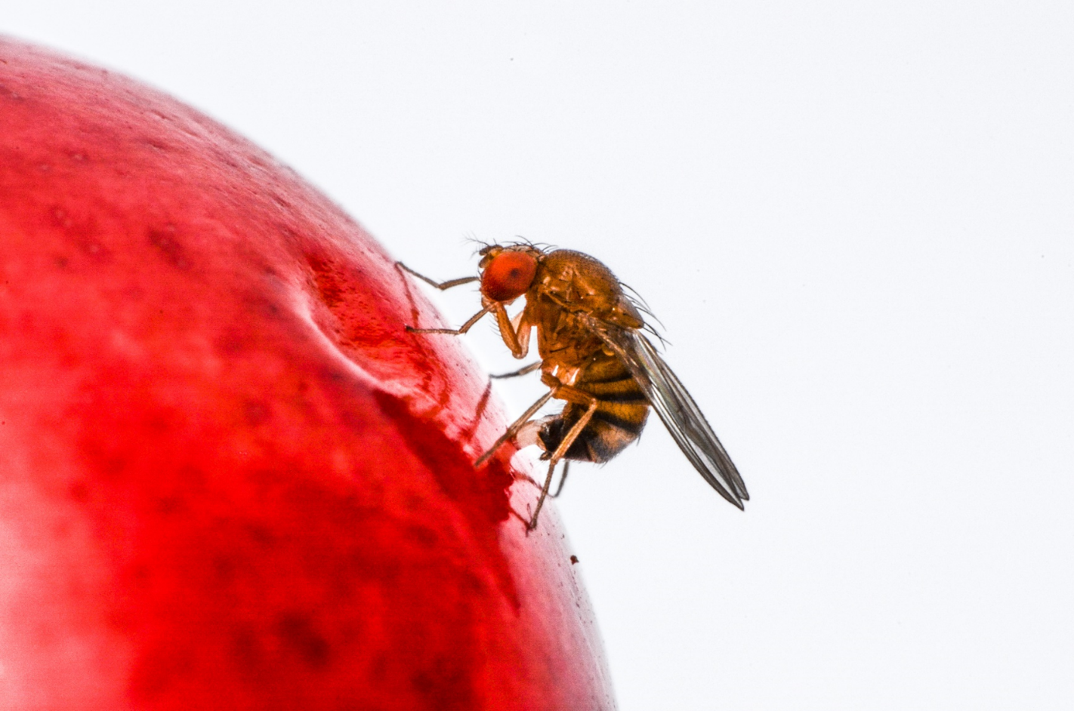
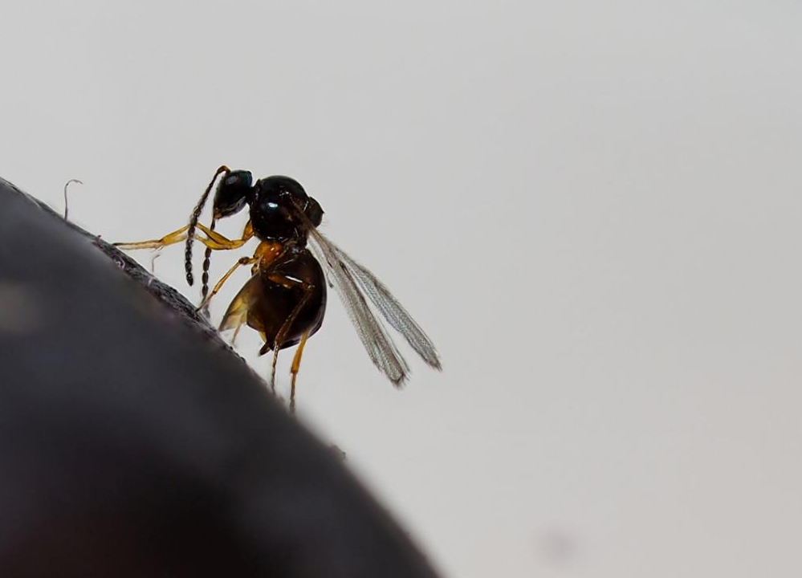
© Time Haye
© Koïchi Beltrando
Establishment biological control – Classical biological control – Biological control by introduction
Marc Kenis and Lukas Seehausen
CABI

Slide 2
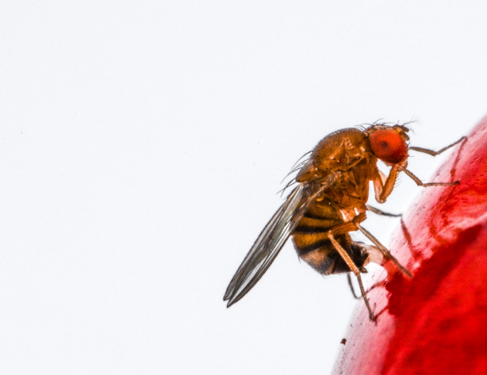
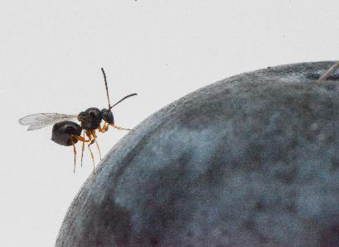
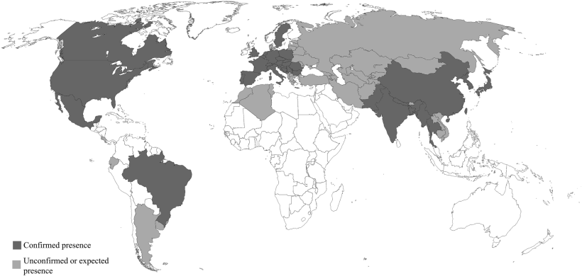
Classical biological control
Introduction of a natural enemy of exotic origin to control a pest, usually also exotic, aiming at a permanent control of the pest (usually an insect or a weed)
Introduction d’un ennemi naturel d’origine exotique pour lutter contre un ravageur, généralement exotique lui aussi, visant un contrôle permanent du ravageur
Asplen et al. 2015

Slide 3
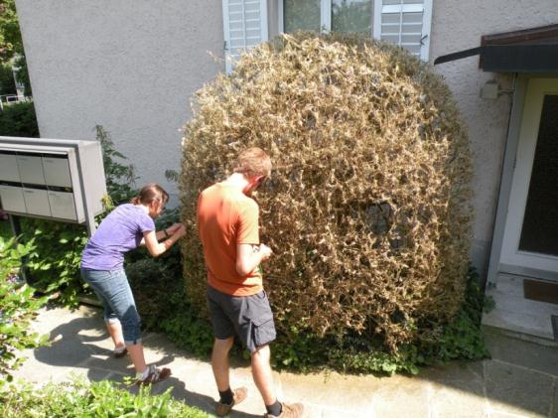
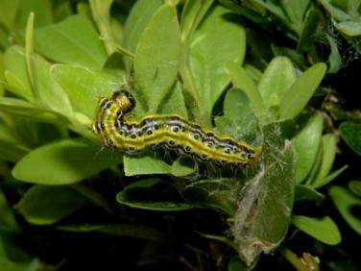
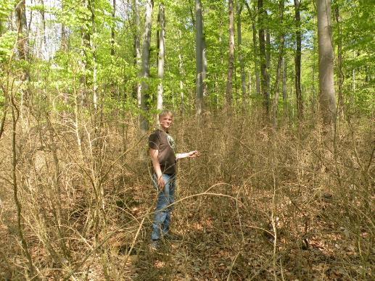
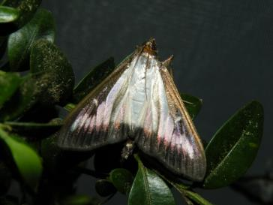
Classical biological control - procedures
E.g. CBC of the box tree moth
Evaluation of the problem, establishment of collaborations and literature survey

Slide 4
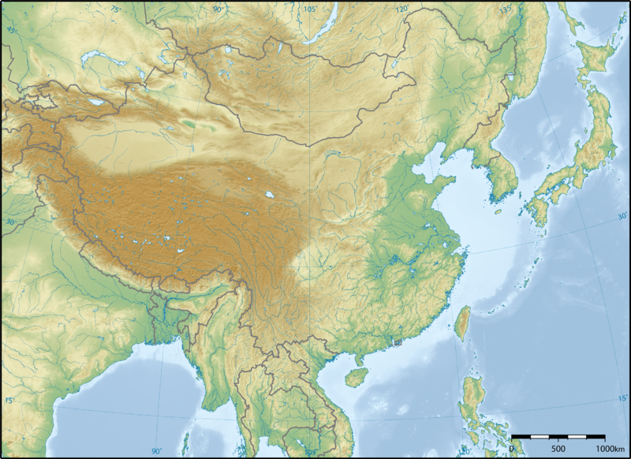
Classical biological control - procedures
Choice of the regions of investigations

Slide 5
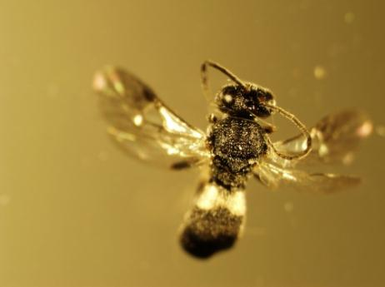
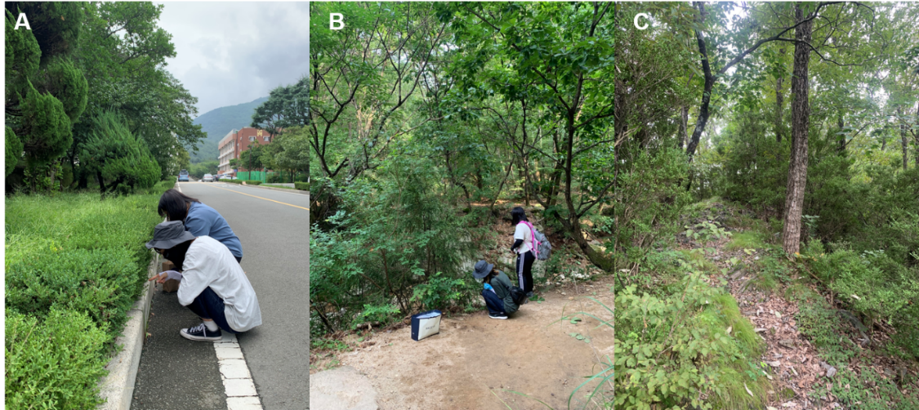
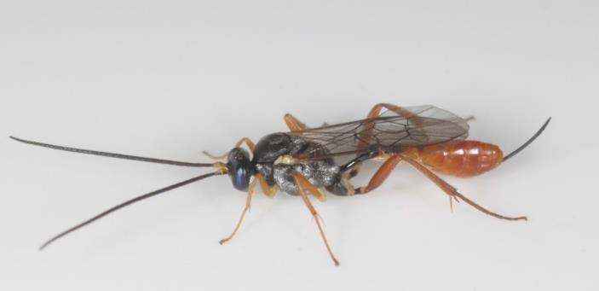
Classical biological control - procedures
Inventory on natural enemies and study of their role as mortality factors in the region of origin

Slide 6
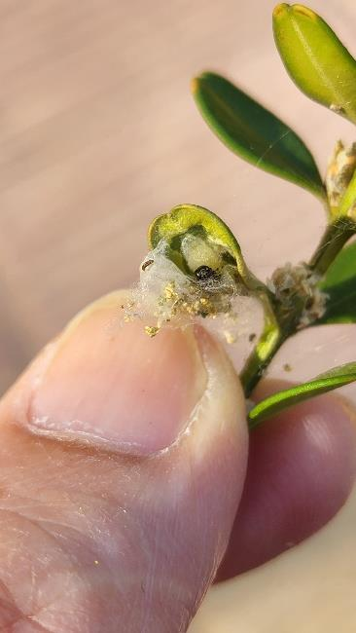
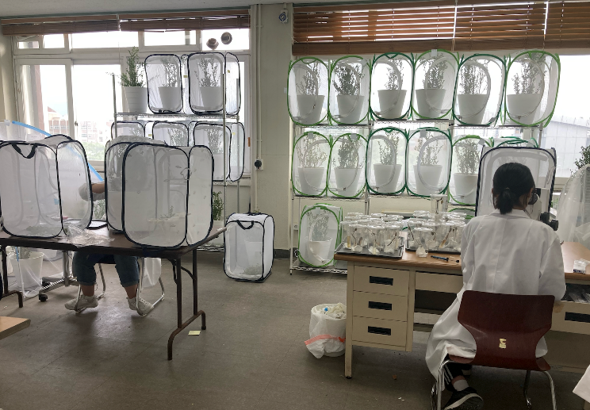
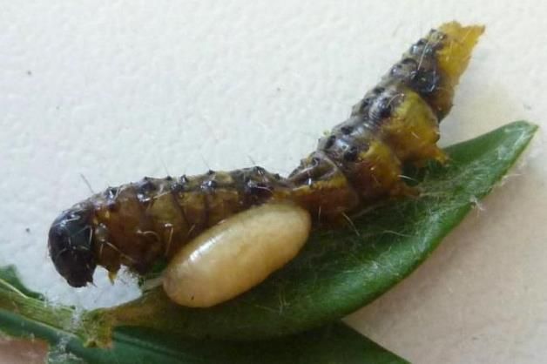
Classical biological control - procedures
Study of the biology and ecology of the main species, especially their specificity
Choice of species to introduce with priority list
Petition & approval

Slide 7
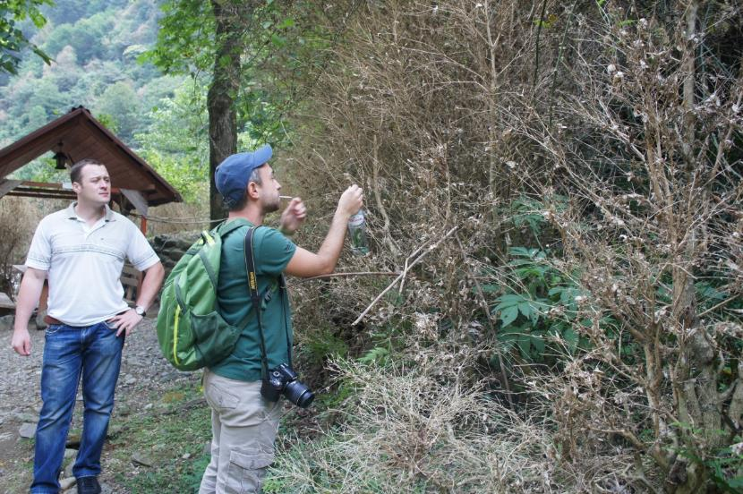
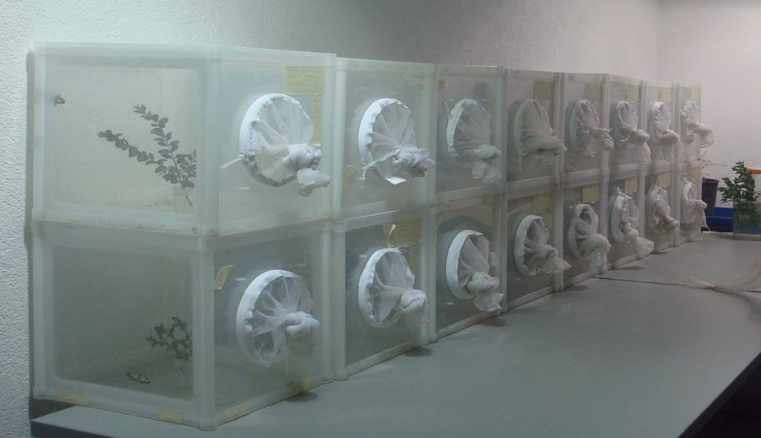
Classical biological control - procedures
Laboratory rearing
Choice of release zones and releases

Slide 8
Classical biological control - procedures
Verification of establishment
Distribution of the biocontrol agent in the invaded zone
Final evaluation of the project

Slide 9
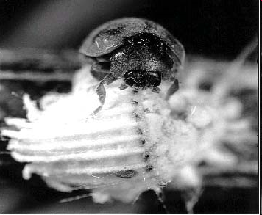
Does it work?
Classical biological control
Between 1889 and 2010:
6164 introductions of insect agents against 692 insect pests
27% of the insects controlled
(but rate would be higher if badly managed and incomplete projects were excluded)
Source: CABI Biocat
Success rate even higher for CBC against invasive weeds

Slide 10
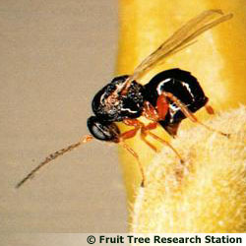
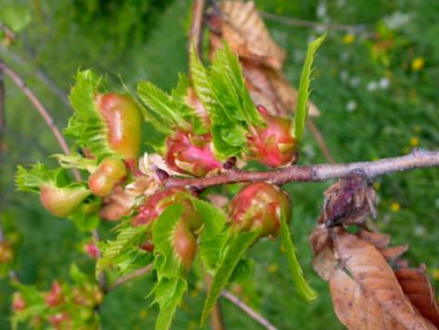
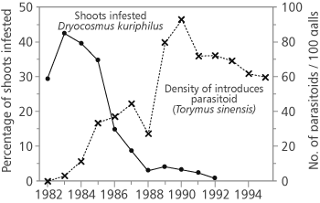
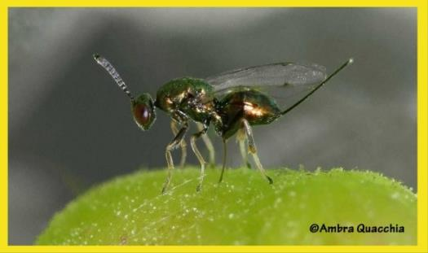
Does it work?
Classical biological control
Moryia et al 1989

Slide 11
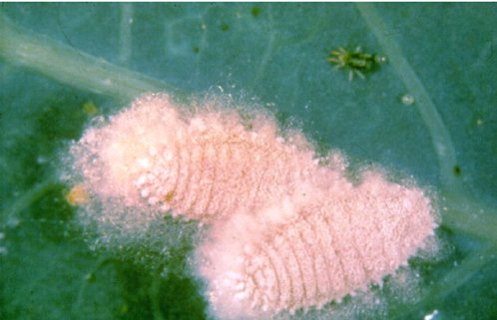
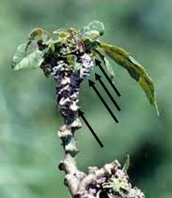
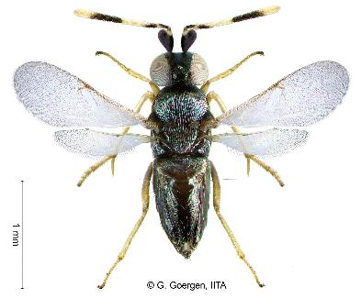
Advantages : huge benefits because control is continuing year after year without further costs – no cost for farmers
Classical biological control
In AfrIca:
Cassava mealy bug (Phenacoccus manihoti)
&
Epidinocarsis lopezi
Cost-Benefit: between 1:200 et 1:500
(in the 1990s – much higher now)
IITA
Moryia et al 1989

Slide 12
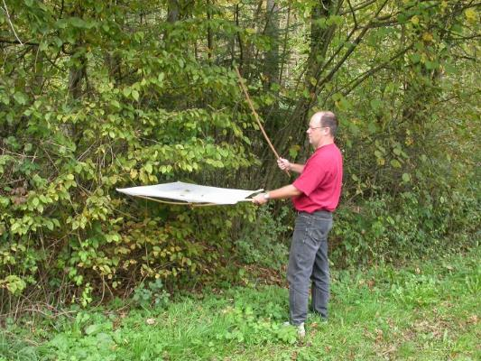
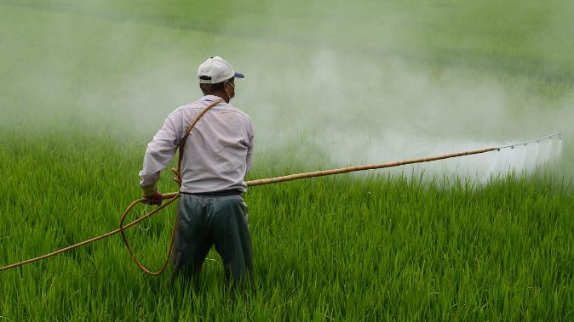
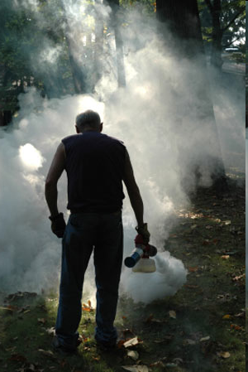
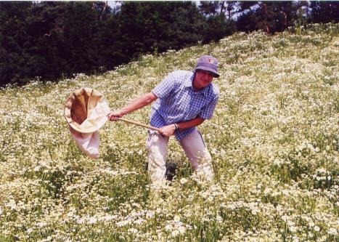
Advantages :
Safe for human health and the environment
Classical biological control
Unep

Slide 13
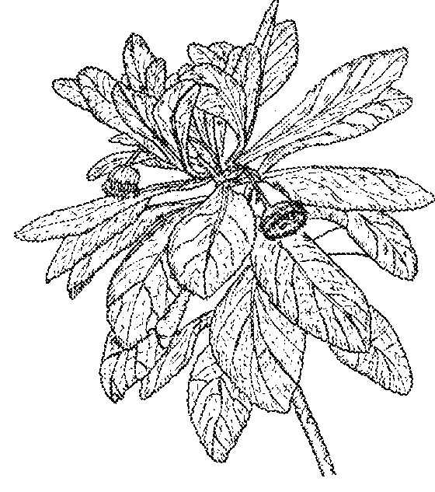
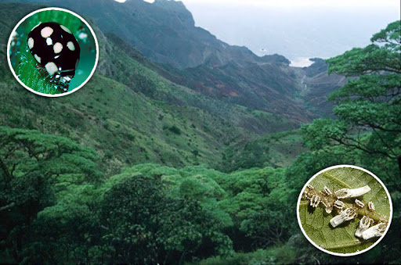
Advantages :
Can also target environmental issues
Classical biological control
Insignorthezia insignis
Threatened and endemic gumwood tree in St Helena
Trees were saved by the introduction of the ladybird Hyperaspis pantherina in the 1990s
CABI et Manie van der Schijff Botanical Garden
And most CBC projects against weeds target environmental weeds

Slide 14
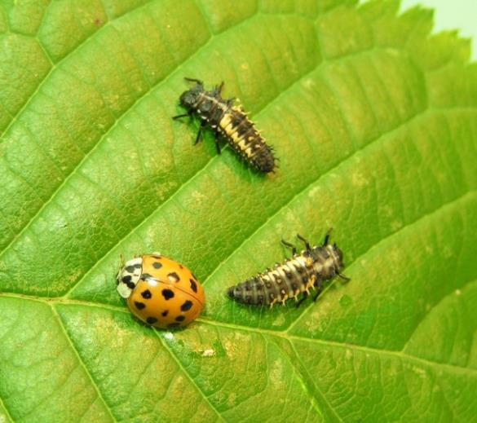
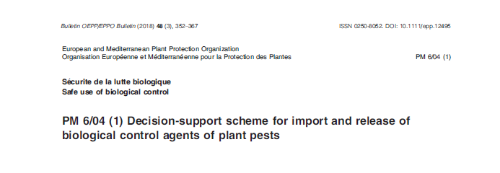
Risk :
Potential non-target effects on native biodiversity
Classical biological control

Slide 15


Funding :
Traditionally funded by public organisations
Classical biological control
Example: Funding of the CABI D. suzukii CBC project in Switzerland:
EU FP7 and Horizon 2020 Programmes
Swiss Federal office of Agriculture
Swiss Federal Office of the Environment
Loterie Romande (enterprise of public utility)

Slide 16

Funding :
But private partners such as grower associations can be involved
Classical biological control
E.g. funding of the Cydalima perspectalis CBC project in Switzerland:
FAO and EU SR for the South Caucasus and the crisis in Georgia
USDA- APHIS
Horticultural associations in USA and Canada

Slide 17
Main constraints:
Classical biological control
No commercial products:
  Mostly -poorly- publicly funded – no investments from companies
  Public funds for research increasingly targeting support to the private sector (e.g. Horizon Europe)
Legislations increasingly complicated
  For exporting genetic resources
  For releasing biological control agents
No European legislation
CBC sometimes misunderstood and badly perceived by some groups

Slide 18
Presenters of business models in the session:
Classical biological control
Vincent Lesieur CSIRO European Laboratory
Manuela Branco ISA, University of Lisbon
Djamila Djeddour CABI
Kim Hoelmer USDA ARS

