Slide 1
Diversifying Business Models for Biocontrol Deployment
Food supplement:
cysts of the brine shrimp Artemia spp.
Patrick Sorgeloos and Patrick Declercq, Ghent University, Gent, Belgium
Felix Wäckers and Dominiek Vangansbeke, Biobest Group, Westerlo, Belgium

Slide 2
Technical description

Slide 3
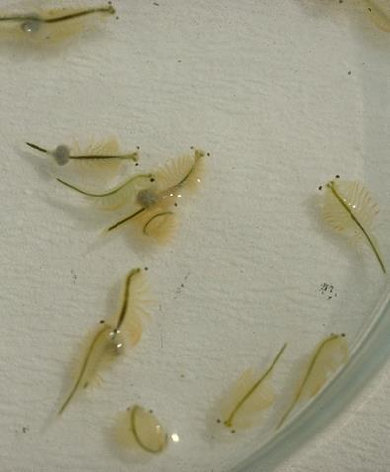
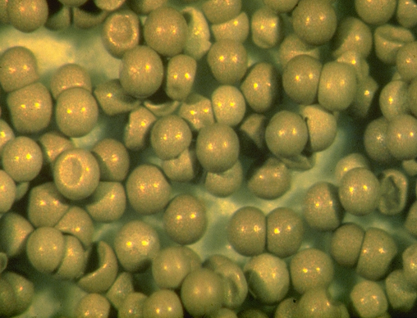
brine shrimp ARTEMIA
1 cm
0.5 mm
cysts
extremophile – living in high salinity waters (up to 10 times seawater concentration)
where others cannot survive
unique biological characteristics to adapt to this extreme environment
Notes:
<culture-aspects, life-stage, cyst, adult>

Slide 4

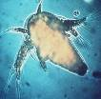
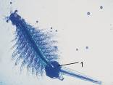
Life cycle of Artemia
100-300 nauplii every 4-5 days during several months
OVOVIVIPAROUS REPRODUCTION
(under optimal conditions)
adults
dry
cysts
±14 days
24h
nauplii
500% weight increase
0.4mm
10mm
OVIPAROUS REPRODUCTION
(under sub-optimal conditions)
100-300 cysts every 4-5 days
Notes:
<culture-aspects, life-stage, life-cycle>

Slide 5
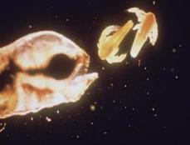
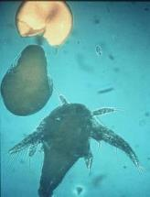
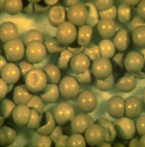
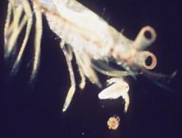

Artemia = crucial live food in the commercial production of fish and crustacean species

Slide 6
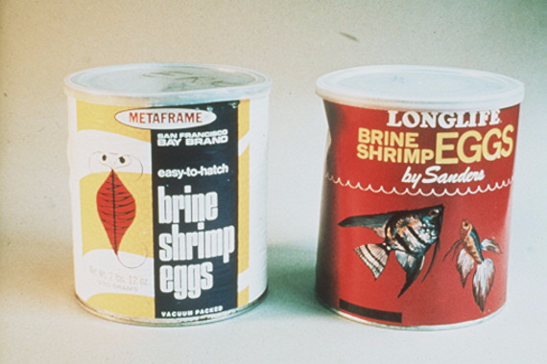
San Francisco Bay, California Great Salt Lake, Utah
First commercial sources of Artemia cysts in the 1960s
main market = aquarium hobbyists <100 kg per year

Slide 7
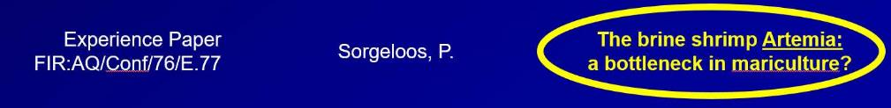
1st FAO Technical Aquaculture Conference, Kyoto, Japan - 1976
POTENTIAL IMPROVEMENTS FOR CRITICAL ARTEMIA SITUATION
exploitation of more natural resources
transplantation and inoculation of suitable habitats
improved techniques for cyst
        - harvesting
        - processing
- storage
- hatching
use of juvenile/adult Artemia biomass as food source
Notes:
<other-aspects, sectors, research, research-nei, slide-content, just-text>

Slide 8
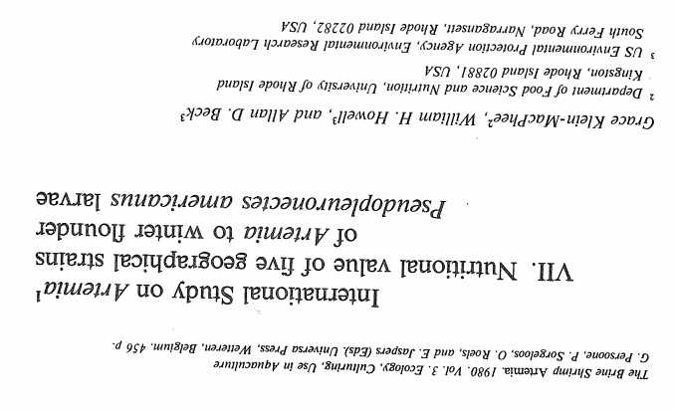
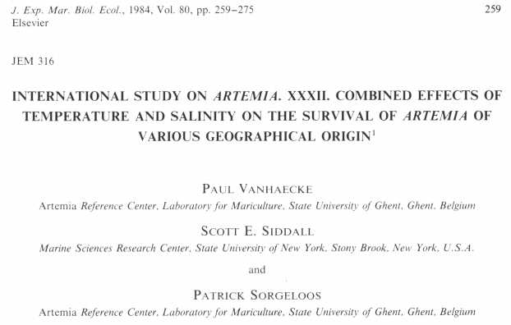
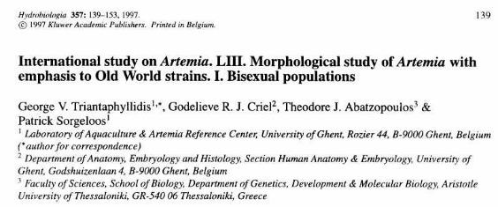
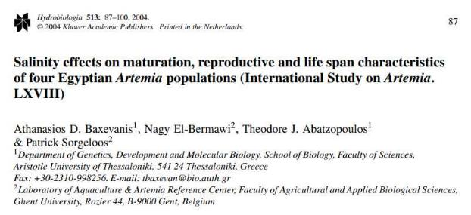

Slide 9
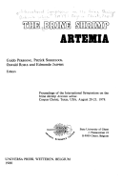
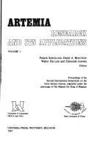
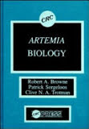
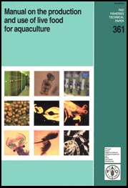
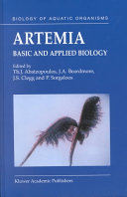
Symposia, proceedings, books, and manuals…
1980
1987
1990
1996
2002

Slide 10
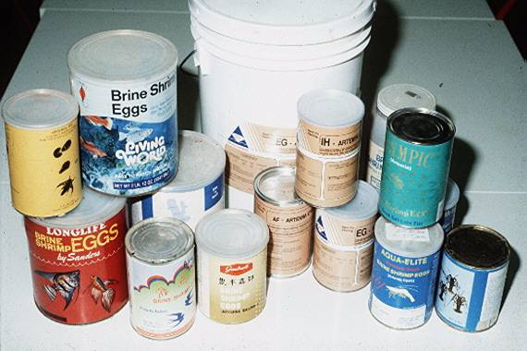
Improved commercial availability of Artemia cysts as of the early 1980’s

Slide 11
Artemia cyst consumption
1970 < 1 ton
1980 < 100 tons
1990 > 1500 tons
2000 > 2000 tons
2010 > 3000 tons
Annual consumption of approx 3500 tons of Artemia cysts, value of 200m US $

Slide 12
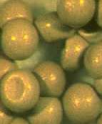
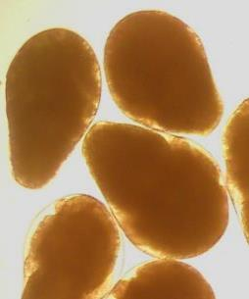
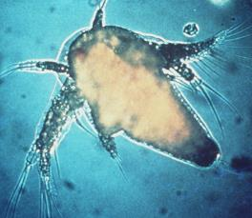
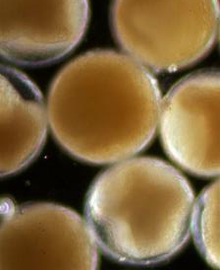
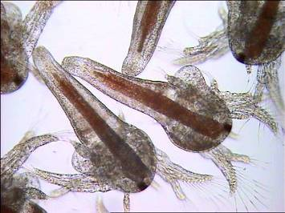
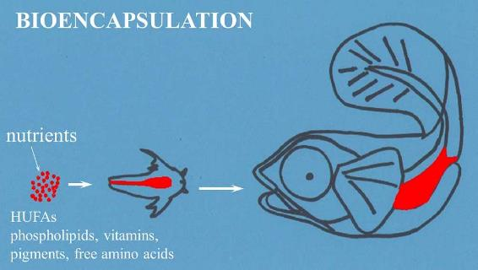
instar I nauplius
umbrella stage
decapsulated cysts
TECHNIQUE
enriched metanauplii

Slide 13
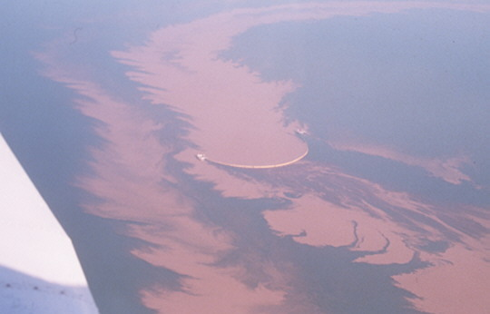
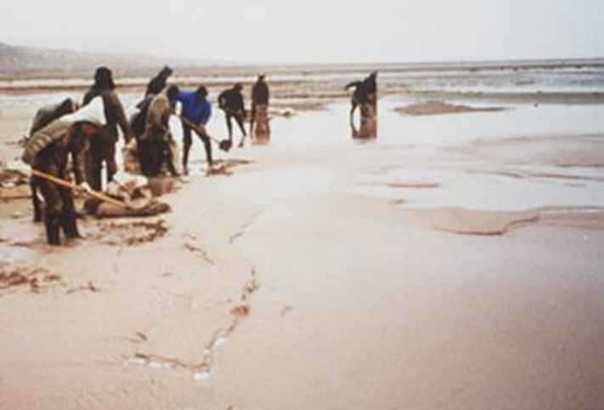
Commercial Artemia sources (fisheries)
Great Salt Lake (Utah, USA)
different salt lakes in Central Asia (Siberia, Kazakhstan and Uzbekistan)
coastal saltworks and inland salt lakes in China

Slide 14
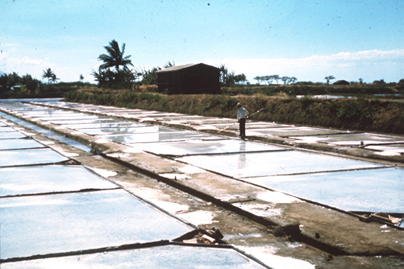
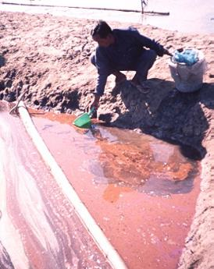
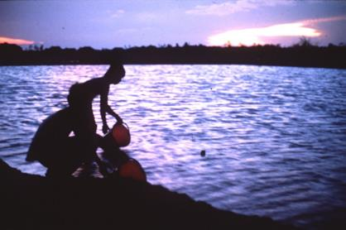
Seasonal solar salt farms in different tropical/subtropical regions
daily cyst harvest
inoculation of Artemia 1 month into the dry season
Notes:
<culture-aspects, culture-step, culture-activity, harvesting, geography, biotope, salt-lake, salina>

Slide 15
Technical description of your method
Type of biocontrol strategy:
- Augmentative Biocontrol: using factitious prey, Artemia cysts in predator rearing
- Conservation Biocontrol: using Artemia as food supplements in the crop
Targeted pests/pathogens/weeds: Optimizing pest control by stimulating generalist predators
Organism or substance providing the biocontrol effect: Generalist predators (e.g. predatory mites and predatory bugs)
Geographical area of implementation: Worldwide

Slide 16
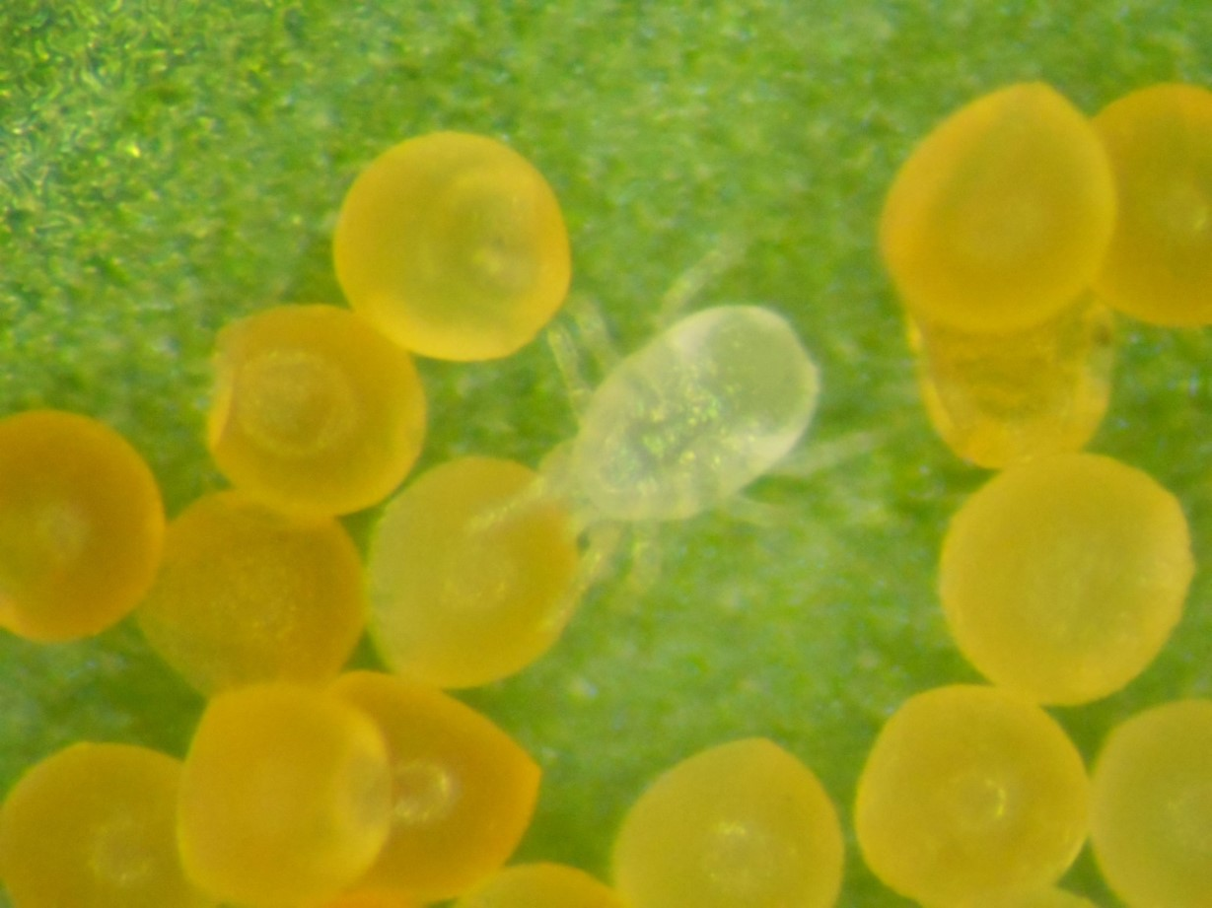
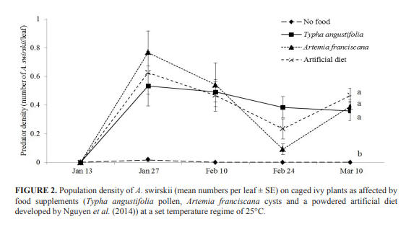
Conservation Biocontrol:
Use of Artemia as a food for predators in the crop
Big differences in quality of the cysts (esp. nutritional composition)
Greenhouse climate conditions (RH) affect cyst palatability for predatory mites and bugs
Vangansbeke et al. 2016

Slide 17
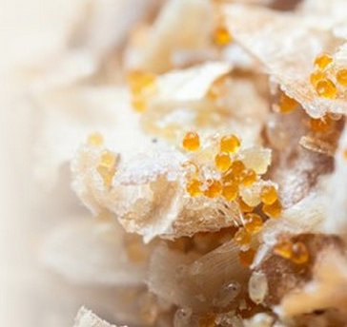
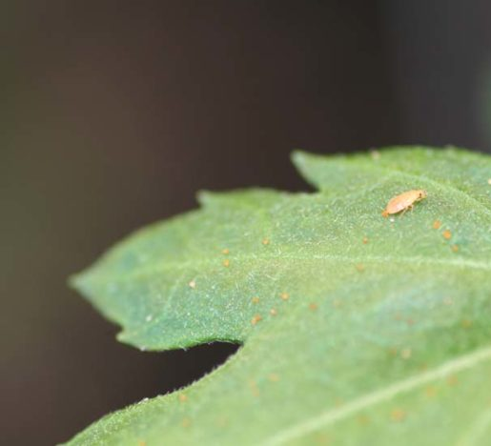
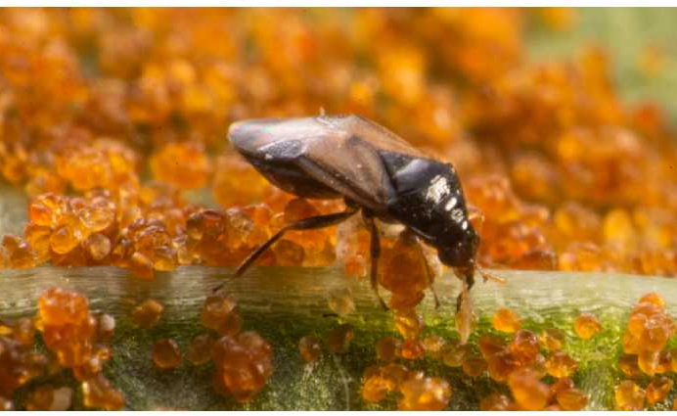
Conservation Biocontrol:
Use of Artemia as a feed for predators in the crop
Sold as a single product or in combination with prey mites
https://www.biobee.com/insect-feed/
https://www.groentennieuws.nl/article/9494949/nieuw-bijvoerproduct-voor-roofmijten-op-de-markt-gebracht/
https://hortinext.digitalezaken.com/research-breakthrough-thrips-control/

Slide 18
Value proposition and value network
Business model description

Slide 19
Value proposition
Is your method available as a product or a service (or both)?
Available as a product, in a range of qualities
Who operates it?
harvested from different salt lakes & produced in pond/tank systems
processed and commercialized by different companies active in the aquaculture sector
Augmentative Biocontrol: used by biocontrol industry for the production of generalist predators
Conservation Biocontrol:
- distributed by biocontrol industry as food supplement;
- used by growers to boost populations of generalist predators in cropping systems

Slide 20
Value proposition
What advantage do you claim for your method?
can be cheaper than Ephestia kuehniella eggs, which have been used for production of arthropod predators, as well as for food supplementation in conservation biocontrol
can be stored unfrozen
longer viability when used in crop, as compared to Ephestia kuehniella
different qualities allow for optimization of different targeted applications
limited risk of pest stimulation

Slide 21
Value proposition
Describe the network of actors that participate to your method and their motivation for participating?
Actors Motivation
Artemia producers additional markets besides aquaculture
biocontrol Industry - methods for arthropod predator rearing
            - food supplements to boost predators in the crop
farmers improve efficay of (preventative) biocontrol

Slide 22
Contributions, gains and levers
Business model description

Slide 23
Business model base: Gains
What forms of gains, direct and indirect, does your method generate?
relative to Ephestia: more reliable and potentially cheaper food for generalist predators
longer lasting food supplement when used in crops
no need to freeze
preventative use in Conservation Biocontrol reduces cost of predator releases
large range of qualities allows for more targeted use

Slide 24
Development potential: Levers
What contextual factors do you think have favoured the development of your control method?
the fact that Artemia spp production was already established for use in aquaculture
the fact that Artemia spp occur worldwide
Can you identify any turning points in the success or failure of your method?
development of decapsulation technique for Artemia cysts without loosing embryo viability
different nutritional composition among Artemia species and strains
possibility to manipulate nutritional composition of Artemia cysts (diet of adult population):
opportunity for further R&D

Slide 25
Development potential: Risks
What were the major obstacles encountered in the past?
Natural sources, processing techniques, controlled farming (ponds and tanks),
Have you been confronted with any scientific controversies or public debates during the deployment or operational use of your control method?
Sustainable harvesting methods (Great Salt Lake recently acquired MSC label)
Today, is the future of the implementation of your method challenged or compromised by certain risks?
Avoid issues with chitin allergies by (unsuspecting) consumers

