Slide 1
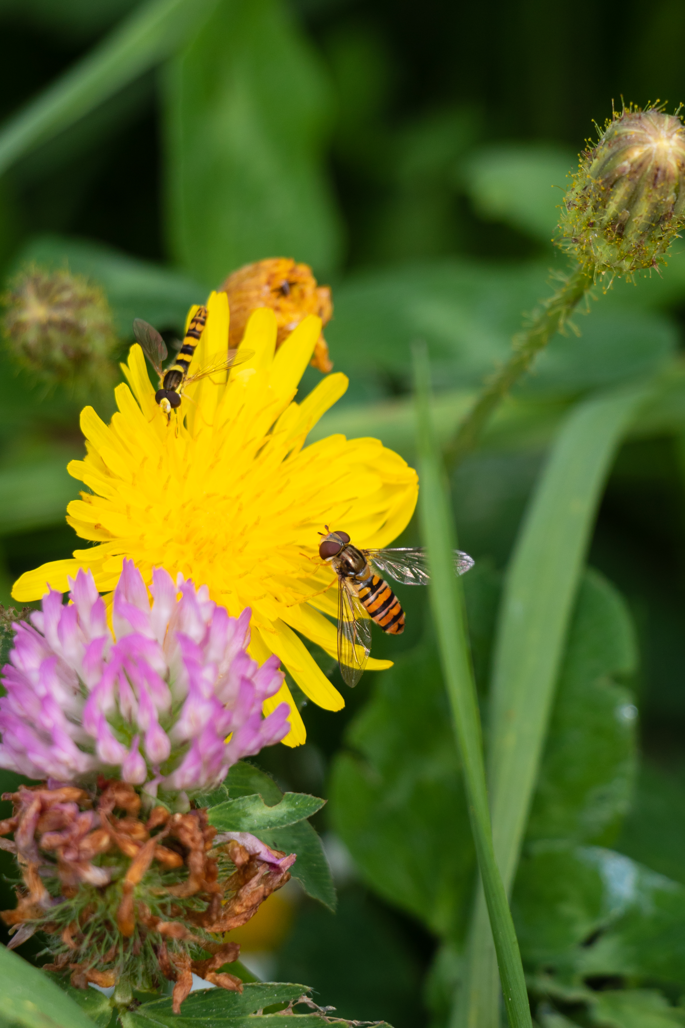
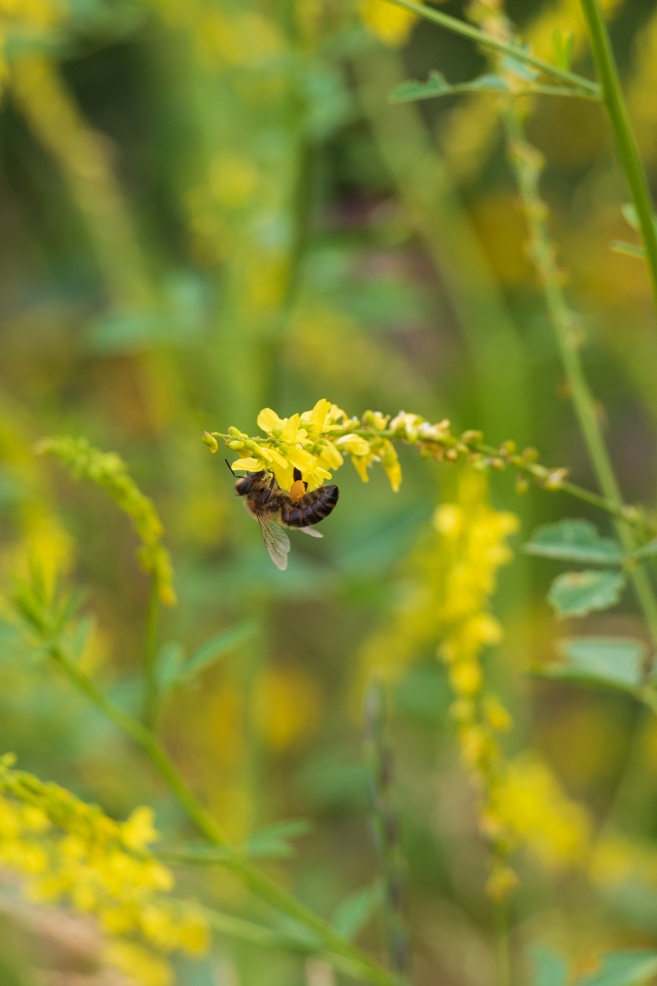
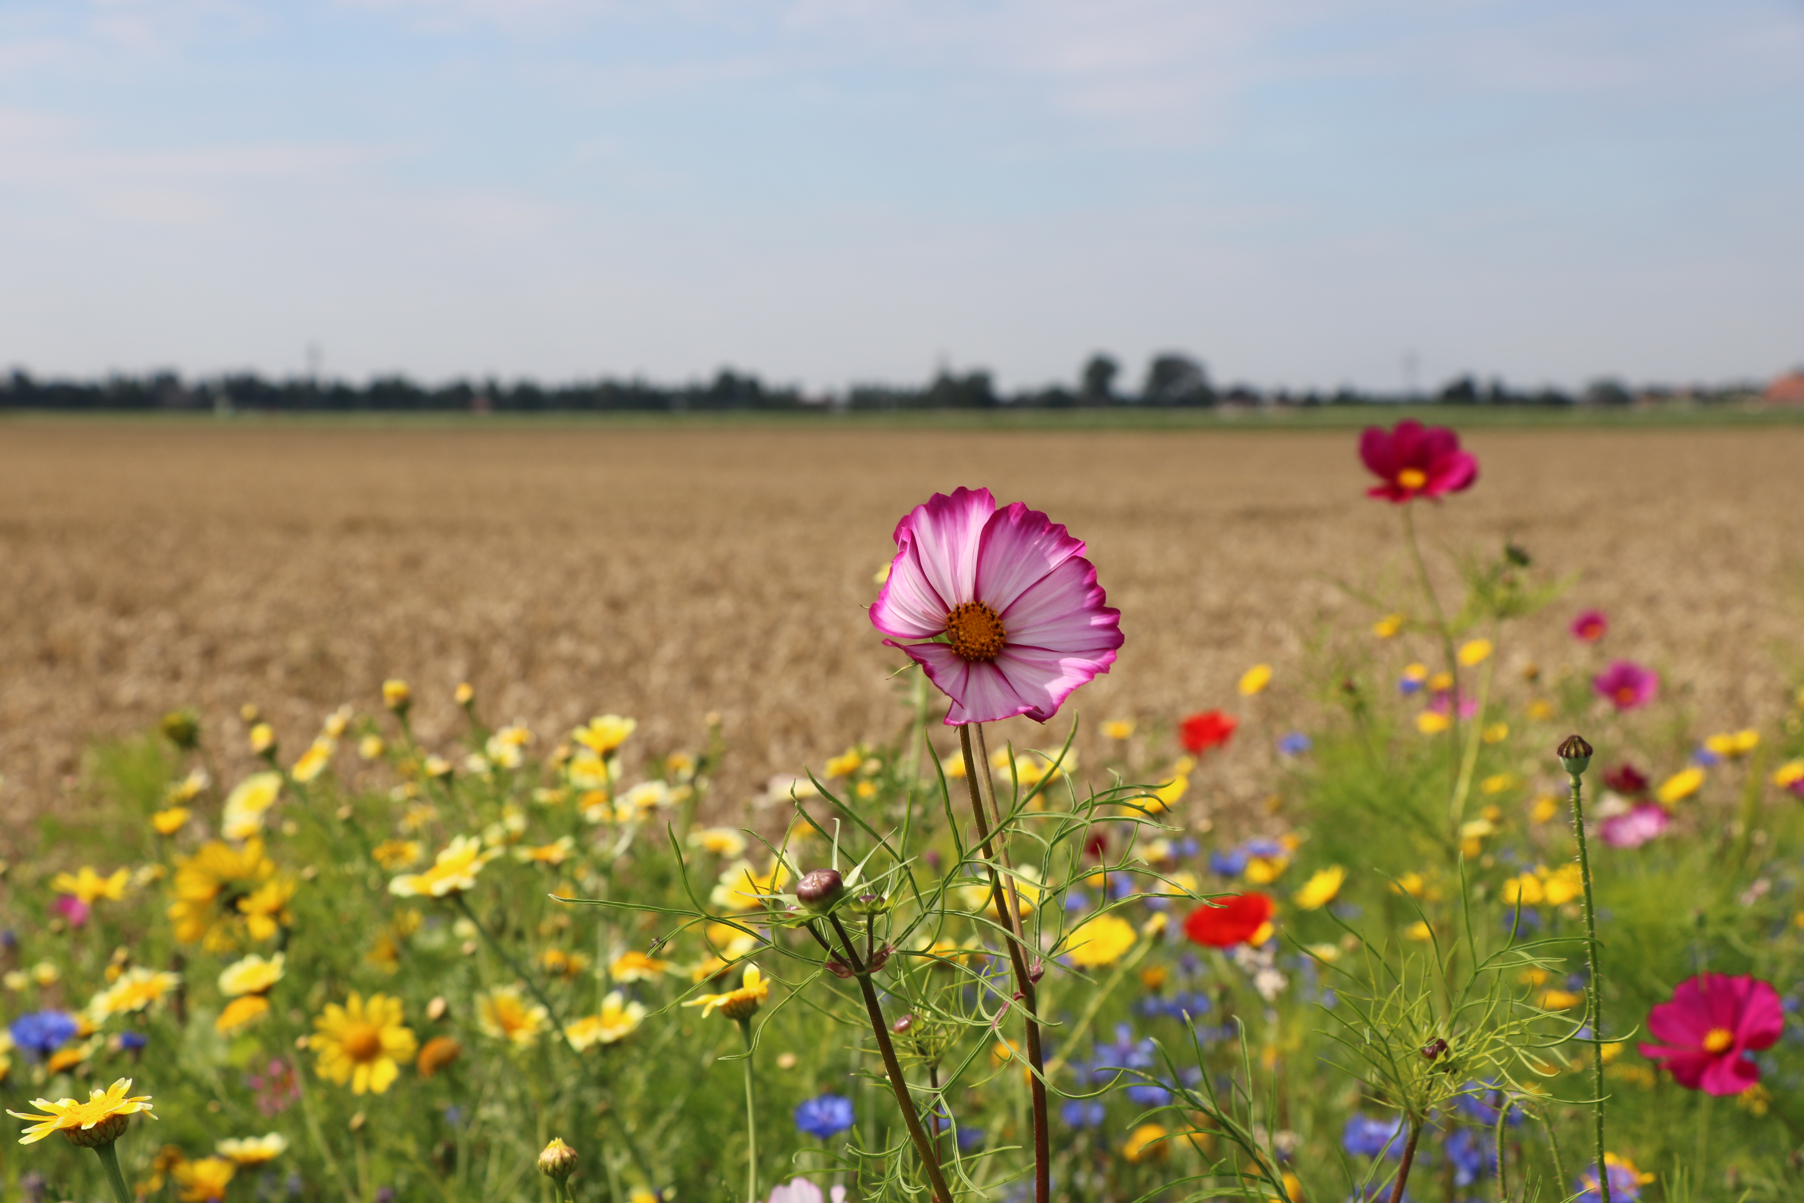
Programmme Biocontrol models
Field margins
Biocontrol strategy
Farmers collective region Hoeksche Waard
Business model
Mellany Klompe
www.cchw.eu

Slide 2
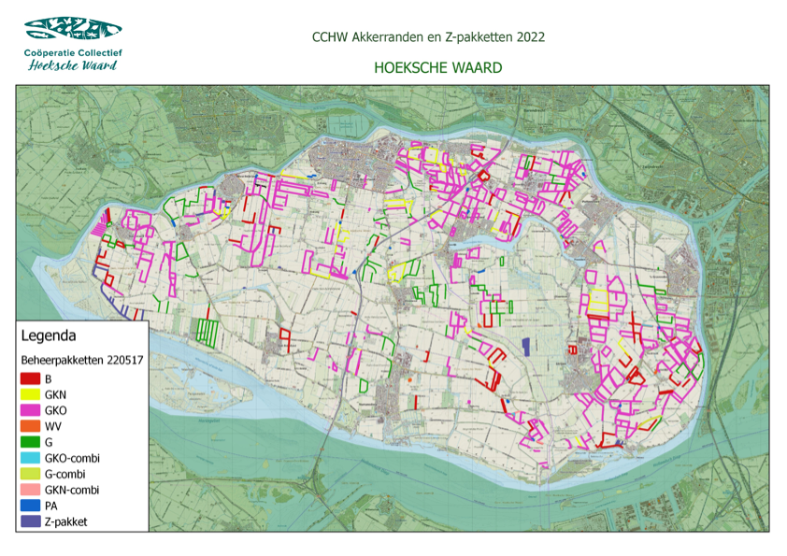
20% flower
50% gras/herbs
20% gras
8% bird/partridge
2% sand bumbelbee

Slide 3
Model Hoeksche Waard
efficiently arranged plots, suitable for scaling and precision agriculture, bordered by green field margins . This contributes to stimulate and maintain biodiversity”
Using gps, gis en geo-information, which can be read by the agricultural machinery. Efficiently for farmers
Bottum-up proces / collaboration

Slide 4
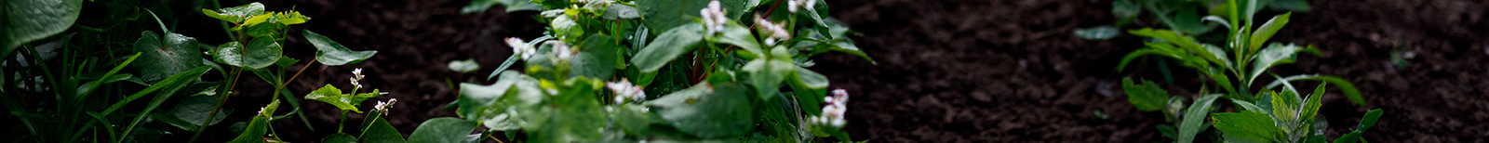
Spatial consequences at farm level
Field margins
  3 to 9 meters wide
  Parallel to the plot edges
  Parallel to the canals
  Designed to serve specific purposes (habitat for insects and bees, habitat for birds, natural pest control, natural pollination)
2) Biodiversity lanes
  In the middle of the plots
  Maximum length for natural pest control < 100-150 meters
  Maximum length for natural pollination < 3 km
  Minimum 3 meters wide
3) Steppingstones
  > 0,5 hectares
  Depending on surface optimization (GPS and CTF farming)
  Build on existing landscape elements like dikes, forest, bushes and canals
  Designed to serve specific purposes (habitat for insects and bees, habitat for wildlife, natural pest control, natural pollination, increase natural resilience)

Slide 5
Spatial consequences at farm level
Steppingstone
0.5 ha
Building on existing bushes
Habitat for partridges/natural pest control/natural pollination/natural resilience
Biodiversity lane
3 meters wide
Middle of the plot
Natural pest control/natural pollination
Field margins
Parallel to the plot edges
6 meters wide, 2 different strips
Natural pest control/natural pollination/
bird habitat

Slide 6
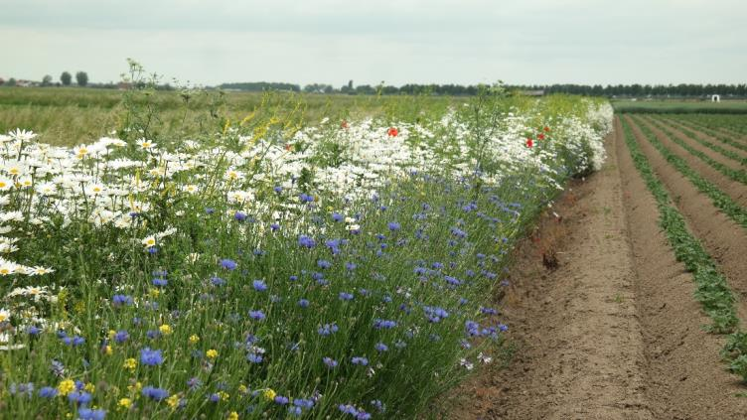
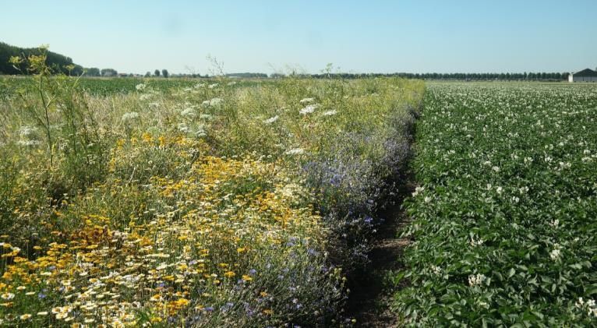
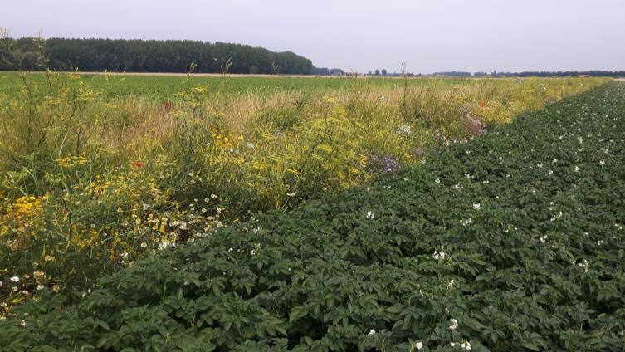
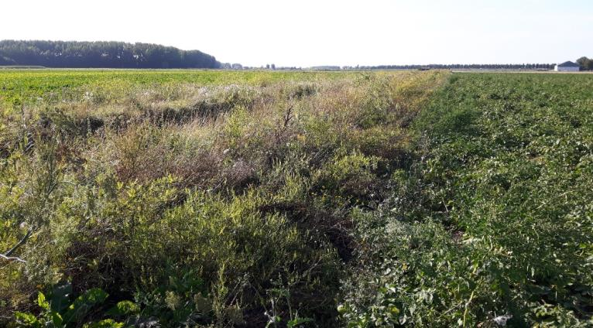
3 juni
28 juni
Gras-herb 2e year (GK2)
11 juli
28 aug.

Slide 7
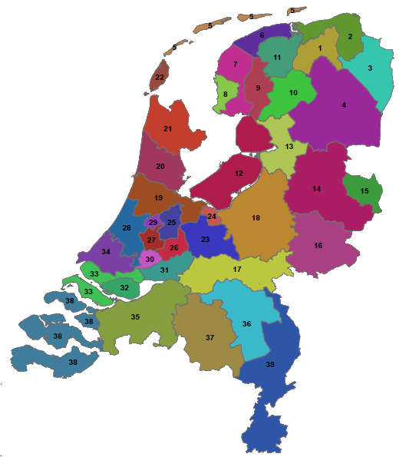
Collective of farmers
Hoeksche Waard (32)
165 ha field margins
80 ha meadow-birds aragements
1/3 participating farms
> 850 km total field margins

Slide 8


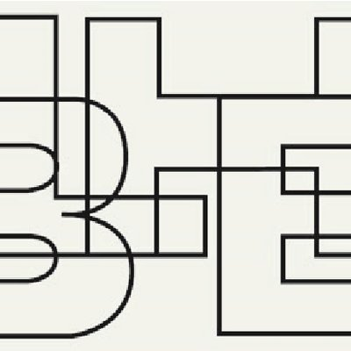





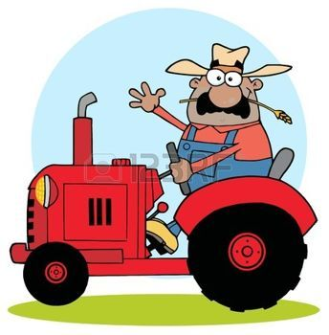


Slide 9
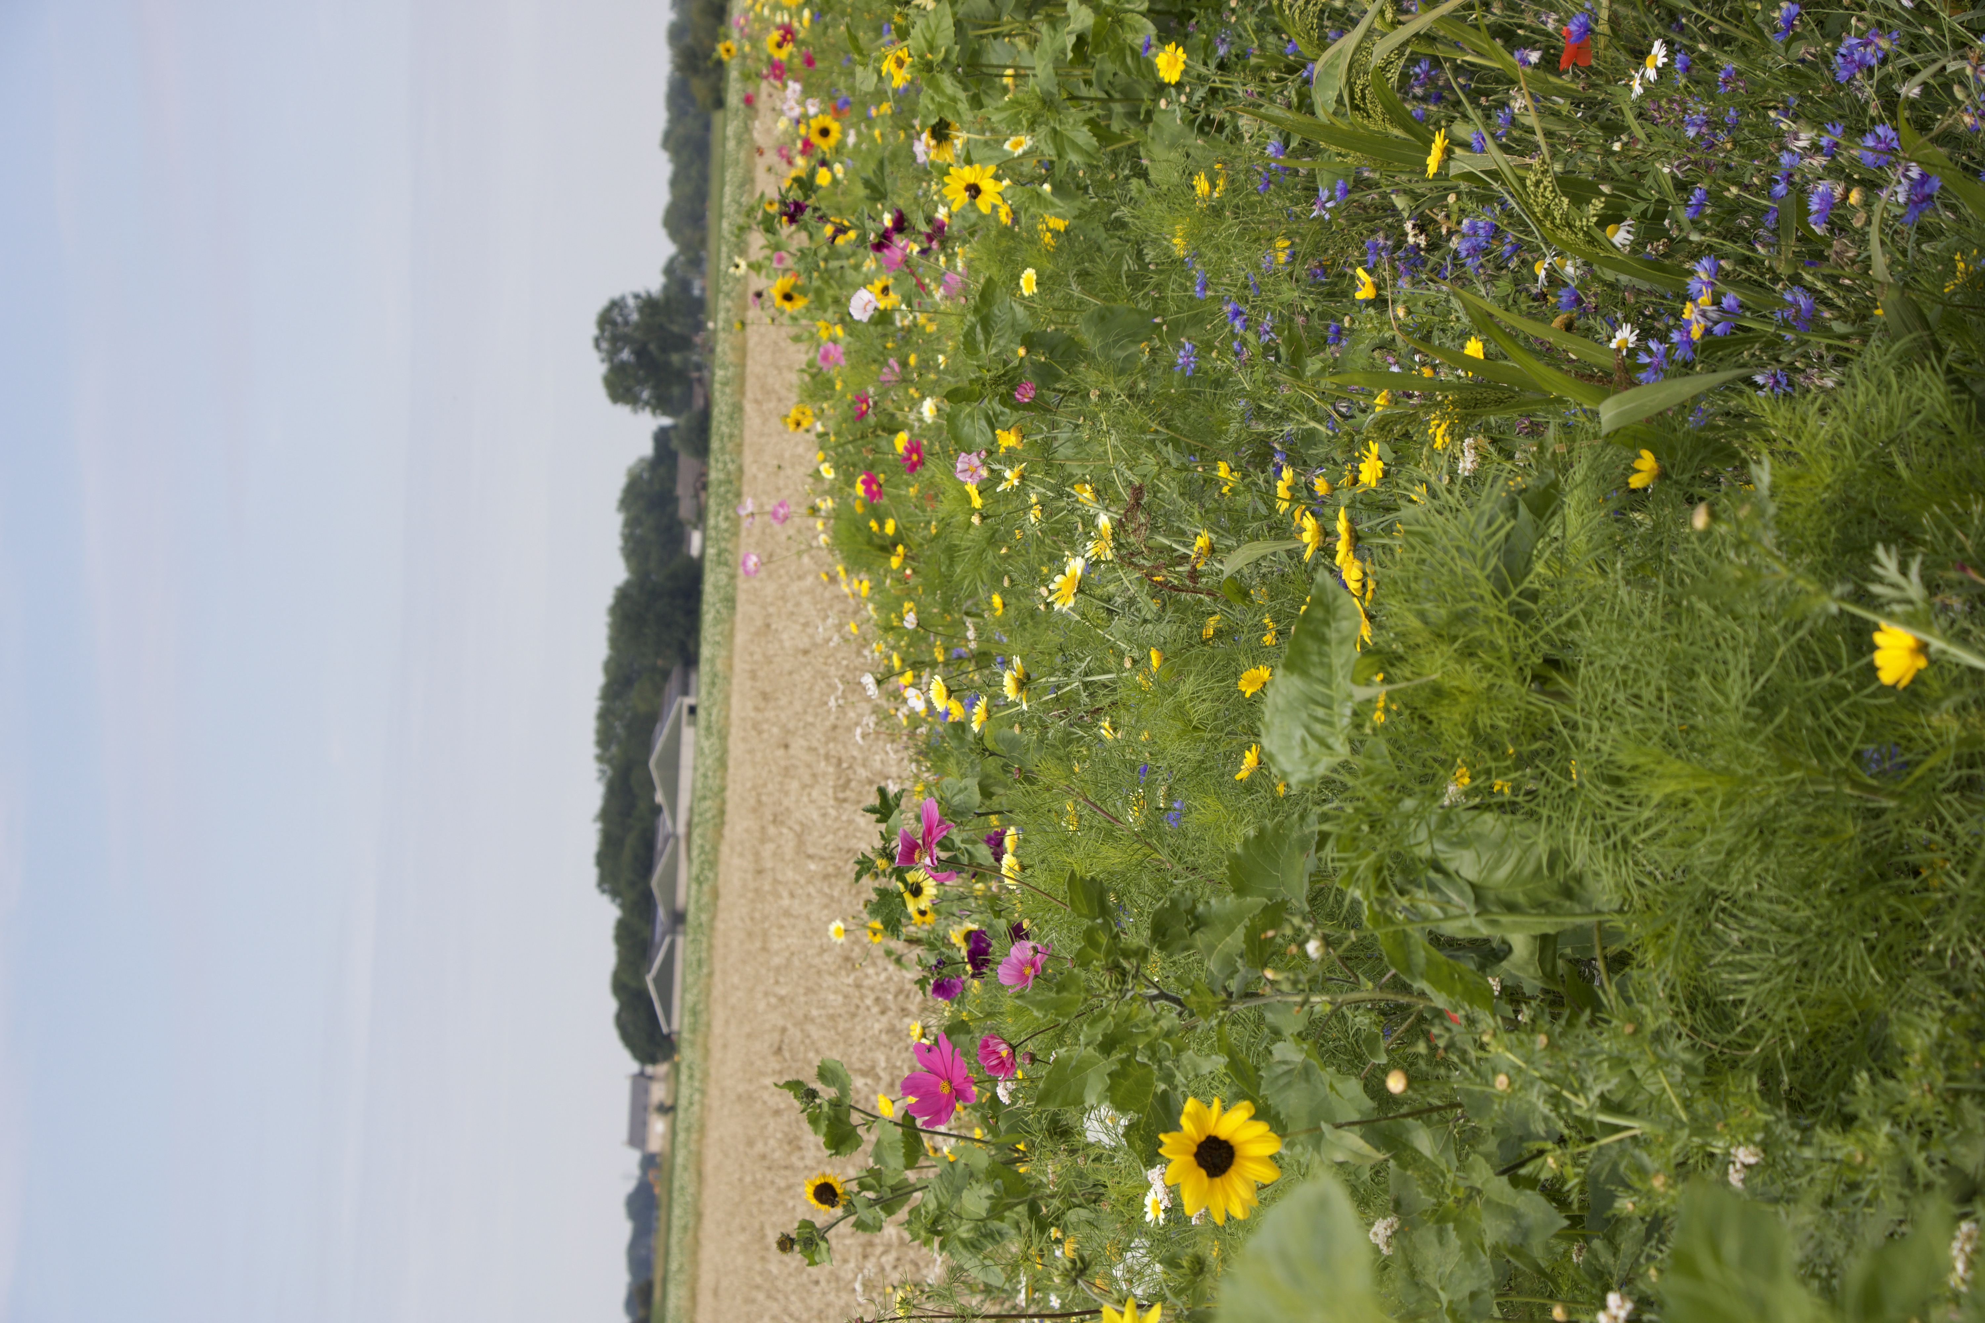
Business model: Contribution
Collective of farmers Hoeksche Waard -> Non-profit
farmland
Contract 6 year
CCHW executive and knowledge partner
budget € 493.963 per year (€ 20.000 private finance HW)
collective purchasing seed(mix) via CCHW
collective sowing / hoeing via CCHW
control / monitoring / evaluation by CCHW
fees based on ‘breakeven” fixed costs of farmland:
gras € 0,09 /m2
gras herb old € 0,17 /m2
gras herb new € 0,21 /m2
flowers / partrige / WV/ sand bumbelbee € 0,30/m2

Slide 10
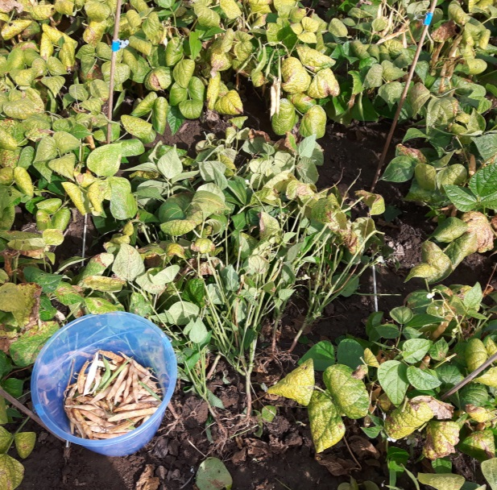
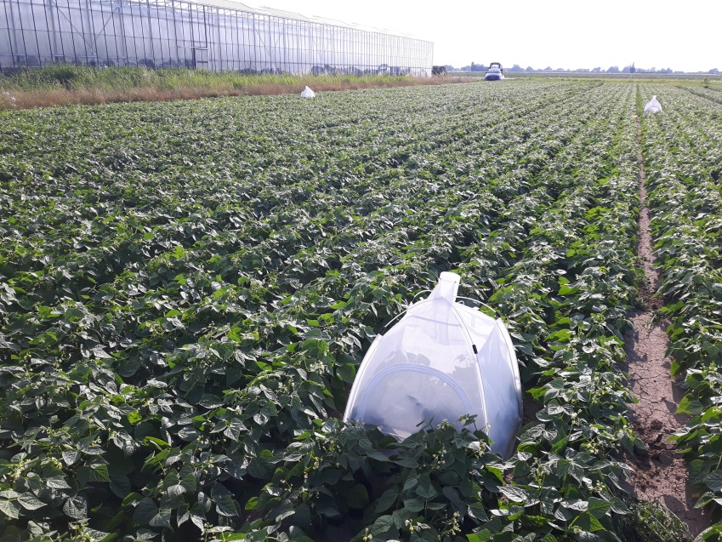
Business model : Gains
Yield
PPP
Implementation sustainability
Landscape quality
Biodiversity
emission / runoff / leaching
Funding for multiple purposes
Pod weight reduced by 29% when pollinators are excluded

Slide 11
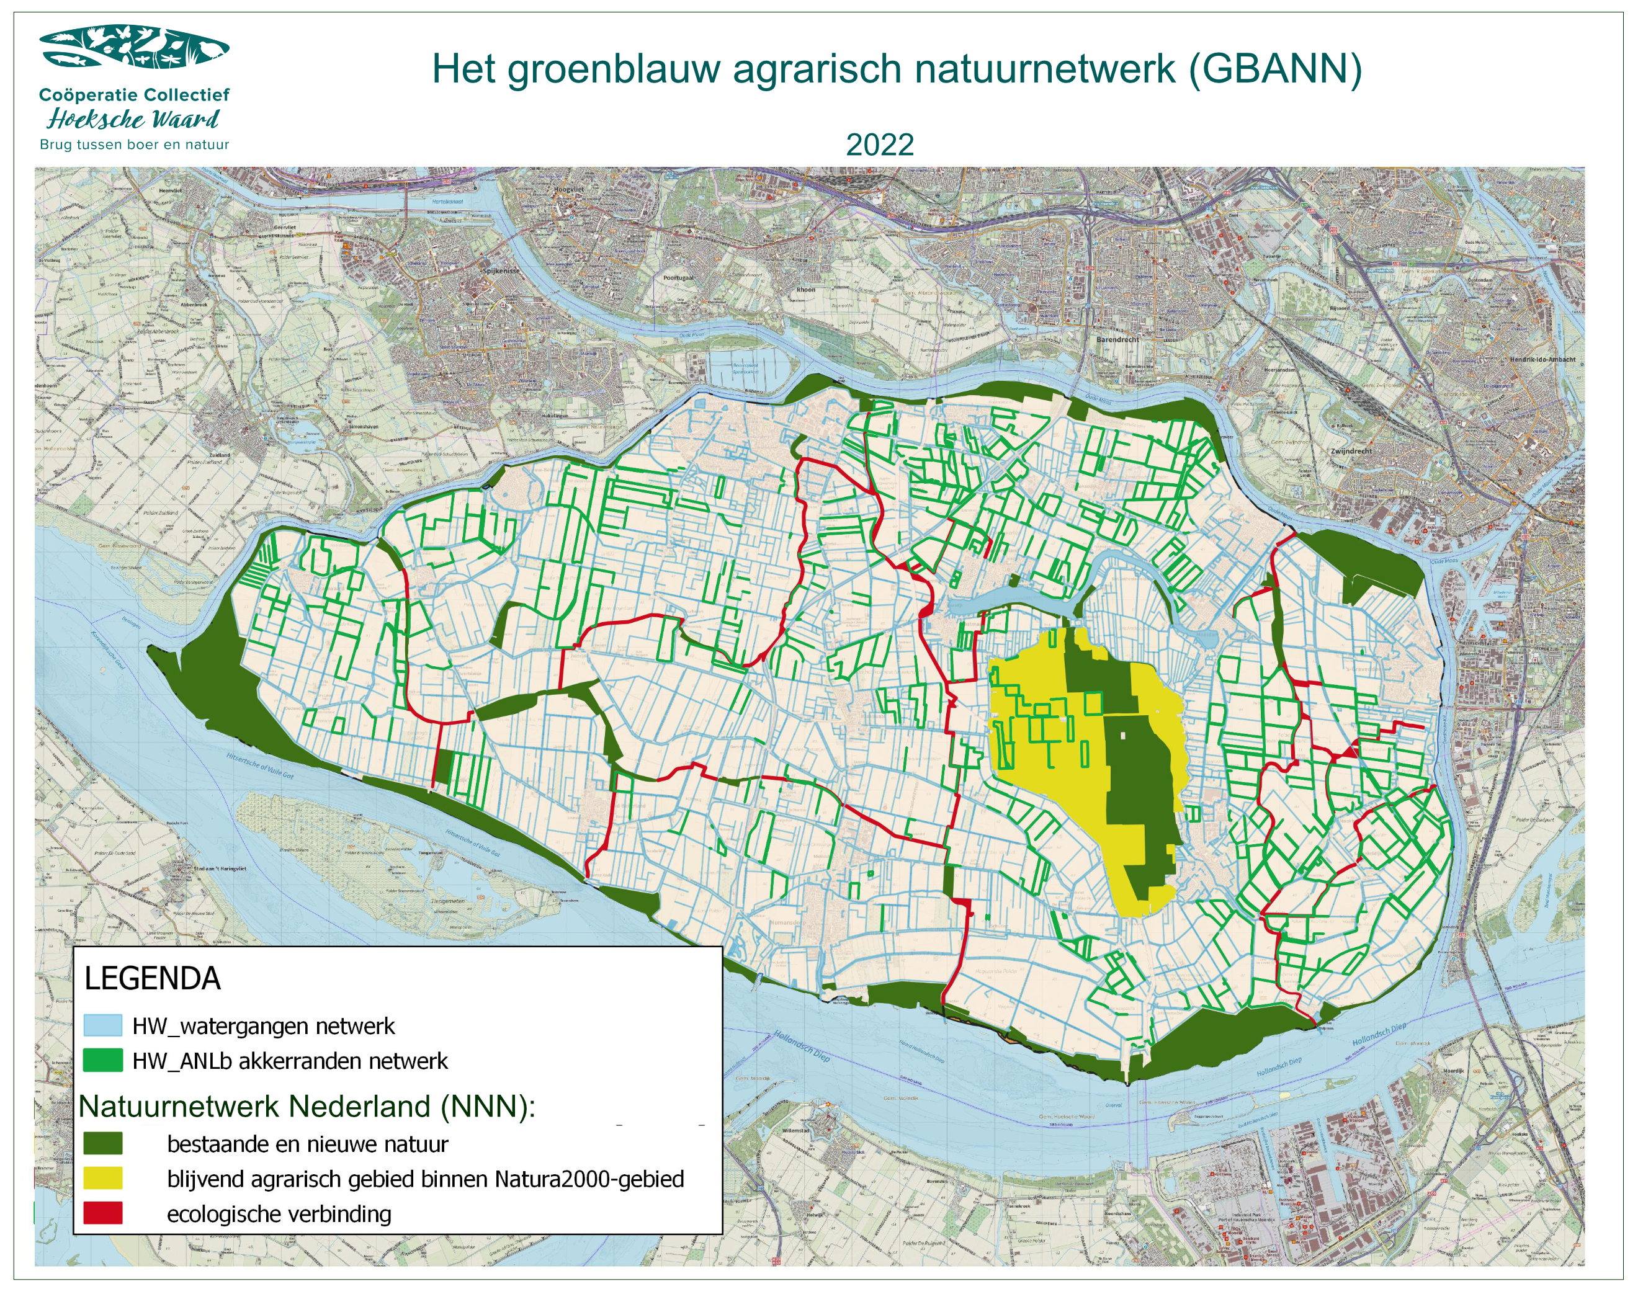
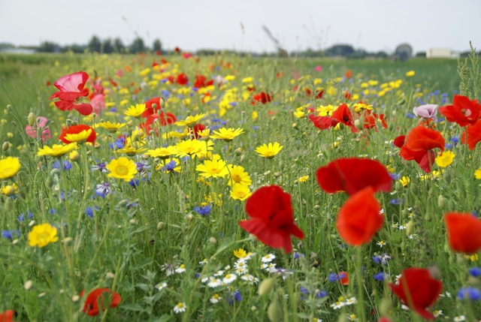
Development potentitial : Levers
create a network with the landscape elements
Farmers collective
Collaboration
Government (regulation / funding)
Private funding
Consumers -> true cost account food

Slide 12
